Slide 1
Feature extraction from images
Report 3
Jerico Miguel Rangel
2018-11666

Slide 2
Objectives
To understand the process of feature extraction using ImageJ
To properly group and identify features
To extract the desired features from an image

Slide 3
Results and Analysis:

Slide 4
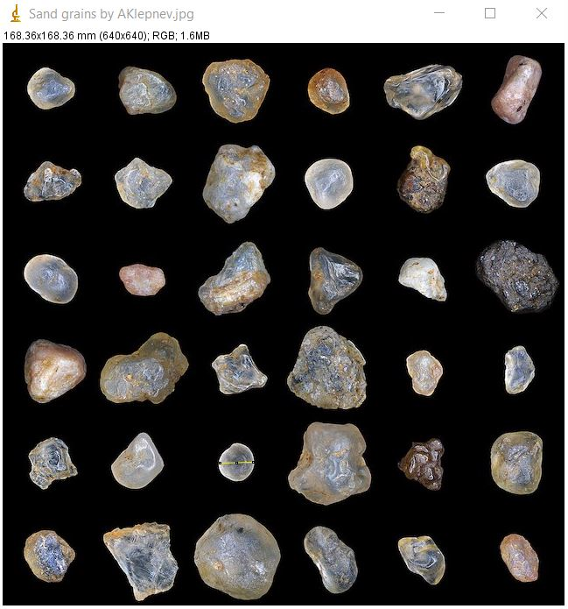
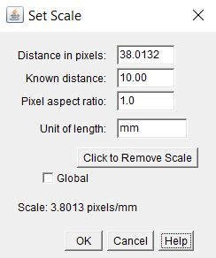
Results
First we set the scale to 10mm arbitrarily. Then we proceed with separating the background from the features.
Activity 1: Extracting features from test image

Slide 5
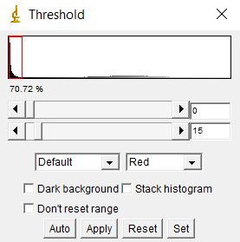
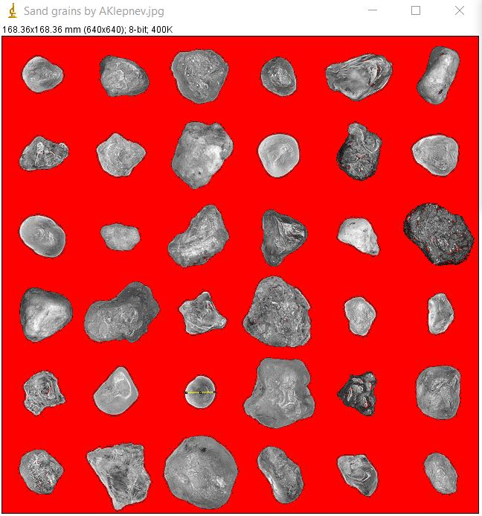
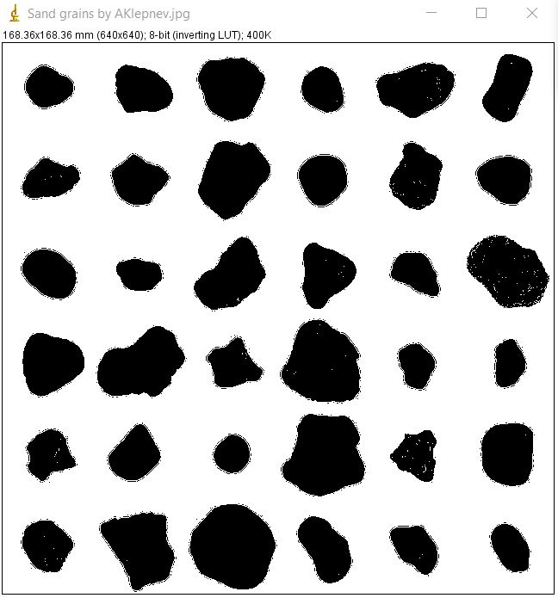
The process of separating image from the background includes setting it to greyscale then adjusting the threshold. Afterwards we set it to binary and invert so that the features turn black.
Making the image greyscale and adjusting threshold for separation
Setting the image to binary and inverting it.

Slide 6
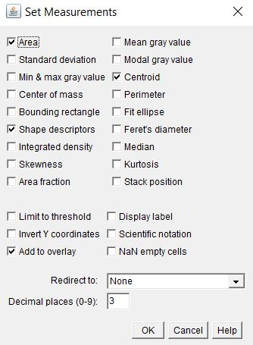
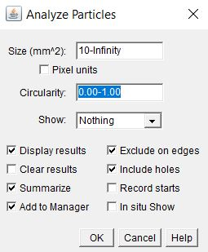
We set the measurements to look at and analyze the particles based on the criteria set below.
Setting measurements
Analysis parameters

Slide 7
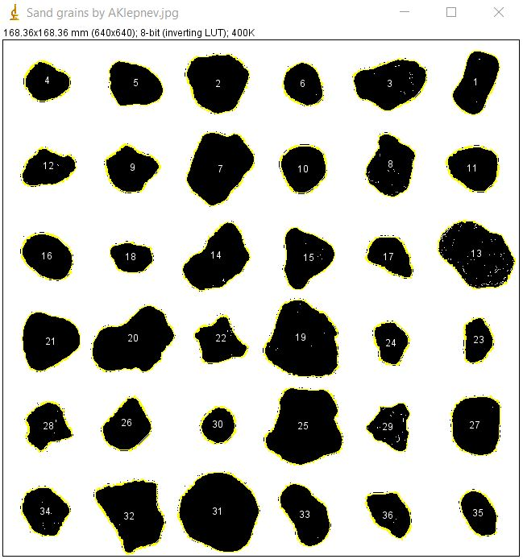
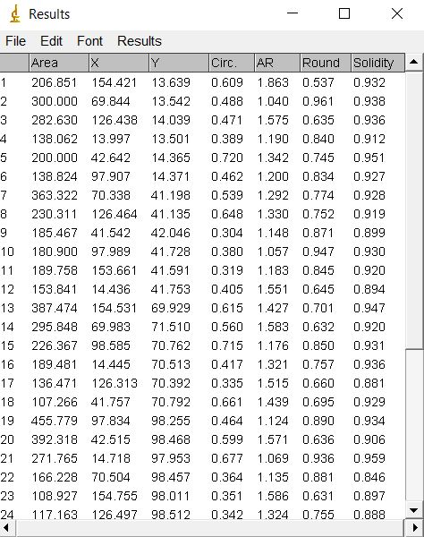
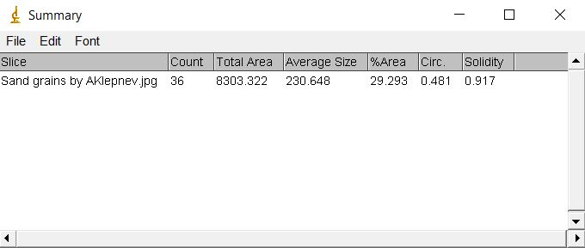
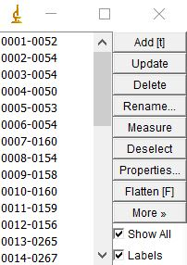
We obtain the labeled image, with the corresponding summary and properties.
Labeled image
Analysis results

Slide 8
Analysis
Following the protocol of separating the features from the background, we are able to label and extract the necessary features with their corresponding properties.
The protocol consists of threshold adjustment and binary setting to make the features easily distinguishable from the background. Afterwards, the desired measurements are set, and the analyzer is configured in a way that easily labels the desired features.

Slide 9
Self-Reflection
The resulting image is properly labeled, which is an indicator that the protocol was followed correctly. It was not very tedious since it only entailed learning how to manipulate the image using the software. The guide was concise and intuitive as well which helped a lot. Aside from this, the original image has well ordered sand grains. Additionally, it is very helpful to determine properties/dimensions such as roundness and area using ImageJ. I hope to be able to use all skills I learned in this course for my growth as a future machine learning engineer/data scientist.

Slide 10
Self-grade
Technical correctness: 33.3/33.3
Presentation quality: 33/33.3
1
I tried my best to make a concise and aesthetically pleasing presentation.
2
Self reflection: 33.3/33.3
I strive to be transparent and honest with how I think I did in this activity.
3

