Slide 1



Citation Management & Research Tools
APA Simplified
By Scolah Kazi, Research & Reference Librarian
BBA-BWE-GLB410-01
Business in a World Economy
www.learnersuae.com

Slide 2
Learning Objectives:
By the end of this session, students will be able to:
LO1 : To apply APA 7th edition citation and referencing rules
LO2 : Identify and access credible open access academic resources
LO3 : Use reference management tools (Zotero/Mendeley)
LO4 : Integrate citation tools into their research workflow
Business in a World Economy
aa

Slide 3
Session Breakdown
Part 1: Citation & APA 7th Edition (60 mins)
Part 2: Open Access Resources (45 mins)
Break (15 mins)
Part 3: Reference Management Tools (60 mins)

Slide 4
Part 1: Citation & APA 7th Edition
Poll
What is your level of confidence in using 7th edition of APA Referencing Style?

Slide 5
Why Citation Matters
• Citations give:
credit to original authors
strengthens your arguments.
• It allows readers to verify sources and explore further reading.
• Avoiding plagiarism is essential for academic integrity.
Example: Instead of copying text, cite it properly: (Adrianova, 2024).

Slide 6
APA 7th In-Text Citation Rules
• Author-date format: (Author, Year)
• Narrative citation: Author (Year) recommended that...
• For 2 authors: (Raghuveer & Jones, 2021)
• For 3+ authors: (Guadalupe et al., 2022).
Example: (Johnson, 2020) or Johnson (2020) argues...

Slide 7
APA 7th Reference List Formatting
Reference List:
References always start on a new page, double-spaced, hanging indent.
• Format: Author, A. A. (Year). Title in italics. Publisher.
• Journal/Magazine article: Author, A. A. (Year). Title. Journal/Magazine Name, volume(issue), pages.
Example: Nwaobi, L. (2025). Reading a P&L report for non-financial managers. Oxford University Press.

Slide 8
Common Citation Mistakes & How to Fix Them
Missing author or date → Use (n.d.) or 'Anonymous'
Incorrect punctuation → Follow APA rules strictly
Inconsistent formatting → Use reference tools like Mendeley
Example mistake: (varaul 2020) → Correct: (Varaul, 2020)

Slide 9
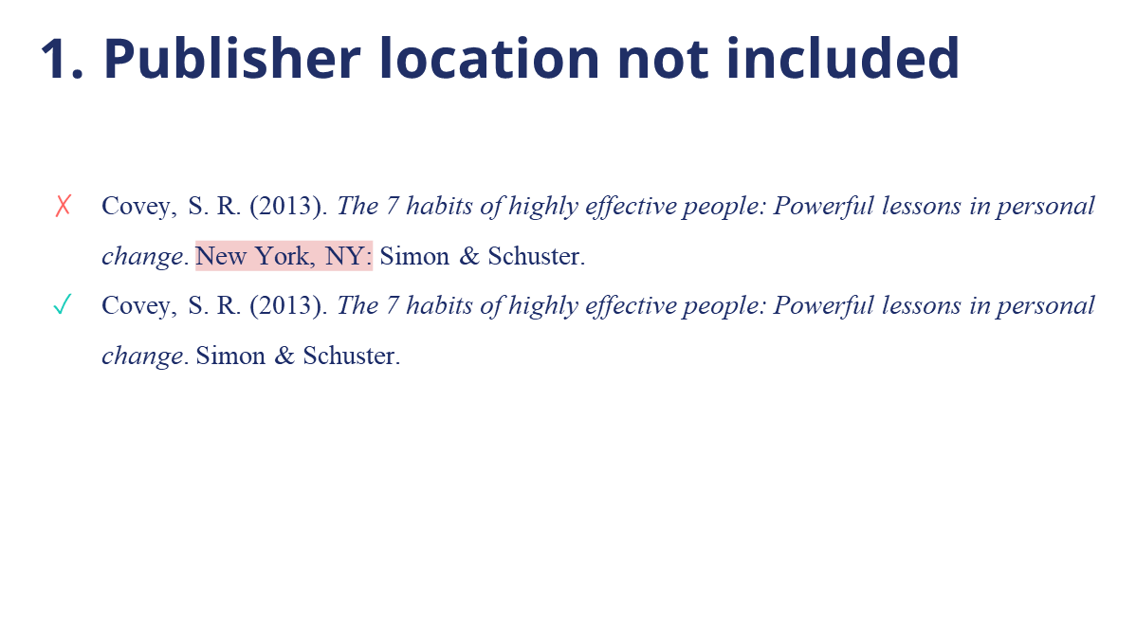
7th Edition APA Referencing
Noteworthy differences include:

Slide 10
Additional Changes in the 7th Ed. APA
2. In-text citations are shortened
✗(Taylor, Kotler, Johnson, & Parker, 2018)
(Taylor et al., 2018)
Up to 20 authors in the reference list
✗Miller, T. C., Brown, M. J., Wilson, G. L., Evans, B. B., Kelly, R. S., Turner, S. T., … Nelson, T. P.
(2023).
Miller, T. C., Brown, M. J., Wilson, G. L., Evans, B. B., Kelly, R. S., Turner, S. T., Lewis, F., Lee, L. H.,
Cox, G., Harris, H. L., Martin, P., Gonzalez, W. L., Hughes, W., Carter, D., Campbell, C., Baker, A.
B., Flores, T., Gray, W. E., Green, G., … Nelson, T. P. (2023).

Slide 11

4. DOIs are formatted as URLs
✗doi: 10.1080/02626667.2018.1560449
✓https://doi.org/10.1080/02626667.2018.1560449
Most journal articles and eBooks have a DOI (Digital Object Identifier) assigned to them. This unique link is stable (it doesn’t change over time) and makes retrieving a source easier for readers.
DOIs are formatted the same as URLs. The label
“DOI:” is no longer used.

Slide 12
5. Citing web pages
✗Jenkins, M. (2023, May 24). The Chinese BBQ luring millions. Retrieved from https://www.bbc.com/travel/article/20230523-the-chinese-bbq-luring-millions
Jenkins, M. (2023, May 24). The Chinese BBQ luring millions. BBC News.
https://www.bbc.com/travel/article/20230523-the-chinese-bbq-luring-millions

Slide 13
6. Contributors other than authors
Media type | Include as author
Film | Director
TV series | Executive producer(s)
Podcast episode | Host of episode
Webinar | Instructor
Online streaming video | Person or group who uploaded the video
Photograph | Photographer

Slide 14
Part 2
Open Access Resources

Slide 15
What is Open Access?
Open Access (OA) refers to free, immediate, online availability of research articles.
Types of Open Access
Gold OA: Articles are freely available on the publisher’s site (e.g., PLOS ONE)
• Green OA: Authors self-archive a version in a repository (e.g., universities in-house publishing and archiving)
• Hybrid OA: Subscription journals offer OA for individual articles (e.g., Elsevier journals with OA option).

Slide 16
Searching and Evaluating OA Resources
Platforms to Search OA Resources:
• DOAJ (Directory of Open Access Journals): https://doaj.org
• CORE: https://core.ac.uk
• Google Scholar: Use 'free full text' filters

Slide 17
Tips for Evaluation : RADAR Test
Consistently apply the RADAR Test to effectively evaluate information sources for academic research writing, to ensure high-quality and reliable sources are used all the time.
Acronym for Relevance, Authority, Date, Accuracy, and Reasonableness.
Relevance:
Is the information directly related to your research topic or question?
Authority:
Who is the author or organization behind the information? Are they credible and reputable?
Date:
When was the information published or last updated? Is it current and relevant to your research?
Accuracy:
Is the information factually correct and supported by evidence?
Reasonableness:
Does the information make logical sense? Is it unbiased and free from extreme or unsupported claims?

Slide 18
The Information Timeline
The information timeline, also known as the information cycle, illustrates the progression of information from the occurrence of an event to its transformation into different types of information.
Initially emerging through informal channels or mass media, facts evolve as they are discussed, leading to a richer understanding of the event.
Over time, popular and scholarly sources may address the event, though not all events warrant scholarly research. Additionally, information can cycle back to earlier stages if related events bring it back into public focus.

Slide 19
The Information Timeline
Event Occurs
Same Day
Weeks After
Months After
One Year After
Eyewitness accounts
Social media updates
Television broadcasts
Radio broadcasts
Online newspapers
Online magazines
Online news sites
Print magazines
Print newspapers
Academic journals
Trade publications
Books
Government reports
Academic journals

Slide 20
Formats and Hierarchy of Information Sources
Personal opinions e.g. blog post, letters to the editors
Information from an individual e.g. individuals' social media
Information from crowdsourced information (i.e. Wikipedia, Quora or Reddit)
Information from an organisation e.g. Marriott International, United Nations
Information from a governmental organisation e.g. Bureau of Statistics, Tourism Development Authority
Information from academic source e.g. Textbooks, Dictionaries
Laws or other such primary sources e.g. UAE Federal or Emirate –Level Laws, International Treaties and Conventions
Peer-reviewed, scholarly sources e.g. Journal of Foodservice Business Research, Anatolia
Relatively easier Source
Better Academic Source
A well-rounded research project will consult multiple format types. Organisation, intended audience, length, and publication standards define the format type of information.

Slide 21
Category | Tip/Trick/Strategy | Illustrated Example
Keyword Selection | Use relevant keywords; avoid common words like "the" "is" | Use "solar effects" and not Instead of "effects of the sun"
Boolean Operators | Combine keywords with AND, OR, NOT for precise results | "climate change AND tourism"; hospitality industry NOT aviation
Quotation Marks | Use quotes for exact phrase searches | "global warming"
Wildcard (*) | Substitute a symbol for one letter of a word. | wom!n = woman, women colo?r = color, colour
Truncation | A symbol added to the end of the root of a word to instruct the database to search for all forms of a word. Truncation symbols may vary by database; common symbols include: *, !, ?, or # | child* = child, childs, children, childrens, childhood
Limiters/Filters | Use filters for date, type, language, etc. | Publication date range 2014 to present; peer-reviewed journals
Subject Headings | Identify and use controlled vocabulary | Searching using LCSH terms
Boolean Searching | Combine multiple concepts using Boolean logic to create search strings | (social sustainability OR social infrastructure) AND tourism
Citation Tracking | Follow cited references for related literature | Check the reference list of your core articles
Database Selection | Choose databases based on your research area | SSRN (Social Science Research Network); EconStor; IDEAS
21
Advanced Search Tips, Tricks & Strategies

Slide 22
Part 3
Reference Management Tools

Slide 23
Paraphrasing, quoting and summarising
Ways to integrate evidence and support your argument and the information you present orally and in writing.
Paraphrasing:
Using your own words to talk about the work and ideas of others without changing the meaning
Quoting:
Using the exact words from another work and presenting them in an appropriately cited format in your text.
Summarising:
You extract from a text the most relevant information for your needs. You probably already do this in your daily life.

Slide 24
Plagiarism and Citations Management
Plagiarism
Plagiarism means that you present a work or part of a work clearly without
acknowledging the source. This can be using someone else's work without a citation, or
using your own work without citing yourself (‘self-plagiarism’). Plagiarism is considered a serious academic offence, and universities often perform plagiarism checks on student assignments.
Most scientific journals also use plagiarism detection software such as Turnitin. To avoid plagiarism, you must cite any text, idea, image, or data that is not your own. Check
the Purdue OWL to learn more about the what, where when and how to cite and reference your information sources.
Tip: use a reference manager

Slide 25
Reference Management Tools Overview
Reference management tools help researchers:
Organize and store references
Generate citations and bibliographies
Integrate with word processors
Comparison:
• Zotero: Free, open-source, browser integration, good for collaboration
• Mendeley: Free, PDF annotation, social features, owned by Elsevier
• EndNote: Paid, advanced features, widely used in academia
Example:
With Zotero plugin you can automatically save a journal article from Google Scholar and cite it in APA 7th format in Word.

Slide 26
Using Mendeley to manage, annotate and cite your research
Create an Account:
Go to the Mendeley website (www.mendeley.com) and sign up for a free account.
You can also download and install the Mendeley Desktop application.
Once you've created a Mendeley account you will be able to :-
Import references – PDFs, from databases
Organise references into folders/collections
Add comments, annotations and tags to your references
Generate citations and export reference lists
Cite while you write in Microsoft Word
Search for open access articles in the Mendeley catalogue and add them to your library
Collaborate and share

Slide 27
How to Use Zotero: Step-by-Step
1. Install Zotero from zotero.org and the browser connector
2. Open Zotero and create a new library or collection
3. Use the browser connector to save references from websites
4. Drag and drop PDFs into Zotero to extract metadata
5. Use the Word plugin to insert citations
6. Generate a bibliography in APA 7th format
Example:
Search for an article on Google Scholar → Click Zotero icon → Insert citation in Word → Generate bibliography

Slide 28
Post webinar – (Reflection Exercise – Submission on LMS)
Submission Deadline : Within 3–5 days after the webinar
1. Select a 150–200 word excerpt from your dissertation work-in-progress. This can be from your introduction, literature review, or theoretical framework chapter.
2. Review and revise the excerpt to ensure all ideas that are not your own are cited correctly using APA 7th edition in-text citation format.
3. Attach the reference list (minimum three entries) for the sources you cited, formatted in proper APA 7th edition style.
4. Write a short reflection (100–150 words) answering the following:
a) What citation challenges did you face when reviewing your own work?
b) How did applying APA rules improve the clarity or credibility of your writing?
c) What will you do differently going forward in citing and referencing your sources?

Slide 29
APA Citation & Writing Resources
Academic Writer
https://academicwriter.apa.org
Created by APA Style experts, this tool offers self-paced learning modules, reference builders, and a guided writing center.
APA Style Web Resource
https://apastyle.apa.org
Provides a foundation for effective scholarly communication with clear, precise, and inclusive writing guidance.
APA Style for Beginners
https://apastyle.apa.org/style-grammar-guidelines/basics
A beginner-friendly gateway to APA Style, helping you communicate clearly and precisely.
APA Documentation - PHSC Writing Center
https://phsc.edu/academics/academic-resources/learning/writing-center/apa
Explains how to use author-date citation style for quotes, paraphrases, and summaries.
APA Format for Students & Researchers (EasyBib)
https://www.easybib.com/guides/citation-guides/apa-format/
Learn the basics of APA formatting for research papers and citations.

Slide 30
APA Citation & Writing Resources
Excelsior Online Writing Lab
https://owl.excelsior.edu
Supports writers transitioning from introductory to advanced academic writing.
How to cite in APA format (Scribbr)
https://www.scribbr.com/apa-examples/
Outlines key citation guidelines from the 7th edition APA Publication Manual.
Purdue Online Writing Lab
https://owl.purdue.edu/owl/research_and_citation/apa_style/apa_style_introduction.html
Offers examples and guidance on APA formatting, in-text citations, and reference pages.
Useful guide to APA format (Bibme.org)
https://www.bibme.org/citation-guide/apa/
Review APA format fundamentals and citation examples for various source types.

Slide 31

Any Questions?
Globalization
24

Slide 32

www.learnersuae.com

