Slide 1

Unit Tests: Using PHPUnit to Test Your Code

Slide 2
With Your Host Juan Treminio
http://jtreminio.com
http://github.com/jtreminio
@juantreminio
#phpc
I love writing tests
I like to work from home
I sometimes write things for my website
My first presentation!!!
Moderator of /r/php

Slide 3
You Already Test
Setting up temporary code
Write code then execute
Hitting F5
Abuse F5 to see changes
Deleting temporary code
Delete test code
Have to write it again

Slide 4
Why Test with PHPUnit?
Automate testing
Make machine do the work
Many times faster than you
Run 3,000 tests in under a minute
Uncover bugs
Previously unidentified paths
“What happens if I do this?”
Change in behavior
Test was passing, now failing. Red light!
Teamwork
Bob may not know your code!
Projects require tests
Can’t contribute without tests

Slide 5
Installing PHPUnit
Don’t use PEAR
Old version
No autocomplete
Keeping multiple devs in sync
Use Composer
Easy!
Fast!
composer.json { "require": { "EHER/PHPUnit": "1.6" }, "minimum-stability": "dev" }

Slide 6
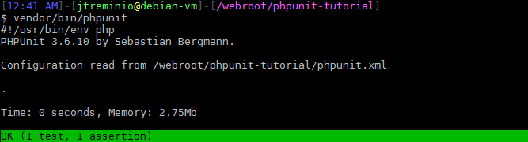
Your First (Useless) Test
Tests must be called
{Class}Test.php
<?php
// tests/DumbTest.php
class DumbTest extends \PHPUnit_Framework_TestCase
{
public function testWhatADumbTest()
{
$this->assertTrue(true);
}
}
Class name should be the same as filename.
Extends PHPUnit_Framework_TestCase
Must have the word “test” in front of method name
Executing PHPUnit
Results of test suite run

Slide 7
Breaking Down a Method for Testing
<?php
class Payment
{
const API_ID = 123456;
const TRANS_KEY = 'TRANSACTION KEY';
public function processPayment(array $paymentDetails)
{
$transaction = new AuthorizeNetAIM(API_ID, TRANS_KEY);
$transaction->amount = $paymentDetails['amount'];
$transaction->card_num = $paymentDetails['card_num'];
$transaction->exp_date = $paymentDetails['exp_date'];
$response = $transaction->authorizeAndCapture();
if ($response->approved) {
return $this->savePayment($response->transaction_id);
} else {
throw new \Exception($response->error_message);
}
}
}
Expecting an array to be passed in
Using new
Calls method in outside class
Interacts with result
Calls method inside class
Throws Exception

Slide 8
Dependency Injection
Don’t use new
Pass in dependencies in method parameters
Learn yourself some DI [1]
// Bad method
public function processPayment(array $paymentDetails)
{
$transaction = new AuthorizeNetAIM(API_ID, TRANS_KEY);
// …
// Good method
public function processPayment(
array $paymentDetails,
AuthorizeNetAIM $transaction
){
// …
[1] http://fabien.potencier.org/article/11/what-is-dependency-injection

Slide 9
Updated Payment Class
<?php
class Payment
{
public function processPayment(
array $paymentDetails,
AuthorizeNetAIM $transaction
){
$transaction->amount = $paymentDetails['amount'];
$transaction->card_num = $paymentDetails['card_num'];
$transaction->exp_date = $paymentDetails['exp_date'];
$response = $transaction->authorizeAndCapture();
if ($response->approved) {
return $this->savePayment($response->transaction_id);
} else {
throw new \Exception($response->error_message);
}
}
}

Slide 10
Introducing Mocks and Stubs
Mocks
Mimic the original method closely
Execute actual code
Give you some control
Stubs
Methods are completely overwritten
Allow complete control
Both are used for outside dependencies we don’t want to our test to have to deal with.

Slide 11
How to Mock an Object
Create separate files
Lots of work
Lots of files to keep track of
Use getMock()
Too many optional parameters!
public function getMock($originalClassName, $methods = array(), array $arguments = array(), $mockClassName = '', $callOriginalConstructor = TRUE, $callOriginalClone = TRUE, $callAutoload = TRUE)
Use getMockBuilder() !
Uses chained methods
Much easier to work with
Mockery [1]
Once you master getMockBuilder() it is no longer necessary
[1] https://github.com/padraic/mockery

Slide 12
->getMockBuilder()
Create a basic mock
Creates a mocked object of the AuthorizeNetAIM class
$payment = $this->getMockBuilder('AuthorizeNetAIM')
->getMock();
Mocked method created at runtime

Slide 13
->getMockBuilder()->setMethods() 1/4
setMethods() has 4 possible outcomes
Don’t call setMethods()
All methods in mocked object are stubs
Return null
Methods easily overridable
$payment = $this->getMockBuilder('AuthorizeNetAIM')
->getMock();
Passes is_a() checks!

Slide 14
->getMockBuilder()->setMethods() 2/4
setMethods() has 4 possible outcomes
Pass an empty array
Same as if not calling setMethods()
All methods in mocked object are stubs
Return null
Methods easily overridable
$payment = $this->getMockBuilder('AuthorizeNetAIM')
->setMethods(array()) ->getMock();

Slide 15
->getMockBuilder()->setMethods() 3/4
setMethods() has 4 possible outcomes
Pass null
All methods in mocked object are mocks
Run actual code in method
Not overridable
$payment = $this->getMockBuilder('AuthorizeNetAIM')
->setMethods(null) ->getMock();

Slide 16
->getMockBuilder()->setMethods() 4/4
setMethods() has 4 possible outcomes
Pass an array with method names
Methods identified are stubs
Return null
Easily overridable
Methods *not* identified are mocks
Actual code is ran
Unable to override
$payment = $this->getMockBuilder('Payment')
->setMethods(
array('authorizeAndCapture',)
)
->getMock();

Slide 17
Other getMockBuilder() helpers
disableOriginalConstructor()
Returns a mock with the class __construct() overriden
$payment = $this->getMockBuilder('AuthorizeNetAIM')
->disableOriginalConstructor() ->getMock();
setConstructorArgs()
Passes arguments to the __construct()
$payment = $this->getMockBuilder('AuthorizeNetAIM ')
->setConstructorArgs(array(API_LOGIN_ID, TRANSACTION_KEY))
->getMock();
getMockForAbstractClass()
Returns a mocked object created from abstract class
$payment = $this->getMockBuilder('AuthorizeNetAIM') ->getMockForAbstractClass();

Slide 18
Using Stubbed Methods 1/3
->expects()
$this->once()
$this->any()
$this->never()
$this->exactly(10)
$this->onConsecutiveCalls()
$payment = $this->getMockBuilder('AuthorizeNetAIM')
->getMock();
$payment->expects($this->once())
->method('authorizeAndCapture');

Slide 19
Using Stubbed Methods 2/3
->method('name')
->will($this->returnValue('value'))
Overriding stub method means specifying what it returns.
Doesn’t run any code
Expected call count
Can return anything
$payment = $this->getMockBuilder('AuthorizeNetAIM')
->getMock();
$payment->expects($this->once())
->method('authorizeAndCapture')
->will($this->returnValue(array('baz' => 'boo')));

Slide 20
Using Stubbed Methods 3/3
A stubbed method can return a mock object!
$payment = $this->getMockBuilder('AuthorizeNetAIM')
->getMock();
$invoice = $this->getMockBuilder('Invoice')
->getMock();
$payment->expects($this->once())
->method('getInvoice')
->will($this->returnValue($invoice));

Slide 21
Assertions
Define what you expect to happen
Assertions check statement is true
36 assertions as of PHPUnit 3.6
$foo = true;
$this->assertTrue($foo);
$foo = false;
$this->assertFalse($foo);
$foo = 'bar';
$this->assertEquals(
'bar',
$foo
);
$arr = array('baz' => 'boo');
$this->assertArrayHasKey(
'baz',
$arr
);

Slide 22
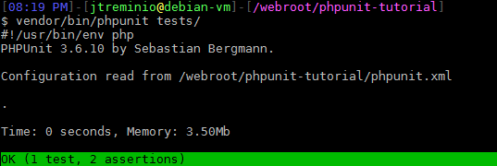
Run a Complete Test 1/2
Payment.php
PaymentTest.php
Mock AuthorizeNetAIM object
<?php
namespace phpunitTests;
class Payment
{
const API_ID = 123456;
const TRANS_KEY = 'TRANSACTION KEY';
public function processPayment(
array $paymentDetails,
\phpunitTests\AuthorizeNetAIM $transaction
) {
$transaction->amount = $paymentDetails['amount'];
$transaction->card_num = $paymentDetails['card_num'];
$transaction->exp_date = $paymentDetails['exp_date'];
$response = $transaction->authorizeAndCapture();
if ($response->approved) {
return $this->savePayment($response->transaction_id);
} else {
throw new \Exception($response->error_message);
}
}
protected function savePayment()
{
return true;
}
}
<?php
class PaymentTest extends \PHPUnit_Framework_TestCase
{
public function testProcessPaymentReturnTrueOnApprovedResponse()
{
$authorizeNetAIM = $this
->getMockBuilder('\phpunitTests\AuthorizeNetAIM')
->getMock();
$authorizeNetResponse = new \stdClass();
$authorizeNetResponse->approved = true;
$authorizeNetResponse->transaction_id = 12345;
$authorizeNetAIM->expects($this->once())
->method('authorizeAndCapture')
->will($this->returnValue($authorizeNetResponse));
$arrayDetails = array(
'amount' => 123,
'card_num' => '1234567812345678',
'exp_date' => '04/07',
);
$payment = new \phpunitTests\Payment();
$this->assertTrue(
$payment->processPayment(
$arrayDetails,
$authorizeNetAIM
)
);
}
}
Mock authorize object (stdClass)
Return object
Instantiate our class to be tested
Our assertion

Slide 23

Run a Complete Test 2/2
Payment.php
PaymentTest.php
Set expected Exception
Cannot be \Exception()!
<?php
namespace phpunitTests;
class Payment
{
const API_ID = 123456;
const TRANS_KEY = 'TRANSACTION KEY';
public function processPayment(
array $paymentDetails,
\phpunitTests\AuthorizeNetAIM $transaction
) {
$transaction->amount = $paymentDetails['amount'];
$transaction->card_num = $paymentDetails['card_num'];
$transaction->exp_date = $paymentDetails['exp_date'];
$response = $transaction->authorizeAndCapture();
if ($response->approved) {
return $this->savePayment($response->transaction_id);
} else {
throw new \phpunitTests\PaymentException(
$response->error_message
);
}
}
protected function savePayment()
{
return true;
}
}
public function testProcessPaymentThrowsExceptionOnUnapproved()
{
$exceptionMessage = 'Grats on failing lol';
$this->setExpectedException(
'\phpunitTests\PaymentException',
$expectedExceptionMessage
);
$authorizeNetAIM = $this
->getMockBuilder('\phpunitTests\AuthorizeNetAIM')
->disableOriginalConstructor()
->setConstructorArgs(
array(
\phpunitTests\Payment::API_ID,
\phpunitTests\Payment::TRANS_KEY
)
)
->setMethods(array('authorizeAndCapture'))
->getMock();
$authorizeNetResponse = new \stdClass();
$authorizeNetResponse->approved = false;
$authorizeNetResponse->error_message = $exceptionMessage;
$authorizeNetAIM->expects($this->once())
->method('authorizeAndCapture')
->will($this->returnValue($authorizeNetResponse));
$arrayDetails = array(
'amount' => 123,
'card_num' => '1234567812345678',
'exp_date' => '04/07',
);
$payment = new \phpunitTests\Payment();
$payment->processPayment($arrayDetails, $authorizeNetAIM);
}
Force else{} to run in code
Exception thrown
No assertion. Was already defined.

Slide 24
Mocking Object Being Tested
public function testProcessPaymentThrowsExceptionOnUnapproved()
{
$exceptionMessage = 'Grats on failing lol';
$this->setExpectedException(
'\phpunitTests\PaymentException',
$expectedExceptionMessage
);
$authorizeNetAIM = $this
->getMockBuilder('\phpunitTests\AuthorizeNetAIM')
->disableOriginalConstructor()
->setConstructorArgs(
array(
\phpunitTests\Payment::API_ID,
\phpunitTests\Payment::TRANS_KEY
)
)
->setMethods(array('authorizeAndCapture'))
->getMock();
$authorizeNetResponse = new \stdClass();
$authorizeNetResponse->approved = false;
$authorizeNetResponse->error_message = $exceptionMessage;
$authorizeNetAIM->expects($this->once())
->method('authorizeAndCapture')
->will($this->returnValue($authorizeNetResponse));
$arrayDetails = array(
'amount' => 123,
'card_num' => '1234567812345678',
'exp_date' => '04/07',
);
$payment = $this
->getMockBuilder('\phpunitTests\Payment')
->setMethods(array('hash'))
->getMock();
$payment->processPayment($arrayDetails, $authorizeNetAIM);
}
Stub one method

Slide 25
Statics are Evil… Or Are They?
Statics are convenient
Statics are quick to use
Statics are now easy to mock*
*Only if both caller and callee are in same class
Statics create dependencies within your code
Static properties keep values
PHPUnit has a “backupStaticAttributes” flag

Slide 26
Mocking Static Methods
Original Code
Test Code
<?php
class Foo
{
public static function doSomething()
{
return static::helper();
}
public static function helper()
{
return 'foo';
}
}
<?php
class FooTest extends PHPUnit_Framework_TestCase
{
public function testDoSomething()
{
$class = $this->getMockClass(
/* name of class to mock */
'Foo',
/* list of methods to mock */
array('helper')
);
$class::staticExpects($this->any())
->method('helper')
->will($this->returnValue('bar'));
$this->assertEquals(
'bar',
$class::doSomething()
);
}
}
Static method call within Foo class
Taken directly from Sebastion Bergmann’s Website
http://sebastian-bergmann.de/archives/883-Stubbing-and-Mocking-Static-Methods.html

Slide 27

Can’t Mock This
Can’t mock static calls to outside classes!
<?php
class Foo
{
public static function doSomething()
{
return PaymentException::helper();
}
public static function helper()
{
return 'foo';
}
}

Slide 28
When to Use Statics?
Same class
Non-complicated operations
Never

Slide 29
Annotations
@covers
Tells what method is being tested
Great for coverage reports
@group
Separate tests into named groups
Don’t run full test suite
@test
May as well!
@dataProvider
Run single test with different input
Many more!

Slide 30
@test
<?php
class PaymentTest extends \PHPUnit_Framework_TestCase
{
/**
* @test
*/
public function processPaymentReturnTrueOnApprovedResponse()
{
// ...
}
/**
* @test
*/
public function processPaymentThrowsExceptionOnUnapproved()
{
// ...
}
}

Slide 31
@group
<?php
class PaymentTest extends \PHPUnit_Framework_TestCase
{
/**
* @test
* @group me
*/
public function processPaymentReturnTrueOnApprovedResponse()
{
// ...
}
/**
* @test
* @group exceptions
*/
public function processPaymentThrowsExceptionOnUnapproved()
{
// ...
}
}

Slide 32
@covers
<?php
class PaymentTest extends \PHPUnit_Framework_TestCase
{
/**
* @test
* @covers \phpunitTests\Payment::processPayment
* @group me
*/
public function processPaymentReturnTrueOnApprovedResponse()
{
// ...
}
/**
* @test
* @covers \phpunitTests\Payment::processPayment
* @group exceptions
*/
public function processPaymentThrowsExceptionOnUnapproved()
{
// ...
}
}

Slide 33
@dataProvider 1/2
Original Code
Test Code
<?php
namespace phpunitTests;
class Sluggify
{
public function sluggify(
$string,
$delimiter = '-',
$maxLength = 96
){
$clean = iconv('UTF-8', 'ASCII//TRANSLIT', $string);
$clean = preg_replace("%[^-/+|\w ]%", '', $clean);
$clean = strtolower(
trim(substr($clean, 0, $maxLength), '-'));
$clean =
preg_replace("/[\/_|+ -]+/", $delimiter, $clean);
return $clean;
}
}
<?php
class SluggifyTest extends \PHPUnit_Framework_TestCase
{
public function sluggifyReturnsCorrectStringTestOne()
{
$sluggify = new \phpunitTests\Sluggify();
$rawString = "Perch頬'erba 蠶erde?"."'";
$expectedString = 'perche-lerba-e-verde';
$this->assertEquals(
$expectedString,
$sluggify->sluggify($rawString)
);
}
public function sluggifyReturnsCorrectStringTestTwo()
{
$sluggify = new \phpunitTests\Sluggify();
$rawString = "Peux-tu m'aider s'il te pla".",";
$expectedString = 'peux-tu-maider-sil-te-plait';
$this->assertEquals(
$expectedString,
$sluggify->sluggify($rawString)
);
}
public function sluggifyReturnsCorrectStringTestThree()
{
$sluggify = new \phpunitTests\Sluggify();
$rawString = "T䮫 efter nu fn vi f dig bort";
$expectedString = 'tank-efter-nu-forrn-vi-foser-dig-bort';
$this->assertEquals(
$expectedString,
$sluggify->sluggify($rawString)
);
}
}
Same overall code, different input
http://cubiq.org/the-perfect-php-clean-url-generator

Slide 34
@dataProvider 2/2
Original Code
Test Code
<?php
namespace phpunitTests;
class Sluggify
{
public function sluggify(
$string,
$delimiter = '-',
$maxLength = 96
){
$clean = iconv('UTF-8', 'ASCII//TRANSLIT', $string);
$clean = preg_replace("%[^-/+|\w ]%", '', $clean);
$clean = strtolower(
trim(substr($clean, 0, $maxLength), '-'));
$clean =
preg_replace("/[\/_|+ -]+/", $delimiter, $clean);
return $clean;
}
}
<?php
class SluggifyTest extends \PHPUnit_Framework_TestCase
{
/**
* @test
* @dataProvider providerSluggifyReturnsSluggifiedString
*/
public function sluggifyReturnsSluggifiedString(
$rawString, $expectedResult
){
$sluggify = new \phpunitTests\Sluggify();
$this->assertEquals(
$expectedResult,
$sluggify->sluggify($rawString)
);
}
/**
* Provider for sluggifyReturnsSluggifiedString
*/
public function providerSluggifyReturnsSluggifiedString()
{
return array(
array(
"Perch頬'erba 蠶erde?"."'",
'perche-lerba-e-verde',
),
array(
"Peux-tu m'aider s'il te pla".",",
'peux-tu-maider-sil-te-plait',
),
array(
"T䮫 efter nu fn vi f dig bort",
'tank-efter-nu-forrn-vi-foser-dig-bort',
),
);
}
}

Slide 35
setUp() && tearDown()
setUp()
Runs code before *each* test method
Set up class variables
tearDown()
Runs code after *each* test method
Useful for database interactions

Slide 36
setUpBeforeClass()
<?php
class TestBase extends \PHPUnit_Framework_TestCase
{
static $runOncePerSuite = false;
public static function setUpBeforeClass()
{
if (!self::$runOncePerSuite) {
/**
* Requires table yumiliciousTests to exist.
* Drops all data from this table and clones yumilicious into it
*/
exec(
'mysqldump -u root --no-data --add-drop-table yumiliciousTests | ' .
'grep ^DROP | ' .
'mysql -u root yumiliciousTests && ' .
'mysqldump -u root yumilicious | ' .
'mysql -u root yumiliciousTests'
);
self::$runOncePerSuite = true;
}
}
}

Slide 37
Extending PHPUnit
<?php
/**
* Some useful methods to make testing with PHPUnit faster and more fun
*/
abstract class TestBase extends \PHPUnit_Framework_TestCase
{
/**
* Set protected/private attribute of object
*
* @param object &$object Object containing attribute
* @param string $attributeName Attribute name to change
* @param string $value Value to set attribute to
*
* @return null
*/
public function setAttribute(&$object, $attributeName, $value)
{
$class = is_object($object) ? get_class($object) : $object;
$reflection = new \ReflectionProperty($class, $attributeName);
$reflection->setAccessible(true);
$reflection->setValue($object, $value);
}
/**
* Call protected/private method of a class.
*
* @param object &$object Instantiated object that we will run method on.
* @param string $methodName Method name to call
* @param array $parameters Array of parameters to pass into method.
*
* @return mixed Method return.
*/
public function invokeMethod(&$object, $methodName, array $parameters = array())
{
$reflection = new \ReflectionClass(get_class($object));
$method = $reflection->getMethod($methodName);
$method->setAccessible(true);
return $method->invokeArgs($object, $parameters);
}
}

Slide 38
XML Config File
phpunit.xml
<?xml version="1.0" encoding="UTF-8"?>
<phpunit backupGlobals="false"
backupStaticAttributes="true"
colors="true"
convertErrorsToExceptions="true"
convertNoticesToExceptions="true"
convertWarningsToExceptions="true"
processIsolation="false"
stopOnFailure="false"
stopOnError="false"
stopOnIncomplete="false"
stopOnSkipped="false"
syntaxCheck="false"
bootstrap="index.php">
<testsuites>
<testsuite name="Application Test Suite">
<directory>./tests/</directory>
</testsuite>
</testsuites>
</phpunit>

Slide 39
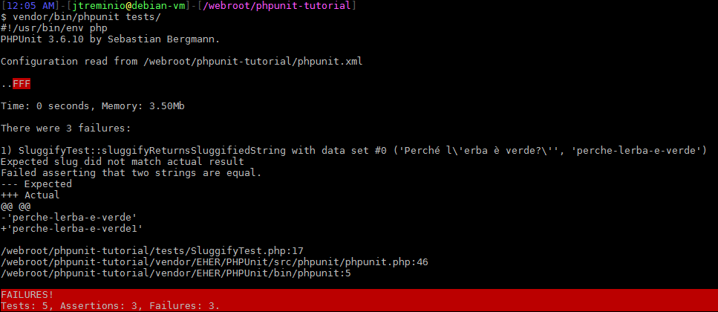
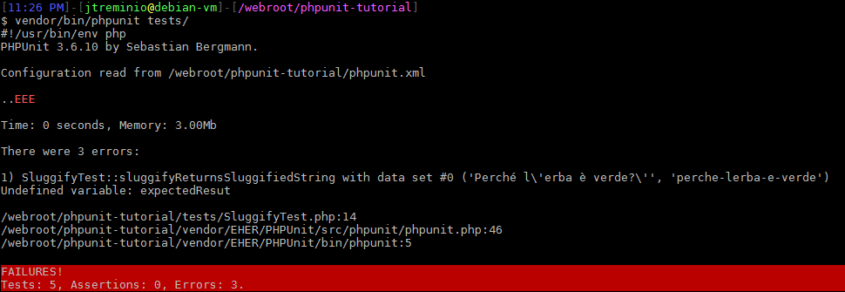
Errors and Failures
Failures
Errors

Slide 40
Mocking Native PHP Functions
DON’T USE RUNKIT!
Allows redefining PHP functions at runtime
Wrap functions in class methods
Allows for easy mocking and stubbing
Why mock native PHP functions?
Mostly shouldn’t
cURL, crypt

Slide 41
Classes Should Remind Ignorant
Should not know they are being tested
Never change original files with test-only code
Creating wrappers for mocks is OK

Slide 42
No ifs or Loops in Tests
Tests should remain simple
Consider using @dataProvider
Consider splitting out the test
Consider refactoring original class

Slide 43
Few Assertions!
As few assertions as possible per method
Max one master assertion

Slide 44
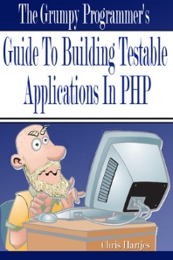
Further Reading
Upcoming Series
http://www.jtreminio.com
Multi-part
Much greater detail
Chris Hartjes’
The Grumpy Programmer's Guide To Building Testable PHP Applications

Slide 45


