Slide 1
Database Tables and Their
Components

Slide 2


► A database table is used to store an entity set
◦ An entity set is a collection of related entities
* An entity is anything you want to keep track of, so an entity may be a person, place, thing, event, etc.

Slide 3


► At the conceptual level, a database table may be viewed as a matrix.
◦ Matrix rows are also known as tuples or records
* each row contains an entity
◦ Matrix columns are also called fields.
* Each column (field) contains the entity’s attribute values

Slide 4

► Primary Key (PK)
◦ an attribute (or combination of attributes) that uniquely identifies each row (entity) in a table.
• A PK composed of two or more attributes is known as a composite PK.
► Foreign Key (FK)
◦ an attribute in one table whose values match the PK values in a related table or whose “values” are null.
• FKs are used link (connect) related tables.

Slide 5

► Entity Integrity
◦ PK uniquely identifies each entity in a table
* PK may not include nulls
► Referential Integrity
◦ FK values in one table match the PK values in the related table
* FK may include nulls

Slide 6


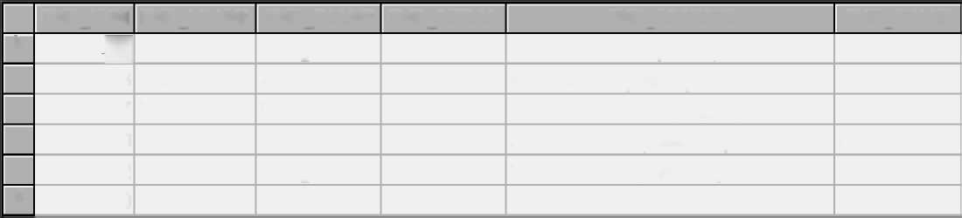

Tables are named. The table you see here is the EMPLOYEE table.
Each column contains the values of an attribute. The EMP_FNAME column only contains employee first names; the EMP_PHONE may only contain employee phone numbers.
Named attributes (fields)
//I
Each row represents an entity
 | EMPJ1UM | EMP_LNAME | EMP_FNAME | EMPJNITIAL | EMP_ADDRESS | EMP_PHONE
► | jjjH | Graham | Georgette | E | 1234 Trident Lane, Eaton, MA12345 | 234-234-6789
 | 506 | Smith | Alex |  | 4321 Hill Drive, Dalton, GA 23456 | 123-456-7890
 | 507 | Thieu | Robert | E | 5678 Crescent Lane, Dalton, GA 23456 | 123-457-1123
 | 510 | Chen | Alice | L | 3456 Lake Drive, Nashville, TN 37654 | 456-333-9876
 | 512 | Alazar | George | D | 2345 Oak Drive, Nashville, TN 33123 | 456-456-7654
* | 0
A row is also called a record or a tuple.
Each row/column intersection contains only one of an entity’s attribute values
The Primary Key (PK) is a unique entity identifier. If you know the PK value, you
all of its row’s attribute values

Slide 7

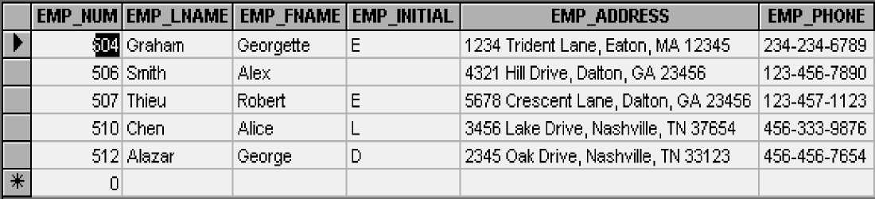

EMPLOYEE table
A table exhibits entity integrity when all of its Primary Key (PK) values uniquely identify each table row (record.)
1. A PK cannot contain duplicate values
2. A PK cannot contains nulls
Note: A null indicates the absence of a value; it is not a blank. (You create a null when you tap the ENTER key without first making an entry. A blank
when you tap the space bar and then tap the ENTER key.)

Slide 8

Foreign keys (FK) and Referential Integrity
A Foreign Key (FK) is an attribute located in one table that “points to” a Primary Key (PK) in a related table. The use of FKs allows you relate one table to another.
To maintain referential integrity, a foreign key (FK) must reference an existing PK value in a related table or it may be null.
INVOICE table
 | IHVHUM | INV_DATE | CUS_NUM | INV_SUBTOTAL | INV_T AX | INV_TOTAL | INV_PAYMENT | IHV_BALAHCE
 | ■ 00541 | Friday, June 11,1999 | 112 | $86.90 | $6.95 | $93.85 | $93.85 | $0.00
 | 100542 | Friday, June 11,1999 | 122 | $24.95 | $2.00 | $26.95 | $26.95 | $0.00
 | 100543 | Saturday, June 12,1999 | 112 | $91.15 | $7.29 | $98.44 | $98.44 | $0.00
IT | 0 |  | 0 | $0.00 | $0.00 | $0.00 | $0.00 | $0.00
LINE table

Slide 9


► Each table row/column intersection contains a single attribute value for a single entity.
◦ Ideally, attributes are simple and single-valued.
◦ Single-valued composite attributes are acceptable
* but composite attributes may make queries more complex and may impose reporting limitations.
◦ Multi-valued attributes, either simple or composite, may ...
* create structural problems
* make queries more complex and may impose reporting limitations.

Slide 10

► Multi-valued attributes are sometimes stored as ◦ strings
• this approach yields query complexity and reporting limitations
° multiple attributes
• this approach yields structural problems
► Ideally, multi-valued attributes are handled through the use of composite tables.

Slide 11

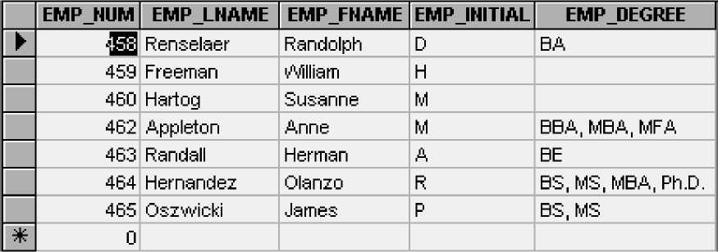
Multi-valued
attribute
Poor practice: Makes it difficult to generate queries such as “How many employees have earned BA or MBA degrees?”

Slide 12

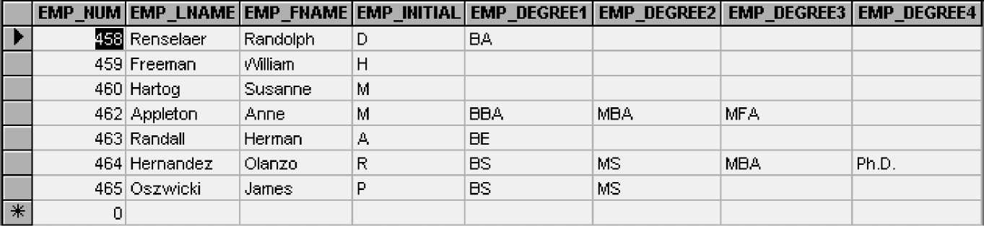
Poor structure: many nulls
table structure must be altered when additional degrees are earned
^ ^ ^ ^

Slide 13
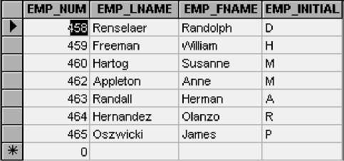
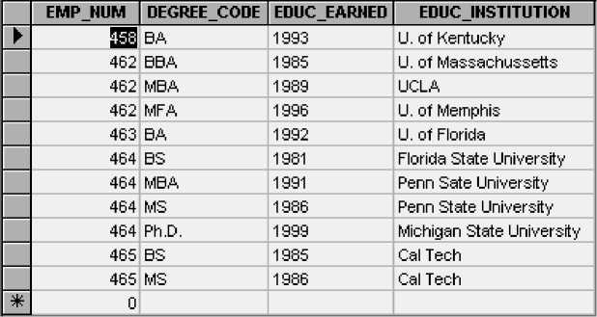
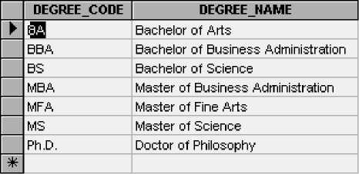
A Composite Table (EDUCATION) is Used To Convert M:N Relationships To 1:M Relationships
Table name: EMPLOYEE
Table name: EDUCATION
Table name: DEGREE

Slide 14
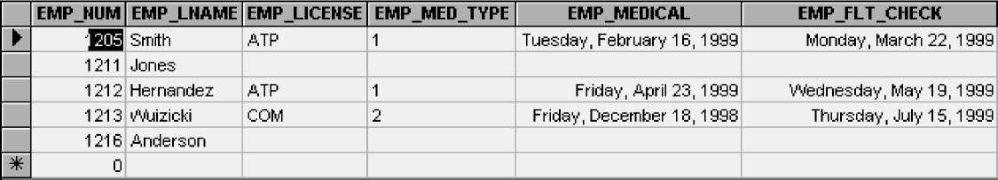
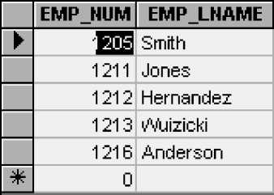
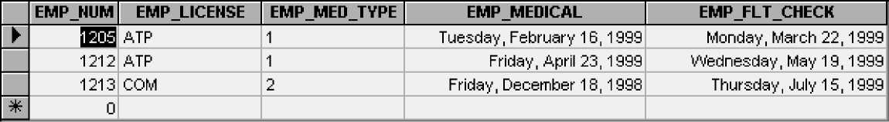
Supertype/Subtype Relationships Are Used To Eliminate or Control the Occurrence of Nulls
A table with many nulls
Supertype. (Table name: EMPLOYEE
Subtype. (Table name: PILOT)

Slide 15
The END

