Slide 1


youtube.com/thejtrent238
algebraic expressions
By: Trent Patterson
(jtrent238)
youtube.com/thejtrent238

Slide 2

youtube.com/thejtrent238
Welcome to algebraic expressions
Who Wants To be A Millionaire
Click For help
START

Slide 3
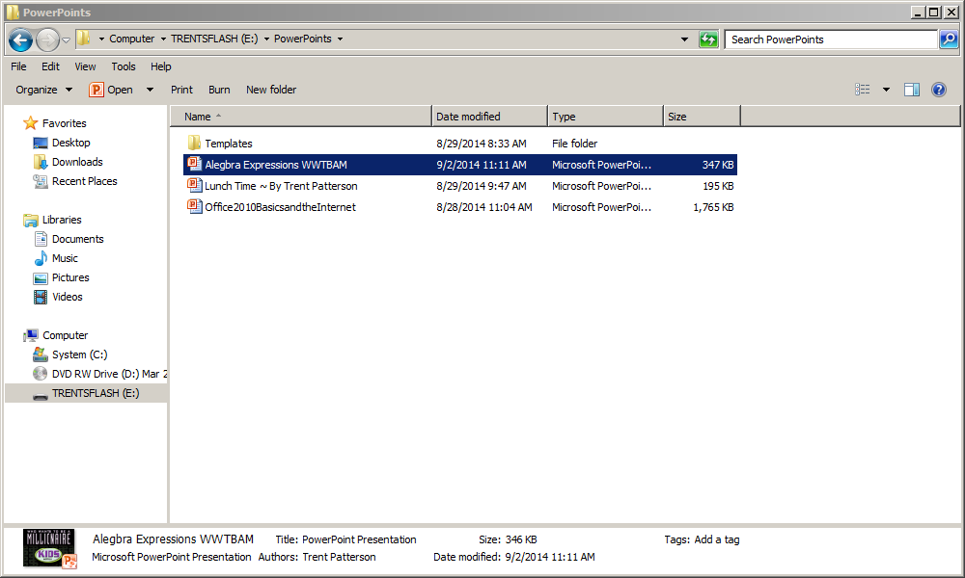
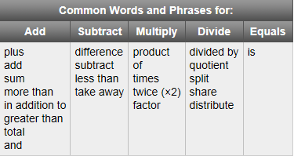
Common Words and Phrases for:
youtube.com/thejtrent238

Slide 4
Who Wants To Be a Millionaire
youtube.com/thejtrent238
100
200
300
400
500
1000
1500
2000
2500
3000
5000
100000
150000
1000000
50/50

Slide 5
youtube.com/thejtrent238
x more than a number than 10
1.
10+x
x+10
A.
B.
10•x
x•10
C.
D.
50/50

Slide 6
Who Wants To Be a Millionaire
youtube.com/thejtrent238
100
200
300
400
500
1000
1500
2000
2500
3000
5000
100000
150000
1000000
50/50

Slide 7
youtube.com/thejtrent238
the sum of nine and eight
2.
9-8
9•8
A.
B.
9/8
9+8
C.
D.
50/50

Slide 8
Who Wants To Be a Millionaire
youtube.com/thejtrent238
100
200
300
400
500
1000
1500
2000
2500
3000
5000
100000
150000
1000000
50/50

Slide 9
youtube.com/thejtrent238
twenty less than a number t plus one
3.
1 + 20 – t
t – 20 - 1
A.
B.
t – 20 + 1
t + 20 + 1
C.
D.
50/50

Slide 10
Who Wants To Be a Millionaire
100
200
300
400
500
1000
1500
2000
2500
3000
5000
100000
150000
1000000
50/50

Slide 11
youtube.com/thejtrent238
thirty-two divided by a number y
4.
y ÷32
32 ÷ y
A.
B.
9 · n
32+y
C.
D.
50/50

Slide 12
Who Wants To Be a Millionaire
youtube.com/thejtrent238
100
200
300
400
500
1000
1500
2000
2500
3000
5000
100000
150000
1000000
50/50

Slide 13
youtube.com/thejtrent238
seven less than a number t
4.
t - 7
7 + t
A.
B.
7 - t
14 - p
C.
D.
50/50

Slide 14
Who Wants To Be a Millionaire
youtube.com/thejtrent238
100
200
300
400
500
1000
1500
2000
2500
3000
5000
100000
150000
1000000
50/50

Slide 15
youtube.com/thejtrent238
Three times a number, increased by seventeen
5.
3 + a + 17
3(a + 17)
A.
B.
3a + 17
(17 + 3)a
C.
D.
50/50

Slide 16
Who Wants To Be a Millionaire
youtube.com/thejtrent238
100
200
300
400
500
1000
1500
2000
2500
3000
5000
100000
150000
1000000
50/50

Slide 17
youtube.com/thejtrent238
Fifteen less than twice a number
6.
15 - 2x
None of the above
A.
B.
2x + 15
2x - 15
C.
D.
50/50

Slide 18
Who Wants To Be a Millionaire
youtube.com/thejtrent238
100
200
300
400
500
1000
1500
2000
2500
3000
5000
100000
150000
1000000
50/50

Slide 19
youtube.com/thejtrent238
Thirty divided by seven times a number
7.
None of the above
30(7n)
A.
B.
30 + 7n
C.
D.
50/50

Slide 20
Who Wants To Be a Millionaire
youtube.com/thejtrent238
100
200
300
400
500
1000
1500
2000
2500
3000
5000
100000
150000
1000000
50/50

Slide 21
youtube.com/thejtrent238
Jenny earns $30 a day working part time at a supermarket. Write an algebraic expression to represent the amount of money she will earn in d days.
8.
A.
30d
B.
30 + d
None of the above
C.
D.
50/50

Slide 22
Who Wants To Be a Millionaire
youtube.com/thejtrent238
100
200
300
400
500
1000
1500
2000
2500
3000
5000
100000
150000
1000000
50/50

Slide 23
youtube.com/thejtrent238
The product of nine and a number, decreased by six
9.
9(m - 6)
6(9 - m)
A.
B.
9m - 6
None of the above
C.
D.
50/50

Slide 24
Who Wants To Be a Millionaire
youtube.com/thejtrent238
youtube.com/thejtrent238
100
200
300
400
500
1000
1500
2000
2500
3000
5000
100000
150000
1000000
50/50

Slide 25
youtube.com/thejtrent238
Half of a number is twenty.
10.
20 = 3x
x × ½ = 20
A.
B.
x = 2x + 20
20 + ½ • x
C.
D.
50/50

Slide 26
Who Wants To Be a Millionaire
youtube.com/thejtrent238
100
200
300
400
500
1000
1500
2000
2500
3000
5000
100000
150000
1000000
50/50

Slide 27
youtube.com/thejtrent238
three times the total of a number and five
11.
3(x + x)
3(x + x)
A.
B.
3(x + 5)
3(x + 0)
C.
D.
50/50

Slide 28
Who Wants To Be a Millionaire
youtube.com/thejtrent238
100
200
300
400
500
1000
1500
2000
2500
3000
5000
100000
150000
1000000
50/50

Slide 29
youtube.com/thejtrent238
eighty less than a number
12.
x – 80
80 - x
A.
B.
x + 80
80 + x
C.
D.
50/50

Slide 30
Who Wants To Be a Millionaire
youtube.com/thejtrent238
100
200
300
400
500
1000
1500
2000
2500
3000
5000
100000
150000
1000000
50/50

Slide 31
youtube.com/thejtrent238
the quotient of a number and four
13.
x ÷ 4x
4x ÷ 4
A.
B.
4 ÷ x
x ÷ 4
C.
D.
50/50

Slide 32
Split cash
youtube.com/thejtrent238
Split cash

Slide 33
50/50
youtube.com/thejtrent238
50/50

Slide 34


Phone a friend
youtube.com/thejtrent238
Phone A Friend

Slide 35
Sorry Try Again
Sorry Try Again
youtube.com/thejtrent238

Slide 36
Super
youtube.com/thejtrent238
Super

Slide 37

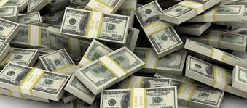
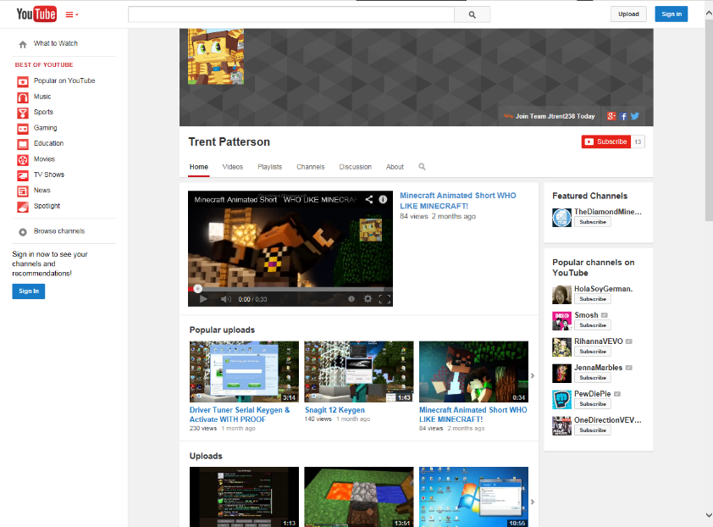
youtube.com/thejtrent238
Go To My Youtube!!!
Click Here

