Slide 1

youtube.com/thejtrent238

Slide 2

youtube.com/thejtrent238
Matter
By: Trent Patterson
(jtrent238)
Start
youtube.com/thejtrent238

Slide 3

Who Wants To Be a Millionaire
youtube.com/thejtrent238
100
200
300
400
500
1000
1500
2000
2500
3000
5000
100000
150000
1000000
50/50

Slide 4

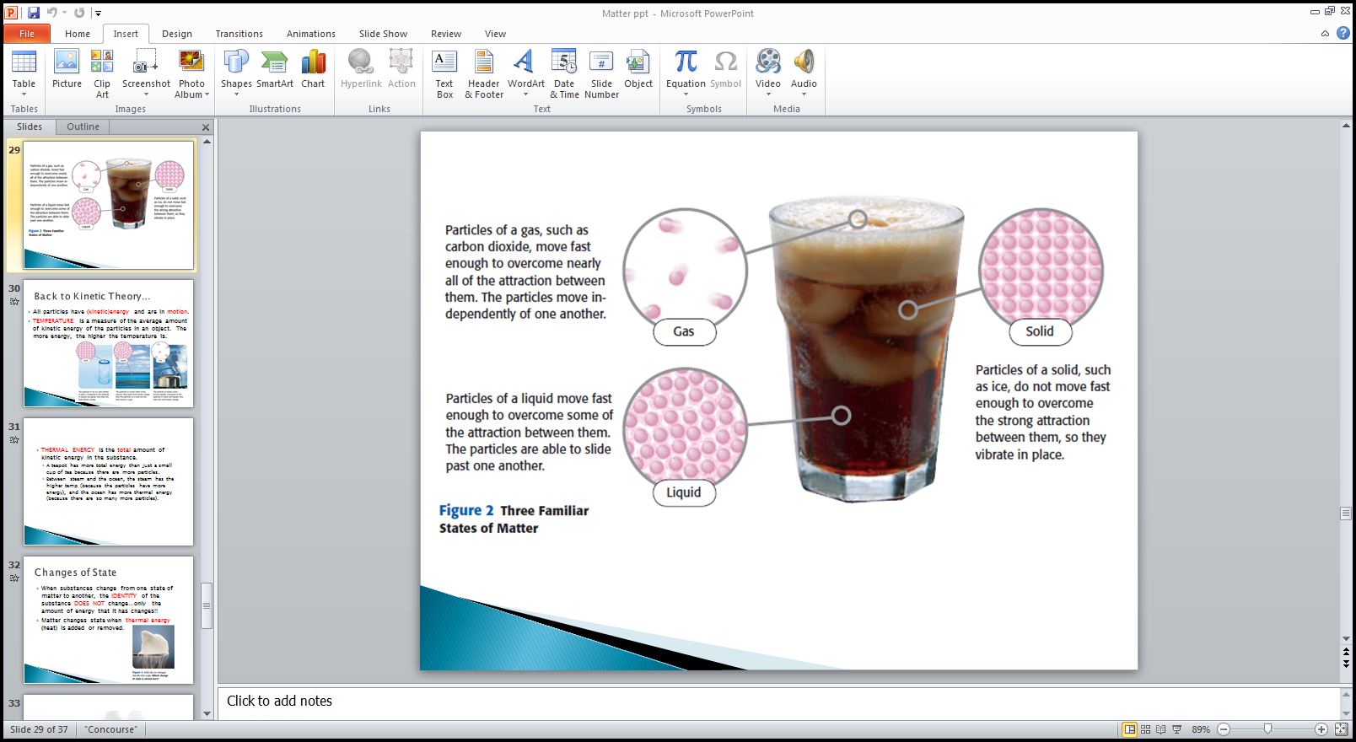
ID:A
youtube.com/thejtrent238
Which of these are particles of a solid?
1.
A.
B.
None of the above
C.
D.
50/50
Next Question

Slide 5
Who Wants To Be a Millionaire
youtube.com/thejtrent238
100
200
300
400
500
1000
1500
2000
2500
3000
5000
100000
150000
1000000
50/50

Slide 6
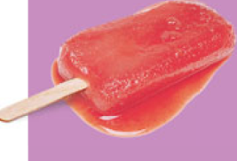
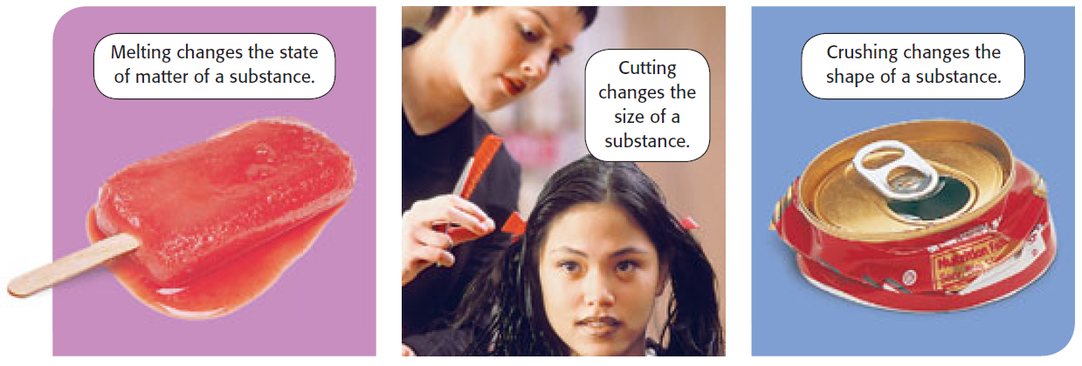
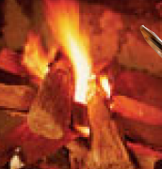
ID:D
youtube.com/thejtrent238
Which is a chemical change?
2.
A.
B.
C.
D.
50/50
Next Question

Slide 7
Who Wants To Be a Millionaire
youtube.com/thejtrent238
100
200
300
400
500
1000
1500
2000
2500
3000
5000
100000
150000
1000000
50/50

Slide 8
ID:C
youtube.com/thejtrent238
Calculate the density of a rock that has a mass of
454 g and a volume of 100.0 cm³.
3.
d = 0.454 g/cm
d = 0.454 g³
A.
B.
d = 0.454 g/cm³
d = 0.454 cm³
C.
D.
50/50
Next Question

Slide 9
Who Wants To Be a Millionaire
youtube.com/thejtrent238
100
200
300
400
500
1000
1500
2000
2500
3000
5000
100000
150000
1000000
50/50

Slide 10
ID:B
youtube.com/thejtrent238
A sample of copper has a volume of 23.4 cm³ and a
mass of 208 g. What is the density of copper?
4.
d = 8.89 g³
d = 8.89 g/cm³
A.
B.
d = 8.89 cm³
d = 8.89 g/cm
C.
D.
50/50
Next Question

Slide 11
Who Wants To Be a Millionaire
youtube.com/thejtrent238
100
200
300
400
500
1000
1500
2000
2500
3000
5000
100000
150000
1000000
50/50

Slide 12
ID:A
youtube.com/thejtrent238
If 10.0 cm³ of ice has a mass of 9.17 g, what is the density of ice?
5.
d = 0.917 g/cm³
d = 0.917 g³
A.
B.
d = 0.917 g/cm
d = 0.917 cm³
C.
D.
50/50
Next Question

Slide 13
Who Wants To Be a Millionaire
youtube.com/thejtrent238
100
200
300
400
500
1000
1500
2000
2500
3000
5000
100000
150000
1000000
50/50

Slide 14
ID:C
youtube.com/thejtrent238
If the density of liquid water is 1.0 g/cm³, would the ice sink or float?
6.
FLOAT!!
SINK!!
A.
B.
50/50
Next Question

Slide 15
Who Wants To Be a Millionaire
youtube.com/thejtrent238
100
200
300
400
500
1000
1500
2000
2500
3000
5000
100000
150000
1000000
50/50

Slide 16
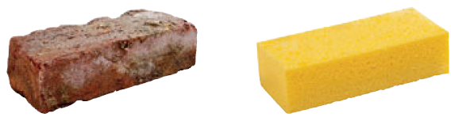
ID:D
youtube.com/thejtrent238
If the particles are closely packed, then the density is _____.
7.
high
low
A.
B.
50/50
Next Question

Slide 17
Who Wants To Be a Millionaire
100
200
300
400
500
1000
1500
2000
2500
3000
5000
100000
150000
1000000
50/50

Slide 18
ID:A
youtube.com/thejtrent238
youtube.com/thejtrent238
Density can be calculated using
8.
d=m/v
d=v/m
A.
B.
d=m•v
d=m+v
C.
D.
50/50
Next Question

Slide 19
Who Wants To Be a Millionaire
youtube.com/thejtrent238
100
200
300
400
500
1000
1500
2000
2500
3000
5000
100000
150000
1000000
50/50

Slide 20
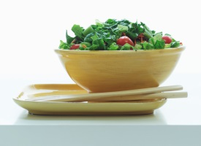

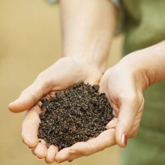
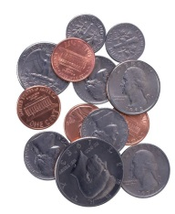
ID:B
youtube.com/thejtrent238
Which of these is a HOMOGENEOUS mixture
9.
A.
B.
C.
D.
50/50
Next Question

Slide 21
Who Wants To Be a Millionaire
youtube.com/thejtrent238
100
200
300
400
500
1000
1500
2000
2500
3000
5000
100000
150000
1000000
50/50

Slide 22
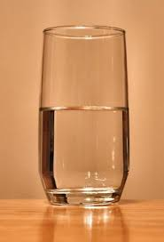
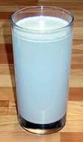
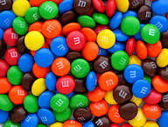
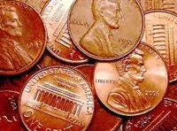
ID:C
youtube.com/thejtrent238
Which of these are a HETEROGENEOUS mixture?
10.
A.
B.
C.
D.
50/50
Next Question

Slide 23
Who Wants To Be a Millionaire
youtube.com/thejtrent238
100
200
300
400
500
1000
1500
2000
2500
3000
5000
100000
150000
1000000
50/50

Slide 24

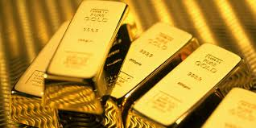
ID:B
youtube.com/thejtrent238
Which one is a PURE SUBSTANCE?
11.
A.
B.
C.
D.
50/50
Next Question

Slide 25
Who Wants To Be a Millionaire
100
200
300
400
500
1000
1500
2000
2500
3000
5000
100000
150000
1000000
50/50

Slide 26
ID:C
youtube.com/thejtrent238
youtube.com/thejtrent238
Which is a example of the kinetic theory?
12.
Kids always smell the
cookies baking from across the house.
When making iced tea, it’s
easier to dissolve sugar
in the hot liquid than cold.
A.
.
B.
If you put a chocolate bar in your pocket,
it will melt.
all of the above
C.
D.
50/50
Next Question

Slide 27
Who Wants To Be a Millionaire
youtube.com/thejtrent238
100
200
300
400
500
1000
1500
2000
2500
3000
5000
100000
150000
1000000
50/50

Slide 28
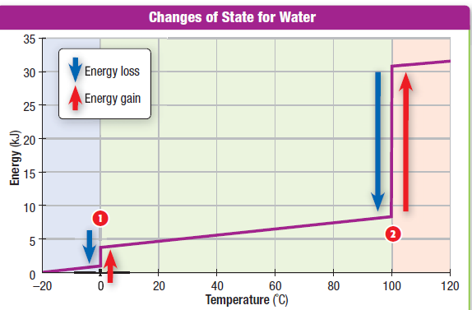
ID:A
youtube.com/thejtrent238
What is this heating curve for?
13.
Water
alcohol
A.
B.
Coffee
Tea
C.
D.
Next Question
50/50

Slide 29
Who Wants To Be a Millionaire
youtube.com/thejtrent238
100
200
300
400
500
1000
1500
2000
2500
3000
5000
100000
150000
1000000
50/50

Slide 30
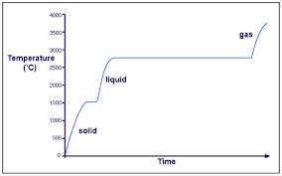
ID:D
youtube.com/thejtrent238
What is this a heating curve of?
14.
water
mercury
A.
B.
bromine
acetone
C.
D.
50/50

Slide 31
Split cash
youtube.com/thejtrent238
Split cash

Slide 32
50/50
youtube.com/thejtrent238
50/50

Slide 33


Phone a friend
youtube.com/thejtrent238
Phone A Friend

Slide 34
Sorry Try Again
Sorry Try Again
youtube.com/thejtrent238

Slide 35
Super
youtube.com/thejtrent238
Super

Slide 36

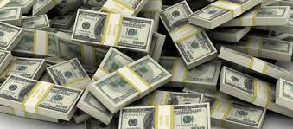

youtube.com/thejtrent238
Go To My Youtube!!!
Click Here

