Slide 1
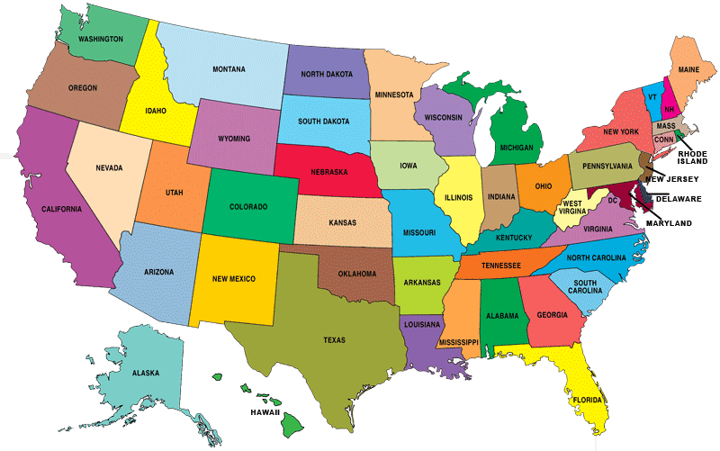
Facts About The States
By: Trent Patterson

Slide 2
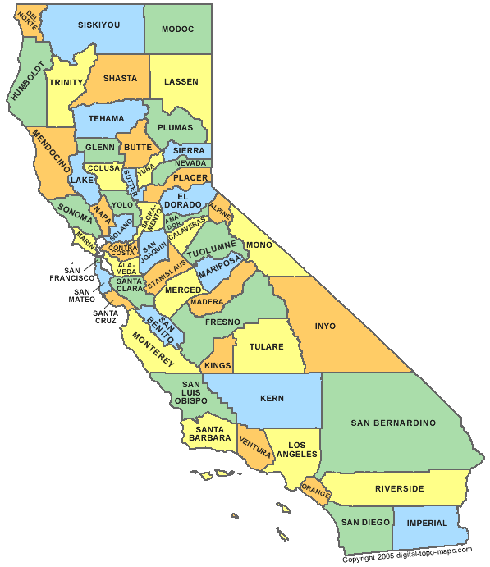
California
Area
Total | 163,707 square miles
Land area | 155,973 square miles
Water area | 7,734 square miles
Land Use (1987) | Thousands of acres
Developed | 4,621
Rural | 49,033
Cropland | 10,209
Pastureland | 1,501
Rangeland | 17,719
Forestland | 15,073

Slide 3
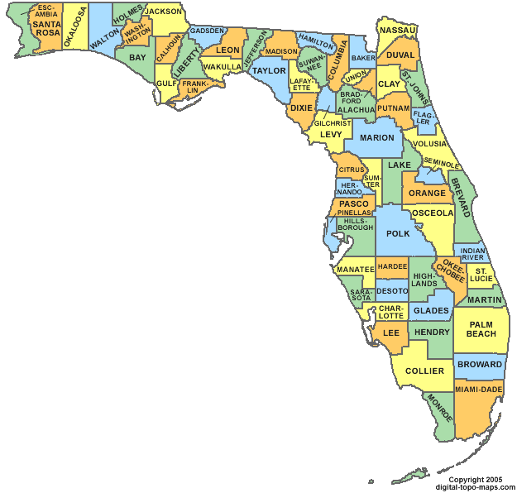
Florida
Area
Total | 65,758 square miles
Land area | 53,997 square miles
Water area | 11,761 square miles
Land Use (1987) | Thousands of acres
Developed | 3,766
Rural | 27,059
Cropland | 3,592
Pastureland | 4,205
Rangeland | 3,592
Forestland | 12,088

Slide 4
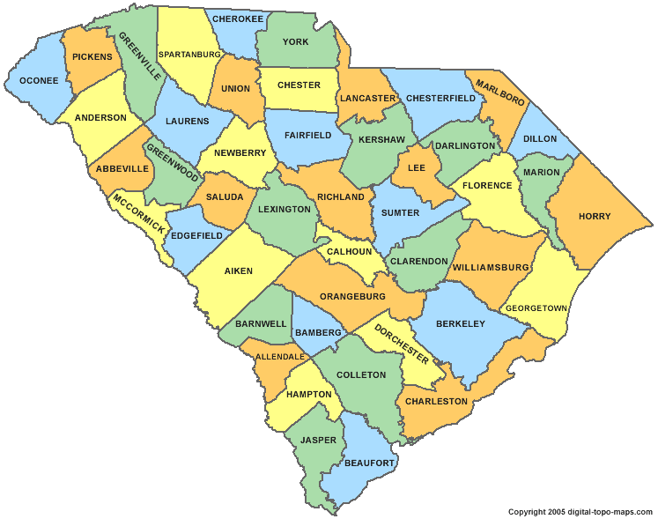
South Carolina
Area
Total | 32,007 square miles
Land area | 30,111 square miles
Water area | 1,896 square miles
Land Use (1987) | Thousands of acres
Developed | 1,422
Rural | 16,363
Cropland | 3,371
Pastureland | 1,177
Rangeland | 0
Forestland | 11,073

Slide 5
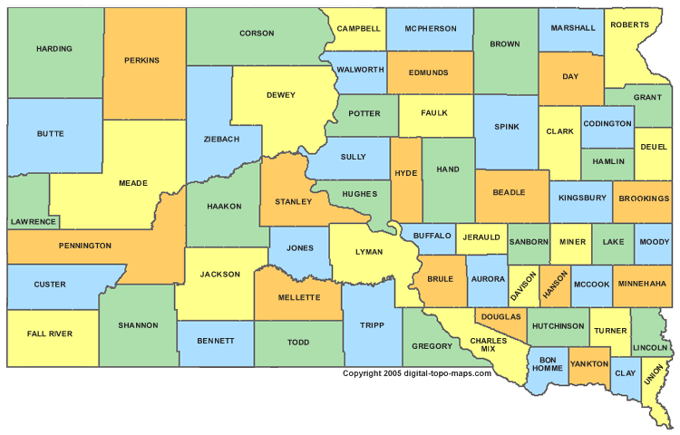
South Dakota
Area
Total | 77,121 square miles
Land area | 75,898 square miles
Water area | 1,224 square miles
Land Use (1987) | Thousands of acres
Developed | 1,064
Rural | 44,403
Cropland | 17,819
Pastureland | 2,354
Rangeland | 22,152
Forestland | 565

Slide 6
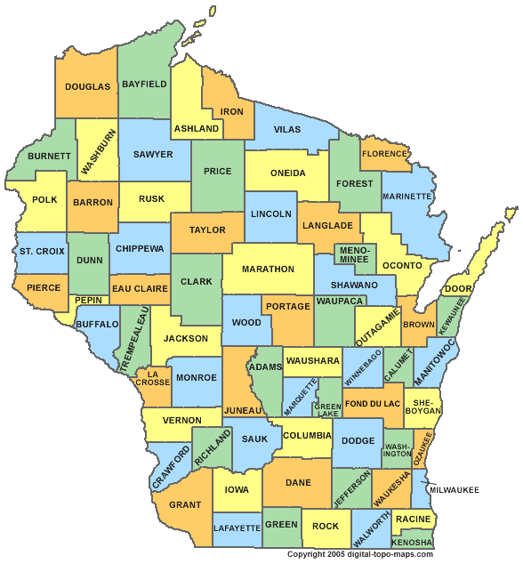
Wisconsin
Area
Total | 65,503 square miles
Land area | 54,314 square miles
Water area | 11,190 square miles
Land Use (1987) | Thousands of acres
Developed | 1,951
Rural | 30,820
Cropland | 11,671
Pastureland | 3,041
Rangeland | 0
Forestland | 13,428

