Slide 1


The Benefits of Exercise
By: Trent Patterson
START

Slide 2


The Benefits of Exercise
Social Benefits
Social Benefits
Physical Benefits
Physical Benefits
Mental Benefits
Mental Benefits
Emotional Benefits
Emotional Benefits
Exit
Exit

Slide 3
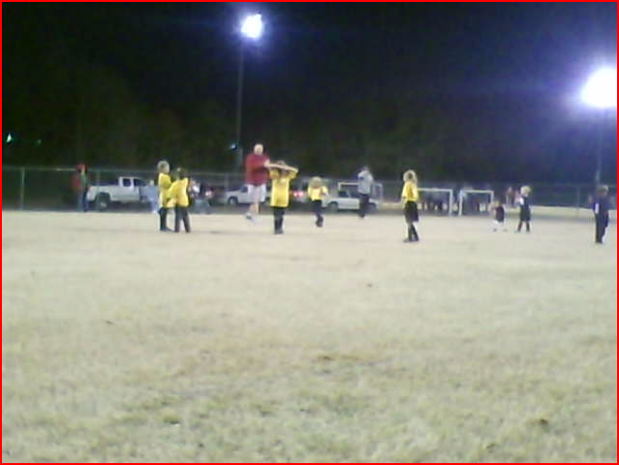


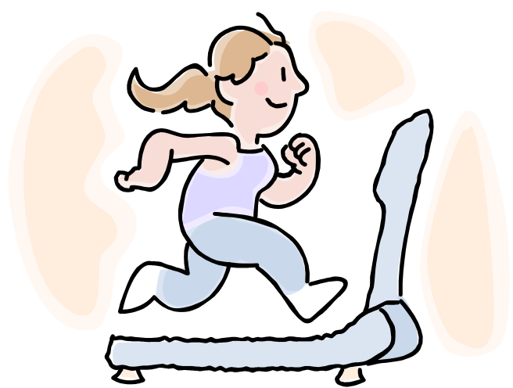


Social Benefits
Soccer
  Exercising gives you a chance to meet new people and make friends. The people you meet will have some of the interests you have. Another benefit of exercise is that you lose weight.

Slide 4



Did you Know?
Did You Know?

Slide 5
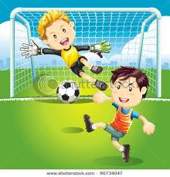
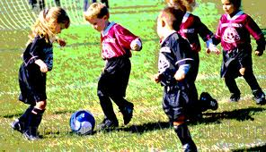


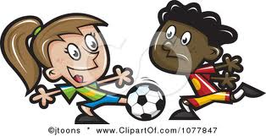
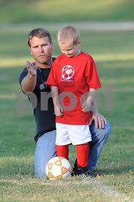
Soccer
Soccer
My Sister Taylor

Slide 6

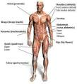

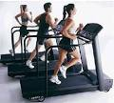

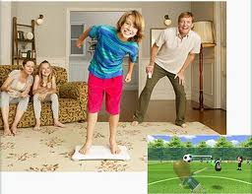
Physical Benefits
Exercise is good for everyone regardless of age.
Regular exercise helps you have good physical fitness.

Slide 7
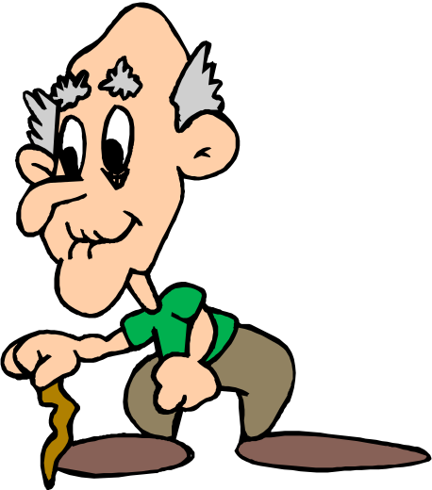

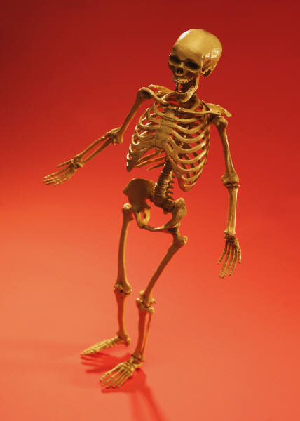
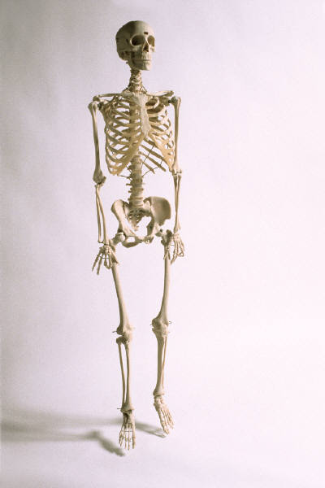
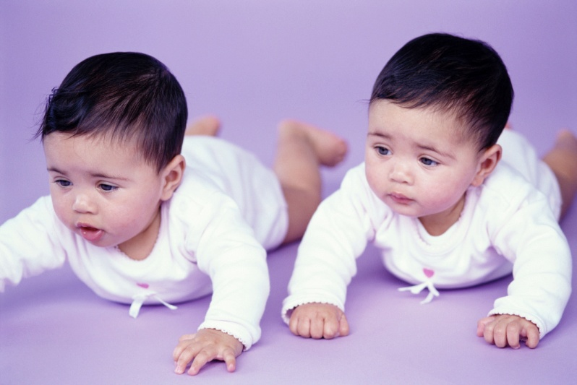
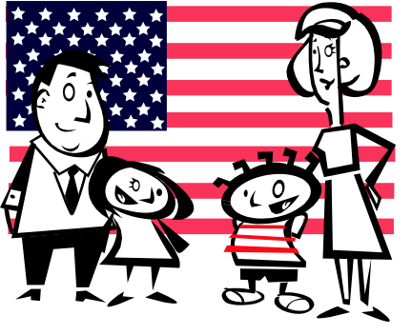
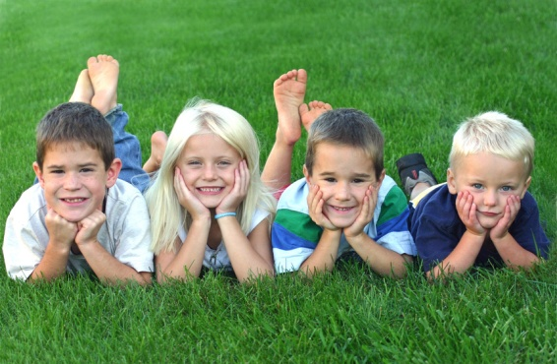
Exercise is good for everyone, regardless of age.

Slide 8
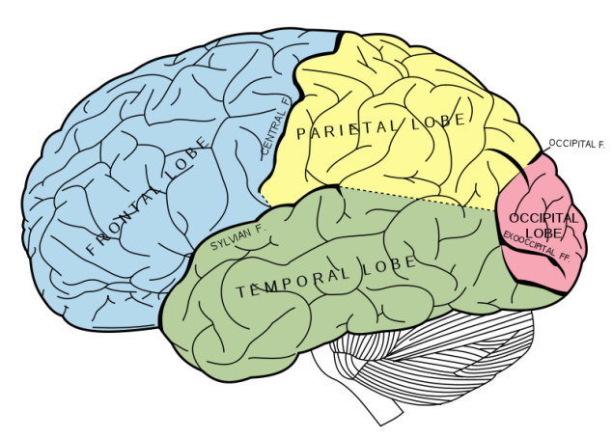

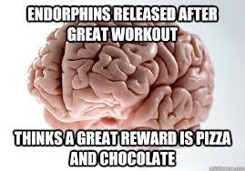
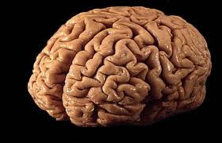
Mental Benefits
Brain
When you exercise for a long period of time your brain makes chemicals called endorphins.

Slide 10
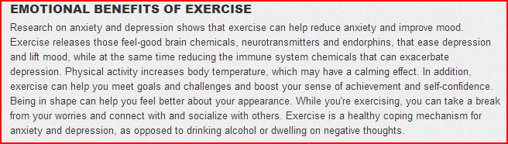
Emotional Benefits

Slide 11
Thank You!!!
Exit

Slide 12
Calories Burned Per Hour*
Click here For Calories Burned Per Hour*

