Slide 1
Easy Cooking
Jake Tribe

Slide 2
Project overview
The product:
An easy to use cooking app that allows those who struggle with technology to easily find recipes.
Project duration:
July 2021 - August 2021

Slide 3
Project overview
The problem:
Those who struggle with technology often struggle to use online cookbooks and miss out on finding great recipes.
The goal:
ICreate an easy to use app that helps tech-challenged people to make great food.

Slide 4
Project overview
My role:
Lead UX Designer
Responsibilities:
User research
Wireframing
Prototyping

Slide 5
User research
Personas
Problem statements
Competitive audit
Ideation
Understanding
the user

Slide 6
User research: summary
I conducted interviews and created empathy maps to better understand the users that I was designing for. I found that the primary group that I was designing for is retirement age women who want to learn new recipes using their older devices.
This group confirmed my initial belief that people want to be able to easily find recipes. However, how to make the recipes easy to find seemed to be a bigger issue until further researched.

Slide 7
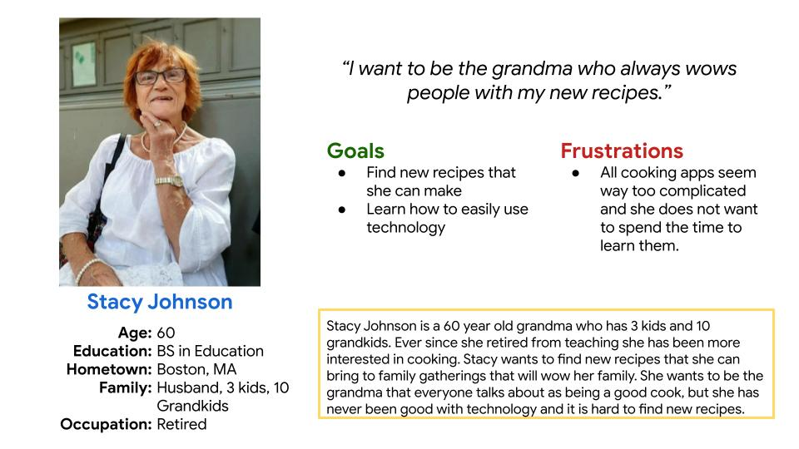
Persona: Stacy Johnson
Problem statement:
Stacy Johnson is a 60-year old grandmother who needs to find new recipes to cook to impress her family.

Slide 8
Competitive audit
After doing a competitive audit, i found that there was a gap in the market for a simple and easy to use recipe app. A lot of recipe apps are trying to do everything and become very complicated. However, sometimes the complexity of the app makes the recipes get lost and for our target user it is important that the recipe is easy to find.

Slide 9
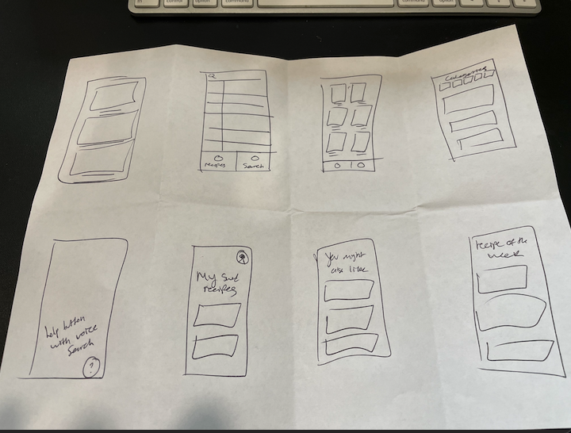
Ideation
I did a crazy eights exercise in order to ideate ideas.

Slide 10
Digital wireframes
Low-fidelity prototype
Usability studies
Starting
the design

Slide 11
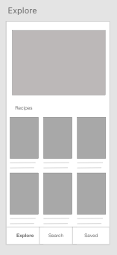
Digital wireframes
Digital wireframes
I created digital wireframes that allowed me to create a prototype and test with users.

Slide 12
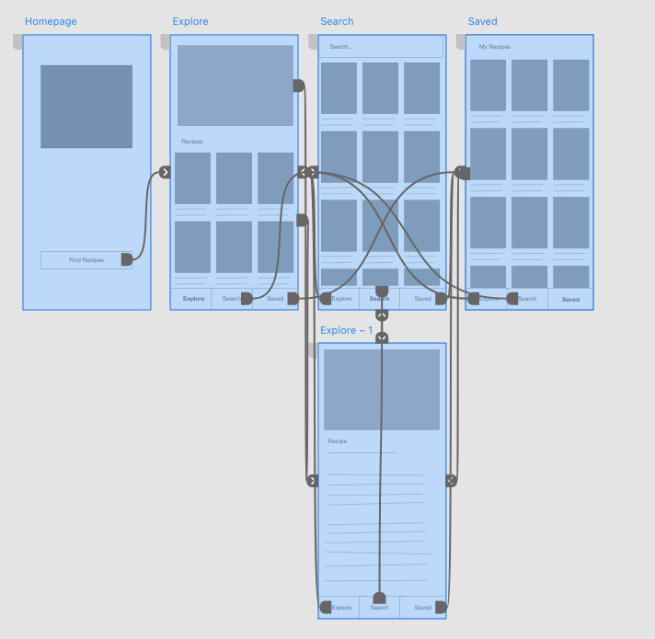
Low-fidelity prototype
I created a low-fidelity prototype so that i could test the userflow of finding a recipe with real users.
Here is the link to the prototype.
https://xd.adobe.com/view/155c775e-ebd7-4340-94c4-827e3339e49d-400f/
Screenshot of prototype with connections or prototype GIF

Slide 13
Usability study: parameters
Study type:
Unmoderated usability study
Location:
Utah, Local Library
Participants:
7 participants
Length:
30-60 minutes

Slide 14
Usability study: findings
Insert a one to two sentence introduction to the findings shared below.
1
2
3
Finding
Finding
Finding
Users want a way to save recipes they like.
Users like the pictures of recipes more than descriptions.
Users need bigger text to see what is being written.

Slide 15
Refining
the design
Mockups
High-fidelity prototype
Accessibility

Slide 16
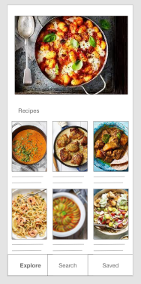
Mockups
I decided to make the main page just show recipes so that those who needed to find a quick recipe could do it.

Slide 17
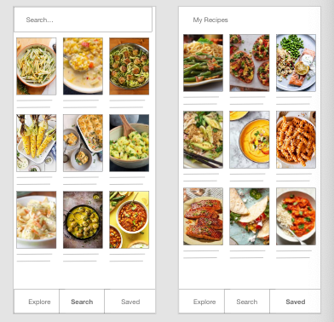
Mockups
The search function and the saved recipes function allow people to easily find and save things that they love to make.

Slide 18
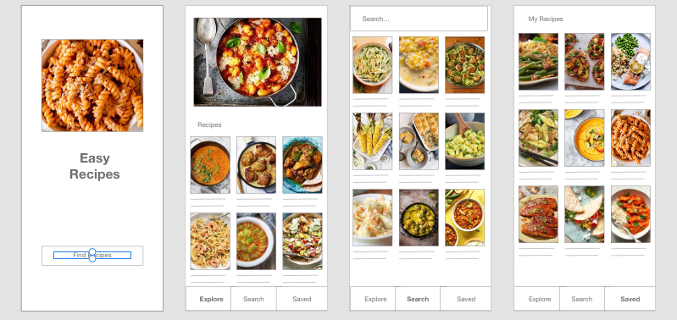
Mockups

Slide 19
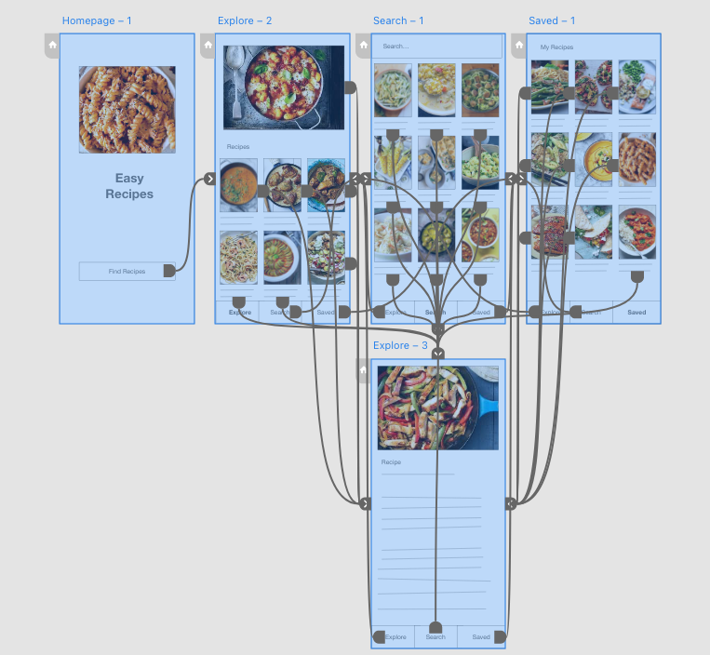
High-fidelity prototype
Finally i made a high-fidelity prototype that i could then eventually pass off to the development team.
Here is a link to view that. https://xd.adobe.com/view/155c775e-ebd7-4340-94c4-827e3339e49d-400f/
Screenshot of prototype with connections or prototype GIF

Slide 20
Accessibility considerations
1
2
3
High Contrast and large text for those who have bad visibility.
Insert one to two sentence summaries describing each accessibility consideration applied in your designs.
Insert one to two sentence summaries describing each accessibility consideration applied in your designs.

Slide 21
Responsive Design
Information architecture
Responsive design

Slide 22
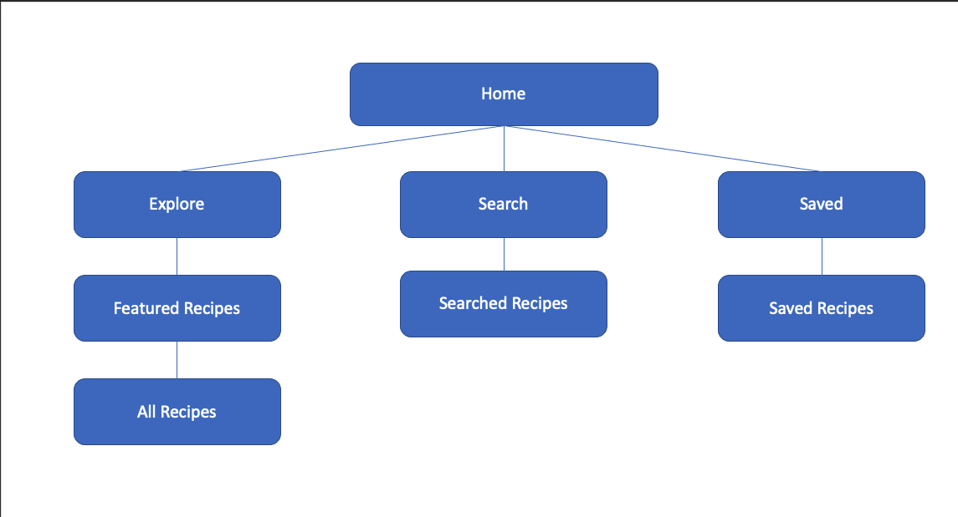
Sitemap
With our App Design complete it was time to move to the supporting website design. I started by making a sitemap and organizing the flow.
Image of sitemap/IA

Slide 23
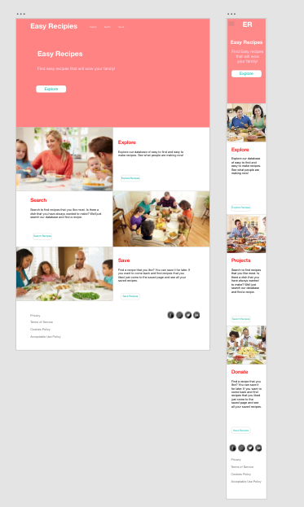
Responsive designs
Then i made a responsive website design that was optimized for mobile, and desktop sizes.
Images of each screen size variation

Slide 24
Going forward
Takeaways
Next steps

Slide 25
Takeaways
Impact:
The impact can best be summarized by a quote from a user. She said “Thank you so much. I can now make food for the people i love that they will love. This is awesome!”
What I learned:
I learned that if you design with one group in mind that has accessibility problems, it often helps the user base as a whole.

Slide 26
Next steps
1
2
3
Find more recipes.
I feel that an app like this is only as good as its content.
Development.
I feel that getting a working app would help us to know more about what we can do better.
Marketing.
After that i feel that it would be best to market the app and make it so that our user base grows.

Slide 27
Let’s connect!
Thank you for your time reviewing my work. If you’d like to get in touch, my contact information is below.
Email: jacobtribe@me.com
Website: jaketribe.com

