Slide 1


Inventario de dispositivos de Networking.
INVEST IN YOUR FUTURE

Slide 2
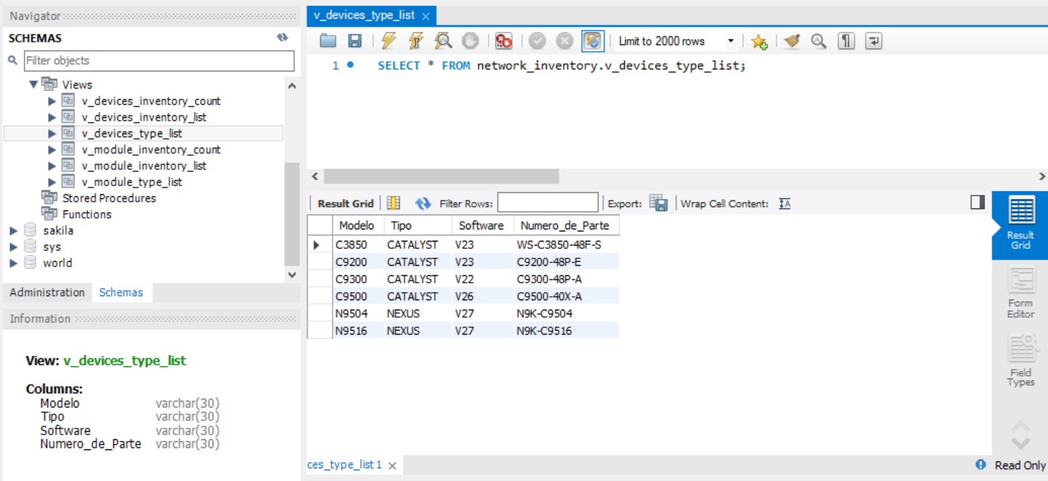
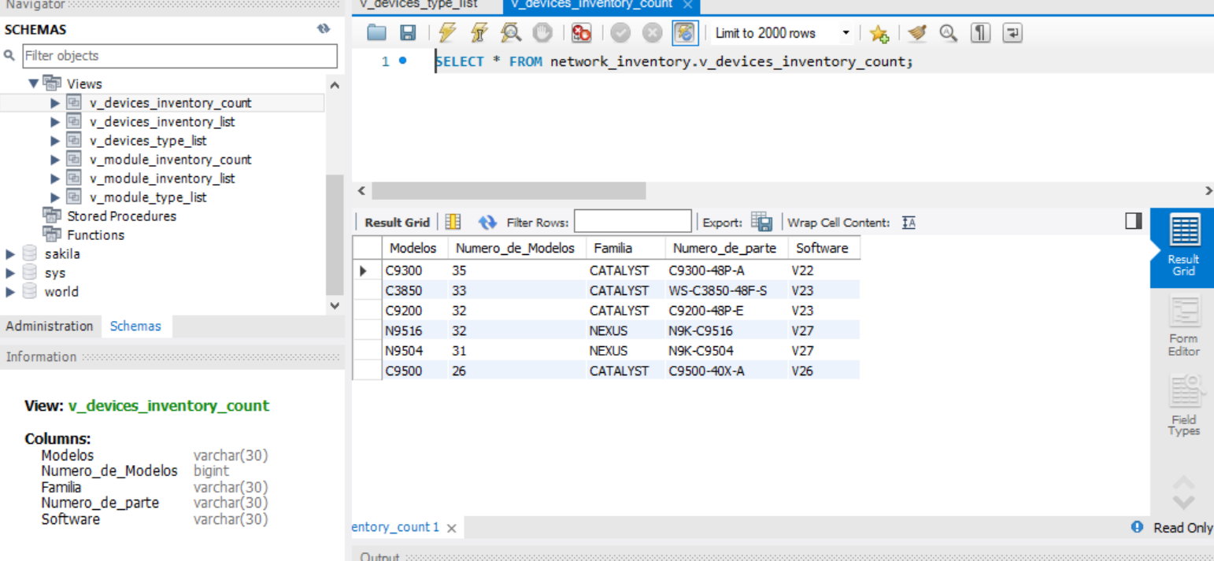


Vistas

Slide 3
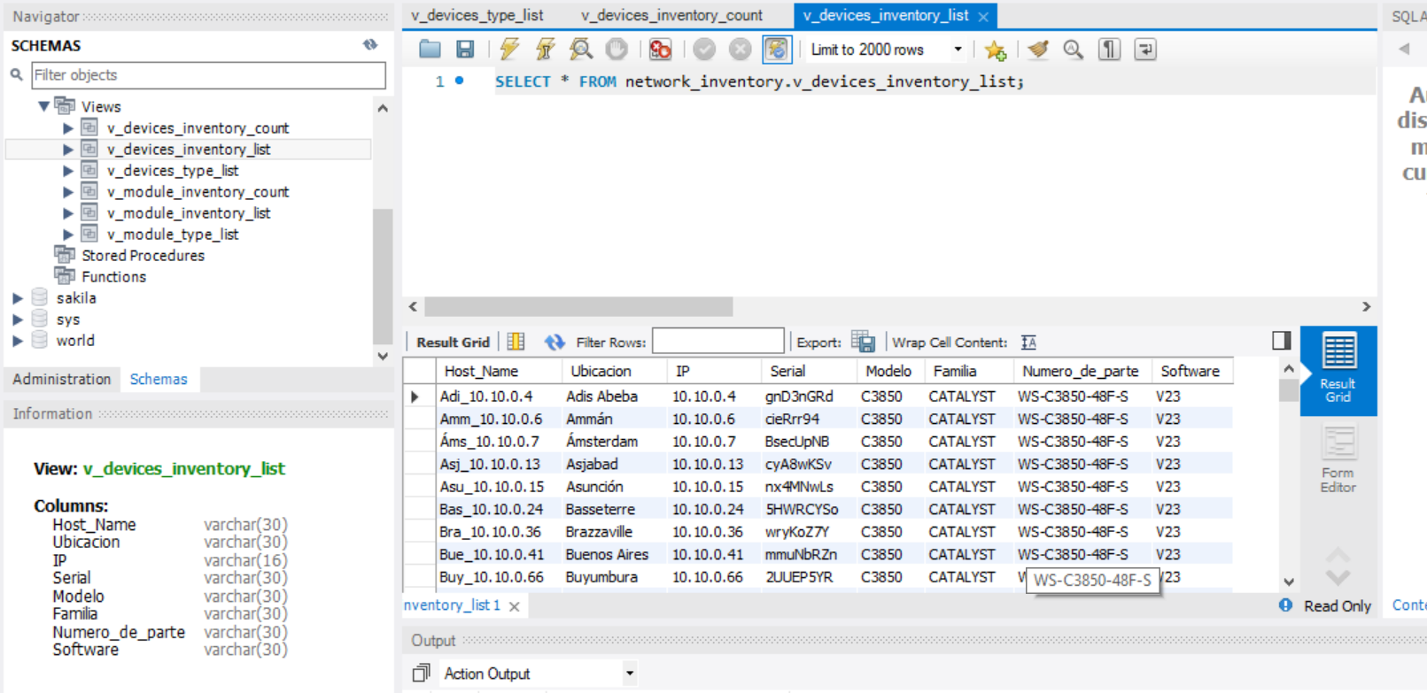
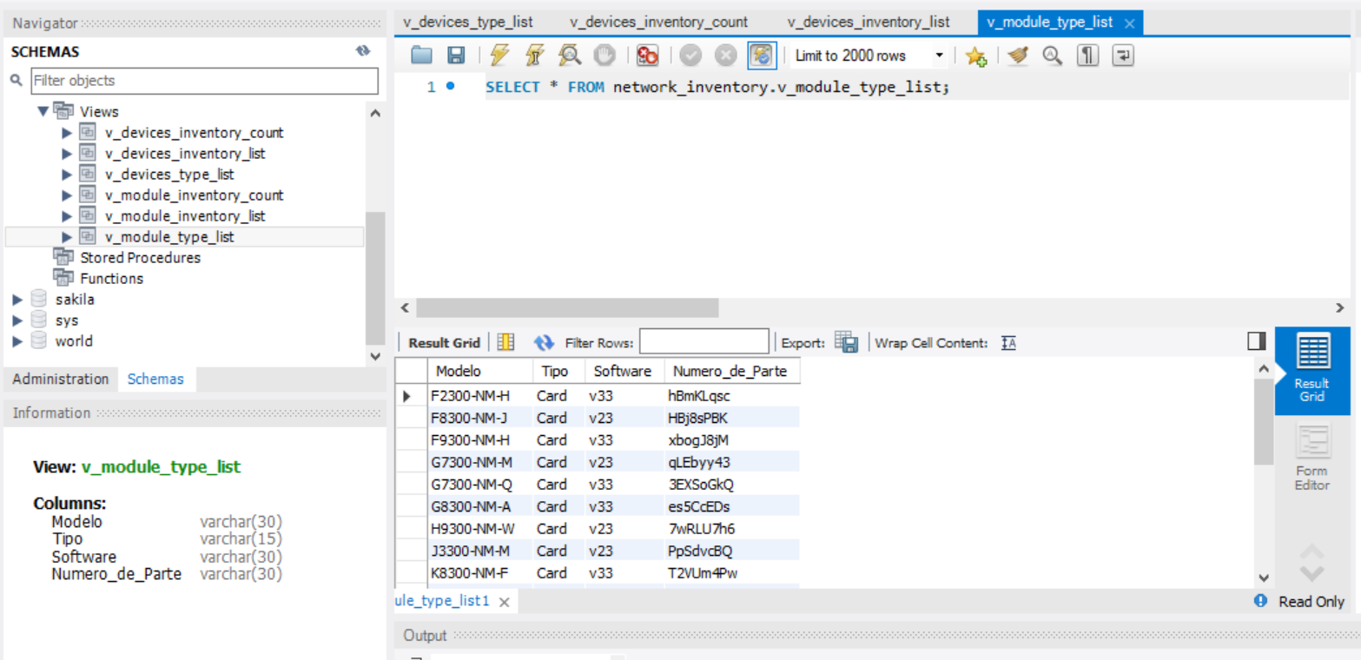
Vistas

Slide 4
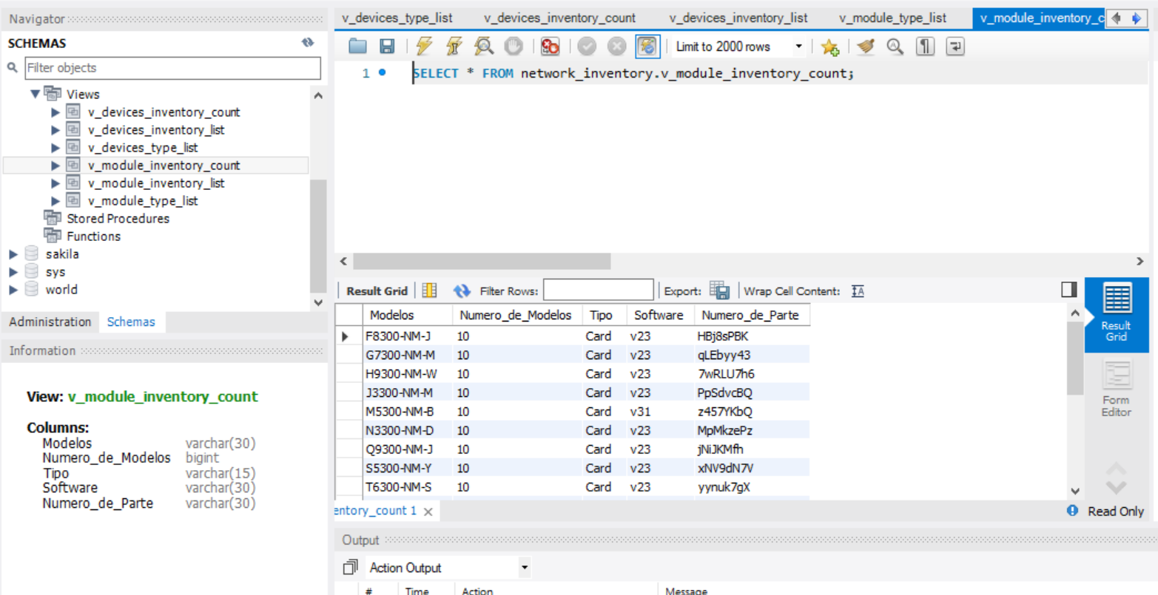
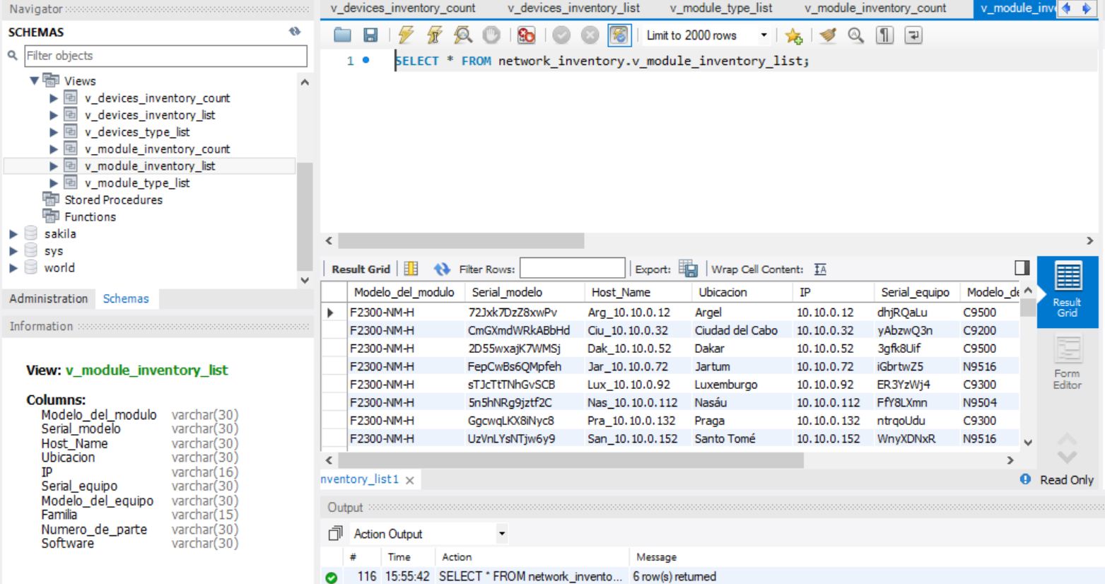
Vistas

Slide 5

Script FIle
https://github.com/jtroconiz/SQL.git

