Slide 1
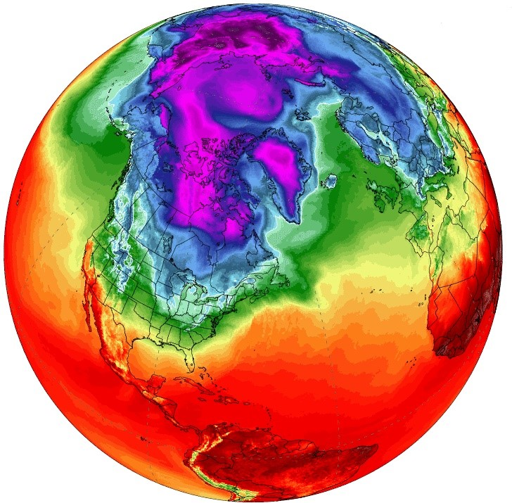


Dawson College Heat Map project
Supervisor and mentor: Mr. Joel Trudeau
Presented by: Arezoo Haydari

Slide 2
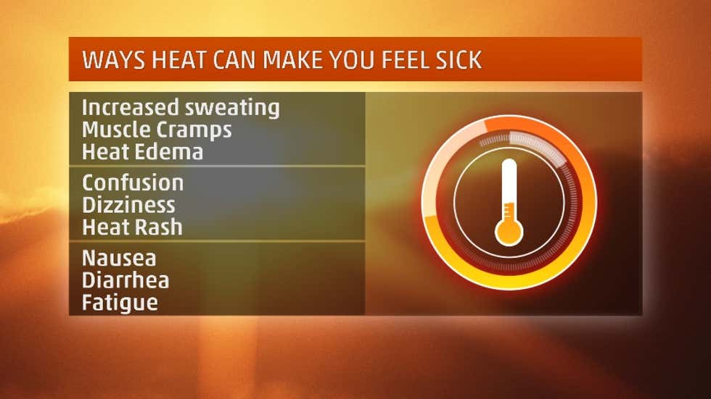
What Is Happening ?
In Canada and around the world heat waves are the significant cause of weather-related illnesses and deaths
156 deaths in July 2009 in British Columbia
280 deaths in July 2010 and 86 deaths in July 2018 in Quebec

Slide 3
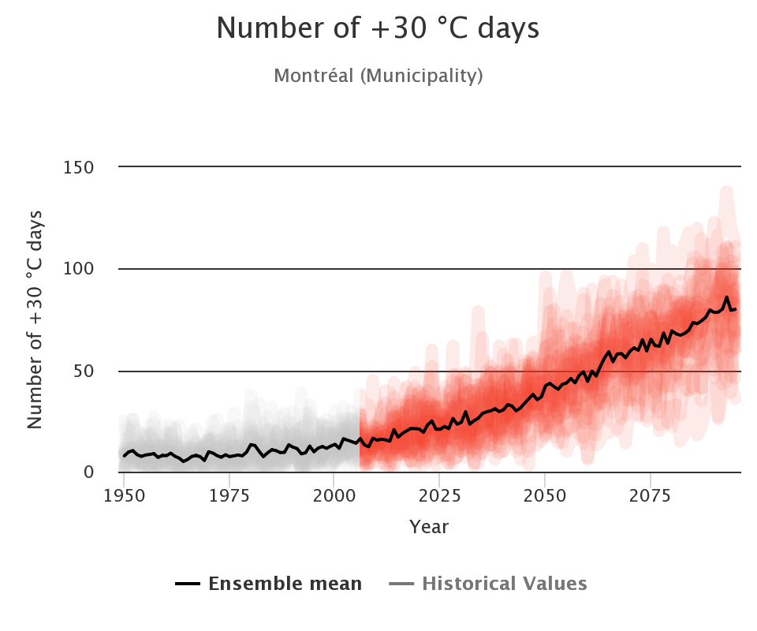
What IS Happening?
Urban Heat Island (UHI) is the main cause of experiencing extreme heat
Rapid urbanization
population growth
acceleration of energy usages

Slide 4
What do experts suggest?
Reducing the urban heat island effects:
Expanding vegetation cover
Implementing climate-sensitive urban design and planning
Integrating natural ventilation and water features into urban designs
Reducing waste heat production

Slide 5
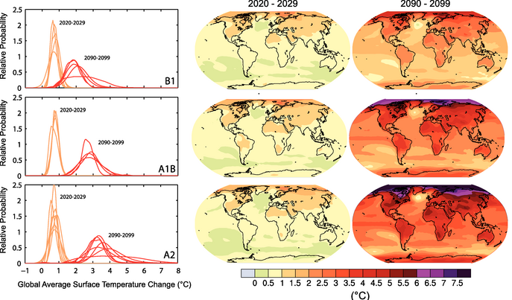
How to Engage Science And Climate Action?
Climate monitoring
Effective planning and operations
Integrated use of Citizen Science with AI can maximize outcomes

Slide 6
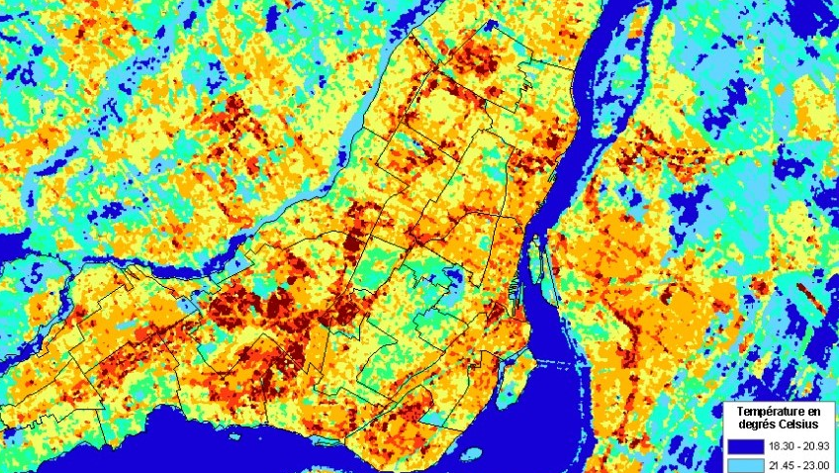
What We Can Do?
Providing a heat map can be a tool to investigate impacts of UHI and its proposed solutions on Global Warming

Slide 7

Dawson College campus is a wise choice for examining the effects of green spaces on UHI
IF YOU CAN PROVIDE AN IMAGE OR TWO INSTEAD OF NAMING FOR THE AI CLIMATE PRESENTATION
Peace Garden (high vegetation density )
Three Sisters Garden (medium vegetation density )
Theatre Garden (moderate to low vegetation density )
Roof Garden and parking lots (low vegetation density )

Slide 8
References

