Slide 1
Spectroscopic Ellipsometry of SiO2 and OTS treatment
Jovan Trujillo
11/06/2006

Slide 2
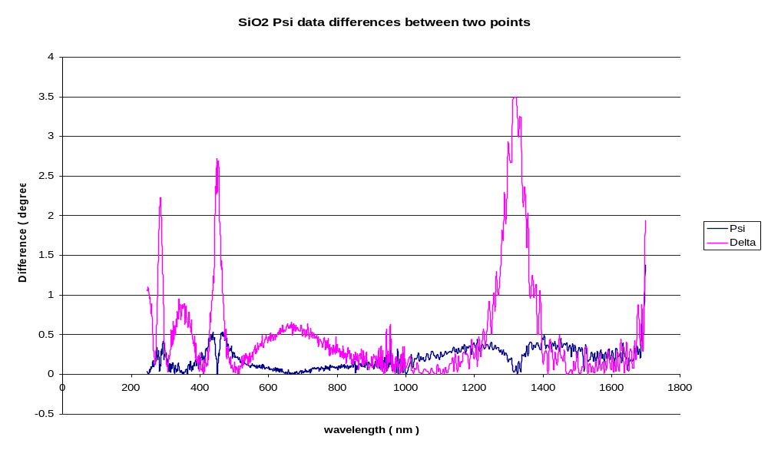
SiO2 measurement variation between 2 points

Slide 3
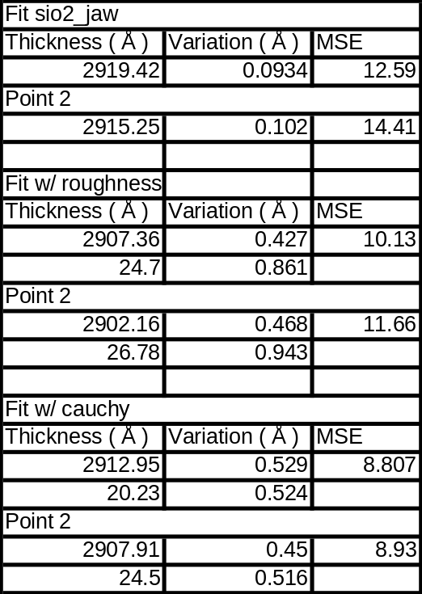
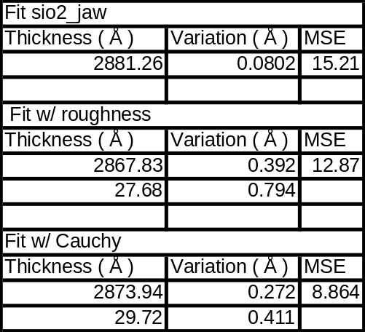
Modeling untreated SiO2
Wafer 1 on 11/02/06
Wafer 2 on 11/03/06
Thickness of sio2_jaw and cauchy/roughness were not correlated. It seems likely
that there is a 2 – 3 nm layer of crud or roughness on these wafers.

Slide 4
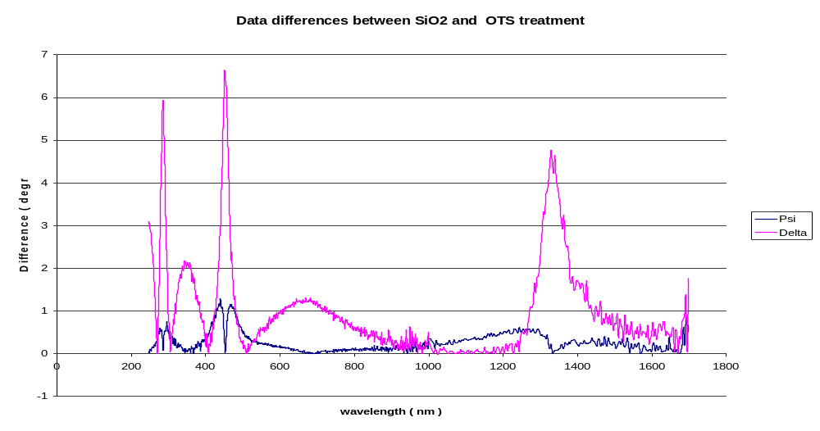
Data difference between SiO2 and OTS treatment
Difference created by OTS treatment seems significant

Slide 5
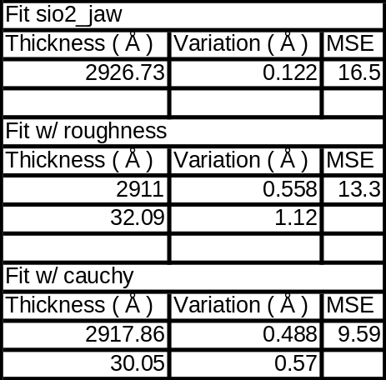
Modeling OTS treatment
Assuming that crud on SiO2 wafer was completely
cleaned off then you have 3 nm of OTS.
Thicknesses were not correlated and MSE
significantly decreased by adding Cauchy layer.

