Slide 1
Two-Qubit CAVITY COUPLING
Effective Hamiltonian

Slide 2



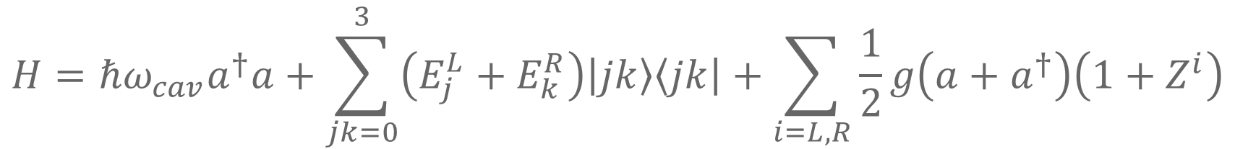













Hamiltonian without Noise
$$H=ℏω_{cav}a^{†}a+\sum_{jk=0}^{3}{\left(E_{j}^{L}+E_{k}^{R}\right)\left|jk\right\rangle \left\langle jk\right|}+\sum_{i=L,R}{\frac{1}{2}g\left(a+a^{†}\right)\left(1+Z^{i}\right)}$$
$$\left|n_{0}+1\right\rangle$$
$${\left|3\right\rangle }_{L}$$
$${\left|3\right\rangle }_{R}$$
$${\left|2\right\rangle }_{L}$$
$${\left|2\right\rangle }_{R}$$
$$\left|n_{0}\right\rangle$$
$$δ_{c}$$
$${\left|1\right\rangle }_{L}$$
$$δ_{f}$$
$${\left|1\right\rangle }_{R}$$
$$ω_{f}$$
$$ω_{c}$$
$$ω_{cav}$$
$${\left|0\right\rangle }_{L}$$
$$\left|n_{0}−1\right\rangle$$
$${\left|0\right\rangle }_{R}$$
Left Qubit
Cavity
Right Qubit

Slide 3
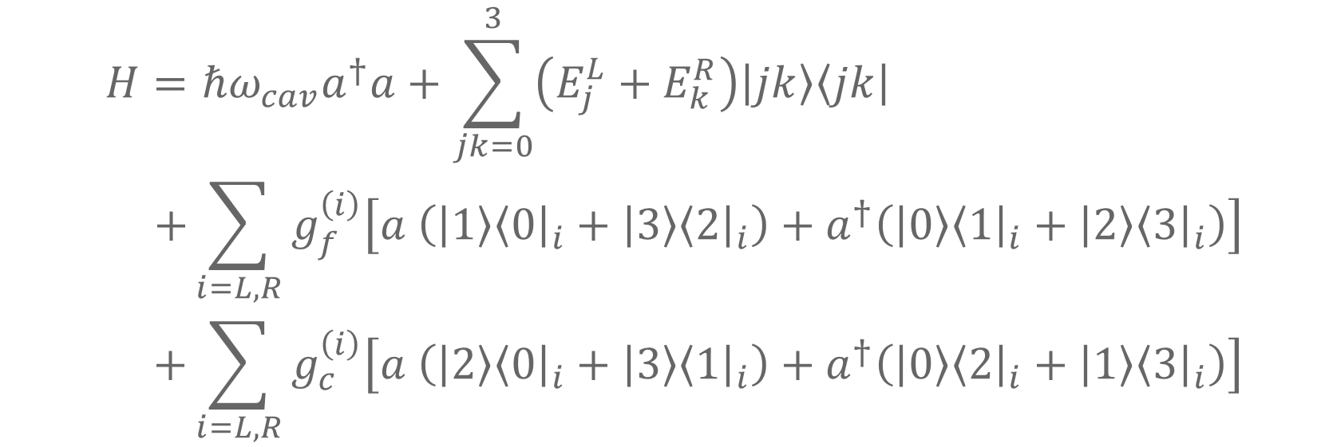
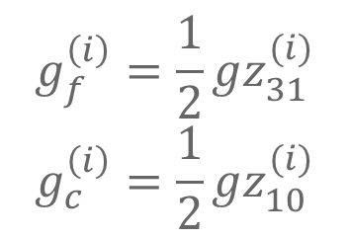
RWA
$$H=ℏω_{cav}a^{†}a+\sum_{jk=0}^{3}{\left(E_{j}^{L}+E_{k}^{R}\right)\left|jk\right\rangle \left\langle jk\right|} \\ +\sum_{i=L,R}{g_{f}^{\left(i\right)}\left[a \left(\left|1\right\rangle {\left\langle 0\right|}_{i}+\left|3\right\rangle {\left\langle 2\right|}_{i}\right)+a^{†}\left(\left|0\right\rangle {\left\langle 1\right|}_{i}+\left|2\right\rangle {\left\langle 3\right|}_{i}\right)\right]} \\ +\sum_{i=L,R}{g_{c}^{\left(i\right)}\left[a \left(\left|2\right\rangle {\left\langle 0\right|}_{i}+\left|3\right\rangle {\left\langle 1\right|}_{i}\right)+a^{†}\left(\left|0\right\rangle {\left\langle 2\right|}_{i}+\left|1\right\rangle {\left\langle 3\right|}_{i}\right)\right]}$$
Spin flip
Charge flip
$$g_{f}^{\left(i\right)}=\frac{1}{2}gz_{31}^{(i)}$$
$$g_{c}^{\left(i\right)}=\frac{1}{2}gz_{10}^{(i)}$$
Flip-flop qubit - cavity coupling
Charge qubit - cavity coupling

Slide 4
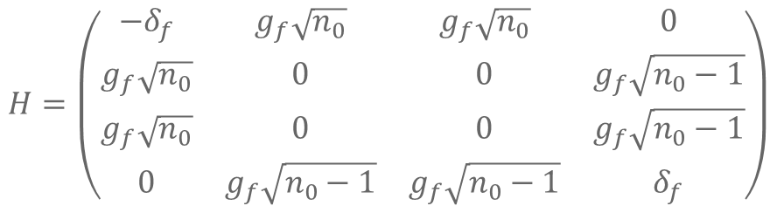
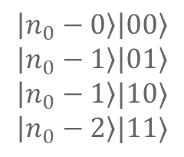
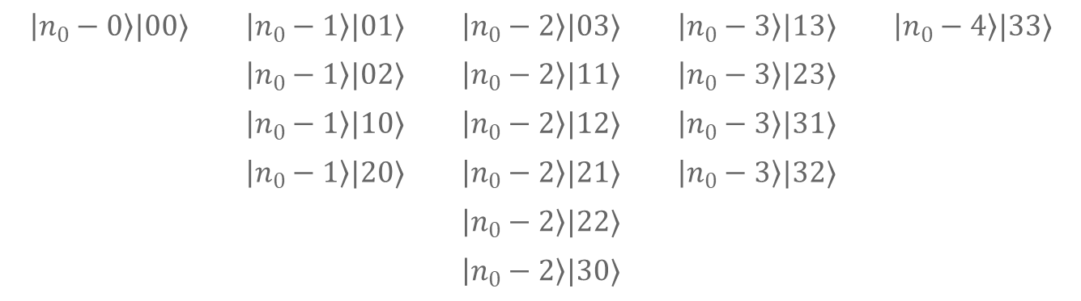
Block Diagonal
$16$ states associated with each $n_{0}$ (if $n_{0}−N<0$ that column is omitted and the block is smaller than $16×16$)
$$\left|n_{0}−0\right\rangle |00⟩$$ | $$\left|n_{0}−1\right\rangle |01⟩$$ | $$\left|n_{0}−2\right\rangle |03⟩$$ | $$\left|n_{0}−3\right\rangle |13⟩$$ | $$\left|n_{0}−4\right\rangle |33⟩$$
 | $$\left|n_{0}−1\right\rangle |02⟩$$ | $$\left|n_{0}−2\right\rangle |11⟩$$ | $$\left|n_{0}−3\right\rangle |23⟩$$
 | $$\left|n_{0}−1\right\rangle |10⟩$$ | $$\left|n_{0}−2\right\rangle |12⟩$$ | $$\left|n_{0}−3\right\rangle |31⟩$$
 | $$\left|n_{0}−1\right\rangle |20⟩$$ | $$\left|n_{0}−2\right\rangle |21⟩$$ | $$\left|n_{0}−3\right\rangle |32⟩$$
 |  | $$\left|n_{0}−2\right\rangle |22⟩$$
 |  | $$\left|n_{0}−2\right\rangle |30⟩$$
If the cavity is in resonance with the flip-flop qubit and not the charge qubit, we can neglect the charge flips and look at only the following 4 states (equivalent to 1st order SW transformation):
$$\left|n_{0}−0\right\rangle \left|00\right\rangle \\ \left|n_{0}−1\right\rangle \left|01\right\rangle \\ \left|n_{0}−1\right\rangle |10⟩$$
$$\left|n_{0}−2\right\rangle |11⟩$$
$$H=\left(\begin{matrix}−δ_{f} & g_{f}\sqrt{n_{0}} & g_{f}\sqrt{n_{0}} & 0 \\ g_{f}\sqrt{n_{0}} & 0 & 0 & g_{f}\sqrt{n_{0}−1} \\ g_{f}\sqrt{n_{0}} & 0 & 0 & g_{f}\sqrt{n_{0}−1} \\ 0 & g_{f}\sqrt{n_{0}−1} & g_{f}\sqrt{n_{0}−1} & δ_{f}\end{matrix}\right)$$
Future note: Since the dominant noise is of the XX (YY) variety, this approximation will also neglect our main source of noise. We need 2nd order SW to capture noise effects.

Slide 5
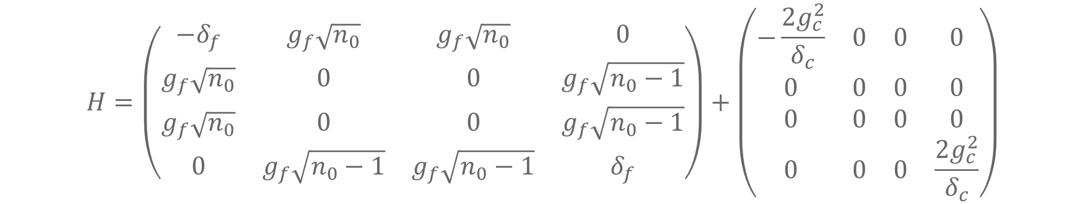

2nd Order SW
$$\left|n_{0}−0\right\rangle \left|00\right\rangle \\ \left|n_{0}−1\right\rangle \left|01\right\rangle \\ \left|n_{0}−1\right\rangle |10⟩$$
$$\left|n_{0}−2\right\rangle |11⟩$$
$$H=\left(\begin{matrix}−δ_{f} & g_{f}\sqrt{n_{0}} & g_{f}\sqrt{n_{0}} & 0 \\ g_{f}\sqrt{n_{0}} & 0 & 0 & g_{f}\sqrt{n_{0}−1} \\ g_{f}\sqrt{n_{0}} & 0 & 0 & g_{f}\sqrt{n_{0}−1} \\ 0 & g_{f}\sqrt{n_{0}−1} & g_{f}\sqrt{n_{0}−1} & δ_{f}\end{matrix}\right)+\left(\begin{matrix}−\frac{2g_{c}^{2}}{δ_{c}} & 0 & 0 & 0 \\ 0 & 0 & 0 & 0 \\ 0 & 0 & 0 & 0 \\ 0 & 0 & 0 & \frac{2g_{c}^{2}}{δ_{c}}\end{matrix}\right)$$

Slide 6
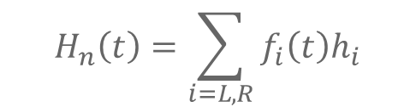
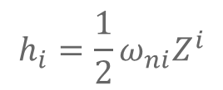
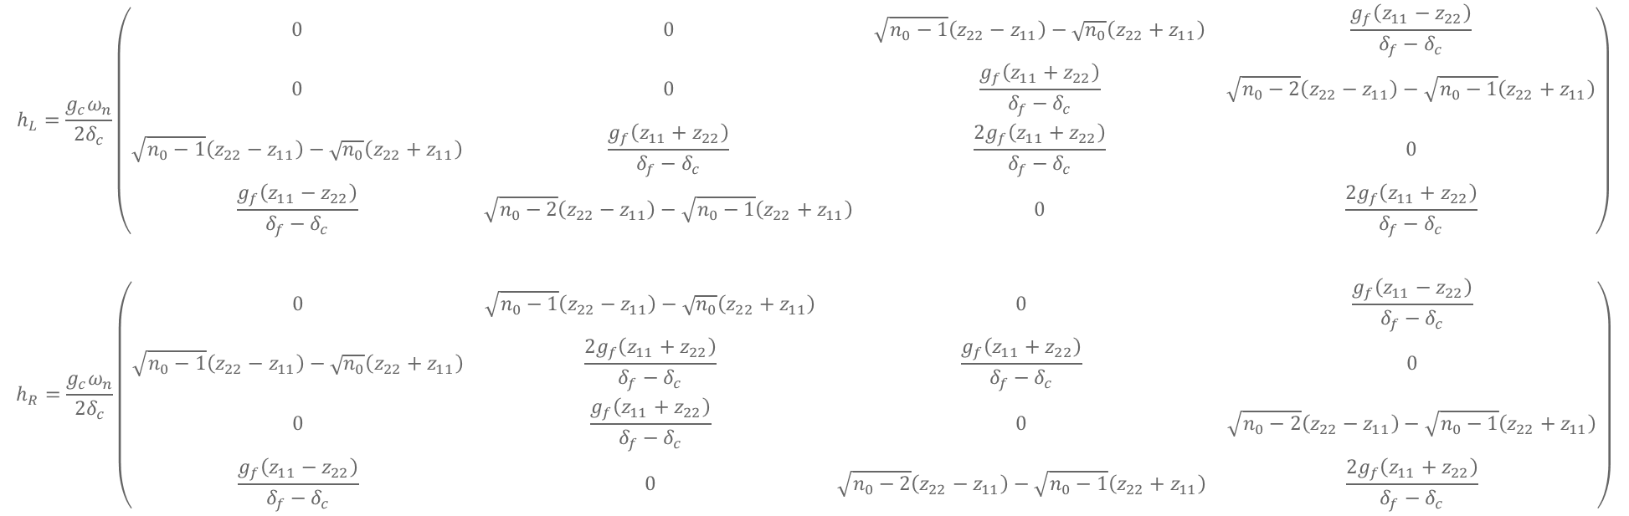
2nd Order SW Noise
$$H_{n}\left(t\right)=\sum_{i=L,R}{f_{i}\left(t\right)h_{i}}$$
$$h_{i}=\frac{1}{2}ω_{ni}Z^{i}$$
$$\left|n_{0}−0\right\rangle \left|00\right\rangle \\ \left|n_{0}−1\right\rangle \left|01\right\rangle \\ \left|n_{0}−1\right\rangle |10⟩$$
$$\left|n_{0}−2\right\rangle |11⟩$$
$$h_{L}=\frac{g_{c}ω_{n}}{{2δ}_{c}}\left(\begin{matrix}0 & 0 & \sqrt{n_{0}−1}\left(z_{22}−z_{11}\right)−\sqrt{n_{0}}\left(z_{22}+z_{11}\right) & \frac{g_{f}\left(z_{11}−z_{22}\right)}{δ_{f}−δ_{c}} \\ 0 & 0 & \frac{g_{f}\left(z_{11}+z_{22}\right)}{δ_{f}−δ_{c}} & \sqrt{n_{0}−2}\left(z_{22}−z_{11}\right)−\sqrt{n_{0}−1}\left(z_{22}+z_{11}\right) \\ \sqrt{n_{0}−1}\left(z_{22}−z_{11}\right)−\sqrt{n_{0}}\left(z_{22}+z_{11}\right) & \frac{g_{f}\left(z_{11}+z_{22}\right)}{δ_{f}−δ_{c}} & \frac{2g_{f}\left(z_{11}+z_{22}\right)}{δ_{f}−δ_{c}} & 0 \\ \frac{g_{f}\left(z_{11}−z_{22}\right)}{δ_{f}−δ_{c}} & \sqrt{n_{0}−2}\left(z_{22}−z_{11}\right)−\sqrt{n_{0}−1}\left(z_{22}+z_{11}\right) & 0 & \frac{2g_{f}\left(z_{11}+z_{22}\right)}{δ_{f}−δ_{c}}\end{matrix}\right)$$
$$h_{R}=\frac{g_{c}ω_{n}}{{2δ}_{c}}\left(\begin{matrix}0 & \sqrt{n_{0}−1}\left(z_{22}−z_{11}\right)−\sqrt{n_{0}}\left(z_{22}+z_{11}\right) & 0 & \frac{g_{f}\left(z_{11}−z_{22}\right)}{δ_{f}−δ_{c}} \\ \sqrt{n_{0}−1}\left(z_{22}−z_{11}\right)−\sqrt{n_{0}}\left(z_{22}+z_{11}\right) & \frac{2g_{f}\left(z_{11}+z_{22}\right)}{δ_{f}−δ_{c}} & \frac{g_{f}\left(z_{11}+z_{22}\right)}{δ_{f}−δ_{c}} & 0 \\ 0 & \frac{g_{f}\left(z_{11}+z_{22}\right)}{δ_{f}−δ_{c}} & 0 & \sqrt{n_{0}−2}\left(z_{22}−z_{11}\right)−\sqrt{n_{0}−1}\left(z_{22}+z_{11}\right) \\ \frac{g_{f}\left(z_{11}−z_{22}\right)}{δ_{f}−δ_{c}} & 0 & \sqrt{n_{0}−2}\left(z_{22}−z_{11}\right)−\sqrt{n_{0}−1}\left(z_{22}+z_{11}\right) & \frac{2g_{f}\left(z_{11}+z_{22}\right)}{δ_{f}−δ_{c}}\end{matrix}\right)$$

Slide 7

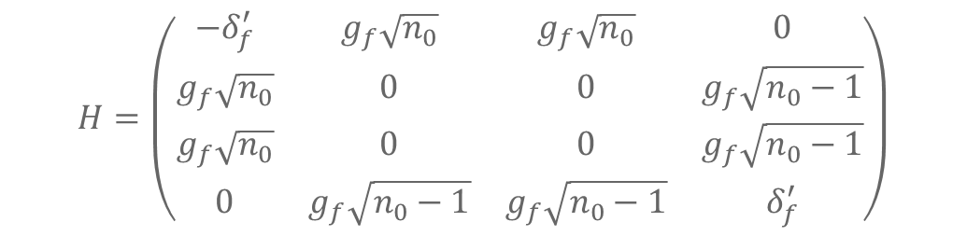
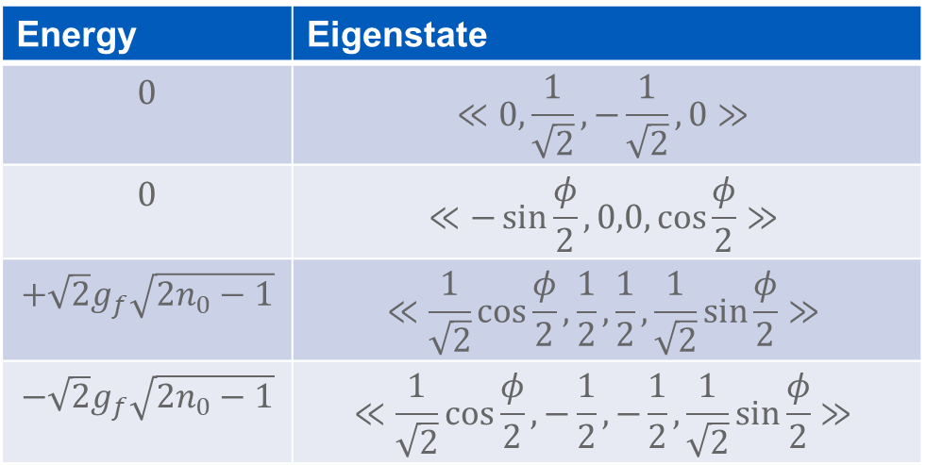
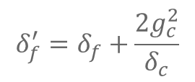
Solving Zero Noise System
$$H=\left(\begin{matrix}−δ_{f}^{′} & g_{f}\sqrt{n_{0}} & g_{f}\sqrt{n_{0}} & 0 \\ g_{f}\sqrt{n_{0}} & 0 & 0 & g_{f}\sqrt{n_{0}−1} \\ g_{f}\sqrt{n_{0}} & 0 & 0 & g_{f}\sqrt{n_{0}−1} \\ 0 & g_{f}\sqrt{n_{0}−1} & g_{f}\sqrt{n_{0}−1} & δ_{f}^{′}\end{matrix}\right)$$
$$\left|n_{0}−0\right\rangle \left|00\right\rangle \\ \left|n_{0}−1\right\rangle \left|01\right\rangle \\ \left|n_{0}−1\right\rangle |10⟩$$
$$\left|n_{0}−2\right\rangle |11⟩$$
$$δ_{f}^{′}=δ_{f}+\frac{2g_{c}^{2}}{δ_{c}}$$
Resonant case: $δ_{f}^{′}=0$
Energy | Eigenstate
$$0$$ | $$≪0,\frac{1}{\sqrt{2}},−\frac{1}{\sqrt{2}},0≫$$
$$0$$ | $$≪−\sin{\frac{φ}{2}},0,0,\cos{\frac{φ}{2}}≫$$
$$+\sqrt{2}g_{f}\sqrt{2n_{0}−1}$$ | $$≪\frac{1}{\sqrt{2}}\cos{\frac{φ}{2}},\frac{1}{2},\frac{1}{2},\frac{1}{\sqrt{2}}\sin{\frac{φ}{2}}≫$$
$$−\sqrt{2}g_{f}\sqrt{2n_{0}−1}$$ | $$≪\frac{1}{\sqrt{2}}\cos{\frac{φ}{2}},−\frac{1}{2},−\frac{1}{2},\frac{1}{\sqrt{2}}\sin{\frac{φ}{2}}≫$$
$$\tan{φ}=\sqrt{2n_{0}\left(2n_{0}−1\right)}$$

Slide 8

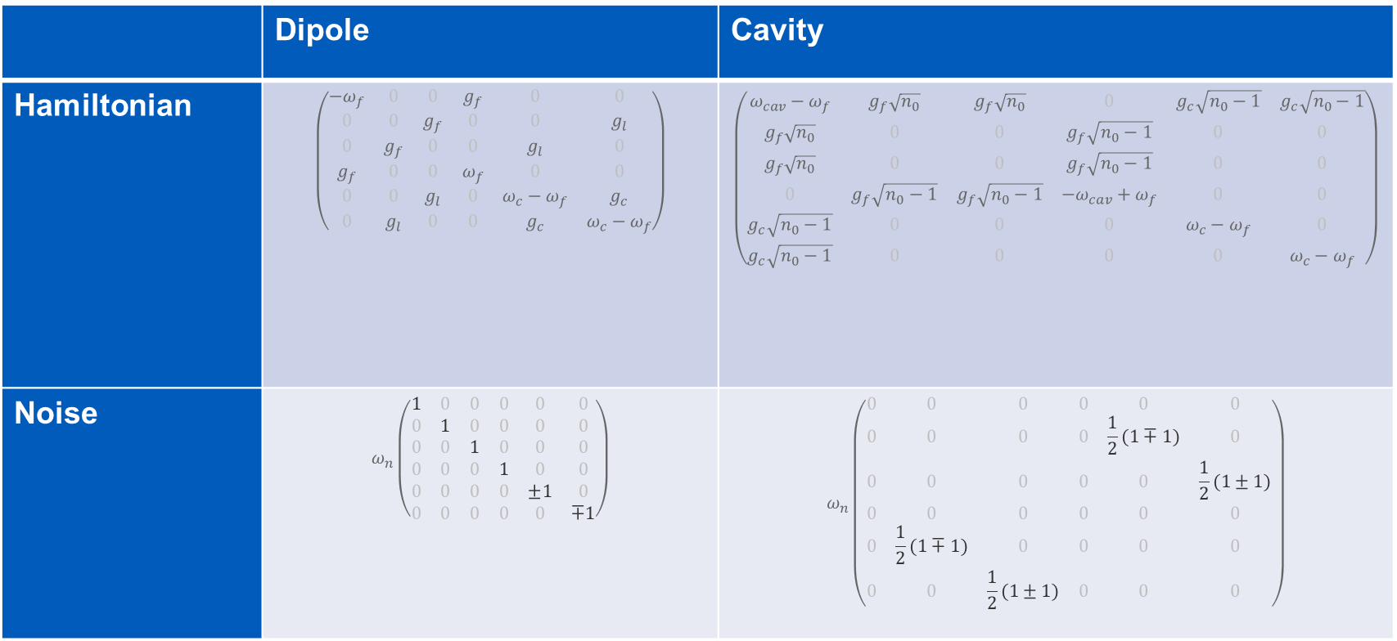
Dipole vs. Cavity Coupling
States: $\left|00\right\rangle ,\left|01\right\rangle$, $\left|10\right\rangle$, $\left|11\right\rangle$, $\left|02\right\rangle$, $\left|20\right\rangle$
 | Dipole | Cavity
Hamiltonian | $$\left(\begin{matrix}−ω_{f} & 0 & 0 & g_{f} & 0 & 0 \\ 0 & 0 & g_{f} & 0 & 0 & g_{l} \\ 0 & g_{f} & 0 & 0 & g_{l} & 0 \\ g_{f} & 0 & 0 & ω_{f} & 0 & 0 \\ 0 & 0 & g_{l} & 0 & ω_{c}−ω_{f} & g_{c} \\ 0 & g_{l} & 0 & 0 & g_{c} & ω_{c}−ω_{f}\end{matrix}\right)$$ | $$\left(\begin{matrix}ω_{cav}−ω_{f} & g_{f}\sqrt{n_{0}} & g_{f}\sqrt{n_{0}} & 0 & g_{c}\sqrt{n_{0}−1} & g_{c}\sqrt{n_{0}−1} \\ g_{f}\sqrt{n_{0}} & 0 & 0 & g_{f}\sqrt{n_{0}−1} & 0 & 0 \\ g_{f}\sqrt{n_{0}} & 0 & 0 & g_{f}\sqrt{n_{0}−1} & 0 & 0 \\ 0 & g_{f}\sqrt{n_{0}−1} & g_{f}\sqrt{n_{0}−1} & −ω_{cav}+ω_{f} & 0 & 0 \\ g_{c}\sqrt{n_{0}−1} & 0 & 0 & 0 & ω_{c}−ω_{f} & 0 \\ g_{c}\sqrt{n_{0}−1} & 0 & 0 & 0 & 0 & ω_{c}−ω_{f}\end{matrix}\right)$$
Noise | $$ω_{n}\left(\begin{matrix}1 & 0 & 0 & 0 & 0 & 0 \\ 0 & 1 & 0 & 0 & 0 & 0 \\ 0 & 0 & 1 & 0 & 0 & 0 \\ 0 & 0 & 0 & 1 & 0 & 0 \\ 0 & 0 & 0 & 0 & ±1 & 0 \\ 0 & 0 & 0 & 0 & 0 & ∓1\end{matrix}\right)$$ | $$ω_{n}\left(\begin{matrix}0 & 0 & 0 & 0 & 0 & 0 \\ 0 & 0 & 0 & 0 & \frac{1}{2}(1∓1) & 0 \\ 0 & 0 & 0 & 0 & 0 & \frac{1}{2}(1±1) \\ 0 & 0 & 0 & 0 & 0 & 0 \\ 0 & \frac{1}{2}(1∓1) & 0 & 0 & 0 & 0 \\ 0 & 0 & \frac{1}{2}(1±1) & 0 & 0 & 0\end{matrix}\right)$$

Slide 9
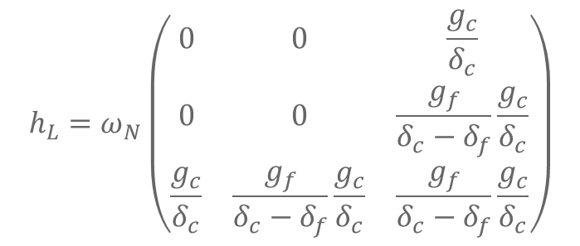
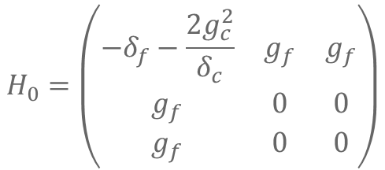
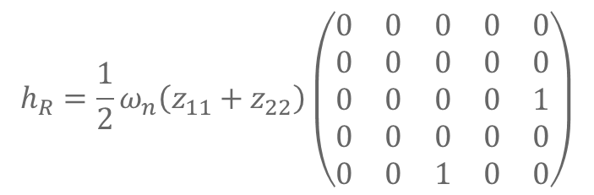
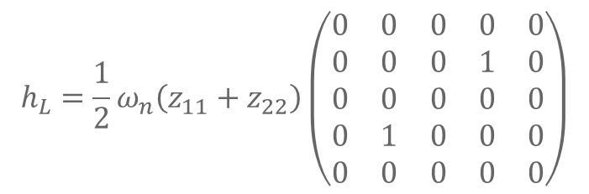
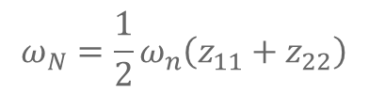
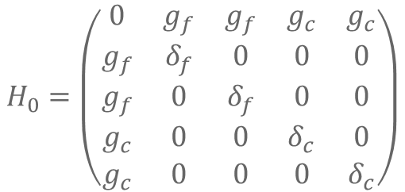
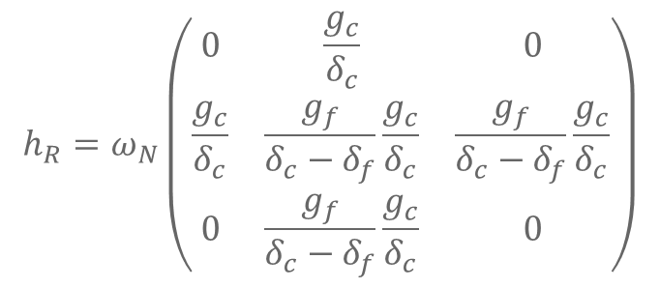
$$n_{0}=1$$
$$H_{0}=\left(\begin{matrix}0 & g_{f} & g_{f} & g_{c} & g_{c} \\ g_{f} & δ_{f} & 0 & 0 & 0 \\ g_{f} & 0 & δ_{f} & 0 & 0 \\ g_{c} & 0 & 0 & δ_{c} & 0 \\ g_{c} & 0 & 0 & 0 & δ_{c}\end{matrix}\right)$$
$$H_{0}=\left(\begin{matrix}−δ_{f}−\frac{2g_{c}^{2}}{δ_{c}} & g_{f} & g_{f} \\ g_{f} & 0 & 0 \\ g_{f} & 0 & 0\end{matrix}\right)$$
$$h_{L}=ω_{N}\left(\begin{matrix}0 & 0 & \frac{g_{c}}{δ_{c}} \\ 0 & 0 & \frac{g_{f}}{δ_{c}−δ_{f}}\frac{g_{c}}{δ_{c}} \\ \frac{g_{c}}{δ_{c}} & \frac{g_{f}}{δ_{c}−δ_{f}}\frac{g_{c}}{δ_{c}} & \frac{g_{f}}{δ_{c}−δ_{f}}\frac{g_{c}}{δ_{c}}\end{matrix}\right)$$
$$h_{L}=\frac{1}{2}ω_{n}\left(z_{11}+z_{22}\right)\left(\begin{matrix}0 & 0 & 0 & 0 & 0 \\ 0 & 0 & 0 & 1 & 0 \\ 0 & 0 & 0 & 0 & 0 \\ 0 & 1 & 0 & 0 & 0 \\ 0 & 0 & 0 & 0 & 0\end{matrix}\right)$$
2nd Order SW
$$h_{R}=ω_{N}\left(\begin{matrix}0 & \frac{g_{c}}{δ_{c}} & 0 \\ \frac{g_{c}}{δ_{c}} & \frac{g_{f}}{δ_{c}−δ_{f}}\frac{g_{c}}{δ_{c}} & \frac{g_{f}}{δ_{c}−δ_{f}}\frac{g_{c}}{δ_{c}} \\ 0 & \frac{g_{f}}{δ_{c}−δ_{f}}\frac{g_{c}}{δ_{c}} & 0\end{matrix}\right)$$
$$h_{R}=\frac{1}{2}ω_{n}\left(z_{11}+z_{22}\right)\left(\begin{matrix}0 & 0 & 0 & 0 & 0 \\ 0 & 0 & 0 & 0 & 0 \\ 0 & 0 & 0 & 0 & 1 \\ 0 & 0 & 0 & 0 & 0 \\ 0 & 0 & 1 & 0 & 0\end{matrix}\right)$$
$$ω_{N}=\frac{1}{2}ω_{n}\left(z_{11}+z_{22}\right)$$

Slide 10
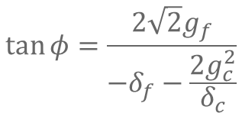
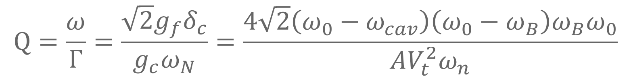
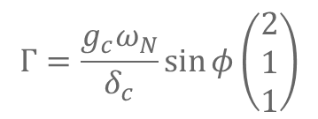
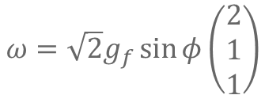
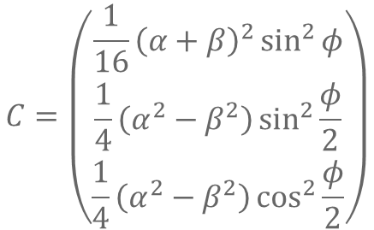
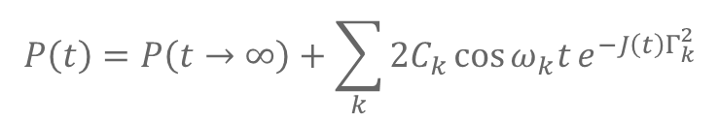
$$n_{0}=1;P_{01}\left(t\right)$$
$$P_{01}\left(t→∞\right)=\frac{1}{4}\left(1+\sin^{4}{\frac{φ}{2}}+\cos^{4}{\frac{φ}{2}}\right)−\frac{1}{2}αβ\left(1−\sin^{4}{\frac{φ}{2}}−\cos^{4}{\frac{φ}{2}}\right)$$
$$\tan{φ}=\frac{{2\sqrt{2}g}_{f}}{−δ_{f}−\frac{2g_{c}^{2}}{δ_{c}}}$$
$$P\left(t\right)=P\left(t→∞\right)+\sum_{k}{2C_{k}\cos{ω_{k}t}e^{−J\left(t\right)Γ_{k}^{2}}}$$
$$C=\left(\begin{matrix}\frac{1}{16}{\left(α+β\right)}^{2}\sin^{2}{φ} \\ \frac{1}{4}\left(α^{2}−β^{2}\right)\sin^{2}{\frac{φ}{2}} \\ \frac{1}{4}\left(α^{2}−β^{2}\right)\cos^{2}{\frac{φ}{2}}\end{matrix}\right)$$
$$ω=\sqrt{2}g_{f}\sin{φ}\left(\begin{matrix}2 \\ 1 \\ 1\end{matrix}\right)$$
$$Γ=\frac{g_{c}ω_{N}}{δ_{c}}\sin{φ}\left(\begin{matrix}2 \\ 1 \\ 1\end{matrix}\right)$$
$$Q=\frac{ω}{Γ}=\frac{\sqrt{2}g_{f}δ_{c}}{g_{c}ω_{N}}=\frac{4\sqrt{2}\left(ω_{0}−ω_{cav}\right)\left(ω_{0}−ω_{B}\right)ω_{B}ω_{0}}{AV_{t}^{2}ω_{n}}$$

Slide 11
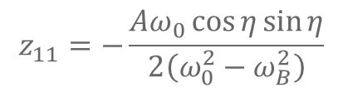
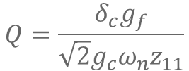
$$Q=\frac{δ_{c}g_{f}}{\sqrt{2}g_{c}ω_{n}z_{11}}$$
$$z_{11}=−\frac{Aω_{0}\cos{η}\sin{η}}{2\left(ω_{0}^{2}−ω_{B}^{2}\right)}$$

Slide 12
Extra Figures

Slide 13
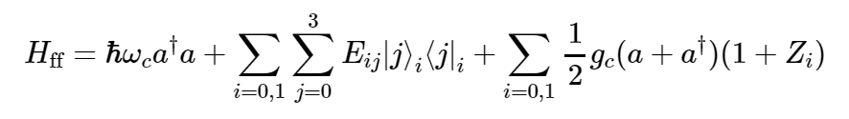
Hamiltonian
$$+\frac{1}{2}\sum_{i}{f_{i}\left(t\right)ω_{i} Z_{i}}$$
Cavity energy
Charge dipole
Relevant for 1Q Noise: Dephasing
Relevant for Cavity Coupling
Relevant for 2Q Noise: Relaxation
Not qualitatively relevant
Flip-flop energies
Charge-cavity coupling
$$Z_{ij}$$ | $$I$$ | $$τ_{x}$$ | $$τ_{y}$$ | $$τ_{z}$$
$$I$$ | $$0$$ | $$−\frac{Aω_{0}Δω_{B}\cos{η}\sin^{2}{η}}{4ω_{B}\left(ω_{0}^{2}−ω_{B}^{2}\right)}$$ | $$0$$ | $$\frac{A^{2}ω_{0}^{3}\cos{η}\sin^{2}{η}}{4ω_{B}{\left(ω_{0}^{2}−ω_{B}^{2}\right)}^{2}}$$
$$σ_{x}$$ | $$\sin{η}+\frac{A\cos{η}\sin{η}}{4ω_{0}}$$ | $$−\frac{Aω_{0}\cos{η}\sin{η}}{2\left(ω_{0}^{2}−ω_{B}^{2}\right)}$$ | $$0$$ | $$−\frac{Δω_{B}\cos{η}\sin{η}}{2ω_{0}}$$
$$σ_{y}$$ | $$0$$ | $$0$$ | $$−\frac{Aω_{0}\cos{η}\sin{η}}{2\left(ω_{0}^{2}−ω_{B}^{2}\right)}\frac{ω_{0}}{ω_{B}}$$ | $$0$$
$$σ_{z}$$ | $$\cos{η}−\frac{A\sin^{2}{η}}{4ω_{0}}$$ | $$\frac{Aω_{0}\sin^{2}{η}}{2\left(ω_{0}^{2}−ω_{B}^{2}\right)}$$ | $$0$$ | $$\frac{Δω_{B}\sin^{2}{η}}{2ω_{0}}$$
$$Z=\sum_{ij}{Z_{ij}σ_{i}τ_{j} }$$

