Slide 1
Two-Qubit CAVITY COUPLING

Slide 2
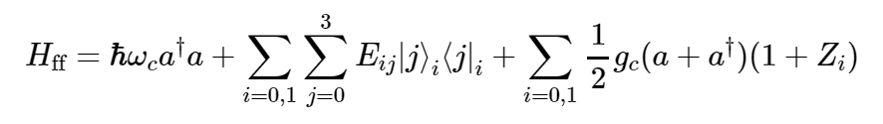
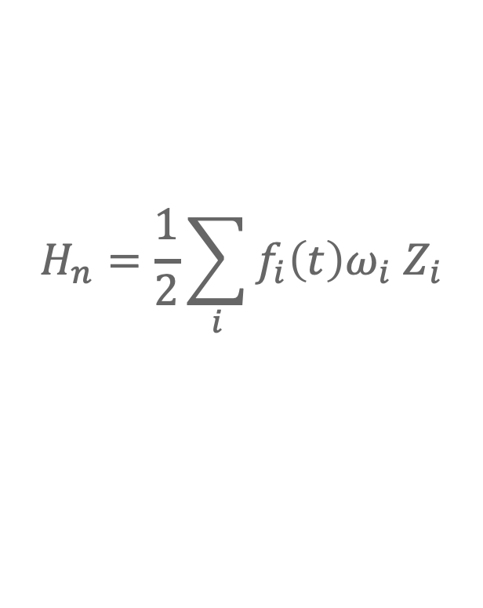
Hamiltonian
Cavity energy
Charge dipole
Flip-flop energies
Charge-cavity coupling
$$H_{n}=\frac{1}{2}\sum_{i}{f_{i}\left(t\right)ω_{i} Z_{i}}$$

Slide 3
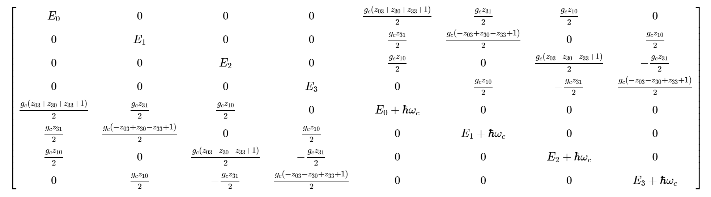
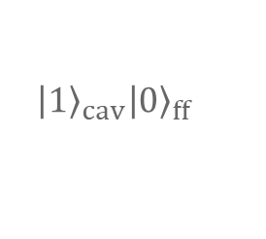
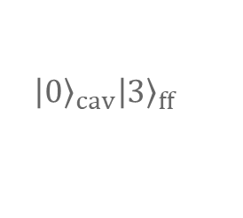

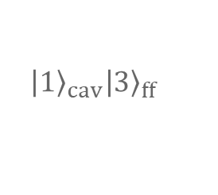
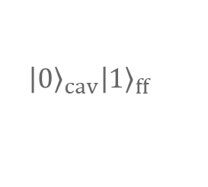

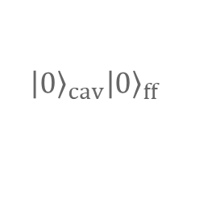
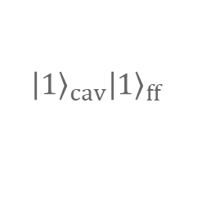
Single Qubit
$$\left|{\left.0\right\rangle }_{cav}\right|{\left.0\right\rangle }_{ff}$$
$$\left|{\left.0\right\rangle }_{cav}\right|{\left.1\right\rangle }_{ff}$$
$$\left|{\left.0\right\rangle }_{cav}\right|{\left.2\right\rangle }_{ff}$$
$$\left|{\left.0\right\rangle }_{cav}\right|{\left.3\right\rangle }_{ff}$$
$$\left|{\left.1\right\rangle }_{cav}\right|{\left.0\right\rangle }_{ff}$$
$$\left|{\left.1\right\rangle }_{cav}\right|{\left.1\right\rangle }_{ff}$$
$$\left|{\left.1\right\rangle }_{cav}\right|{\left.2\right\rangle }_{ff}$$
$$\left|{\left.1\right\rangle }_{cav}\right|{\left.3\right\rangle }_{ff}$$

Slide 4
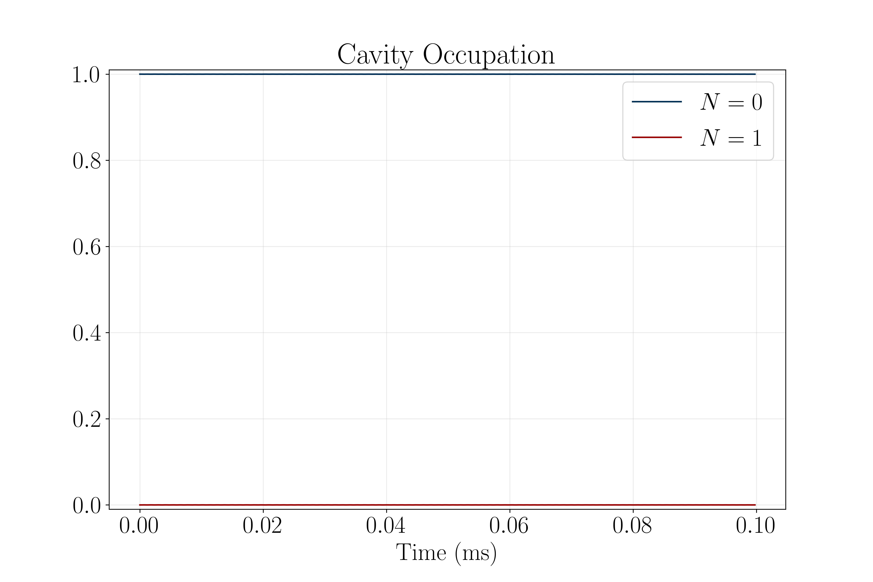
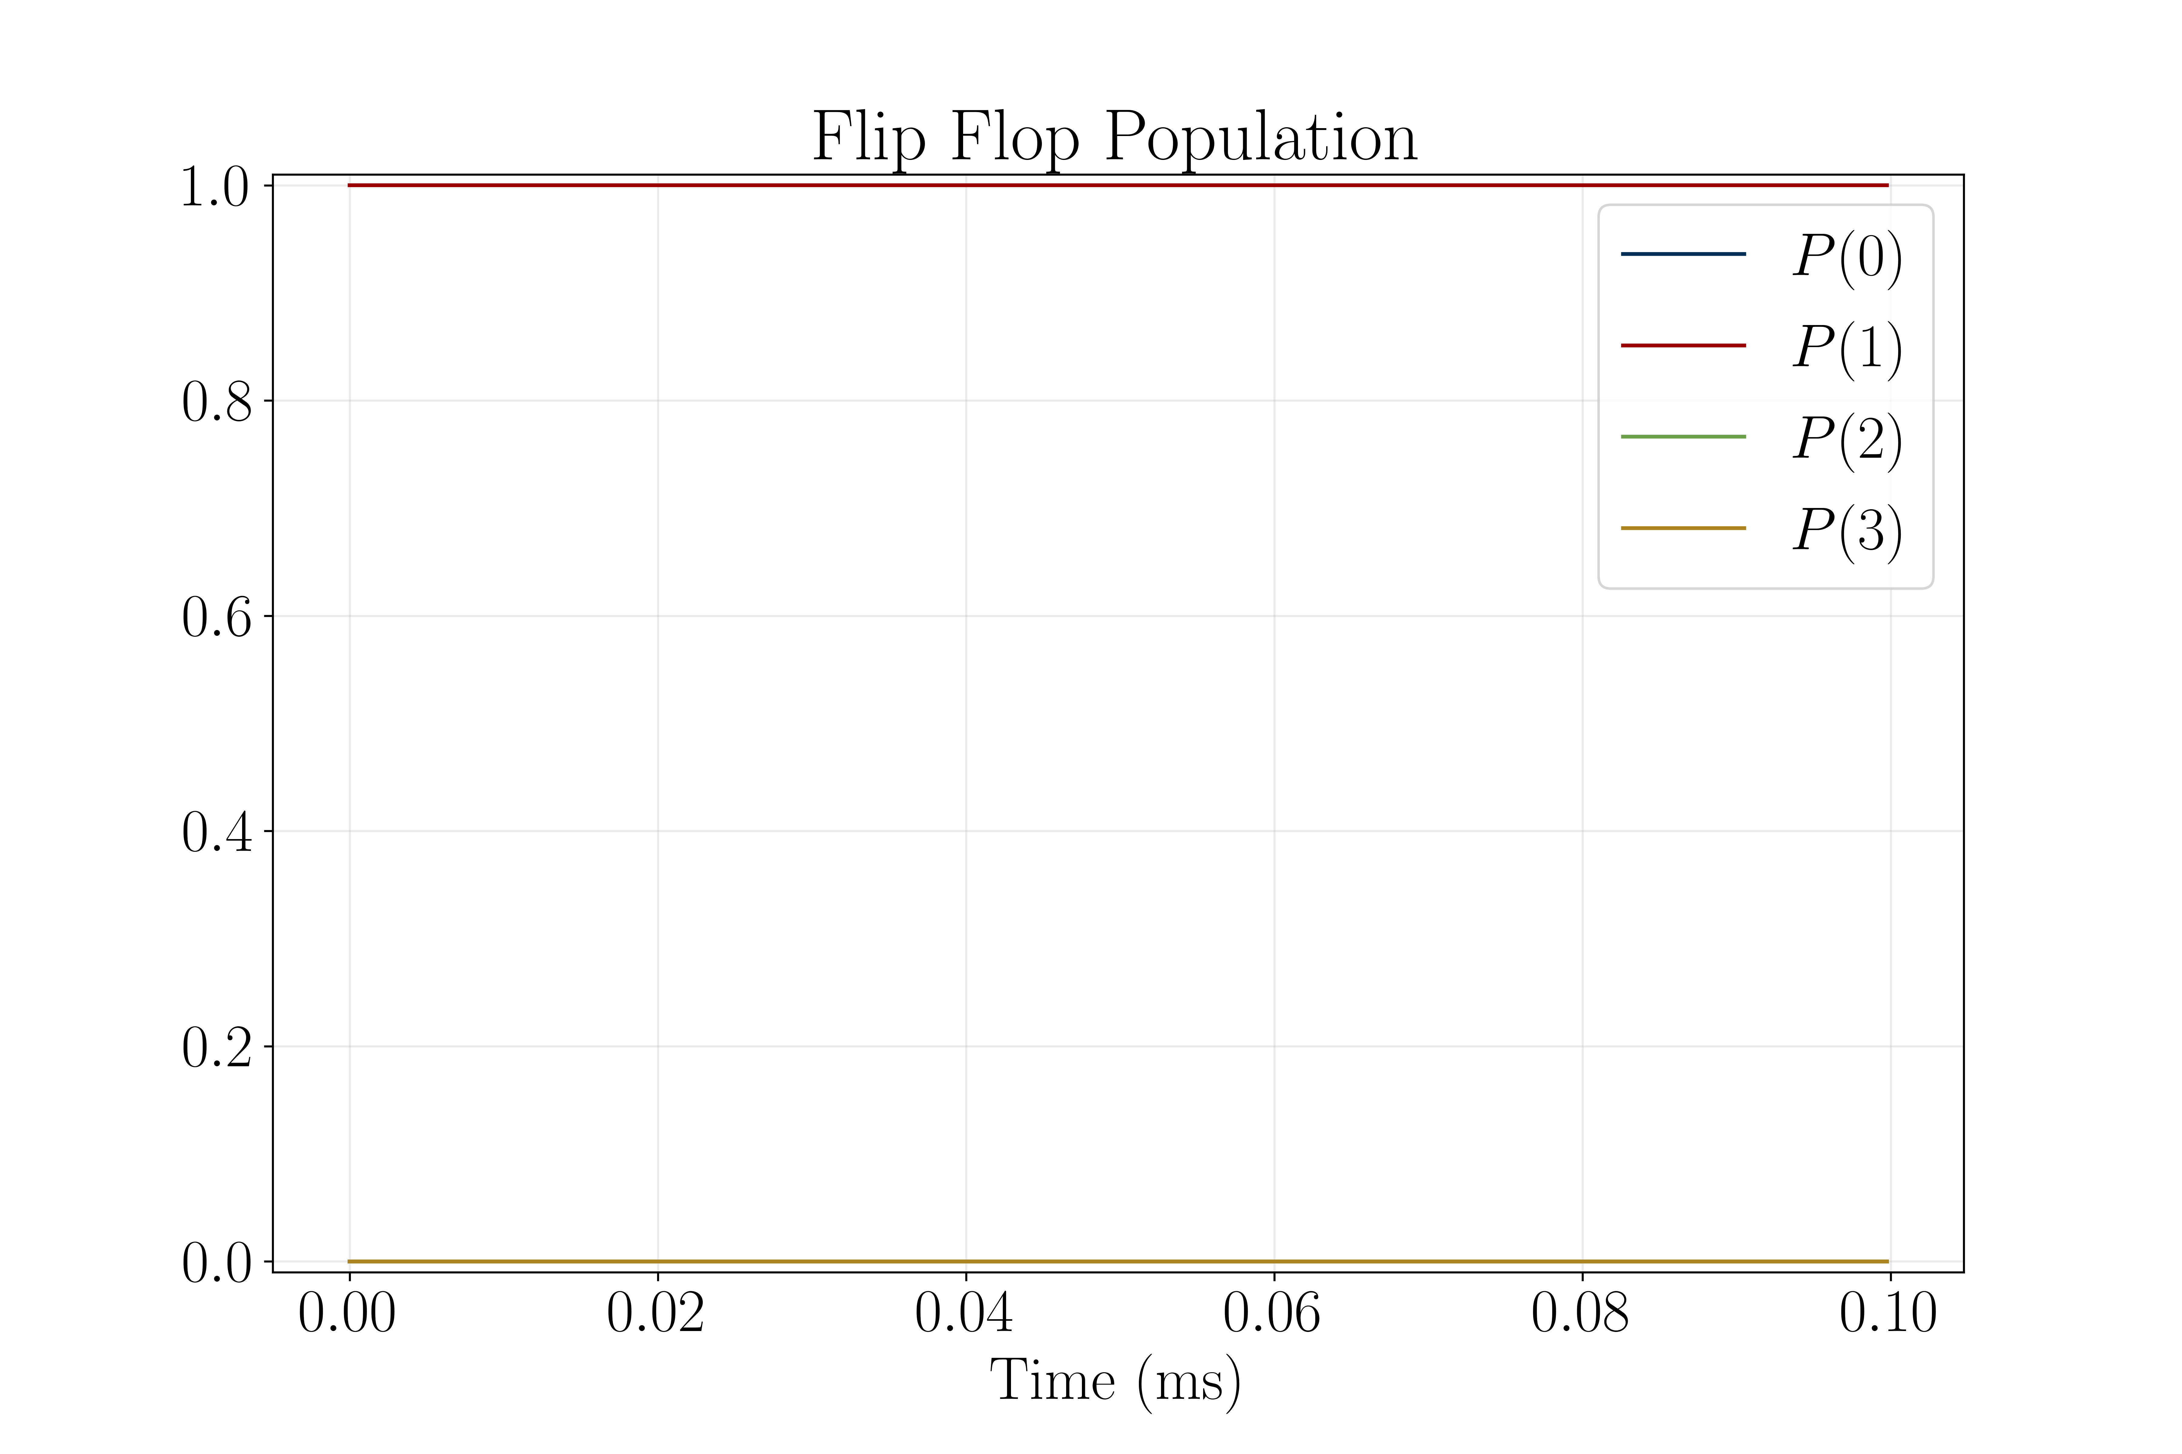
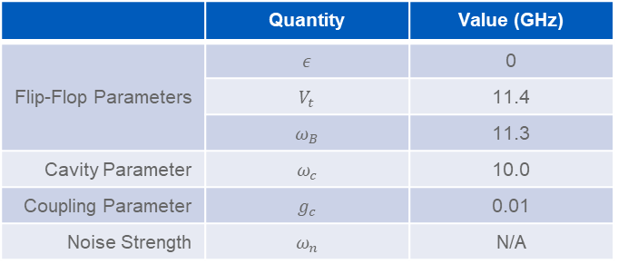
Single Qubit Time Evolution w/o Noise
 | Quantity | Value (GHz)
Flip-Flop Parameters | $$ε$$ | 0
 | $$V_{t}$$ | 11.4
 | $$ω_{B}$$ | 11.3
Cavity Parameter | $$ω_{c}$$ | 10.0
Coupling Parameter | $$g_{c}$$ | 0.01
Noise Strength | $$ω_{n}$$ | N/A

Slide 5

Single Qubit Time Evolution w/ Noise
 | Quantity | Value (GHz)
Flip-Flop Parameters | $$ε$$ | 0
 | $$V_{t}$$ | 11.4
 | $$ω_{B}$$ | 11.3
Cavity Parameter | $$ω_{c}$$ | 10.0
Coupling Parameter | $$g_{c}$$ | 0.01
Noise Strength | $$ω_{n}$$ | 0.323

Slide 7
Extra Figures
All of the following slides are the same as the ones before except with fewer terms omitted.

