Slide 1
Two-Qubit CAVITY COUPLING
Effective Hamiltonian

Slide 2



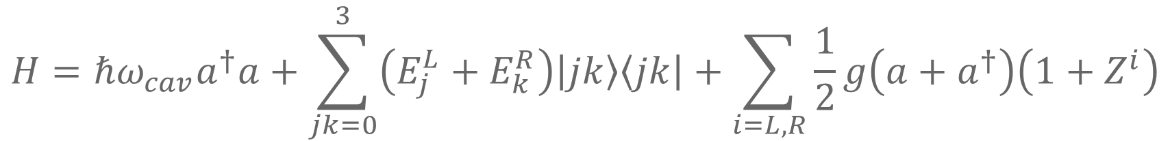













Hamiltonian without Noise
$$H=ℏω_{cav}a^{†}a+\sum_{jk=0}^{3}{\left(E_{j}^{L}+E_{k}^{R}\right)\left|jk\right\rangle \left\langle jk\right|}+\sum_{i=L,R}{\frac{1}{2}g\left(a+a^{†}\right)\left(1+Z^{i}\right)}$$
$$\left|n_{0}+1\right\rangle$$
$${\left|3\right\rangle }_{L}$$
$${\left|3\right\rangle }_{R}$$
$${\left|2\right\rangle }_{L}$$
$${\left|2\right\rangle }_{R}$$
$$\left|n_{0}\right\rangle$$
$$δ_{c}$$
$${\left|1\right\rangle }_{L}$$
$$δ_{f}$$
$${\left|1\right\rangle }_{R}$$
$$ω_{f}$$
$$ω_{c}$$
$$ω_{cav}$$
$${\left|0\right\rangle }_{L}$$
$$\left|n_{0}−1\right\rangle$$
$${\left|0\right\rangle }_{R}$$
Left Qubit
Cavity
Right Qubit

Slide 3
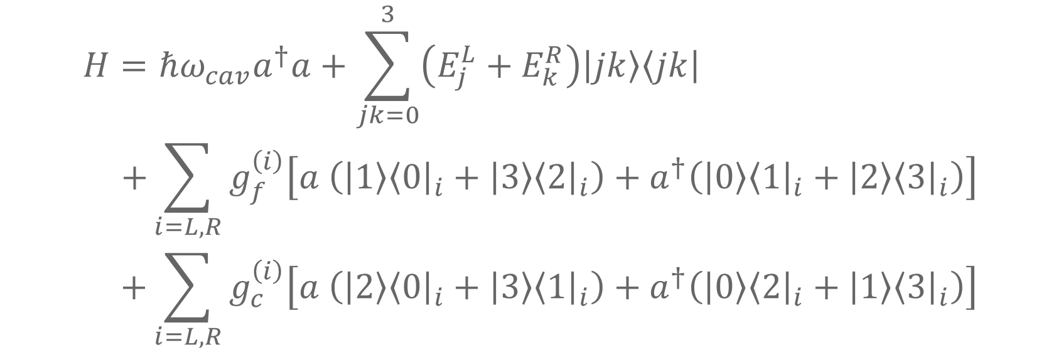
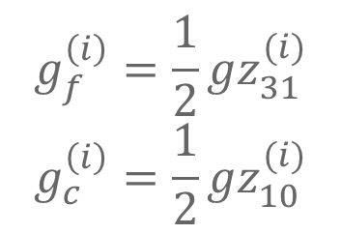
RWA
$$H=ℏω_{cav}a^{†}a+\sum_{jk=0}^{3}{\left(E_{j}^{L}+E_{k}^{R}\right)\left|jk\right\rangle \left\langle jk\right|} \\ +\sum_{i=L,R}{g_{f}^{\left(i\right)}\left[a \left(\left|1\right\rangle {\left\langle 0\right|}_{i}+\left|3\right\rangle {\left\langle 2\right|}_{i}\right)+a^{†}\left(\left|0\right\rangle {\left\langle 1\right|}_{i}+\left|2\right\rangle {\left\langle 3\right|}_{i}\right)\right]} \\ +\sum_{i=L,R}{g_{c}^{\left(i\right)}\left[a \left(\left|2\right\rangle {\left\langle 0\right|}_{i}+\left|3\right\rangle {\left\langle 1\right|}_{i}\right)+a^{†}\left(\left|0\right\rangle {\left\langle 2\right|}_{i}+\left|1\right\rangle {\left\langle 3\right|}_{i}\right)\right]}$$
Spin flip
Charge flip
$$g_{f}^{\left(i\right)}=\frac{1}{2}gz_{31}^{(i)}$$
$$g_{c}^{\left(i\right)}=\frac{1}{2}gz_{10}^{(i)}$$
Flip-flop qubit - cavity coupling
Charge qubit - cavity coupling

Slide 4
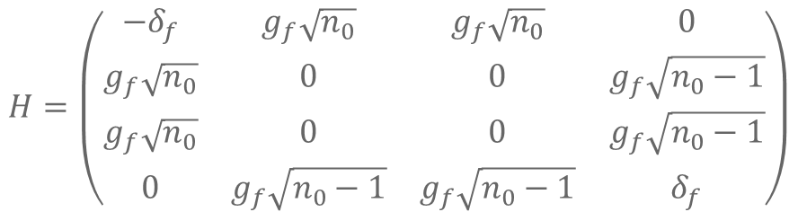
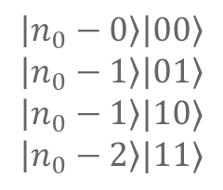
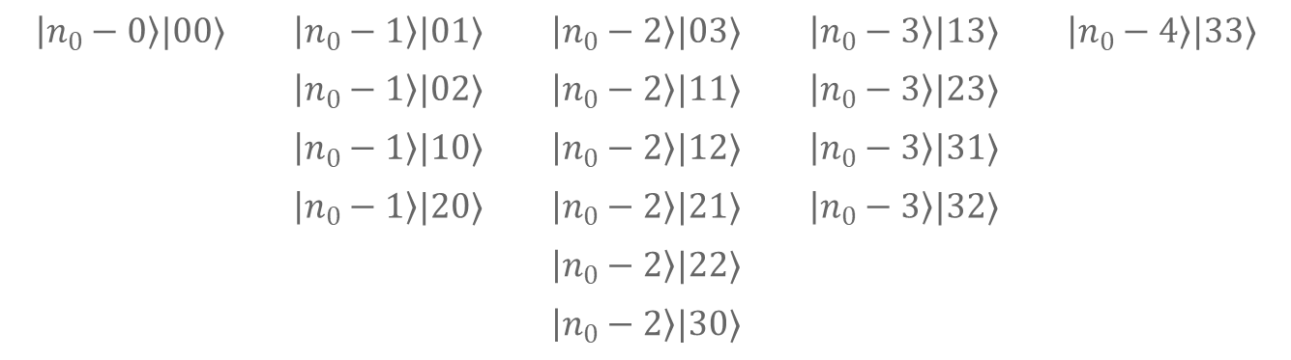
Block Diagonal
$16$ states associated with each $n_{0}$ (if $n_{0}−N<0$ that column is omitted and the block is smaller than $16×16$)
$$\left|n_{0}−0\right\rangle |00⟩$$ | $$\left|n_{0}−1\right\rangle |01⟩$$ | $$\left|n_{0}−2\right\rangle |03⟩$$ | $$\left|n_{0}−3\right\rangle |13⟩$$ | $$\left|n_{0}−4\right\rangle |33⟩$$
 | $$\left|n_{0}−1\right\rangle |02⟩$$ | $$\left|n_{0}−2\right\rangle |11⟩$$ | $$\left|n_{0}−3\right\rangle |23⟩$$
 | $$\left|n_{0}−1\right\rangle |10⟩$$ | $$\left|n_{0}−2\right\rangle |12⟩$$ | $$\left|n_{0}−3\right\rangle |31⟩$$
 | $$\left|n_{0}−1\right\rangle |20⟩$$ | $$\left|n_{0}−2\right\rangle |21⟩$$ | $$\left|n_{0}−3\right\rangle |32⟩$$
 |  | $$\left|n_{0}−2\right\rangle |22⟩$$
 |  | $$\left|n_{0}−2\right\rangle |30⟩$$
If the cavity is in resonance with the flip-flop qubit and not the charge qubit, we can neglect the charge flips and look at only the following 4 states (equivalent to 1st order SW transformation):
$$\left|n_{0}−0\right\rangle \left|00\right\rangle \\ \left|n_{0}−1\right\rangle \left|01\right\rangle \\ \left|n_{0}−1\right\rangle |10⟩$$
$$\left|n_{0}−2\right\rangle |11⟩$$
$$H=\left(\begin{matrix}−δ_{f} & g_{f}\sqrt{n_{0}} & g_{f}\sqrt{n_{0}} & 0 \\ g_{f}\sqrt{n_{0}} & 0 & 0 & g_{f}\sqrt{n_{0}−1} \\ g_{f}\sqrt{n_{0}} & 0 & 0 & g_{f}\sqrt{n_{0}−1} \\ 0 & g_{f}\sqrt{n_{0}−1} & g_{f}\sqrt{n_{0}−1} & δ_{f}\end{matrix}\right)$$
Future note: Since the dominant noise is of the XX (YY) variety, this approximation will also neglect our main source of noise. We need 2nd order SW to capture noise effects.

Slide 5
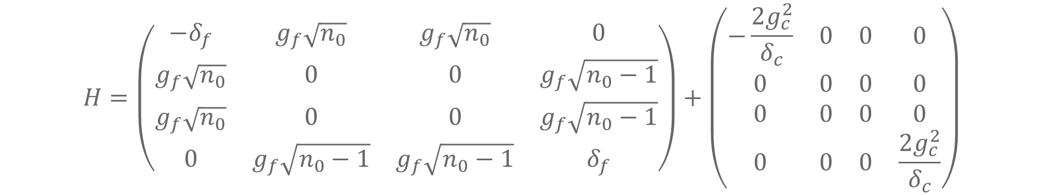

2nd Order SW
$$\left|n_{0}−0\right\rangle \left|00\right\rangle \\ \left|n_{0}−1\right\rangle \left|01\right\rangle \\ \left|n_{0}−1\right\rangle |10⟩$$
$$\left|n_{0}−2\right\rangle |11⟩$$
$$H=\left(\begin{matrix}−δ_{f} & g_{f}\sqrt{n_{0}} & g_{f}\sqrt{n_{0}} & 0 \\ g_{f}\sqrt{n_{0}} & 0 & 0 & g_{f}\sqrt{n_{0}−1} \\ g_{f}\sqrt{n_{0}} & 0 & 0 & g_{f}\sqrt{n_{0}−1} \\ 0 & g_{f}\sqrt{n_{0}−1} & g_{f}\sqrt{n_{0}−1} & δ_{f}\end{matrix}\right)+\left(\begin{matrix}−\frac{2g_{c}^{2}}{δ_{c}} & 0 & 0 & 0 \\ 0 & 0 & 0 & 0 \\ 0 & 0 & 0 & 0 \\ 0 & 0 & 0 & \frac{2g_{c}^{2}}{δ_{c}}\end{matrix}\right)$$

Slide 6

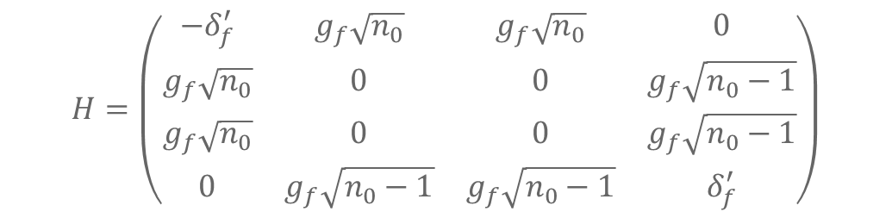
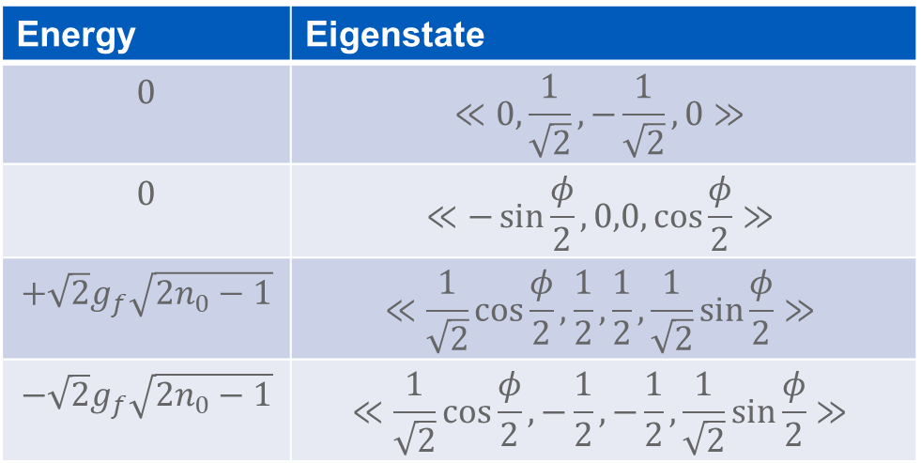
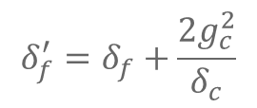
Solving Zero Noise System
$$H=\left(\begin{matrix}−δ_{f}^{′} & g_{f}\sqrt{n_{0}} & g_{f}\sqrt{n_{0}} & 0 \\ g_{f}\sqrt{n_{0}} & 0 & 0 & g_{f}\sqrt{n_{0}−1} \\ g_{f}\sqrt{n_{0}} & 0 & 0 & g_{f}\sqrt{n_{0}−1} \\ 0 & g_{f}\sqrt{n_{0}−1} & g_{f}\sqrt{n_{0}−1} & δ_{f}^{′}\end{matrix}\right)$$
$$\left|n_{0}−0\right\rangle \left|00\right\rangle \\ \left|n_{0}−1\right\rangle \left|01\right\rangle \\ \left|n_{0}−1\right\rangle |10⟩$$
$$\left|n_{0}−2\right\rangle |11⟩$$
$$δ_{f}^{′}=δ_{f}+\frac{2g_{c}^{2}}{δ_{c}}$$
Resonant case: $δ_{f}^{′}=0$
Energy | Eigenstate
$$0$$ | $$≪0,\frac{1}{\sqrt{2}},−\frac{1}{\sqrt{2}},0≫$$
$$0$$ | $$≪−\sin{\frac{φ}{2}},0,0,\cos{\frac{φ}{2}}≫$$
$$+\sqrt{2}g_{f}\sqrt{2n_{0}−1}$$ | $$≪\frac{1}{\sqrt{2}}\cos{\frac{φ}{2}},\frac{1}{2},\frac{1}{2},\frac{1}{\sqrt{2}}\sin{\frac{φ}{2}}≫$$
$$−\sqrt{2}g_{f}\sqrt{2n_{0}−1}$$ | $$≪\frac{1}{\sqrt{2}}\cos{\frac{φ}{2}},−\frac{1}{2},−\frac{1}{2},\frac{1}{\sqrt{2}}\sin{\frac{φ}{2}}≫$$
$$\tan{φ}=\sqrt{2n_{0}\left(2n_{0}−1\right)}$$

Slide 7
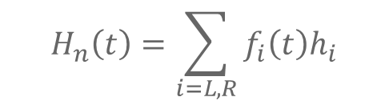
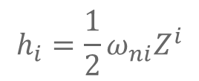
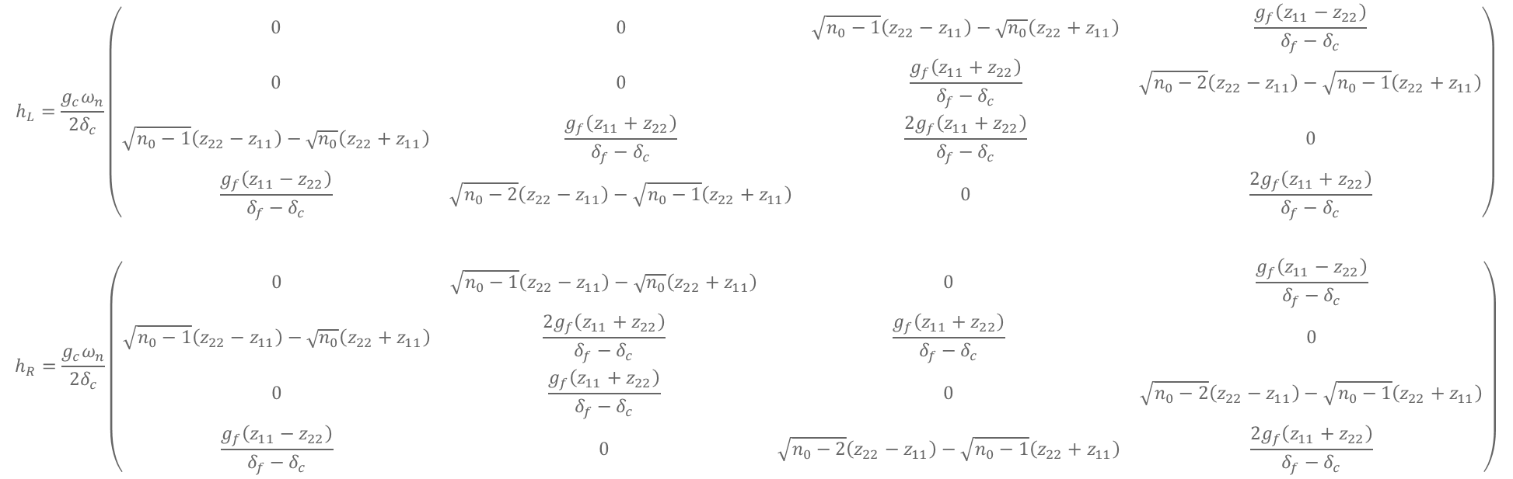
2nd Order SW Noise
$$H_{n}\left(t\right)=\sum_{i=L,R}{f_{i}\left(t\right)h_{i}}$$
$$h_{i}=\frac{1}{2}ω_{ni}Z^{i}$$
$$\left|n_{0}−0\right\rangle \left|00\right\rangle \\ \left|n_{0}−1\right\rangle \left|01\right\rangle \\ \left|n_{0}−1\right\rangle |10⟩$$
$$\left|n_{0}−2\right\rangle |11⟩$$
$$h_{L}=\frac{g_{c}ω_{n}}{{2δ}_{c}}\left(\begin{matrix}0 & 0 & \sqrt{n_{0}−1}\left(z_{22}−z_{11}\right)−\sqrt{n_{0}}\left(z_{22}+z_{11}\right) & \frac{g_{f}\left(z_{11}−z_{22}\right)}{δ_{f}−δ_{c}} \\ 0 & 0 & \frac{g_{f}\left(z_{11}+z_{22}\right)}{δ_{f}−δ_{c}} & \sqrt{n_{0}−2}\left(z_{22}−z_{11}\right)−\sqrt{n_{0}−1}\left(z_{22}+z_{11}\right) \\ \sqrt{n_{0}−1}\left(z_{22}−z_{11}\right)−\sqrt{n_{0}}\left(z_{22}+z_{11}\right) & \frac{g_{f}\left(z_{11}+z_{22}\right)}{δ_{f}−δ_{c}} & \frac{2g_{f}\left(z_{11}+z_{22}\right)}{δ_{f}−δ_{c}} & 0 \\ \frac{g_{f}\left(z_{11}−z_{22}\right)}{δ_{f}−δ_{c}} & \sqrt{n_{0}−2}\left(z_{22}−z_{11}\right)−\sqrt{n_{0}−1}\left(z_{22}+z_{11}\right) & 0 & \frac{2g_{f}\left(z_{11}+z_{22}\right)}{δ_{f}−δ_{c}}\end{matrix}\right)$$
$$h_{R}=\frac{g_{c}ω_{n}}{{2δ}_{c}}\left(\begin{matrix}0 & \sqrt{n_{0}−1}\left(z_{22}−z_{11}\right)−\sqrt{n_{0}}\left(z_{22}+z_{11}\right) & 0 & \frac{g_{f}\left(z_{11}−z_{22}\right)}{δ_{f}−δ_{c}} \\ \sqrt{n_{0}−1}\left(z_{22}−z_{11}\right)−\sqrt{n_{0}}\left(z_{22}+z_{11}\right) & \frac{2g_{f}\left(z_{11}+z_{22}\right)}{δ_{f}−δ_{c}} & \frac{g_{f}\left(z_{11}+z_{22}\right)}{δ_{f}−δ_{c}} & 0 \\ 0 & \frac{g_{f}\left(z_{11}+z_{22}\right)}{δ_{f}−δ_{c}} & 0 & \sqrt{n_{0}−2}\left(z_{22}−z_{11}\right)−\sqrt{n_{0}−1}\left(z_{22}+z_{11}\right) \\ \frac{g_{f}\left(z_{11}−z_{22}\right)}{δ_{f}−δ_{c}} & 0 & \sqrt{n_{0}−2}\left(z_{22}−z_{11}\right)−\sqrt{n_{0}−1}\left(z_{22}+z_{11}\right) & \frac{2g_{f}\left(z_{11}+z_{22}\right)}{δ_{f}−δ_{c}}\end{matrix}\right)$$

Slide 8
Extra Figures

