Slide 1
Two-Qubit CAVITY COUPLING
Effective Hamiltonian

Slide 2
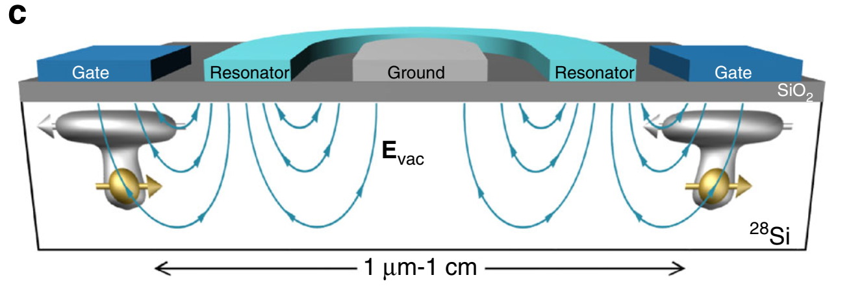

Slide 3
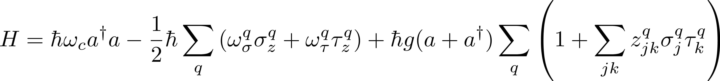














Hamiltonian
Cavity energy
Qubit energy
Cavity coupling
$$\left|N+2\right\rangle$$
$${\left|3\right\rangle }_{L}$$
$${\left|3\right\rangle }_{R}$$
$${\left|2\right\rangle }_{L}$$
$${\left|2\right\rangle }_{R}$$
$$\left|N+1\right\rangle$$
$${\left|1\right\rangle }_{L}$$
$${\left|1\right\rangle }_{R}$$
$$ω_{τ}$$
$$ω_{σ}$$
$$ω_{c}$$
$${\left|0\right\rangle }_{L}$$
$$\left|N\right\rangle$$
$${\left|0\right\rangle }_{R}$$
Left Qubit
Cavity
Right Qubit

Slide 4
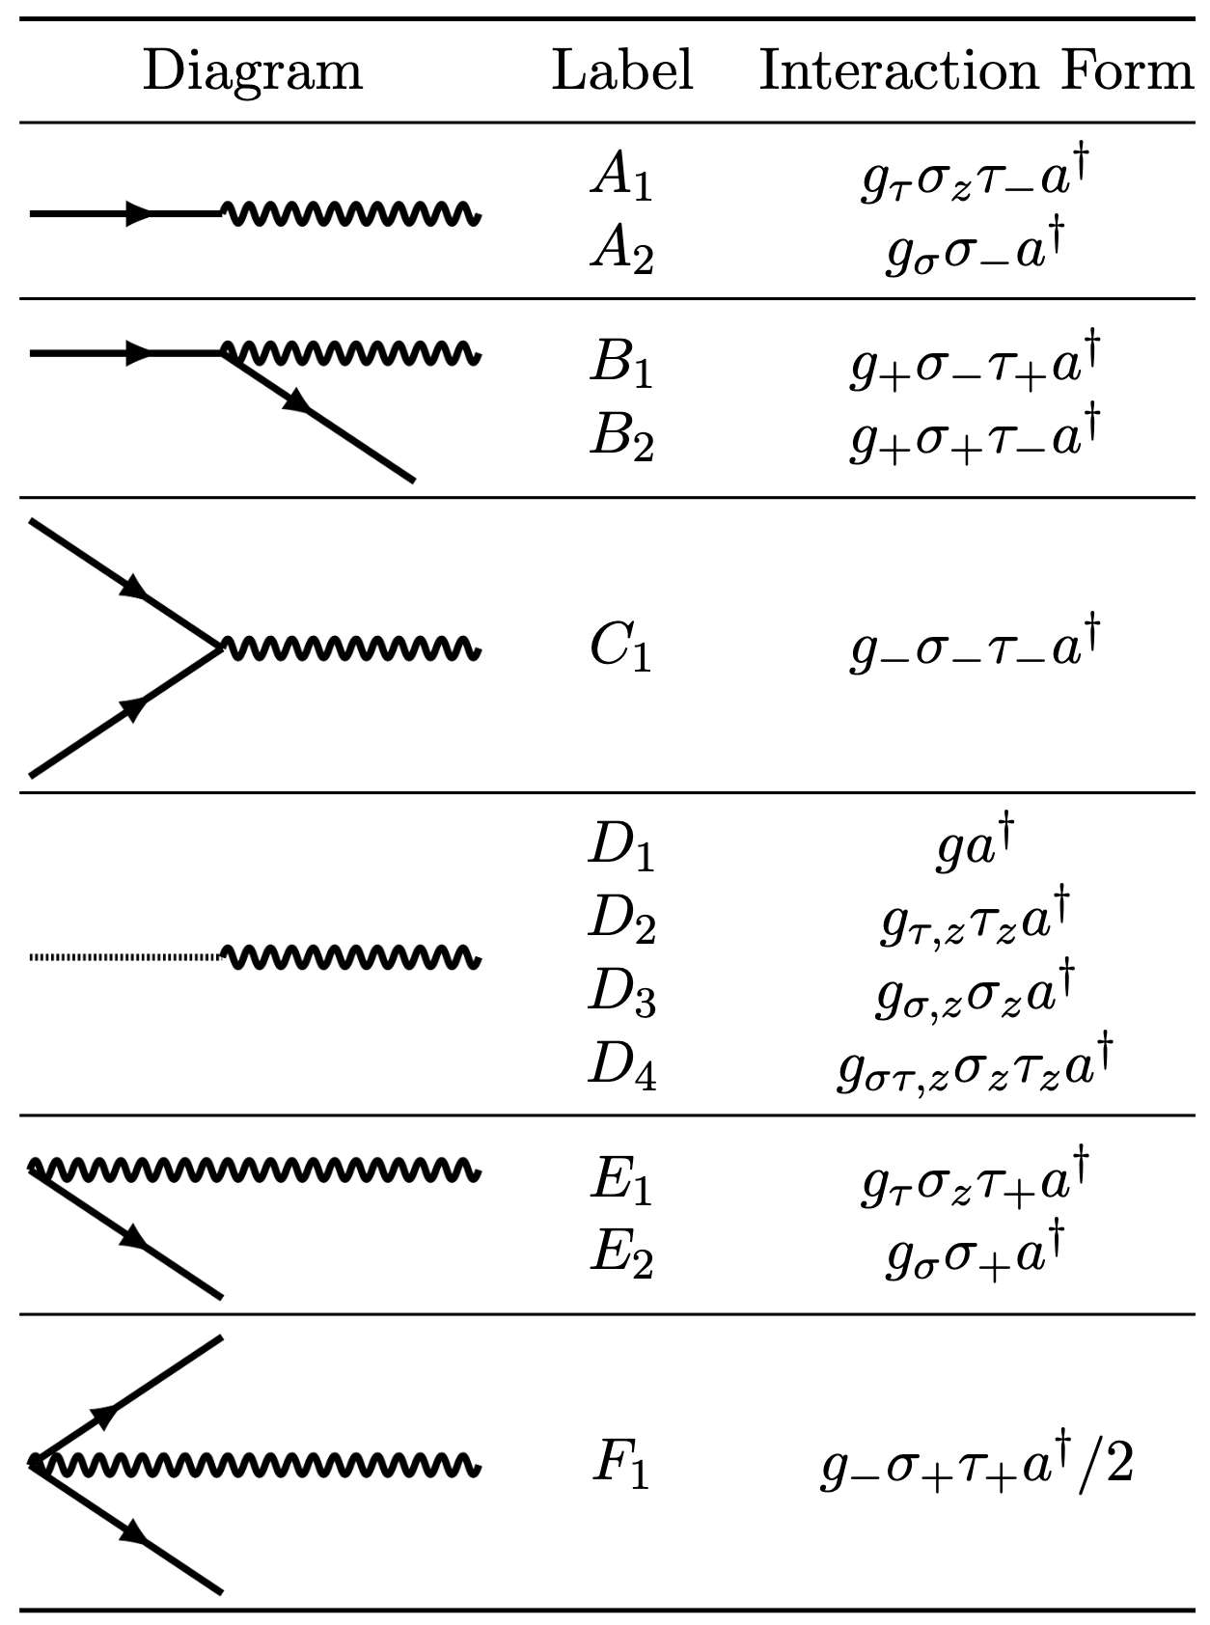
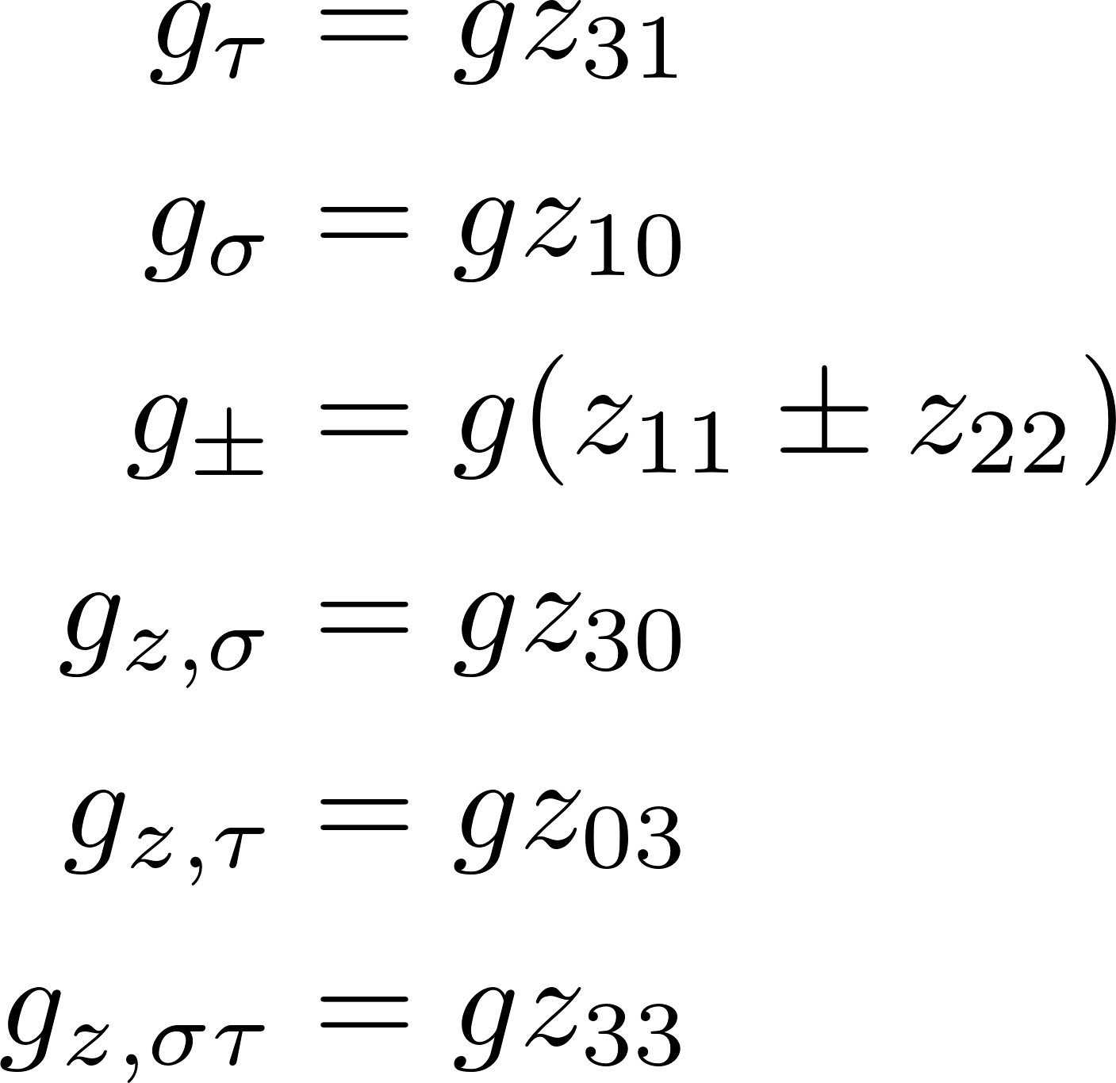
Interaction Diagrams

Slide 5
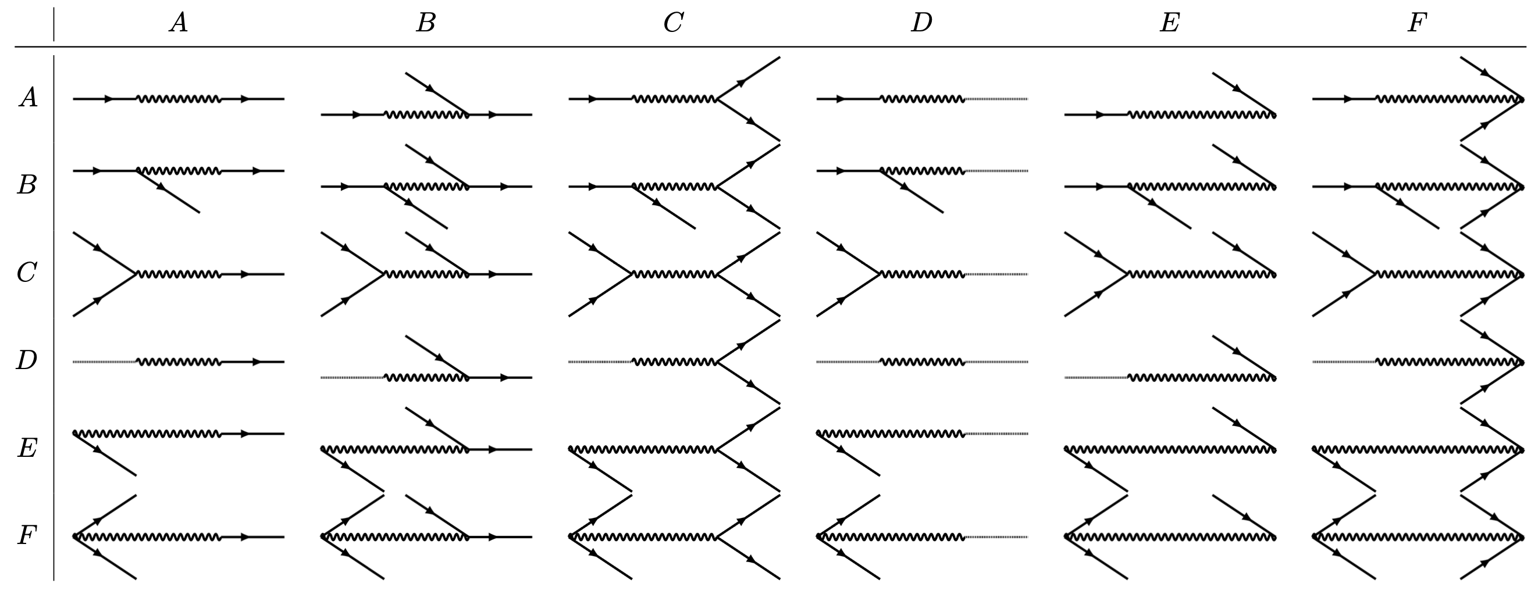
2nd Order Interaction Diagrams

Slide 6
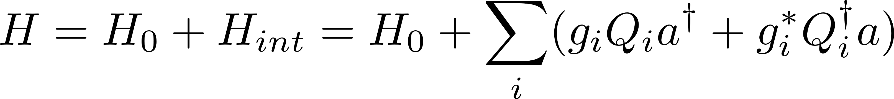
Effective Hamiltonian

Slide 7
Additional SLides

