Slide 1
An introduction to the Levenberg-Marquardt Algorithm
J Tyler Smith

Slide 2
Outline
Least Squares Curve Fitting Problem
Least Squares Gradient
Linear Case
Nonlinear Case
Gradient Descent
Gauss-Newton Method
Levenberg-Marquardt Method

Slide 3
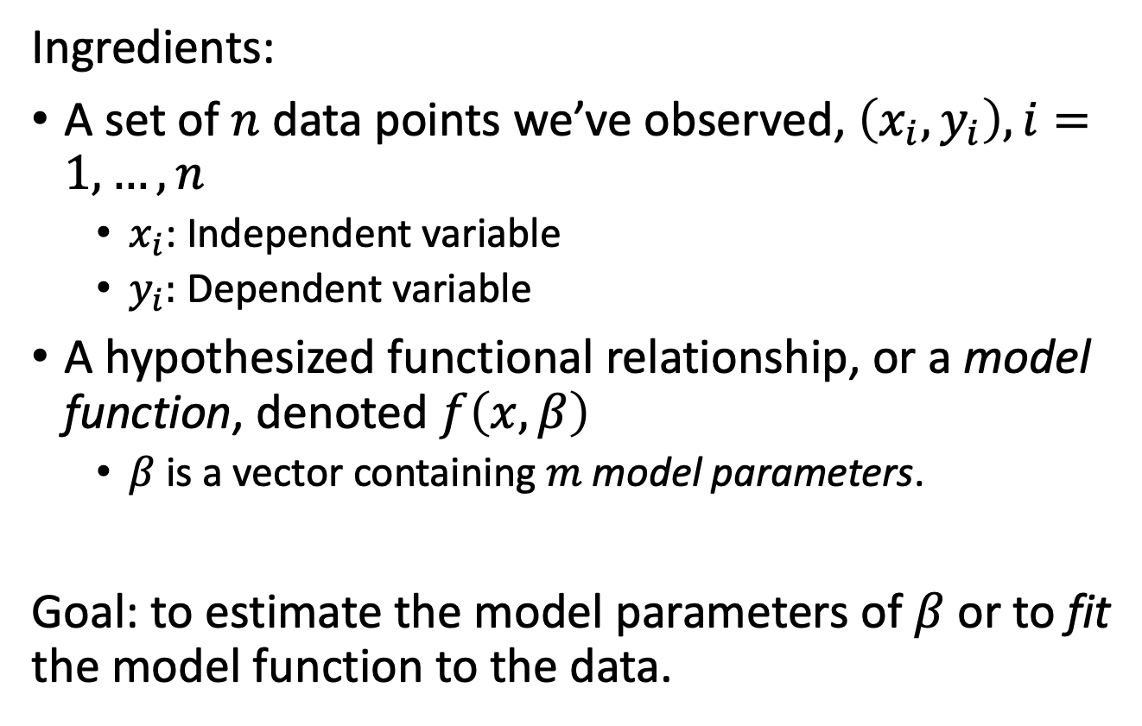
Least Squares Curve Fitting Problem
Ingredients:
A set of $n$ data points we’ve observed, $\left(x_{i},y_{i}\right), i=1,…,n$
$x_{i}$: Independent variable
$y_{i}:$ Dependent variable
A hypothesized functional relationship, or a model function, denoted $f\left(x,β\right)$
$β$ is a vector containing $m$ model parameters.
Goal: to estimate the model parameters of $β$ or to fit the model function to the data.

Slide 4
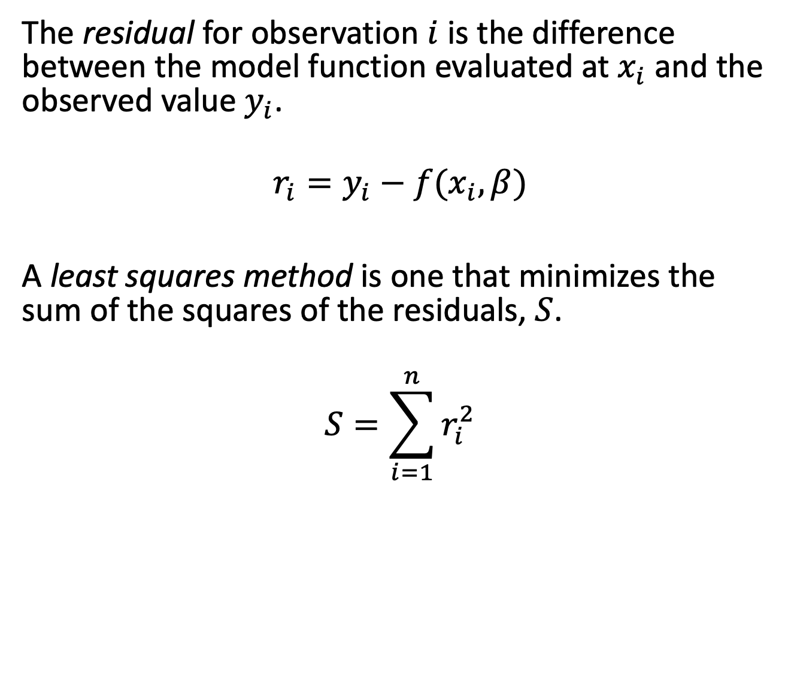
Least Squares Curve Fitting Problem
The residual for observation $i$ is the difference between the model function evaluated at $x_{i}$ and the observed value $y_{i}$.
$$r_{i}=y_{i}−f(x_{i},β)$$
A least squares method is one that minimizes the sum of the squares of the residuals, $S$.
$$S=\sum_{i=1}^{n}{r_{i}^{2}}$$

Slide 5
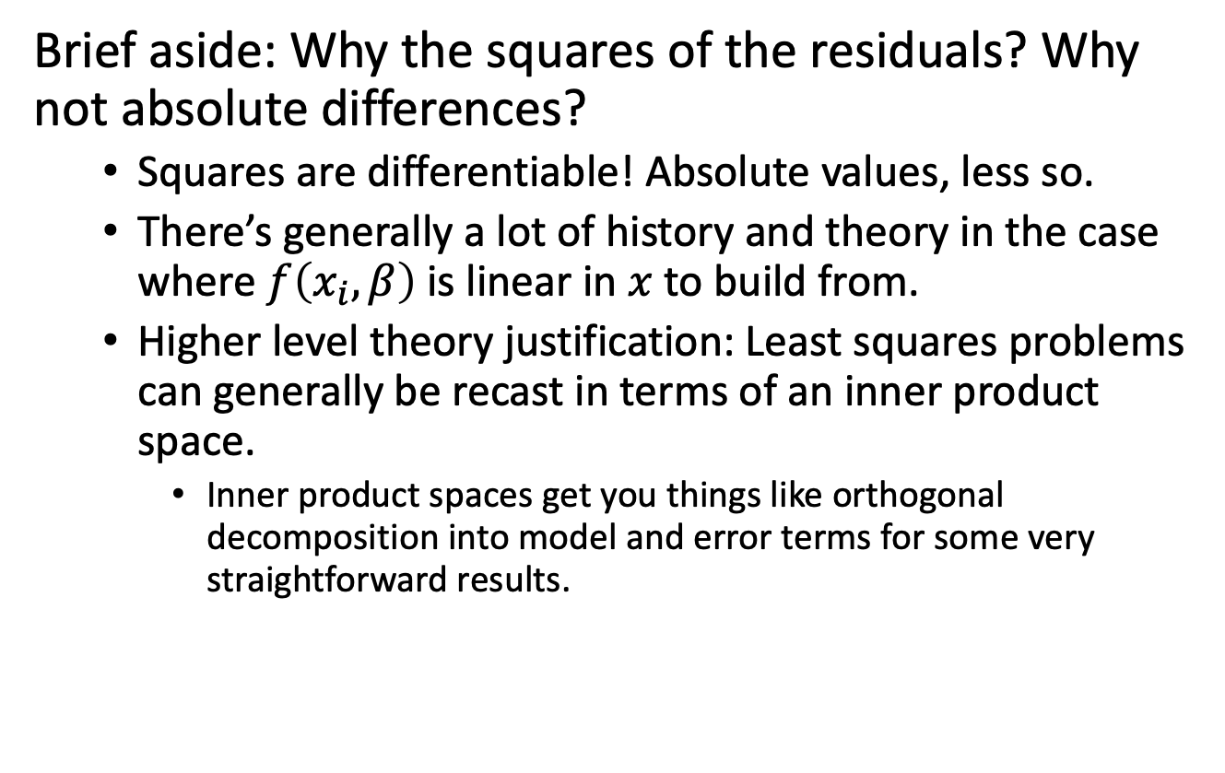
Least Squares Curve Fitting Problem
Brief aside: Why the squares of the residuals? Why not absolute differences?
Squares are differentiable! Absolute values, less so.
There’s generally a lot of history and theory in the case where $f\left(x_{i},β\right)$ is linear in $x$ to build from.
Higher level theory justification: Least squares problems can generally be recast in terms of an inner product space.
Inner product spaces get you things like orthogonal decomposition into model and error terms for some very straightforward results.

Slide 6
Least Squares Curve Fitting Problem
A simple linear example: Ice cream sales
Gower Drug Store in Lewisburg, KY has an old timey soda fountain. Over a set of Saturdays in July, Ed Gower wants to see if the (afternoon) temperature is related to how many ice cream sodas he sells, and he applies a simple linear regression.
Temp (F) | 76 | 87 | 95 | 81
Sales | 6 | 9 | 12 | 8

Slide 7
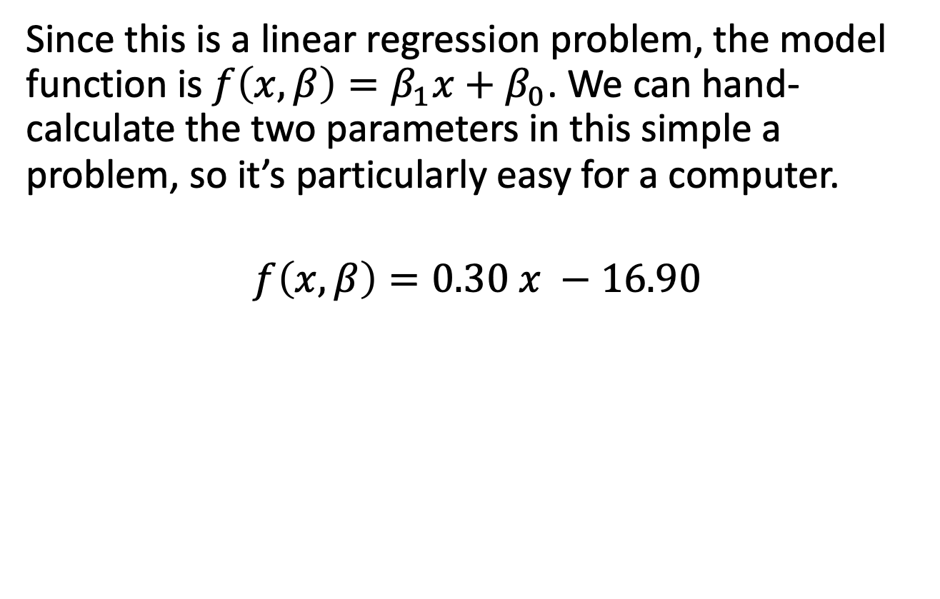
Least Squares Curve Fitting Problem
Since this is a linear regression problem, the model function is $f\left(x,β\right)=β_{1}x+β_{0}$. We can hand-calculate the two parameters in this simple a problem, so it’s particularly easy for a computer.
$$f\left(x,β\right)=0.30 x −16.90$$

Slide 8
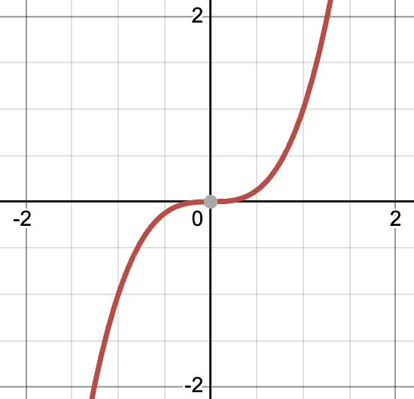
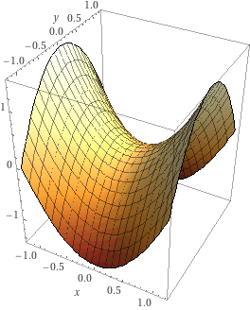
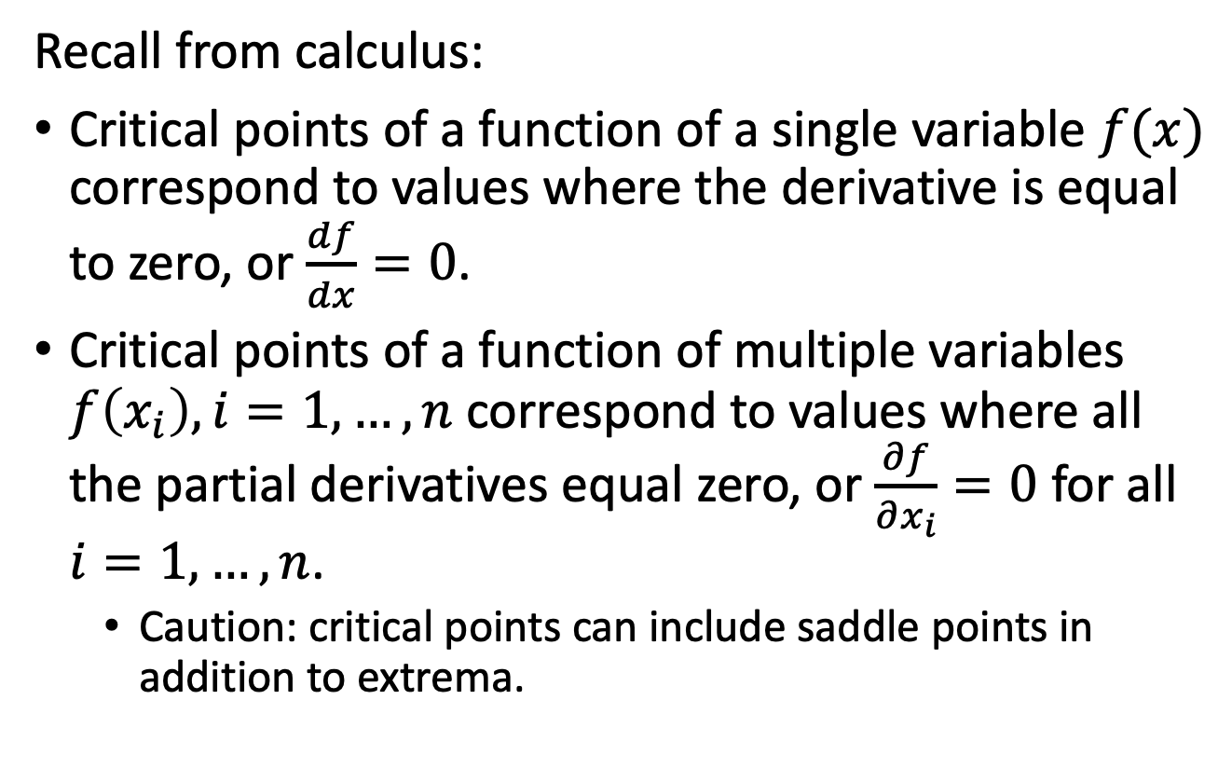
Least Squares Gradient
Recall from calculus:
Critical points of a function of a single variable $f(x)$ correspond to values where the derivative is equal to zero, or $\frac{df}{dx}=0$.
Critical points of a function of multiple variables $f\left(x_{i}\right), i=1,…,n$ correspond to values where all the partial derivatives equal zero, or $\frac{∂f}{∂x_{i}}=0$ for all $i=1,…,n$.
Caution: critical points can include saddle points in addition to extrema.
Notes:
The two images show the functions y=x^3 (courtesy of Desmos) with a saddle point at x=0, and z=x^2-y^2, with a saddle point at (x,y)=(0,0) (courtesy of Wolfram Alpha).

Slide 9
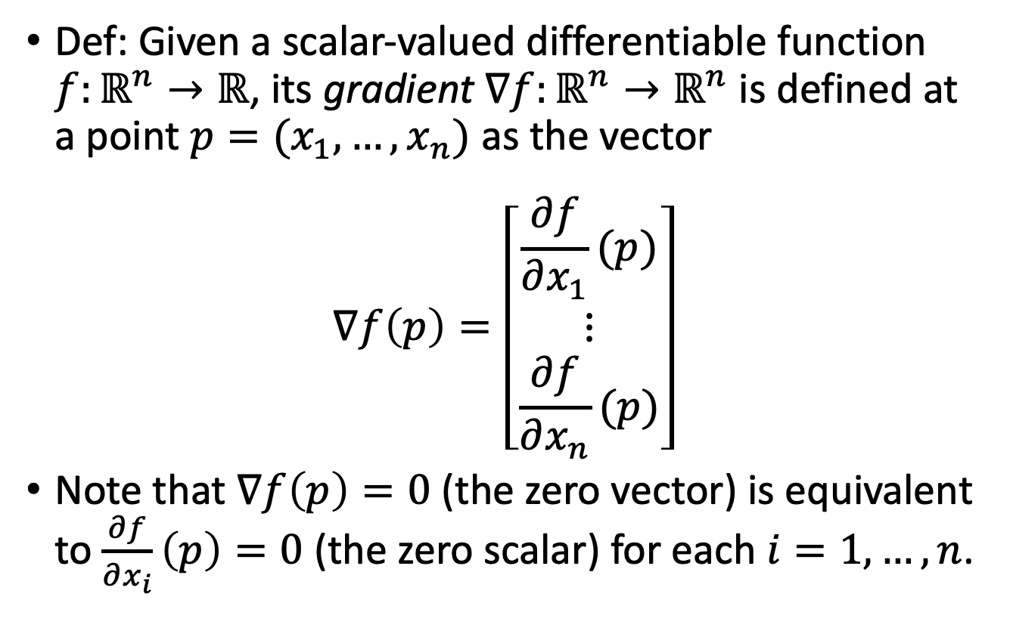
Least Squares Gradient
Def: Given a scalar-valued differentiable function $f:ℝ^{n}→ℝ$, its gradient $∇f:ℝ^{n}→ℝ^{n}$ is defined at a point $p=(x_{1},…,x_{n})$ as the vector
$$∇f\left(p\right)=\left[\begin{matrix}\frac{∂f}{∂x_{1}}(p) \\ ⋮ \\ \frac{∂f}{∂x_{n}}(p)\end{matrix}\right]$$
Note that $∇f\left(p\right)=0$ (the zero vector) is equivalent to $\frac{∂f}{∂x_{i}}\left(p\right)=0$ (the zero scalar) for each $i=1,…,n$.

Slide 10
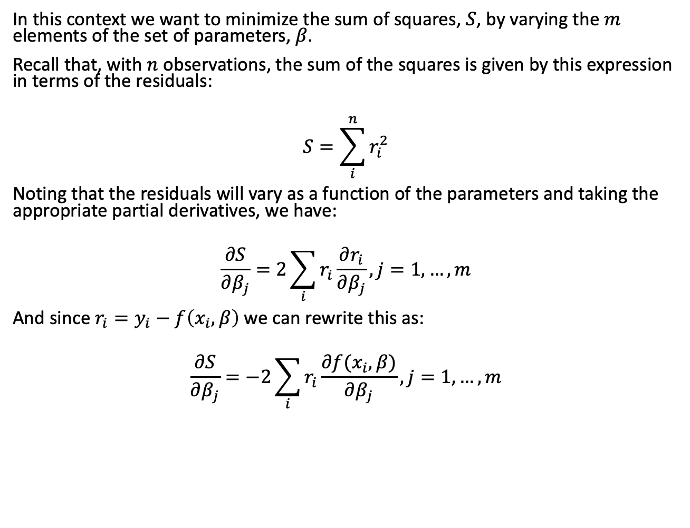
Least Squares Gradient
In this context we want to minimize the sum of squares, $S$, by varying the $m$ elements of the set of parameters, $β$.
Recall that, with $n$ observations, the sum of the squares is given by this expression in terms of the residuals:
$$S=\sum_{i}^{n}{r_{i}^{2}}$$
Noting that the residuals will vary as a function of the parameters and taking the appropriate partial derivatives, we have:
$$\frac{∂S}{∂β_{j}}=2\sum_{i}{r_{i}}\frac{∂r_{i}}{∂β_{j}}, j=1,…,m$$
And since $r_{i}=y_{i}−f\left(x_{i},β\right)$ we can rewrite this as:
$$\frac{∂S}{∂β_{j}}=−2\sum_{i}{r_{i}}\frac{∂f(x_{i},β)}{∂β_{j}}, j=1,…, m$$

Slide 11
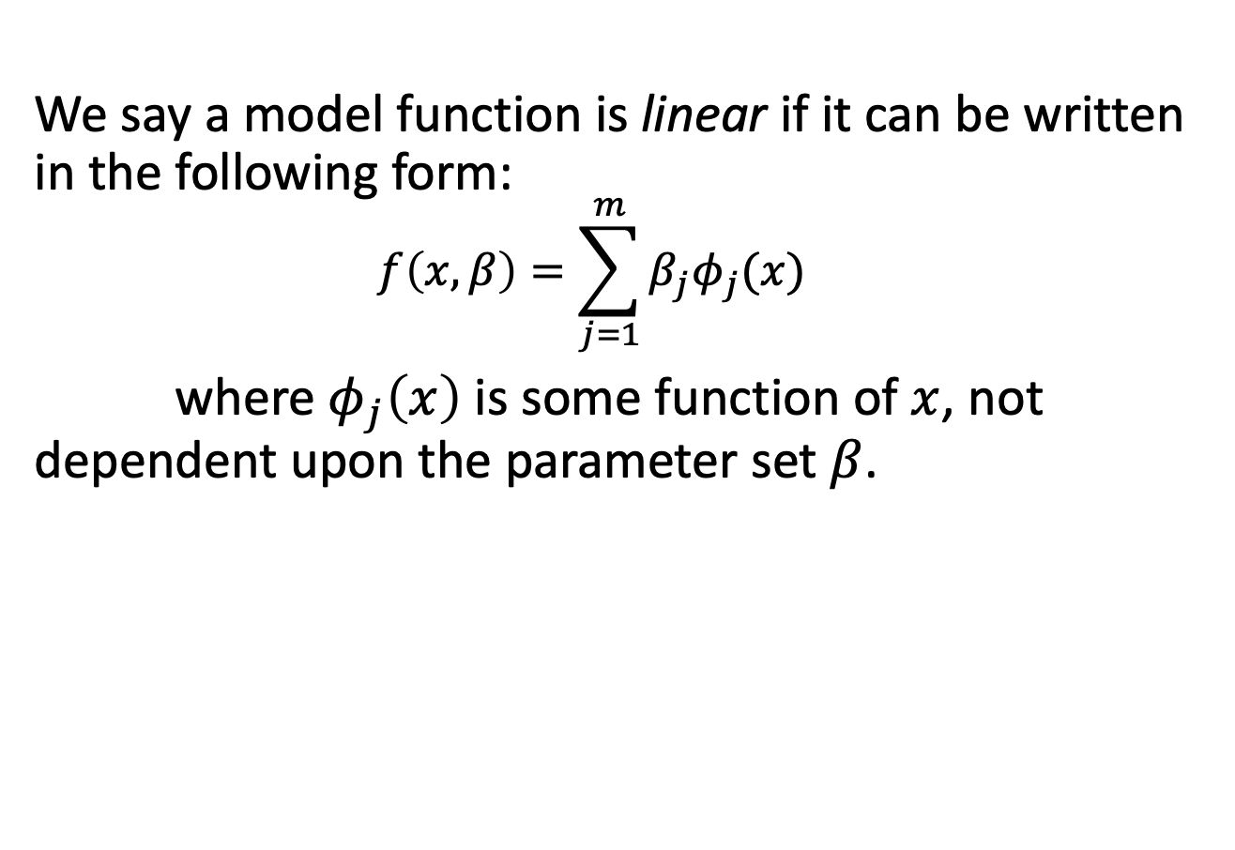
Linear Case
We say a model function is linear if it can be written in the following form:
$$f\left(x,β\right)=\sum_{j=1}^{m}{β_{j}φ_{j}(x)}$$
where $φ_{j}\left(x\right)$ is some function of $x$, not dependent upon the parameter set $β$.

Slide 12
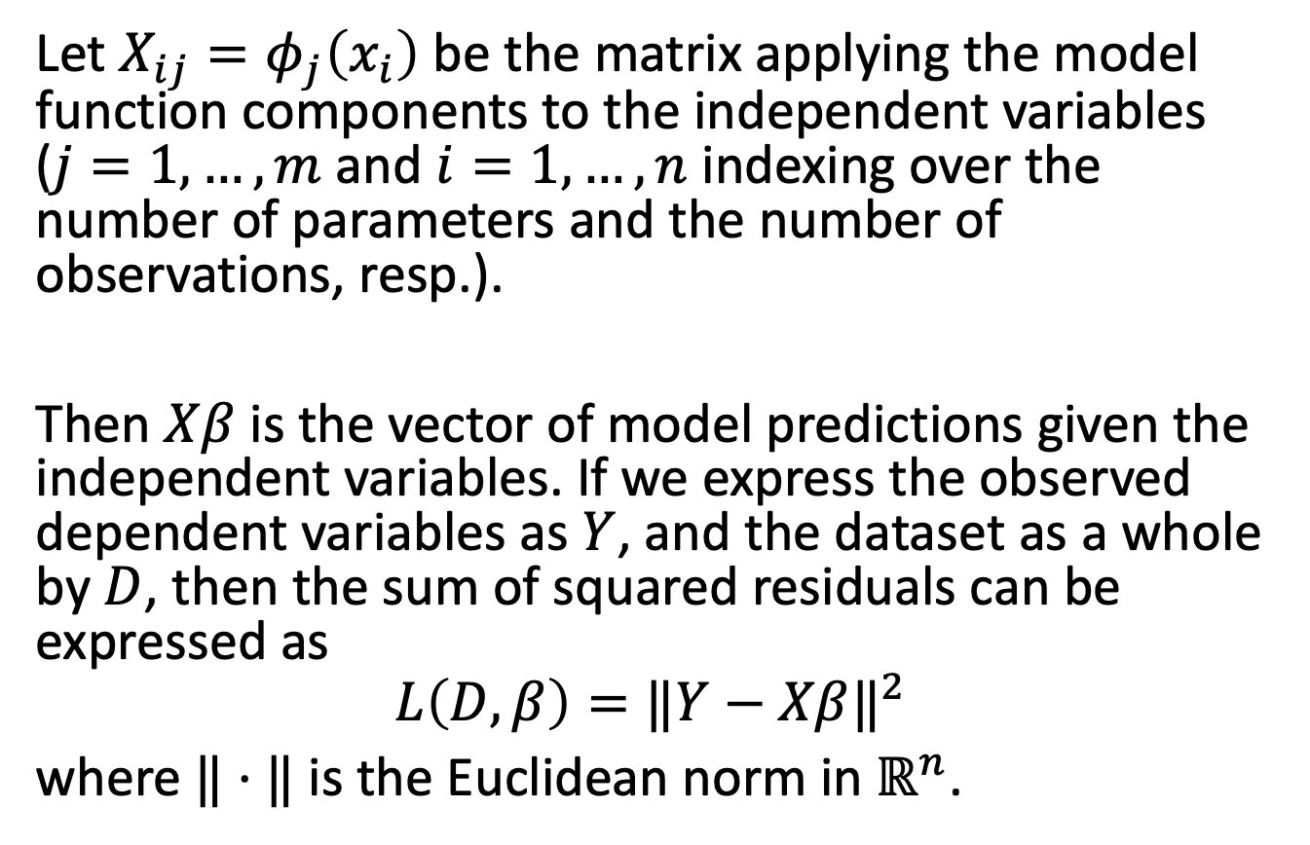
Linear Case
Let $X_{ij}=φ_{j}\left(x_{i}\right)$ be the matrix applying the model function components to the independent variables ($j=1,…,m$ and $i=1,…,n$ indexing over the number of parameters and the number of observations, resp.).
Then $Xβ$ is the vector of model predictions given the independent variables. If we express the observed dependent variables as $Y$, and the dataset as a whole by $D$, then the sum of squared residuals can be expressed as
$$L\left(D,β\right)={‖Y−Xβ‖}^{2}$$
where $‖⋅‖$ is the Euclidean norm in $ℝ^{n}$.
Notes:
Note that if Y is a 1xn vector, we’re comparing distances between n-tuples.

Slide 13
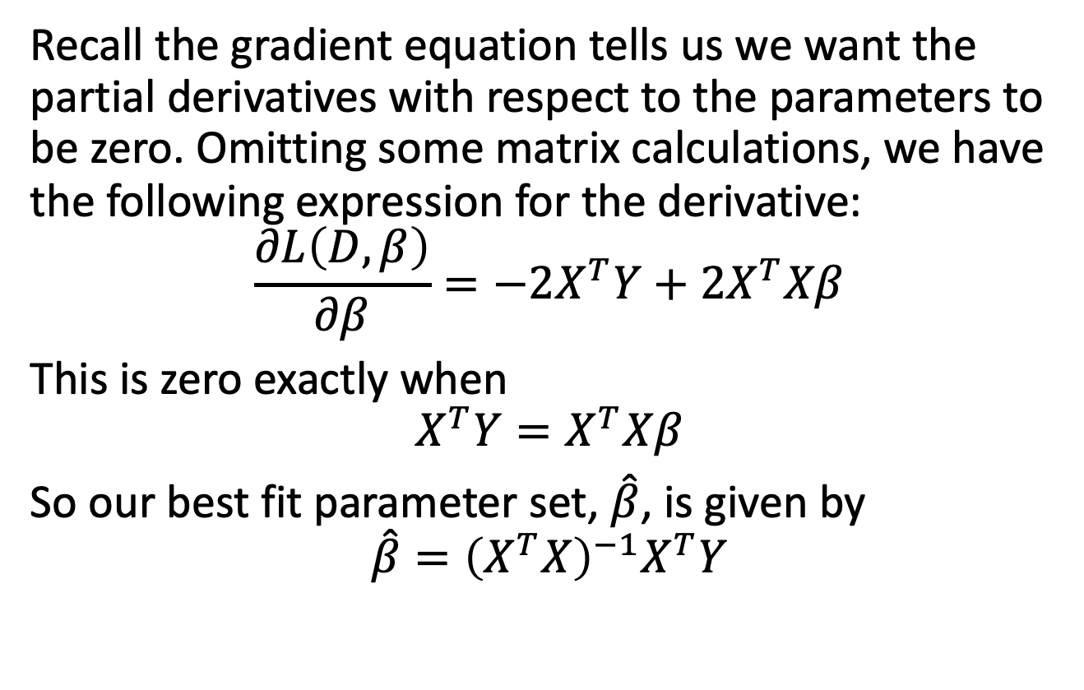
Linear Case
Recall the gradient equation tells us we want the partial derivatives with respect to the parameters to be zero. Omitting some matrix calculations, we have the following expression for the derivative:
$$\frac{∂L\left(D,β\right)}{∂β}=−2X^{T}Y+2X^{T}Xβ$$
This is zero exactly when
$$X^{T}Y=X^{T}Xβ$$
So our best fit parameter set, $\hat{β}$, is given by
$$\hat{β}={\left(X^{T}X\right)}^{−1}X^{T}Y$$
Notes:
Recall X is the matrix of independent variables and Y the vector of dependent variables, with beta the set of parameters for the linear operator.

Slide 14
Nonlinear Case
The linear case has an explicit solution to the least squares problem, as we just saw.
There, the minimum was unique and global. (This follows from a convexity argument.)
Though a few nonlinear model functions admit solutions, this is not the general case.
We aren’t even guaranteed uniqueness of solutions, and the parameter space may have many local minima.
As a result, we typically rely on iterative methods to search the parameter space.
Notes:
Those iterative methods can be stochastic or deterministic, and use various procedures to traverse the parameter space.

Slide 15
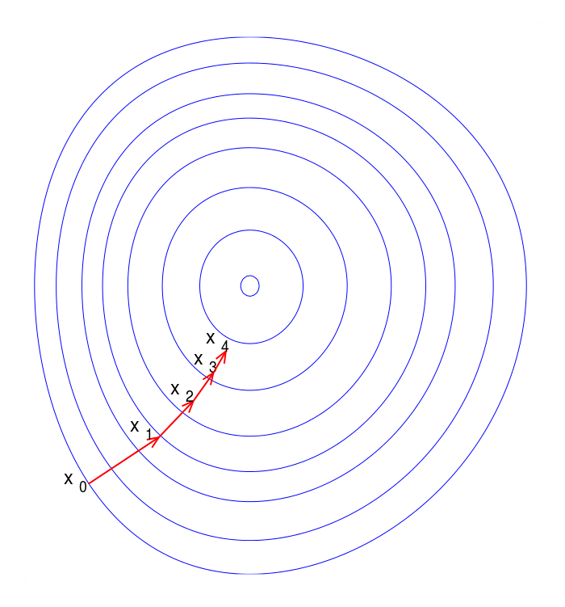
Gradient Descent
Imagine you’re lost on a mountainside, and you’re wanting to get off the mountain as quickly as possible. However, it’s foggy, and you’re only able to see your immediate surroundings. One strategy that you can use is to find the direction of steepest decline in your immediate vicinity, go that way a bit, and re-assess after a few minutes or so of walking.
Notes:
Illustration: Gradient descent on a series of level sets. Note that each step is perpendicular to the level set.

Slide 16
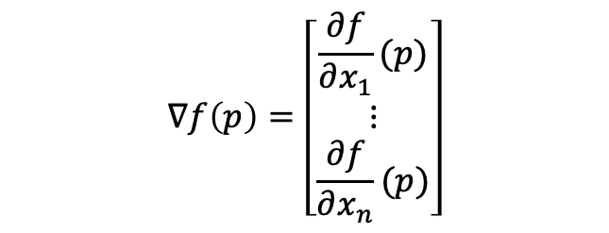
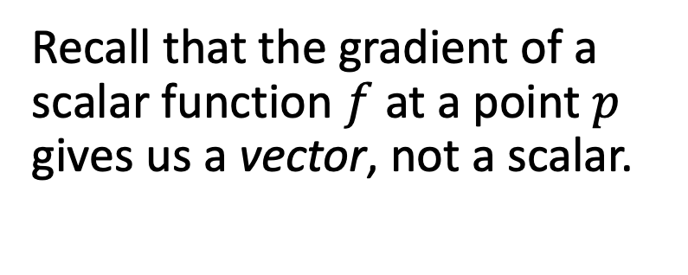
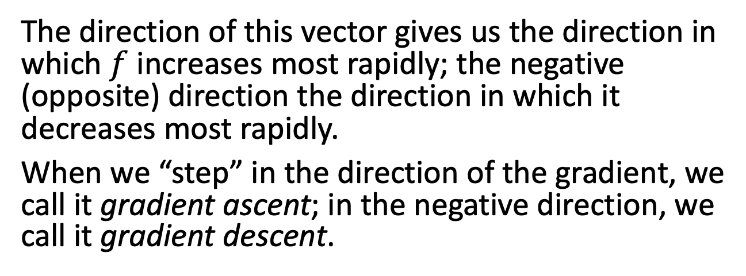
Gradient Descent
Recall that the gradient of a scalar function $f$ at a point $p$ gives us a vector, not a scalar.
$$∇f\left(p\right)=\left[\begin{matrix}\frac{∂f}{∂x_{1}}(p) \\ ⋮ \\ \frac{∂f}{∂x_{n}}(p)\end{matrix}\right]$$
The direction of this vector gives us the direction in which $f$ increases most rapidly; the negative (opposite) direction the direction in which it decreases most rapidly.
When we “step” in the direction of the gradient, we call it gradient ascent; in the negative direction, we call it gradient descent.

Slide 17
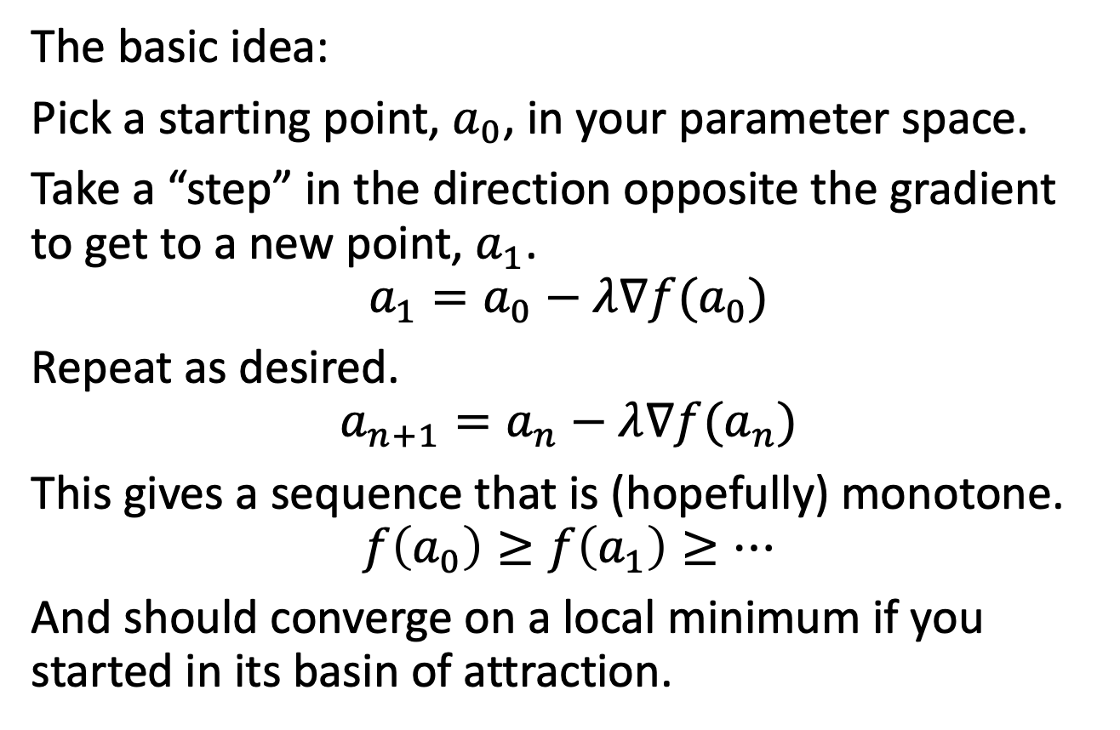
Gradient Descent
The basic idea:
Pick a starting point, $a_{0}$, in your parameter space.
Take a “step” in the direction opposite the gradient to get to a new point, $a_{1}$.
$$a_{1}=a_{0}−λ∇f(a_{0})$$
Repeat as desired.
$$a_{n+1}=a_{n}−λ∇f(a_{n})$$
This gives a sequence that is (hopefully) monotone.
$$f\left(a_{0}\right)≥f\left(a_{1}\right)≥…$$
And should converge on a local minimum if you started in its basin of attraction.
Notes:
The negative in the formula is because we’re moving opposite the gradient. Gradient ascent would have +.

Slide 18
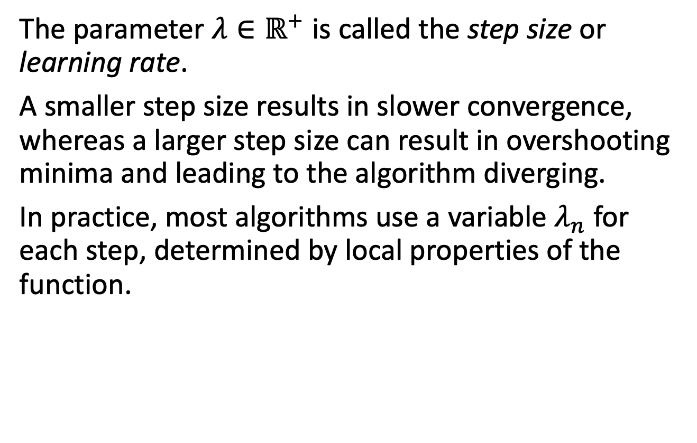
Gradient Descent
The parameter $λ∈ℝ^{+}$ is called the step size or learning rate.
A smaller step size results in slower convergence, whereas a larger step size can result in overshooting minima and leading to the algorithm diverging.
In practice, most algorithms use a variable $λ_{n}$ for each step, determined by local properties of the function.
Notes:
The different ways of dealing with $γ_{n}$ are the primary distinguishing features of different instantiations of the gradient descent technique. For example, if f is twice-differentiable, we can use information about the Hessian matrix. Line search methods can also be used to optimize the step size. Each method has conditions in which it may be favored over another method based on properties of the function f.

Slide 19
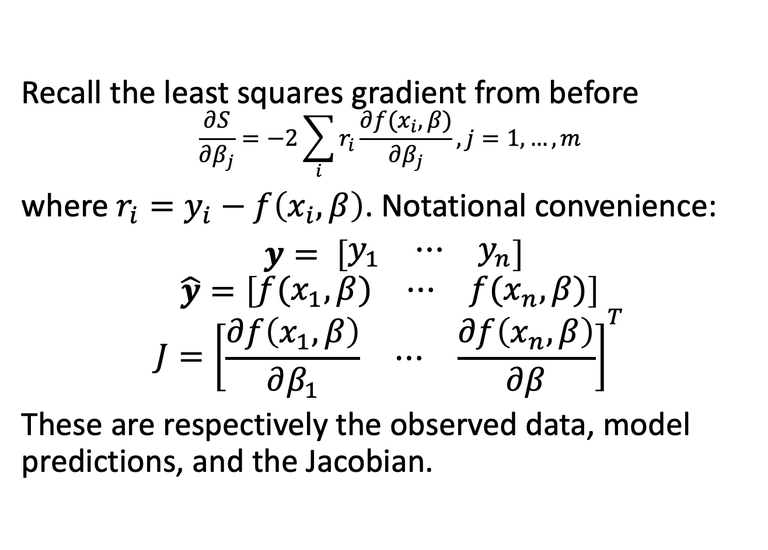
Gradient Descent
Recall the least squares gradient from before
$$\frac{∂S}{∂β_{j}}=−2\sum_{i}{r_{i}}\frac{∂f(x_{i},β)}{∂β_{j}}, j=1,…, m$$
where $r_{i}=y_{i}−f\left(x_{i},β\right)$. Notational convenience:
$y= \left[\begin{matrix}y_{1} & ⋯ & y_{n}\end{matrix}\right]$
$$\hat{y}=\left[\begin{matrix}f(x_{1},β) & ⋯ & f(x_{n},β)\end{matrix}\right]$$
$$J={\left[\begin{matrix}\frac{∂f\left(x_{1},β\right)}{∂β_{1}} & ⋯ & \frac{∂f\left(x_{n},β\right)}{∂β}\end{matrix}\right]}^{T}$$
These are respectively the observed data, model predictions, and the Jacobian.

Slide 20
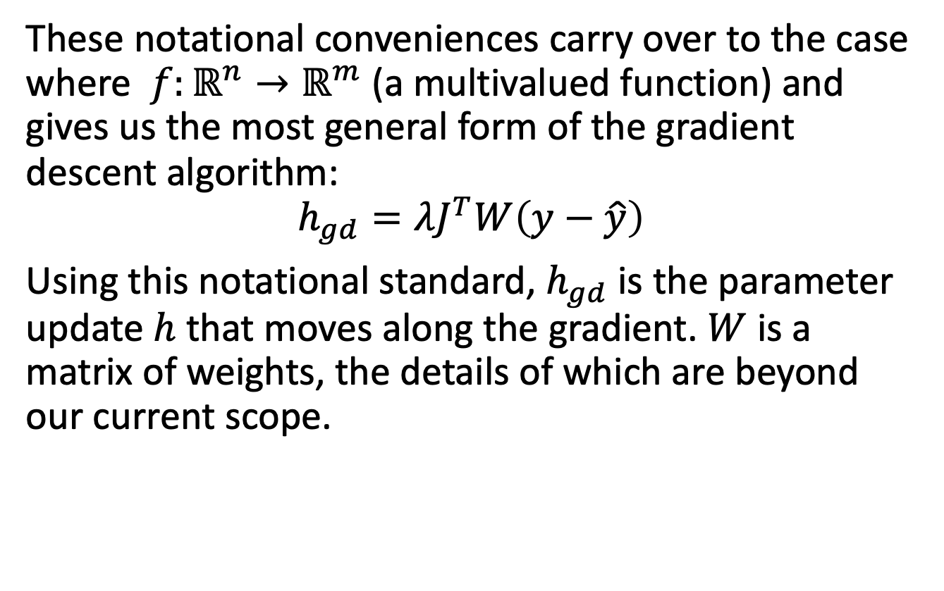
Gradient Descent
These notational conveniences carry over to the case where $f:ℝ^{n}→ℝ^{m}$ (a multivalued function) and gives us the most general form of the gradient descent algorithm:
$$h_{gd}=λJ^{T}W\left(y−\hat{y}\right)$$
Using this notational standard, $h_{gd}$ is the parameter update $h$ that moves along the gradient. $W$ is a matrix of weights, the details of which are beyond our current scope.
Notes:
I’m introducing this notation because this is the notation ultimately used in the Matlab documentation for these procedures.

Slide 21
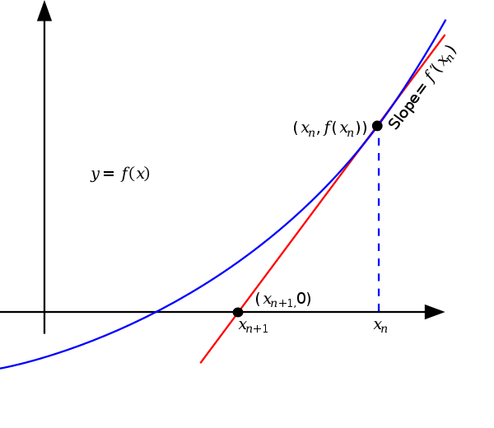
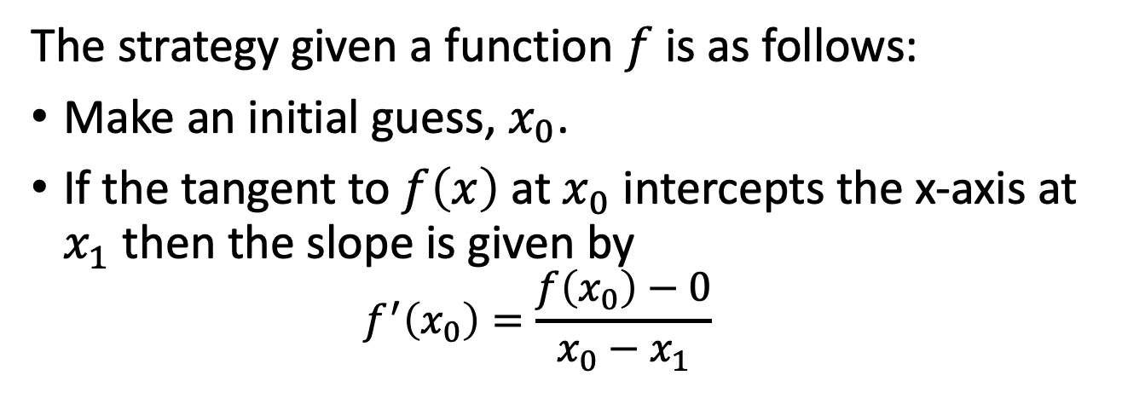
Gauss-Newton Method
We start by considering Newton-Raphson’s method, a technique for finding zeros of a function using the tangent line.
The strategy given a function $f$ is as follows:
Make an initial guess, $x_{0}$.
If the tangent to $f\left(x\right)$ at $x_{0}$ intercepts the x-axis at $x_{1}$ then the slope is given by
$$f^{′}\left(x_{0}\right)=\frac{f\left(x_{0}\right)−0}{x_{0}−x_{1}}$$

Slide 22


Gauss-Newton Method
Solving for $x_{1}$ gives
$$x_{1}=x_{0}−\frac{f\left(x_{0}\right)}{f^{′}\left(x_{0}\right)}$$
Iterate as desired, with the update rule
$$x_{n+1}=x_{n}−\frac{f\left(x_{n}\right)}{f^{′}\left(x_{n}\right)}$$
Note that this requires the function $f$ be differentiable and that $f^{′}\left(x_{n}\right)≠0$ at each step.
Notes:
You may hear this referred to as using the first order Taylor series approximation. This is because the first order Taylor series approximation is exactly the linearization.

Slide 23
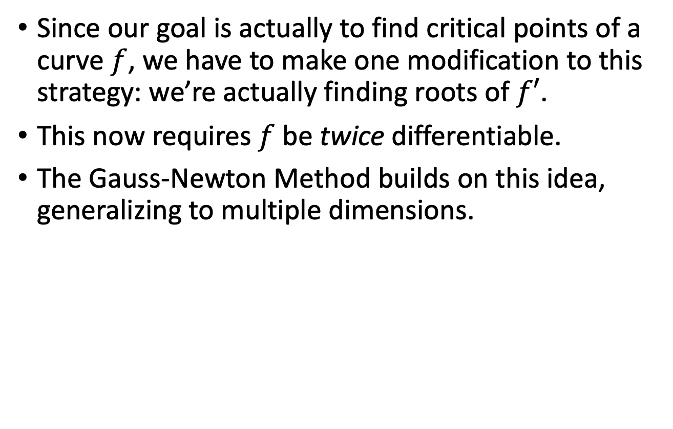
Gauss-Newton Method
Since our goal is actually to find critical points of a curve $f$, we have to make one modification to this strategy: we’re actually finding roots of $f′$.
This now requires $f$ be twice differentiable.
The Gauss-Newton Method builds on this idea, generalizing to multiple dimensions.

Slide 24
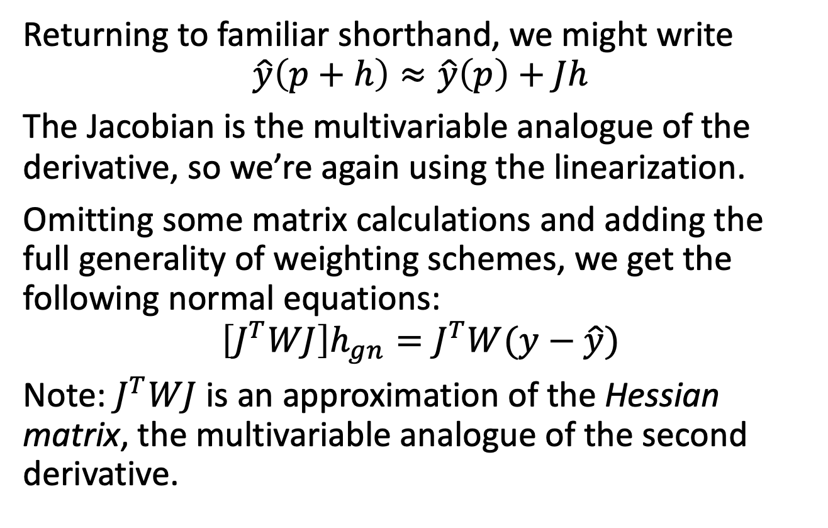
Gauss-Newton Method
Returning to familiar shorthand, we might write
$$\hat{y}\left(p+h\right)≈\hat{y}\left(p\right)+Jh$$
The Jacobian is the multivariable analogue of the derivative, so we’re again using the linearization.
Omitting some matrix calculations and adding the full generality of weighting schemes, we get the following normal equations:
$$\left[J^{T}WJ\right]h_{gn}=J^{T}W(y−\hat{y})$$
Note: $J^{T}WJ$ is an approximation of the Hessian matrix, the multivariable analogue of the second derivative.
Notes:
Recall h_gn is the parameter update. Notice that the RHS looks pretty similar to the gradient descent method.

Slide 25
Levenberg-Marquardt Method
In general, Gauss-Newton tends to converge faster but puts more structural constraints on the problem and is more sensitive to the initial guess.
The Hessian approximation in the latter is useful (it’s extra info about curvature!) but it’s more fragile (it’s ill-conditioned if you’re not near a root).
Levenberg-Marquardt combines the two methods for something more robust.
Notes:
The Hessian approximation is the main reason Gauss-Newton both converges faster (it’s using information from the curvature) and is more fragile (being further from the root you’re looking for results in the approximation being poorly conditioned). The correction vector can even point *away from* the general direction of descent and diverge in many cases!

Slide 26
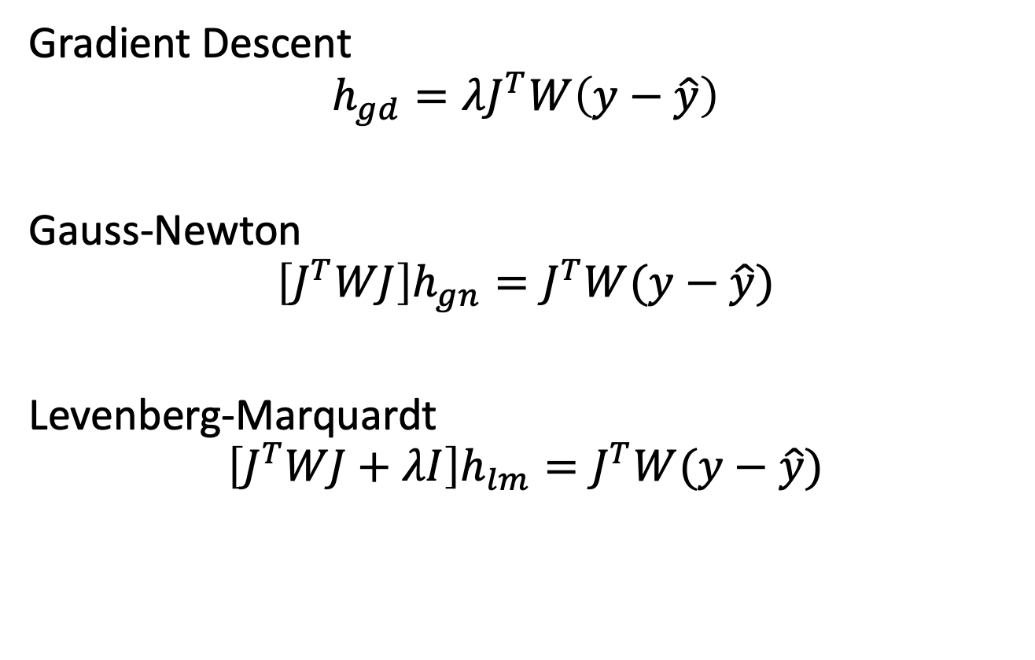
Levenberg-Marquardt Method
Gradient Descent
$$h_{gd}=λJ^{T}W\left(y−\hat{y}\right)$$
Gauss-Newton
$$\left[J^{T}WJ\right]h_{gn}=J^{T}W(y−\hat{y})$$
Levenberg-Marquardt
$$\left[J^{T}WJ+λI\right]h_{lm}=J^{T}W(y−\hat{y})$$
Notes:
Why did I change over to the slightly less transparent notation in both? Well, because it’s the best way to combine the two algorithms. I is the identity matrix.

Slide 27
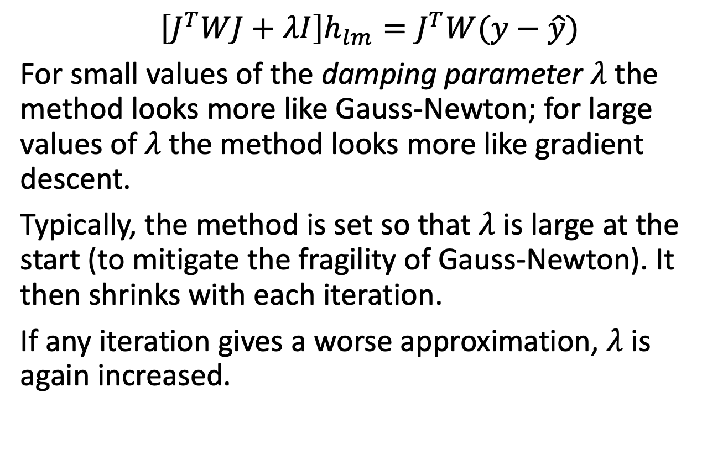
Levenberg-Marquardt Method
$$\left[J^{T}WJ+λI\right]h_{lm}=J^{T}W(y−\hat{y})$$
For small values of the damping parameter $λ$ the method looks more like Gauss-Newton; for large values of $λ$ the method looks more like gradient descent.
Typically, the method is set so that $λ$ is large at the start (to mitigate the fragility of Gauss-Newton). It then shrinks with each iteration.
If any iteration gives a worse approximation, $λ$ is again increased.

Slide 28
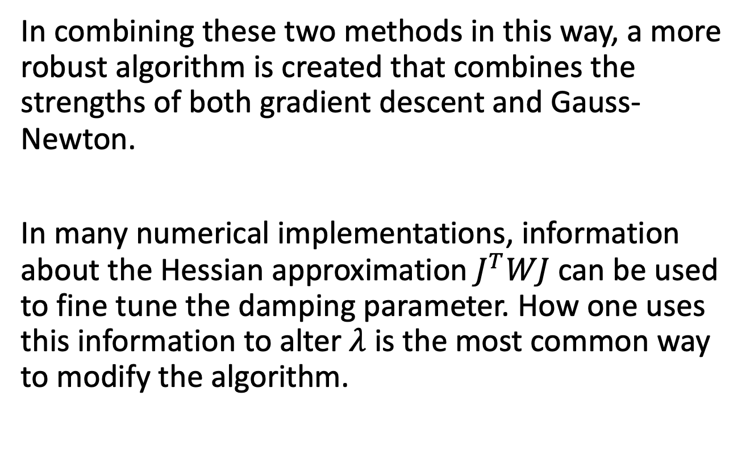
Levenberg-Marquardt Method
In combining these two methods in this way, a more robust algorithm is created that combines the strengths of both gradient descent and Gauss-Newton.
In many numerical implementations, information about the Hessian approximation $J^{T}WJ$ can be used to fine tune the damping parameter. How one uses this information to alter $λ$ is the most common way to modify the algorithm.

Slide 29
Questions?

