Slide 1

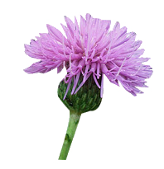
Bloom Filters
An Interactive scriptable implementation
Msc in Informatics & Multimedia
Department of Informatics Engineering TEI of Crete
Tσαγκατάκης Γιάννης
jtsagata@gmail.com

Slide 2
What is a bloom filter
A set like data structure
  a bit array of m bits
  k different hash functions
    independent and uniformly distributed
    md5, hashmix, crypto hashes, murmur, fnv
Operations
  add(data)
  exists?(data)
Missing operations !!
  delete, count, enumerate
Operation exists?() is not working !

Slide 3
It’s a useless data structure
Spell Checkers
Forbidden password lists
Bad sites list (chrome)
Yahoo mail (contact list)
Internet cache protocol (ICP) Request handling
Bitcoin network (SPV nodes)
medium ,avoid recommend previously read articles
Squid web proxy, for cache digests
Databases: postgresq, cassandra, HBase, google Bigtable

Slide 4

Physical analogy
Is it possible that my set contains a particular element ?
Quora: How do bloom filters work?

Slide 5

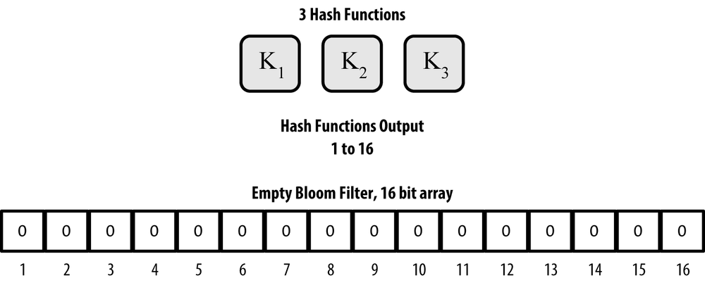
The data structure : Organization
An example of a bloom filter, with a 16-bit field and three hash functions.
Mastering Bitcoin by Andreas M. Antonopoulos

Slide 6
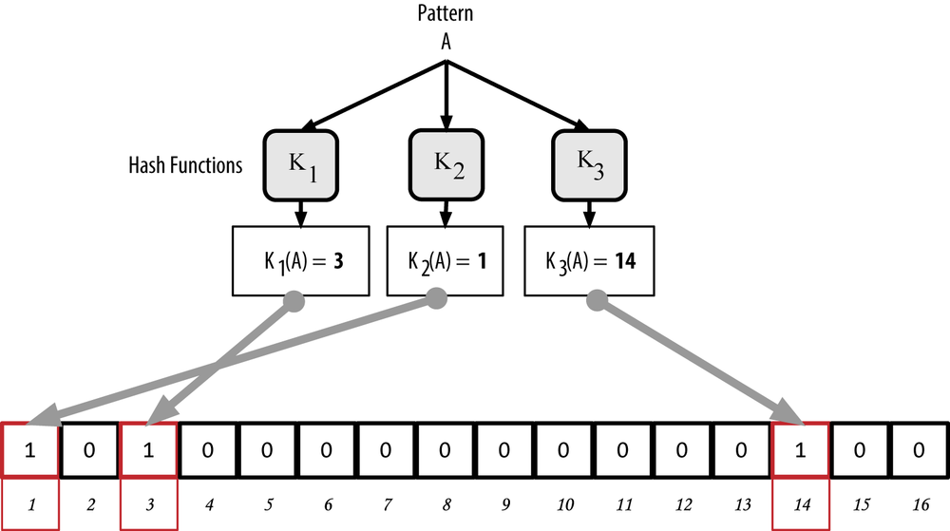
The data structure : Inserting
Adding pattern “A”
Mastering Bitcoin by Andreas M. Antonopoulos

Slide 7
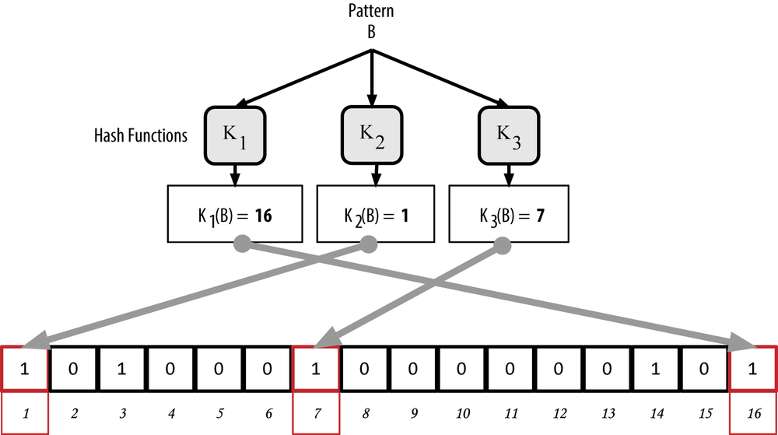
The data structure : Inserting more
Adding the pattern “B”
Mastering Bitcoin by Andreas M. Antonopoulos

Slide 8
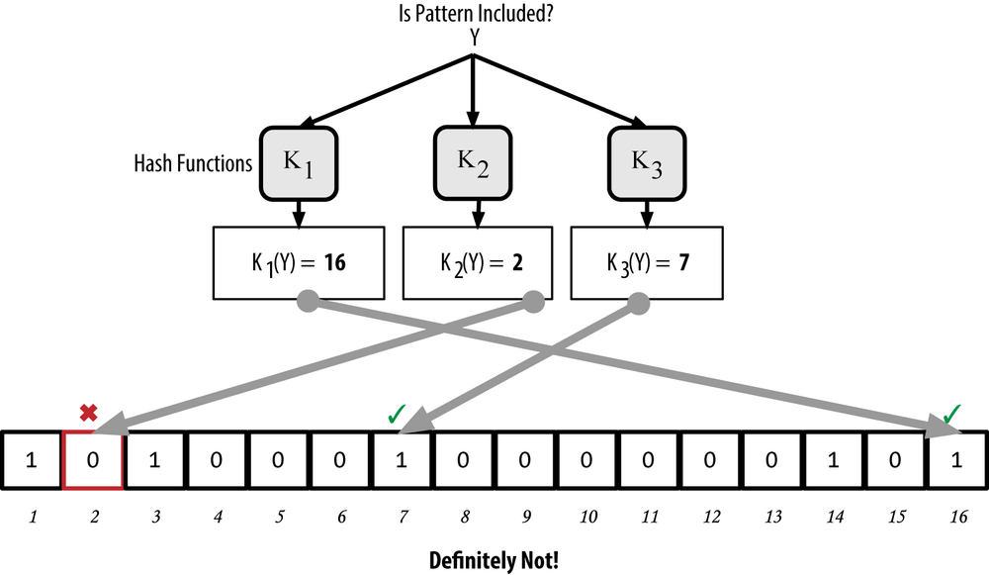
The data structure : Testing
Mastering Bitcoin by Andreas M. Antonopoulos

Slide 9
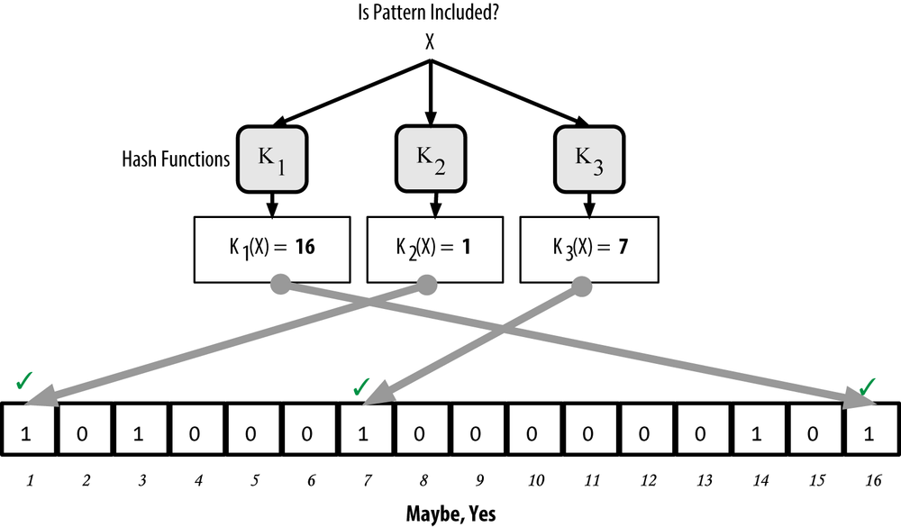
The data structure : Testing
Mastering Bitcoin by Andreas M. Antonopoulos

Slide 10




The Verdict
True
False
Exists
TRUE POSITIVE
FALSE NEGATIVE
Never !
Absent
FALSE POSITIVE
TRUE NEGATIVE
Probably YES /Always NO

Slide 11
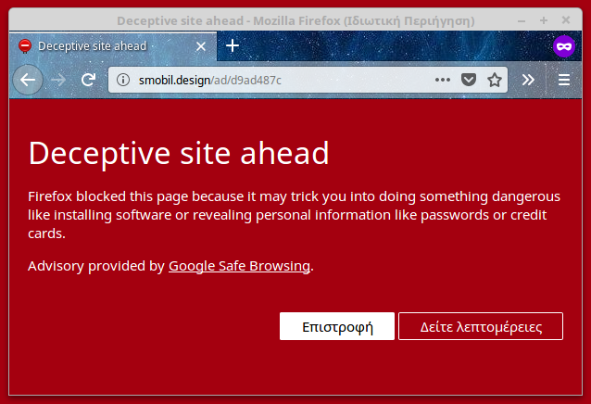
Example: Chrome Safe Browsing
The problem
  1 million URLs of malicious web sites
  Is this URL safe to browse ?
  Avoid going at the network.
The solution
  A 18MB bloom filter
  9.6 bits per site (almost a byte)
  False positive 1%
    Go and check at a web service
http://blog.alexyakunin.com/2010/03/nice-bloom-filter-application.html

Slide 12
Tools used
C++14
  Clang++ v7
  Boost libraries
  AmokHuginnsson/replxx
Clion IDE
Cmake / ninja
Doxygen with LaTeX

Slide 13
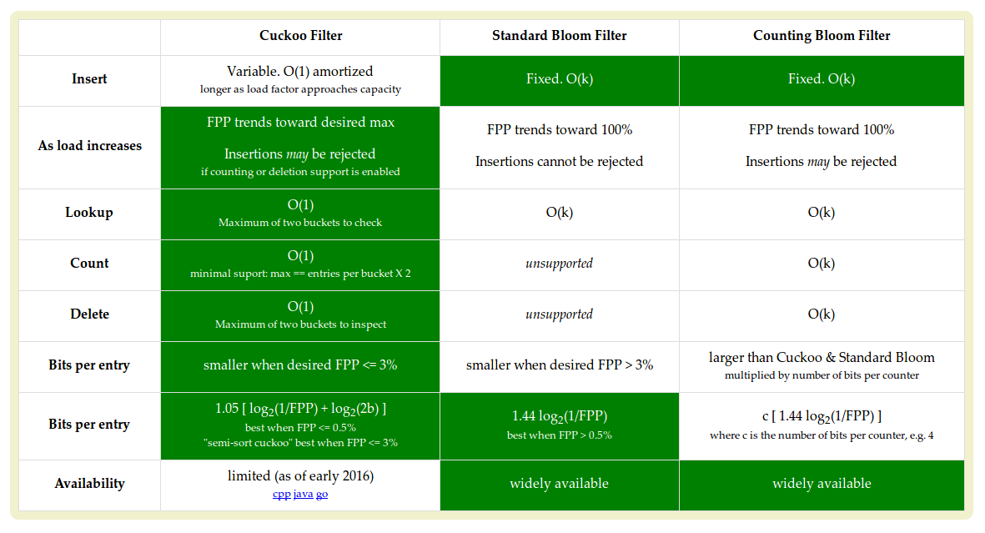
Extensions and alternatives
https://bdupras.github.io/filter-tutorial/

Slide 14
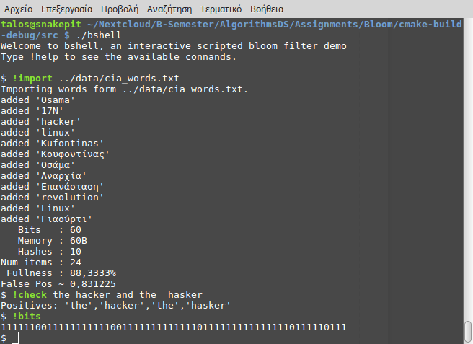
Interactive demo: Hash collision

Slide 15
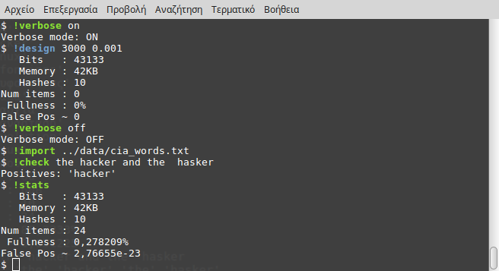
Interactive demo: Design a bloom filter

Slide 16

Questions
One hash makes you member
And one hash makes you not
And the hash that std gives you give false positives at all
If bits are low follow Alice

