Slide 1
Real Time Filter Implementation
On FPGA board
Ioannis Tsagkatakis
Karim Sherif

Slide 2
Part 1 Hardware Design
Filter bank
  Filter Chooser
  Multiplier
    Adder
  Zipper
Cache mem
  Fifo_buffer_3
  FIFO IP Core
Filter Controller
Controller Enable

Slide 3
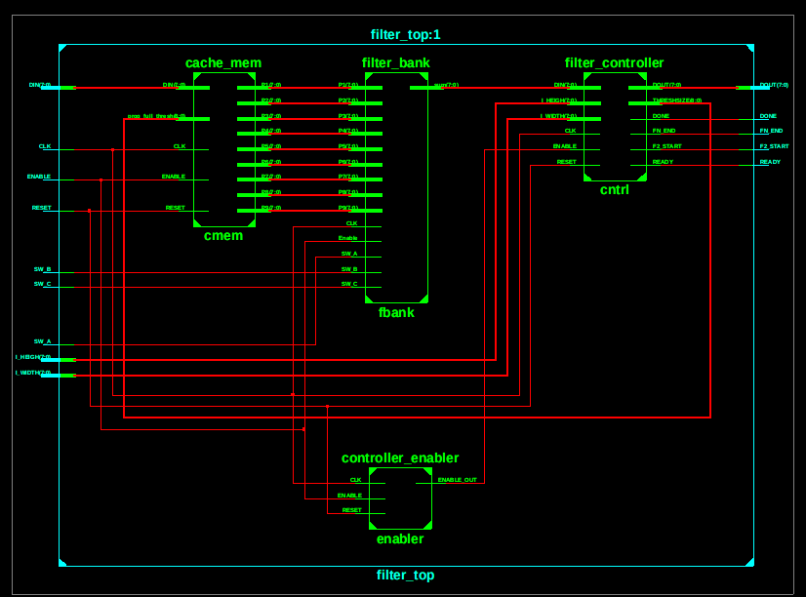
Top Level

Slide 4
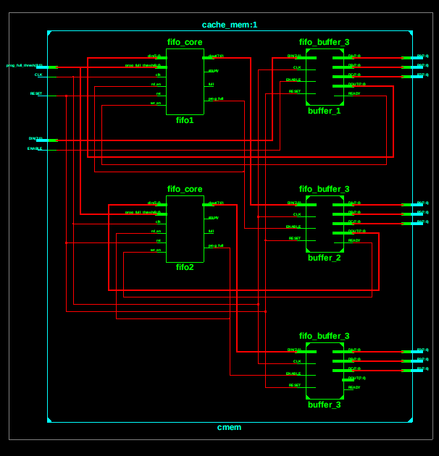
Top Level :: CacheMem

Slide 5
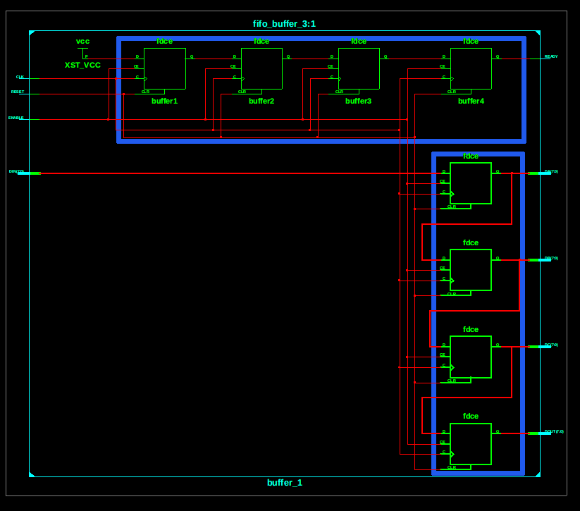
Top Level :: CacheMem :: Fifo Buffer

Slide 6
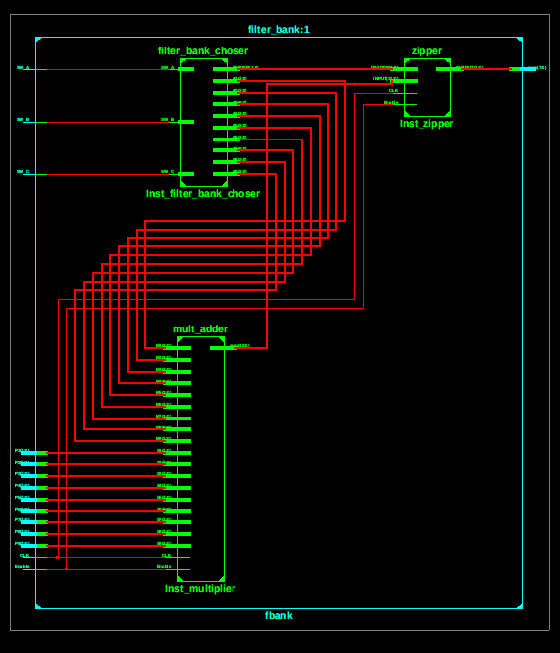
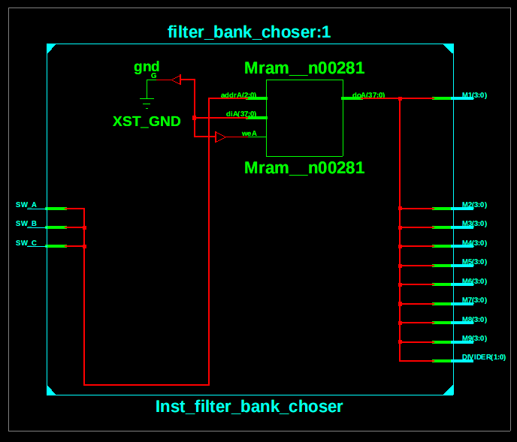
Top Level :: Filter Bank

Slide 7
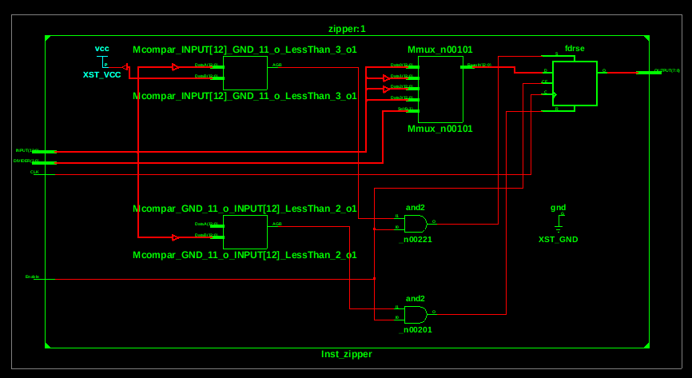
Top Level :: Filter Bank :: Zipper

Slide 8
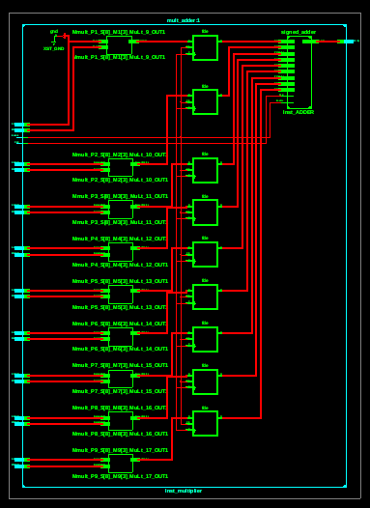
Top Level :: Filter Bank :: MADD

Slide 9
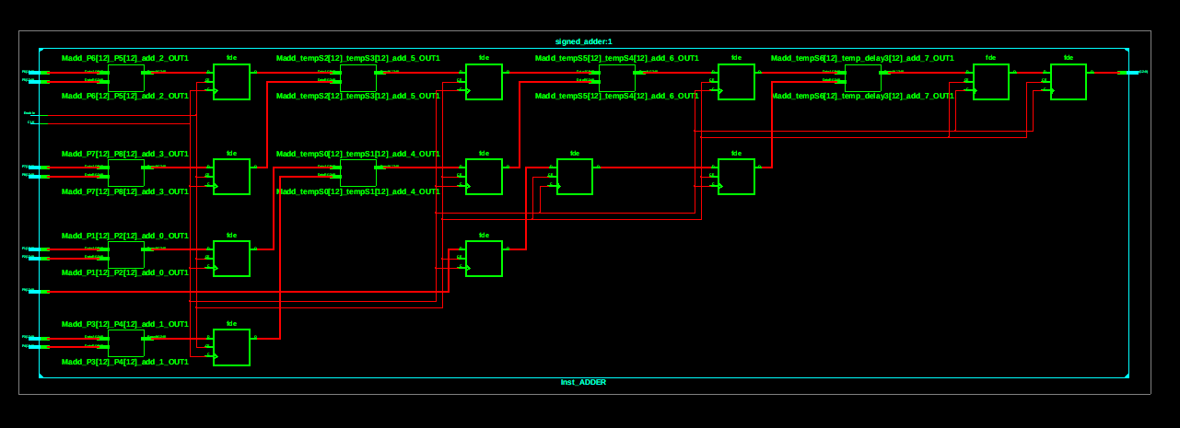
Top Level::Filter Bank :: MADD:: ADD

Slide 10
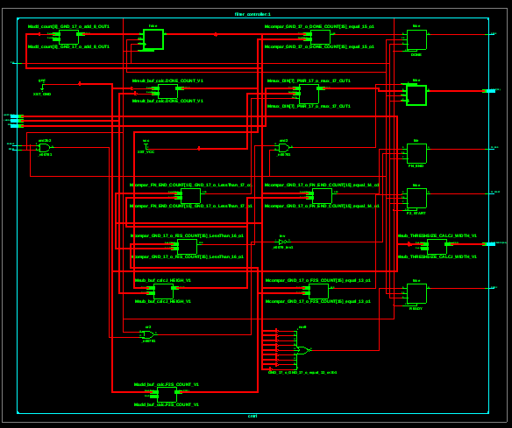
Top Level :: Control Logic

Slide 11
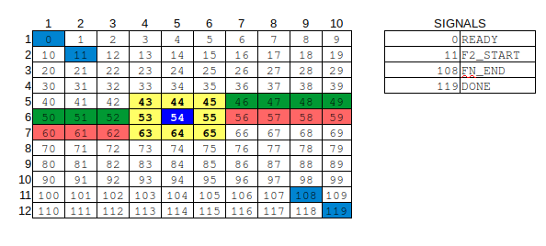
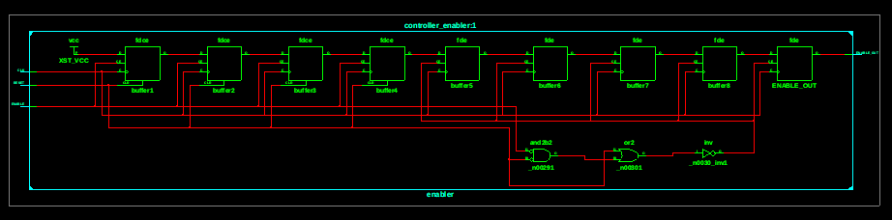
Top Level :: Control Logic

