Slide 1
An optimal keyboard layout for the Greek Language
Using Evolutionarily Algorithms
Giannis Tsagatakis
https://github.com/jtsagata
mtp164@edu.teicrete.gr
Computational Intelligence
Prof G. Papadourakis
Department of Informatics Engineering
TEI of Crete
Msc in Informatics & Multimedia

Slide 2
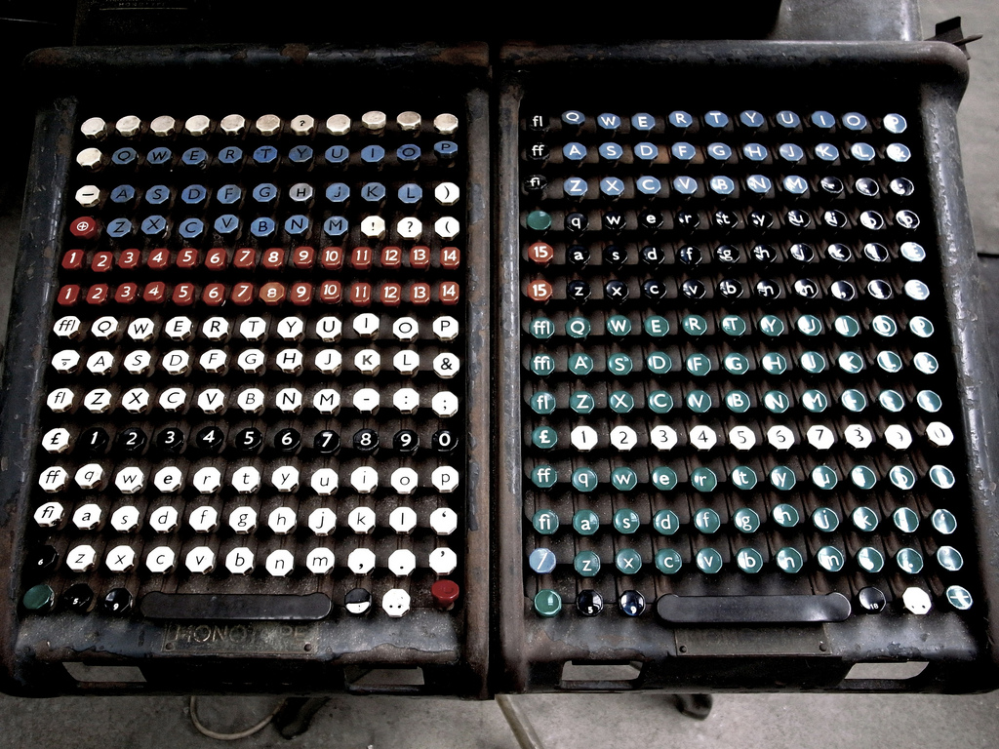
Origins
Linotype
1970 -1980

Slide 3
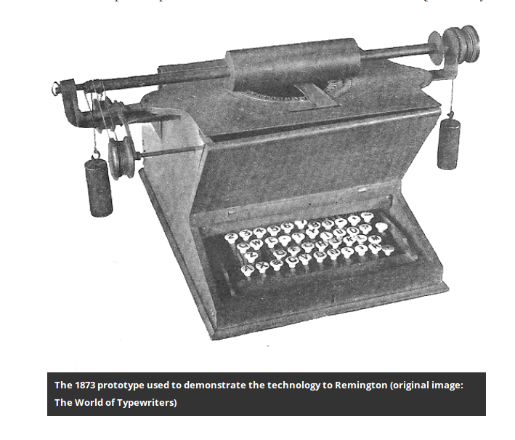
The Origins QUERTY
Sholes and Gliden typewriter
Remington in 1873
Remington 2 1878

Slide 4
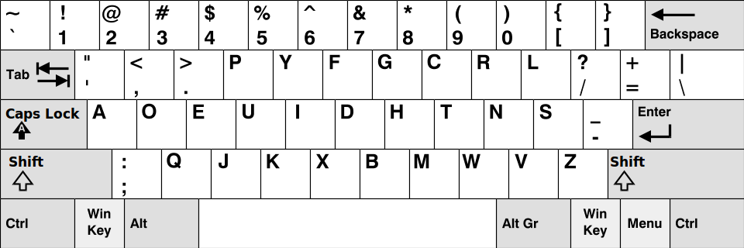
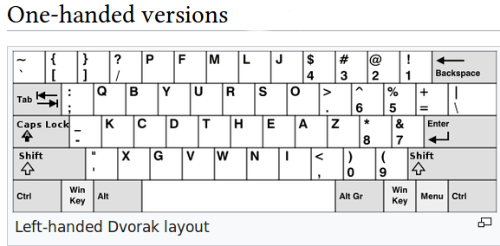
A better Way Dvorak Simplified
August Dvorak 1932
ANSI 1991

Slide 5
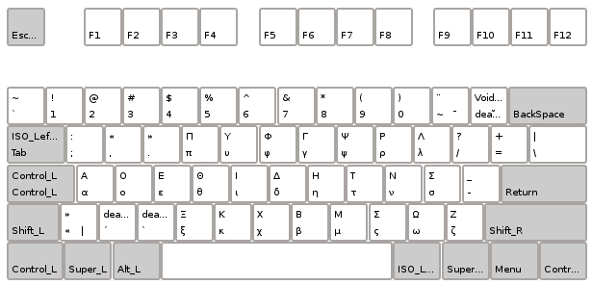
Greek Dvorak ?
What Did the Dvorak ever done to us ?
No Greek layout based on Dvorak exists (afaik)
Based on scientific work
Greek QUERTY layout is even worst
  Accent characters
  Polytonic
http://thelibrarybasement.com/2012/02/18/polytonic-greek-in-dvorak-layout-for-linux/

Slide 6


Resistance
Κυρ Στέφανε, Βάλε και Antivirus, Τρέχω Windows, Και Windows 10 Βάλε και μνήμες Κυρ Στέφανε

Slide 7
Seeking a better
Keyboard Layout
for The Greek Language

Slide 8
Typing Effort
Limited use of bottom row
Increase use of home row
Limited same finger typing
Balanced use of of both hands (debate «ui» vs «ts»)
Limited use of weak fingers (debate pinky and ring)
(Stroke path) Triads 3-key effort

Slide 9
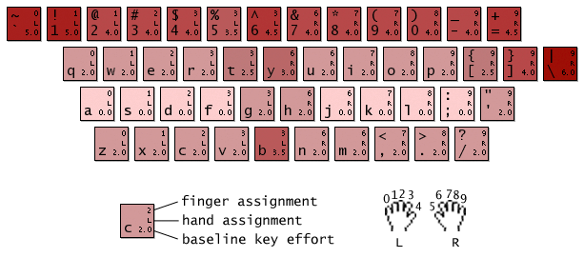
Base Effort
total distance traveled by fingers during typing

Slide 10
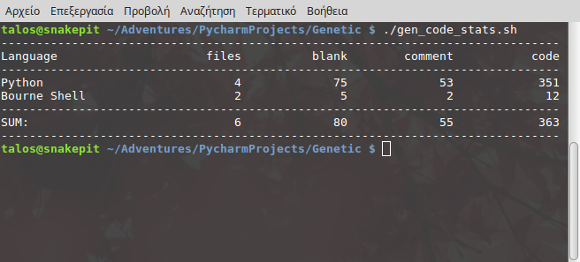
Initial Implementation
https://github.com/jtsagata/keyboard-monkey
In Python
From Scratch
351 LOC Working
Need more work

Slide 11
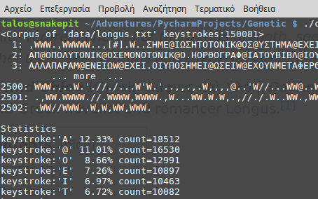
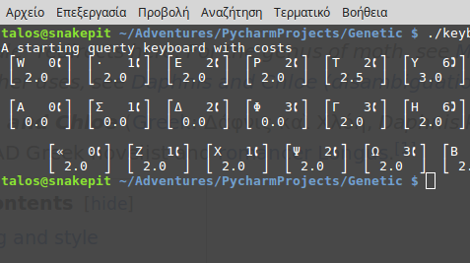
Implementation Details :1
The Corpus Class
Convert a corpus text to keystrokes
Using ‘greek tonos’
Removes other characters noise
Daphnis and Chloe by Longus (2 century AD)
The Keyboard Class
Hardware details
Mutation / crossover operations
Export as png/pdf
Generate layout for X11
‘Levenstein’ distance

Slide 12
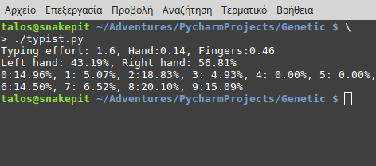
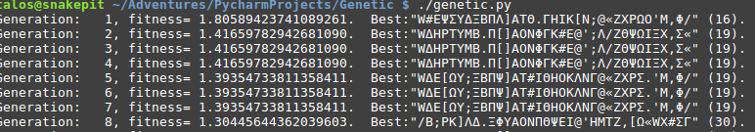
Implementation Details :2
The Typist Class
The Algorithm
Evolutionary (NO DNA)
Multicore Evaluation
Still needs tuning
Lots to be done
Working
Types a Corpus Text on a Keyboard
Statistics
Typing Effort

Slide 13
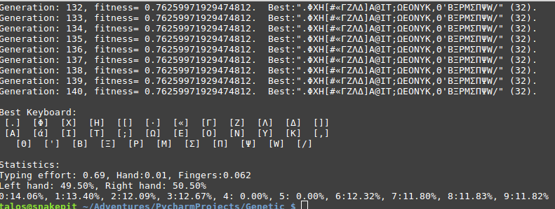
A First “Good” Layout
TODO: Show and calculate population stats
TODO: Graph and reports module
TODO: Parameters Class
TODO: History Object

Slide 14
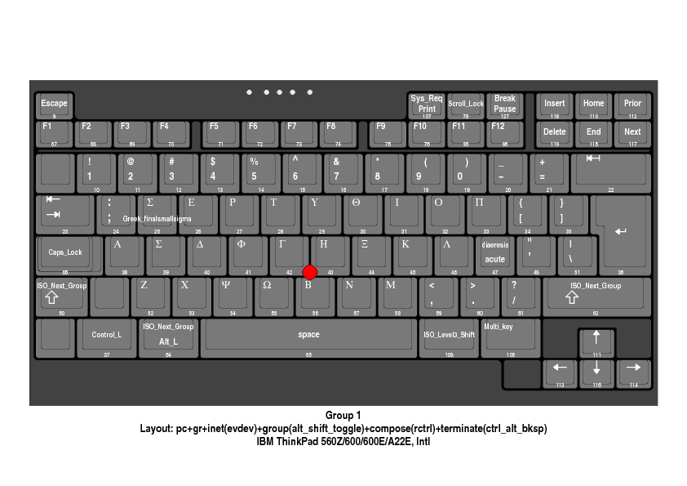
Deliverables (TODO)
X11 Keyboards for evaluation and testing
Produce windows .klc files ?
If there is time to implement

Slide 15
Future Project Ideas :1
A Keyboard Layout for the C++/Java crowd.
Alternative Physical keyboards Layouts
(see next slide)
A Greek/English Keyboard Multi-Layout
  What English keyboard ?
  (Qwerty, Dvorak, Colemak, custom)
  Same location of Letters
    Good Idea? (‘cross scripting’ font rendering)
    Adoption Strategy ?
A Custom hardware one handed implementation

Slide 16
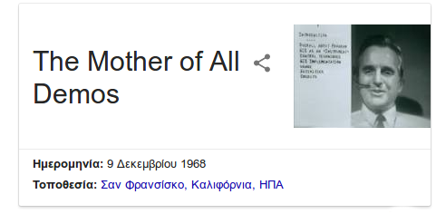
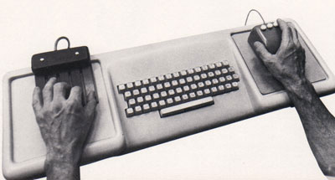
Future Project Ideas :2
Design a totally custom keyboard
  Hardware implementation
  One handed
  Based on FrogPad
  Engelbart NLS idea
NLS, or the "oN-Line System"
The Mother of All Demos
Douglas Engelbart
9 December, 1968

Slide 17
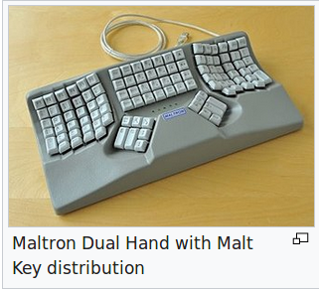
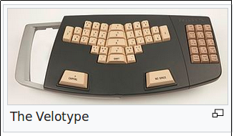
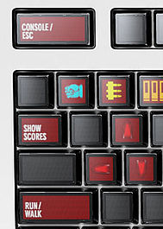
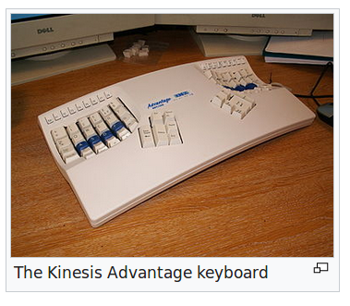
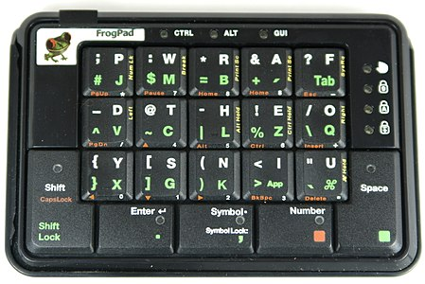
Keyboards
Optimus Maximus

Slide 18
Implementations
The Carplax Project
http://mkweb.bcgsc.ca/carpalx/ (Perl)
https://github.com/wincent/yak-layout (Racket)
https://github.com/ajnirp/keyboard-layout (LISP)
http://mtgap.bilfo.com/keyboard.html (Ruby)
https://bitbucket.org/ArneBab/evolve-keyboard-layout (Python)
Many good implementations of genetic algorithms in Python and other languages

Slide 19
Literature
Toward Optimal Arabic Keyboard Layout Using Genetic Algorithm, Malas et all, MESM 2008, Amman, Jordan
The Standard and Dvorak Keyboards Revisited: Direct Measures of Speed, Leonard, J. West, SFI Working Paper 1998
Fact or Fiction? The Legend of the QUERTY Keyboard, Jimmy Stamp, Smithonian Magazine 2013 (available online)

Slide 20
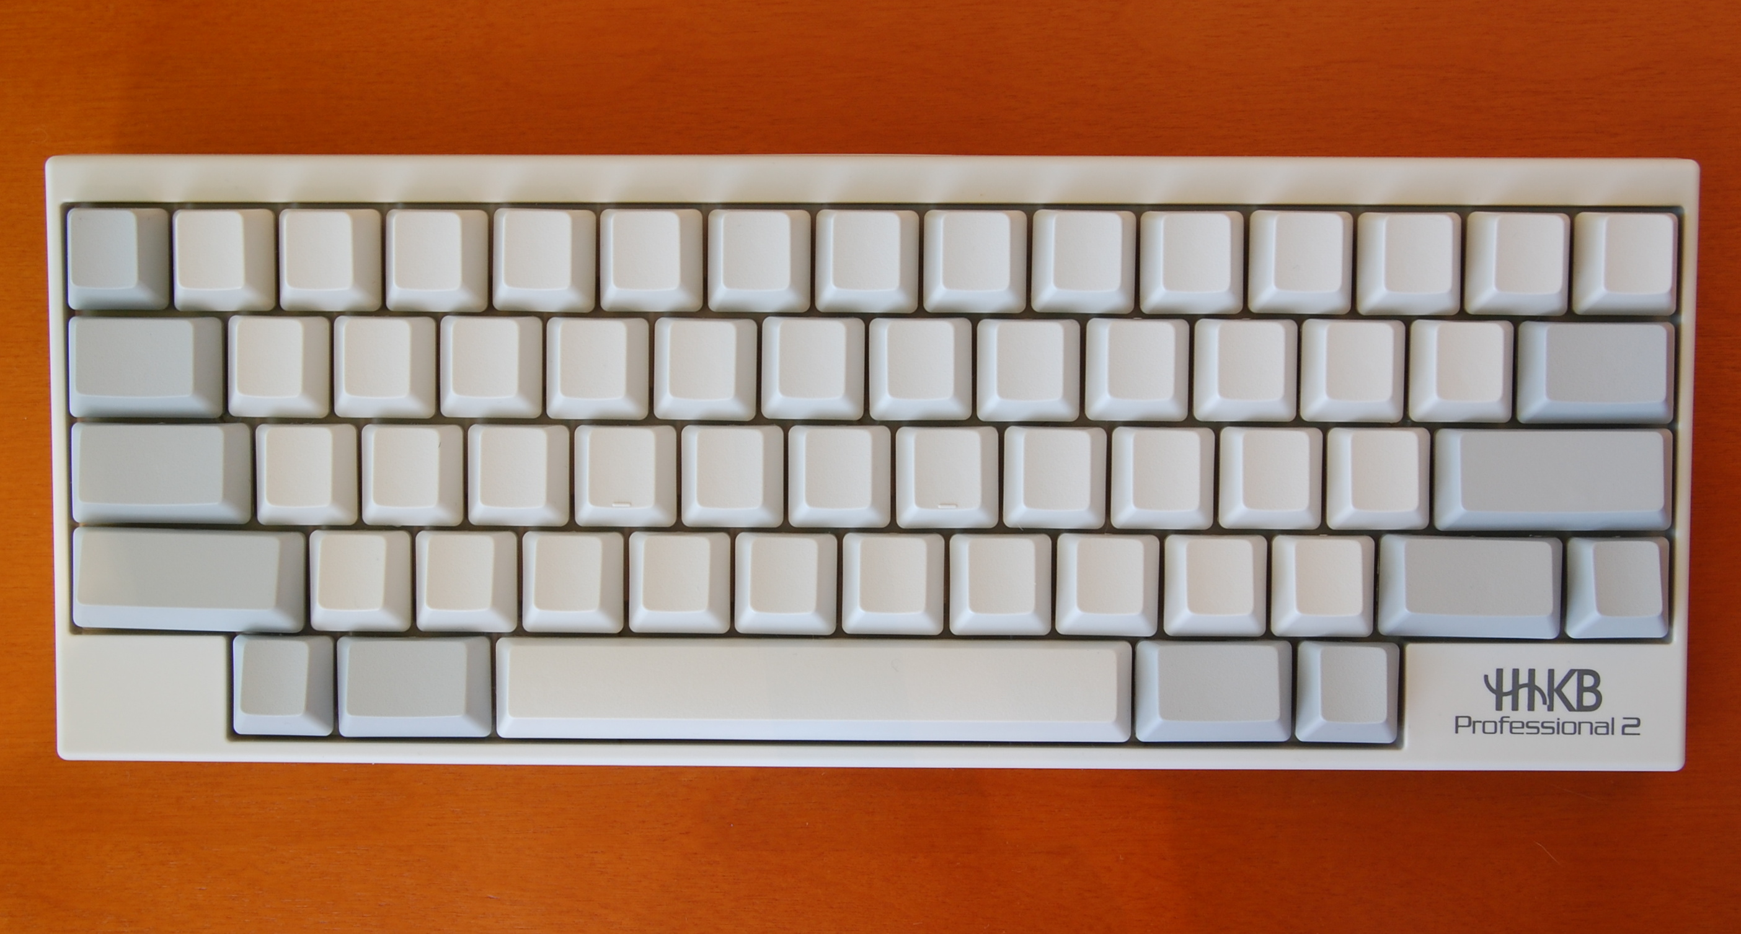
Happy Hacking

