Slide 1
Real Time Imaging
State Machine on NEXYS 4
IOANNIS TSAGKATAKIS
KARIM BOTROS

Slide 2
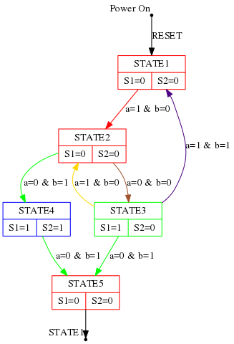
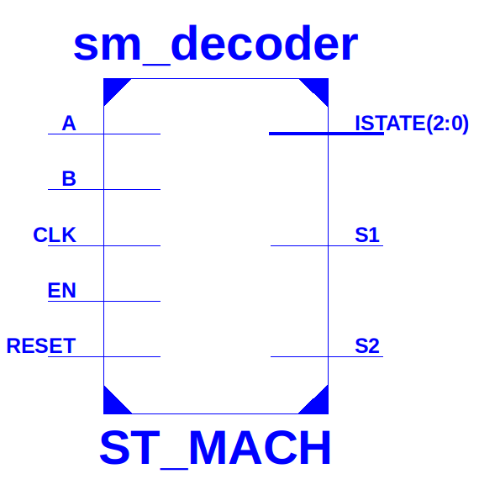
The state machine

Slide 3
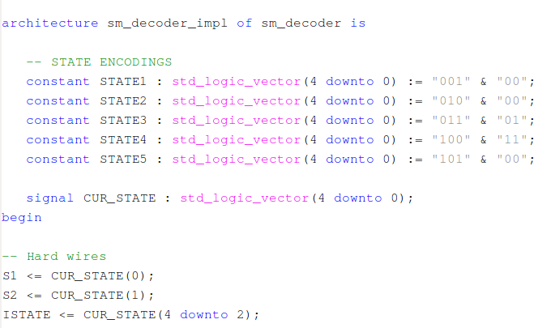
State Machine Encoding
ISTATE
S2 S1

Slide 4
Operation
Input
  Switch A
  Switch B
  RESET
  ENABLE Btn
Output
  S1 & S2
    2 right leds
    3color led
  Internal State
    5 left leds
    7 Segment disp.

Slide 5
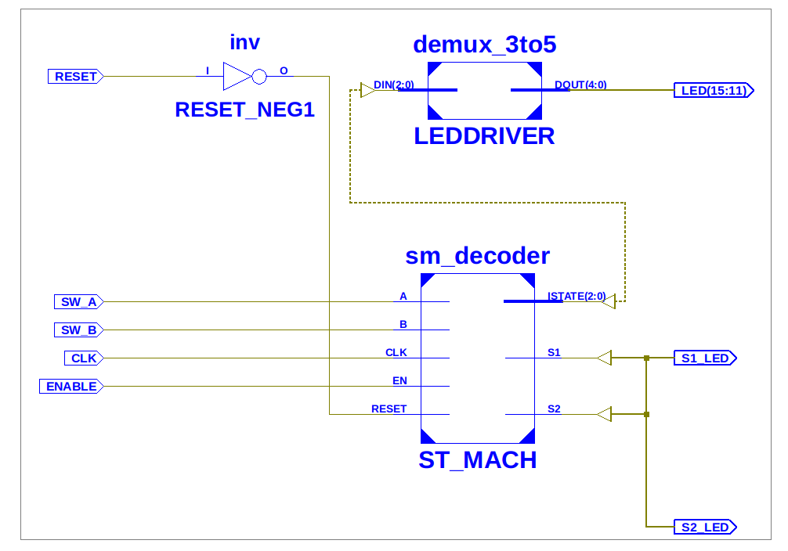
The Output Leds Driver

Slide 6
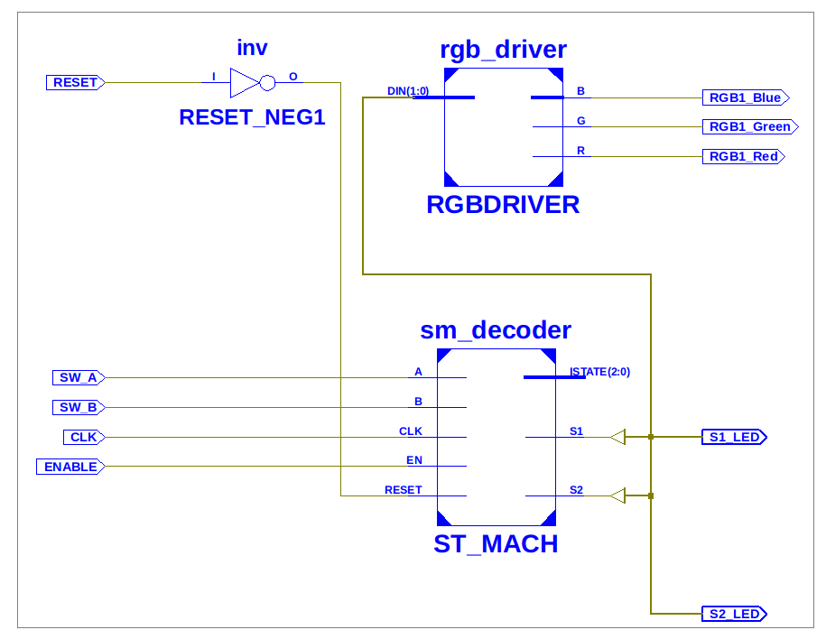
The RGB Led Driver

Slide 7
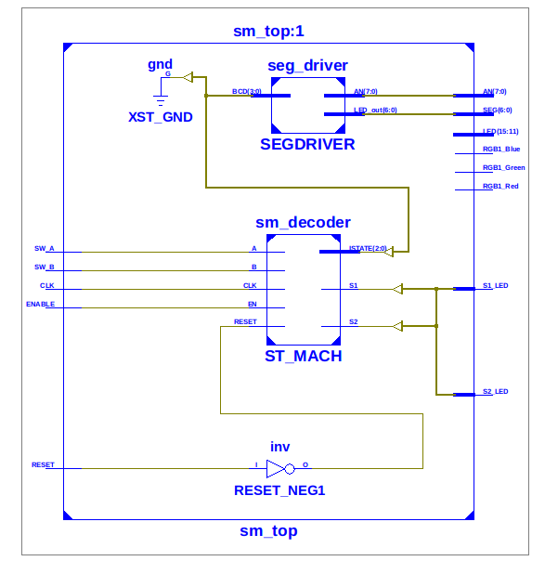
The & Segment Driver

Slide 8
Demo Time
Code on Github
https://github.com/jtsagata/nexys4_sm_lab

