Slide 1
Indexing and Searching Document Collections using Lucene
Program Structure and Algorithms
Jyoti Sharma

Slide 2
Contents
Searching
Indexing
Lucene
Indexing with Lucene
Implementation
References

Slide 3
Searching
Indexing
Looking up words in an index
Factors Affecting Search
Precision – How well the system can filter
Speed
Single, Multiple Phase queries, Results ranking, Sorting, Boolean queries
Sequential Search is bad (Not Scalable)
Index speeds up selection
Index is a special data structure which allows rapid searching.

Slide 4
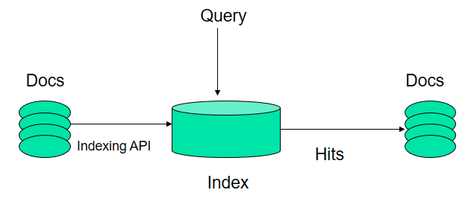
Search Process

Slide 5
Lucene and why?
High-performance, full-featured text search engine library
Written 100% in pure java
Easy to use yet powerful API good documentation
Open source (Not proprietary)
Powerful And Highly Scalable
Algorithms
Efficient, fast and optimized
Incremental Indexing
Boolean Query, Fuzzy Query, Range Query, Multi Phrase Query, Wild Card Query etc…
Content Tagging – Documents as Collection of terms
Heterogeneous documents - Useful when different set of metadata present for different mime types

Slide 6
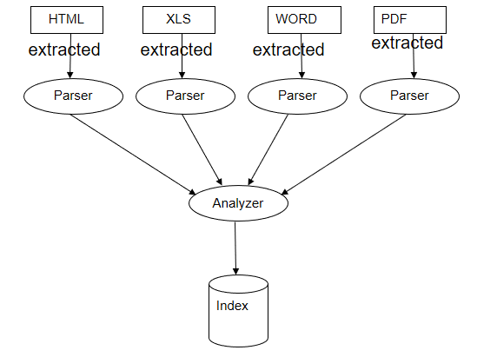
Indexing With Lucene
What type of documents can be indexed?
Any document from which text can be fetched and extracted over the net with a URL
Uses Inverted Index
- The index stores statistics about terms in order to make term-based search more efficient.

Slide 7
REFERENCES
“Lucene in Action” - Erik Hatcher, Otis Gospodnetic Manning Publications (December 28, 2004)
“The Apache Software Foundation” – www.apache.org
“Apache Lucene” - http://lucene.apache.org/
“Information Retrieval” - http://en.wikipedia.org/wiki/Information_retrieval
“Apache TIKA” - https://tika.apache.org/
http://www.mkyong.com/spring3/spring-3-mvc-hello-world-example-annotation/
https://github.com/arleyprates/lucene/tree/master/src/lucene/ri
https://stackoverflow.com/questions/4322426/problem-with-precision-and-recall-measuring-in-lucene
http://howtodoinjava.com/lucene/lucene-search-highlight-example/
https://github.com/rickcrawford/lucene-example

Slide 8
Thank you

