Slide 1

CS 456: Web Programming
Spring 2022
Lectures 8-9 – Bootstrap

Slide 2
Summary
Introduction
Responsive Design
Getting Started & Grid Basics
Bootstrap Components
Navigation Bar
Forms
Other Components
Final Remarks

Slide 3
Introduction

Slide 4
What is Bootstrap?
Free open-source framework for web interface. In this course, we are going to use the most current version, Bootstrap 5.
Uses CSS classes and JS code for easy front-end design.
Specializes in responsive design with a mobile first focus.

Slide 5
History of Bootstrap
First version released in 2011, created by Mark Otto & Jacob Thornton to be used internally on Twitter.
Current version is 5.1.3
Highly popular framework
For a while it was the project with the highest number of stars in GitHub (over 155K stars and 76K forks in GitHub) <https://github.com/twbs/bootstrap>

Slide 6
Responsive Design

Slide 7
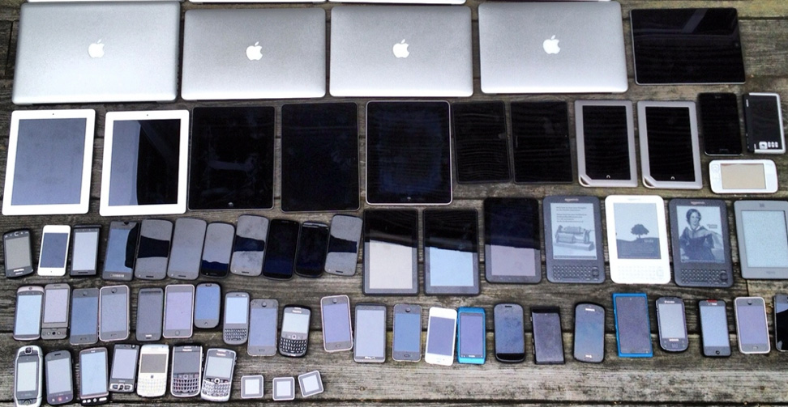
Responsive Design
Responsive Design is a concept to design an interface that can adapt to the screen size of different devices.

Slide 8
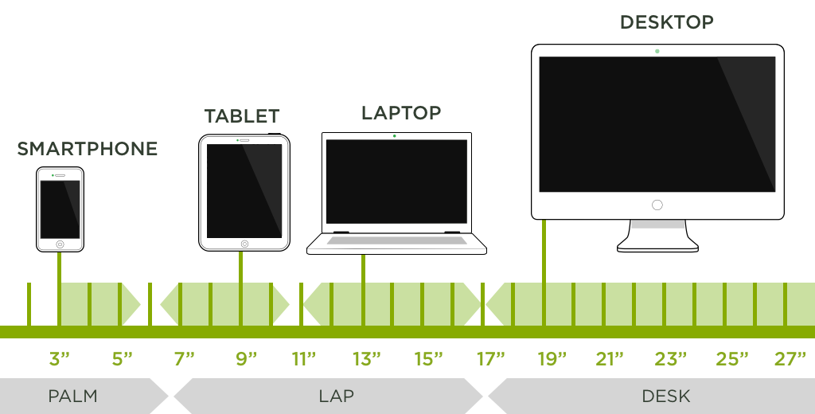
Devices Screen Size

Slide 9
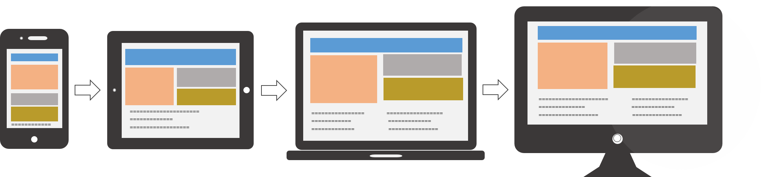
Mobile First Approach
Mobile First is an approach that concerns first with the interface design for mobile devices, and then adapt such design to others.

Slide 10
Getting Started and Grid Basics

Slide 11
Adding Bootstrap to the Web Page
Follow these steps to add Bootstrap to your web page (code example in the next slide):
Meta tag charset (optional but strongly recommended)
Meta tag to set the viewport (essential for responsive design)
Import the CSS Bootstrap file
Import the JS Bootstrap file

Slide 12
Adding Bootstrap to the Web Page
<head>
<meta charset="utf-8" /> <!-- charset -->
<meta name="viewport" content="width=device-width, initial-scale=1" /> <!-- viewport -->
<link rel="stylesheet" href="https://cdn.jsdelivr.net/npm/bootstrap@5.1.3/dist/css/bootstrap.min.css" /> <!-- Bootstrap CSS -->
<script src="https://cdn.jsdelivr.net/npm/bootstrap@5.1.3/dist/js/bootstrap.bundle.min.js"></script> <!-- Bootstrap JS -->
</head>

Slide 13
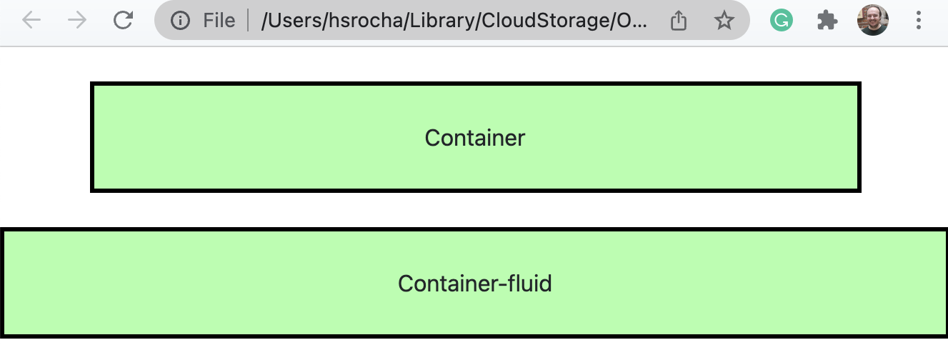
Containers
Container is the essential component for responsible design in Bootstrap, and all your page content should be inside one.
Two main containers: container and container-fluid

Slide 14
Container Example
<body>
<div class="container" style="background-color:#AAFFAA">
<h1>Hello Bootstrap!</h1>
<p>Some Text here.</p>
</div>
</body>
See it display in your browser, change the browser window size and watch it adapt. After that, modify to “container-fluid” and see the difference.

Slide 15
Bootstrap Grid
Bootstrap has a grid to divide your content into columns.
The grid is flexible and responsive. We have rows, and each can be divided up to 12 columns.

Slide 16
Auto Grid
The easiest way is to use the automatic grid.
We use the class “col” to create a column.
Bootstrap will divide the content evenly among the columns, as long as you use less than 12 columns.

Slide 17
Auto Grid Example
<div class="container">
<div class="row">
<div class="col"> Text 1 </div>
<div class="col"> Text 2 </div>
<div class="col"> Text 3 </div>
</div>
<div class="row">
<div class="col"> Text 4 </div>
<div class="col"> Text 5 </div>
<div class="col"> Text 6 </div>
</div>
</div>

Slide 18
Manual Grid Options
We can also control the grid manually, based on six default viewports with a width breakpoint.
We use a column class for each viewport and choose how many columns it occupies (less than 12).
 | X-Small | Small | Medium | Large | X-Large | XX-Large
Class | col-* | col-sm-* | col-md-* | col-lg-* | col-xl-* | col-xxl-*
Screen size | < 576 px | ≥ 576 px | ≥ 768 px | ≥ 992 px | ≥ 1200 px | ≥ 1400 px
Device | Mobile | Tablet | Laptop | Desktop | Desktop | Desktop
Container | 100% | 540 px | 720 px | 960 px | 1140 px | 1320 px

Slide 19
Grid Sketch
<div class="container">
<div class="row">
<div class="container">
<div class="row">
<div class="col-sm-5">
<div class="col-sm-7">

Slide 20
Manual Grid Example
<div class="container">
<div class="row">
<div class="col-6 col-sm-4 col-lg-2"> Text 1 </div>
<div class="col-6 col-sm-4 col-lg-2"> Text 2 </div>
<div class="col-6 col-sm-4 col-lg-2"> Text 3 </div>
<div class="col-6 col-sm-4 col-lg-2"> Text 4 </div>
<div class="col-6 col-sm-4 col-lg-2"> Text 5 </div>
<div class="col-6 col-sm-4 col-lg-2"> Text 6 </div>
</div> <!-- In this example, x-small devices will display 2 divs per line (each occupies 6 cols), small & medium 3 divs, and large+ 6 divs. -->
</div>

Slide 21
Column Offset
If we want to “skip” a column, we can use “offset-*” for all viewports, or “offset-[sm/md/lg/xl/xll]-*” for a specific one.
Example: offset-lg-1 would skip 1 column in large viewport.
<div class="container">
<div class="row">
<div class="col-12 col-sm-6 offset-sm-2 ">
<div class="col-12 col-sm-4">

Slide 22
Mixing Auto and Manual Grid
We can mix manual and auto grid; in such cases the auto grid will cover the remaining columns.
<div class="container">
<div class="row">
<div class="col-12 col-sm-3"> Text 1 </div>
<div class="col"> Text 2 </div>
<div class="col-12 col-sm-3"> Text 3 </div>
</div> <!-- In this example, x-small devices will display each div in a new row, small+ will display the 3 divs into a single row; the middle div have 6 cols --> </div>

Slide 23
Nested Columns
Inside a column, we can subdivide it into more rows and cols; the internal row will also have 12 columns proportional to the parent column size.
<div class="container">
<div class="row">
<div class="col-4">
<div class="col-7 offset-1">
<div class="row">
<div class=”col-9">

Slide 24
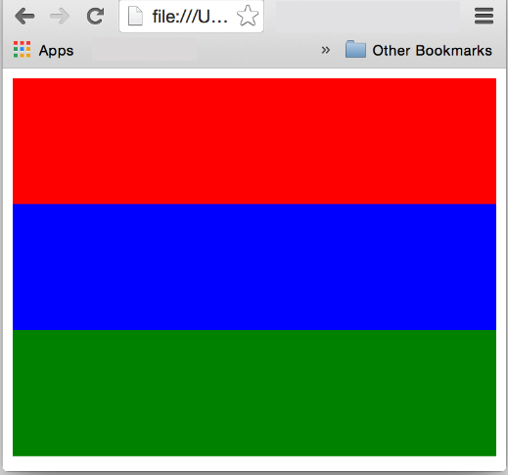
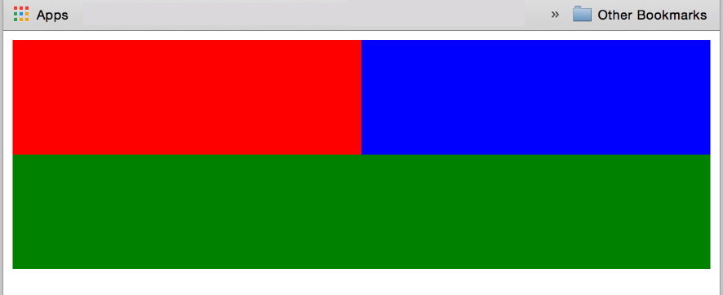
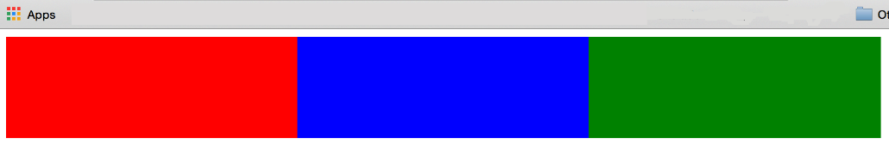
Exercise 1
Implement a web page (compliant to HTML5 standards) that behaves like the sketches bellow depending on the screen size.
>=768 e <992px
<768px
>=992px

Slide 25
Bootstrap Components

Slide 26
Bootstrap Icons
Maintained as a separate project, Bootstrap Icons is a library of ready to use icons (1500+ icons) to put in our web sites.
<https://icons.getbootstrap.com/>
First, we need to import the CSS with the icons in the <head>
<link rel="stylesheet" href="https://cdn.jsdelivr.net/npm/bootstrap-icons@1.7.2/font/bootstrap-icons.css" />

Slide 27
Bootstrap Icons – Usage
We use the tag <span> (although any empty tag would work) and set the class attribute to “bi-[icon-name]”; the tag will be replaced by the icon and use the current font-size and text color.
<a href="settings.html"> <span class="bi-gear-fill"></span> Settings </a>
<button> <span class="bi-search"></span> Search </button>

Slide 28
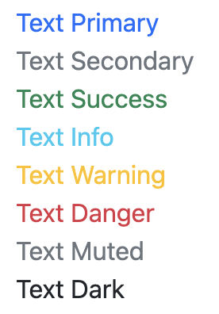
Contextual Text Colors
There are contextual text colors to provide “meaning through colors”.
text-primary, text-secondary, text-success, text-info, text-warning, text-danger, text-muted, text-dark, text-light, text-white, text-body.
<span class="text-danger"> <span class="bi-exclamation-triangle-fill"></span> Attention! </span>

Slide 29
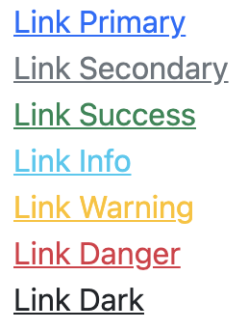
Contextual Links Colors
There are classes to format the link colors using the same contextual elements from the previous slide.
There is a hover effect on these classes.
link-primary, link-secondary, link-success, link-info, link-warning, link-danger, link-dark, link-light.
<a href="about.html" class="link-info"> About </a>

Slide 30
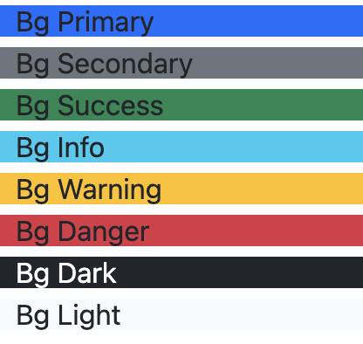
Contextual Background Colors
Similarly, we can use contextual colors for backgrounds.
bg-primary, bg-secondary, bg-success, bg-info, bg-warning, bg-danger, bg-dark, bg-light.
<span class="bg-dark text-white"> Dark BG and White Text </span>

Slide 31
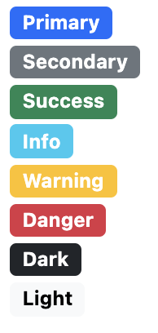
Contextual Badges
We can also create badges with the “badge” class and use the contextual backgrounds from last slide to color the badges.
Add the class “rounded-pill” for a more rounded badge.
<span class="badge rounded-pill bg-primary"> <span class="bi-chat-right-text-fill"></span> New Messages! </span>

Slide 32
Alerts
Very useful in Web Applications, since we often need to “alert” the user about something.
Use the “alert” class and followed by the contextual coloring: alert-primary, alert-secondary, alert-success, alert-info, alert-warning, alert-danger, alert-dark, alert-light.
<div class="alert alert-success"> <strong>Success. </strong> Data saved in the system.</div>
<div class="alert alert-danger"> <strong> Error. </strong> Please contact the sysadmin.</div>

Slide 33
Closing Alerts
We can create alert messages that can be closed (hidden)
First, add the class “alert-dismissible” to your alert.
Second, create a button with the specific code for closing it.
Optionally, you may add “fade show” classes to your alert to add a fading effect to it.
<div class="alert alert-danger alert-dismissible fade show"> <button type="button" class="btn-close" data-bs-dismiss="alert"> </button>
<strong> Error. </strong> Please contact the sysadmin.</div>

Slide 34
Responsive Images
Add the class “img-fluid” to an <img> tag to make it responsive and automatically fit the container’s size.
<div class="row">
<div class="col-12 col-md-3">
<img src="images/my_image.png" alt="Example" class="img-fluid"/>
</div>
</div>

Slide 35
Jumbotron
Jumbotron was a component in Bootstrap 3, it was a big padded box which placed some emphasis on the content.
Bootstrap 5 has no jumbotron component, but we can create one
<header class="mt-4 p-5 bg-primary text-white text-center rounded">
<div class="container">
<h1> My Custom Jumbotron </h1>
</div>
</header>

Slide 36
Navigation Bar

Slide 37
Navigation Bar
We use the tag <nav> for the main navigation bar of the page, we add the “navbar” and the “navbar-expand-sm” classes.
Inside the <nav> we need a <div> container wrapping a list <ul class=“navbar-nav”>
There are no “row” or “col” inside the container.
Inside the <ul> we have <li class=“nav-item”>
Finally, inside the <li> we have the links <a class=“nav-link”>

Slide 38
Simple Navbar Example
<nav class="navbar navbar-expand-sm bg-warning">
<div class="container-fluid">
<ul class="navbar-nav">
<li class="nav-item">
<a href="#" class="nav-link"> Home </a> </li>
<li class="nav-item">
<a href="#" class="nav-link"> Products </a> </li>
<li class="nav-item">
<a href="#" class="nav-link"> About </a> </li>
</ul>
</div>
</nav>

Slide 39
Navbar Colors
We can use the bg-colors we saw earlier.
Moreover, use the attributes “navbar-light” and “navbar-dark”
navbar-light is for light colored backgrounds and navbar-dark is for dark colored backgrounds.
<nav class="navbar navbar-expand-sm bg-dark navbar-dark">
<!-- ... -->
</nav>

Slide 40
Navbar Icon for Small Devices
We add another <div> grouping the <ul>, and a button between the container <div> and this new <div>.
<nav class="navbar navbar-expand-sm bg-dark navbar-dark">
<div class="container-fluid">
<button class="navbar-toggler" type="button" data-bs-toggle="collapse" data-bs-target="#mainMenu">
<span class="navbar-toggler-icon"></span>
</button>
<div class="collapse navbar-collapse" id="mainMenu">
<ul class="navbar-nav">
<!-- ... -->

Slide 41
More Navbar Option
There are many more options to customize your navbar: logo, search field, fixed or sticky, horizontal alignment, etc.
<https://www.w3schools.com/bootstrap5/bootstrap_navbar.php>
<https://getbootstrap.com/docs/5.0/components/navbar/>

Slide 42

Exercise 2
Create a page using Bootstrap following the structure bellow
navbar
header (jumbotron)
Col 4 (md)
Col 4 (md)
Col 4 (md)
footer

Slide 43
Forms

Slide 44
Forms
Let's begin with a simple form with little formatting.
Please, do not forget to set method=“post” when you have a password
Always create a <label> for your form fields and use the “label-control” class.
Your field (input, select, textarea, etc.) should have the “form-control” class.
Create a <span class=“form-text”> to add text to your form.

Slide 45
Simple Form Example
<form method="post" action="http://localhost:3000">
<label class="form-label" for="txt_login">Login:</label>
<input class="form-control" type="email" name="txt_login" id="txt_login" />
<label class="form-group" for="txt_pass">Password:</label>
<input class="form-control" type="password" name="txt_pass" id="txt_pass" />
<span class="form-text"> Must be 8-20 characters long.</span> <br/>
<button type="submit" class="btn btn-primary"> Sign-in </button>
</form>

Slide 46
Attention: Names/Ids in Form Fields
You must always set a “name” and “id” attributes for your form fields; otherwise, you will not be able to recover its values later.
In the following examples, to save space in the slides, the form fields may not have “name/id”. This is just for a condensed display, do not forget to set up “name/id” for all your fields.

Slide 47
Buttons
We can create buttons with <button> <input> or even a link.
Add the class “btn” to set as a button and followed by the contextual background for the button
Possible backgrounds: btn-primary, btn-secondary, btn-success, btn-info, btn-warning, btn-danger, btn-dark, btn-light, btn-link.
There is also the outline button classes: btn-outline-primary, …

Slide 48
Horizontal Form
To create a horizontal form, we need to use the Grid (more specifically, the columns) to align the elements.
Use the “col-form-label” instead of “form-label” for <label>, this will align the label vertically with its corresponding field (based on the “for” attribute)
You can set the column directly into the label; but for fields you will need to wrap them into a div with the column.

Slide 49
Horizontal Form Example
<form method="post" action="http://localhost:3000">
<div class="row">
<label class="col-form-label col-12 col-md-1"> Login:</label>
<div class="col-12 col-md-3">
<input class="form-control" type="email" name="txt_login" />
</div>
</div> <!– closing row -->
<!-- repeat similarly for password -->
<div class="row"> <div class="col-12 col-md-3 offset-md-1">
<button type="submit" class="btn btn-primary"> Sign-in </button>
</div></div>
</form>

Slide 50
Give me Some Space…
You noticed how the horizontal form is too tightly close (vertically).
We can fix that with some margin top or bottom at the rows.
Bootstrap already have margin classes defined: mt-* (margin top), mb-* (margin botton), ms-* (margin start – left), me-* (margin end – right).

Slide 51
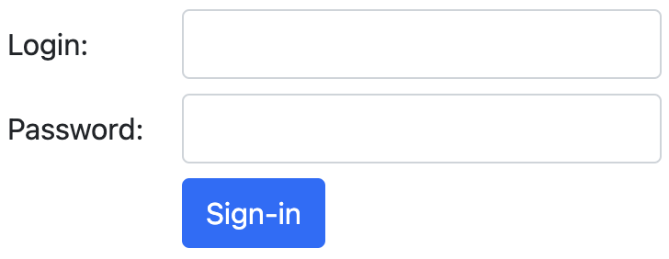
Horizontal Form Example with Margin
<form method="post" action="http://localhost:3000">
<div class="row mb-2">
<label class="col-form-label col-12 col-md-1"> Login:</label>
<div class="col-12 col-md-3">
<input class="form-control" type="email" name="txt_login" />
</div>
</div> <!– closing row -->
<!-- repeat similarly for password -->
<div class="row mb-2"> <div class="col-12 col-md-3 offset-md-1">
<button type="submit" class="btn btn-primary"> Sign-in </button>
</div></div>
</form>

Slide 52
Button Block
As you can see, the inputs resize according to the column, but not the button.
For that we need to add “btn-block” to the button, and “d-grid” to the parent container (usually the div with the column)
The button will automatically resize to fill all columns of its parent

Slide 53
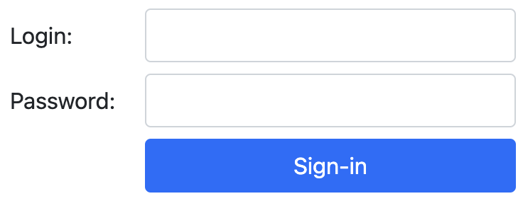
Button Block Example
<div class="row mb-2">
<div class="col-12 col-md-3 offset-md-1 d-grid">
<button type="submit" class="btn btn-block btn-primary"> Sign-in </button>
</div>
</div>

Slide 54
Form Validation
Bootstrap has many different classes to help with form validation
Lets do a basic one, put the class “was-validated” on the form.
Remember to set the fields to required.
For more options on validation:
<www.w3schools.com/bootstrap5/bootstrap_form_validation.php>
<getbootstrap.com/docs/5.0/forms/validation/>

Slide 55
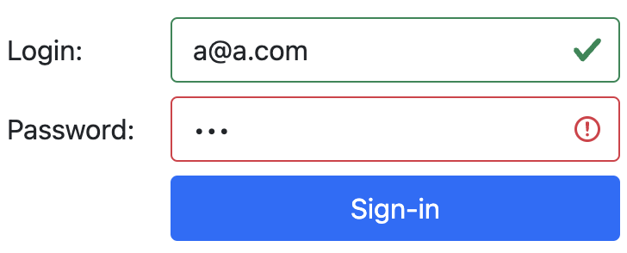
Form Validation
<form class="was-validated" method="post" action="http://localhost:3000">
<div class="row">
<label class="col-form-label col-12 col-md-1"> Login:</label>
<div class="col-12 col-md-3">
<input class="form-control" type="email" name="txt_login" required />
</div>
</div> <!– closing row -->
<!-- repeat similarly
for password -->

Slide 56
More Form Options
There are many more options for Form Fields & Buttons.
If you need to format another type of input, just look in the Bootstraps help or the W3Schools tutorials.

Slide 57
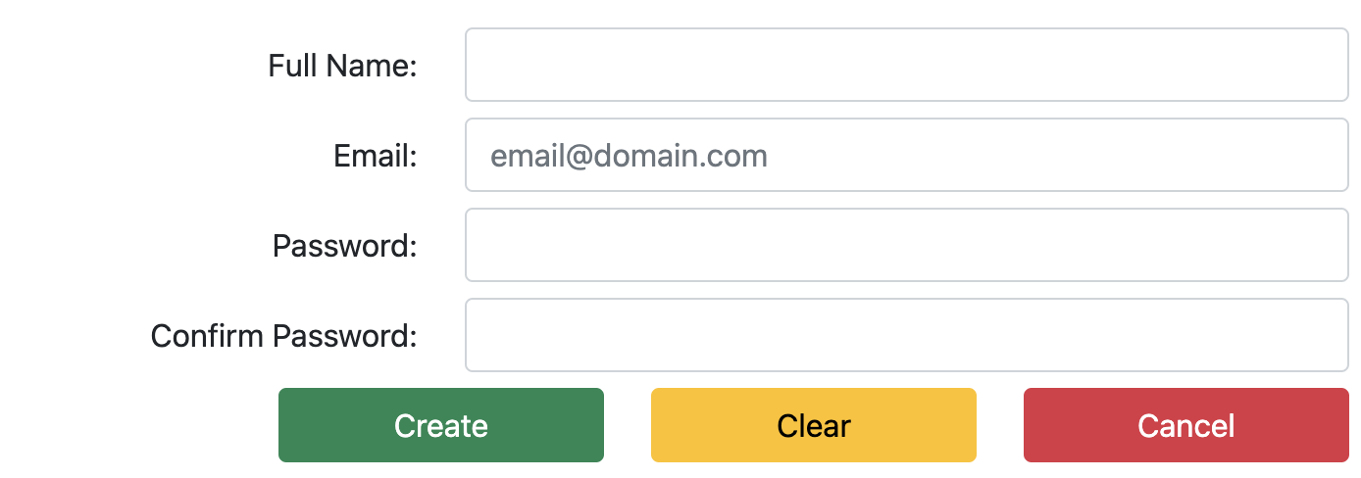
Exercise 3
Create the form bellow to register a new user, use Bootstrap classes and formatting as much as possible, and internal CSS styles when appropriate.

Slide 58
Other Components

Slide 59
Other Bootstrap Components
There are many other great and useful Bootstrap components.
Modal
Carousel / Slide Show
Off-canvas
Cards
Collapse
If ever need anything like that for your web site, get the code example and adapted to your needs.

Slide 60
Bootstrap Templates
Here are some Bootstrap templates for web sites
<getbootstrap.com/docs/5.0/examples/>
<www.w3schools.com/bootstrap5/bootstrap_templates.php>
Be open about using templates! If you are using a template, do not attempt to hide this. It is perfectly fine to use them, as long as you explicitly mention it.

Slide 61
Final Remarks

Slide 62
References
W3Schools <www.w3schools.com>
W3Schools Bootstrap 5 Tutorial <www.w3schools.com/bootstrap5/index.php>
Get Bootstrap Docs <getbootstrap.com/docs/5.0/getting-started/introduction/>
Bootstrap Icons <icons.getbootstrap.com/ >

