Slide 1

Code Basics
Programming concepts
In C#, JavaScript, & Scratch

Slide 2





Variables : a place to store information
Type | C# Example | JavaScript Example | Scratch Example
String | string firstName = "Bob"; | var firstName = "Bob";
Integer | int luckyNumber = 42; | var luckyNumber = 42;
Boolean | bool isFinished = false; | var isFinished = false;
DateTime | DateTime birthday = "12-10-2012"; | var birthday = "12-10-2012";
Decimal | decimal sumTotal = 99.95M; | var sumTotal = 99.95;

Slide 3


Input/Output : user interaction
Language | Code (Input) | Code (Output)
C# | Console.WriteLine("Enter name"); string name = Console.ReadLine(); | Console.WriteLine("Hi there!");
JavaScript | var name = prompt("Enter name"); | console.log("Hi there!");
Scratch

Slide 4
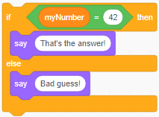
Branching : making decisions
Language | Code
C# | if(myNumber == 42) { Console.WriteLine("That's the answer!"); } else { Console.WriteLine("Bad guess!"); }
JavaScript | if(myNumber == 42) { console.log("That's the answer!"); } else { console.log("Bad guess!"); }
Scratch

Slide 5
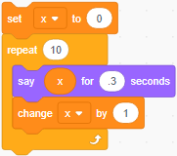
Looping : repeating commands
Language | Code (for loop)
C# | for(int x = 0; x < 10; x++) { Console.WriteLine(x); }
JavaScript | for(var x = 0; x < 10; x++) { console.log(x); }
Scratch
Output
0 1 2 3 4 5 6 7 8 9

Slide 6
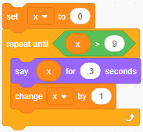
Looping : repeating commands
Language | Code (while loop)
C# | int x = 0; while(x < 10) { Console.WriteLine(x); x = x + 1; }
JavaScript | var x = 0; while(x < 10) { console.log(x); x = x + 1; }
Scratch
Output
0 1 2 3 4 5 6 7 8 9

Slide 7
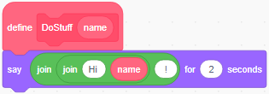
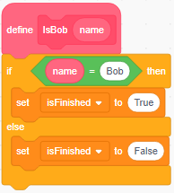
Functions : reusing code
Language | Code (Subroutine) | Code (Function)
C# | public void DoStuff(string name) { Console.WriteLine("Hi " + name + "!"); } | public bool IsBob(string name) { return name == "Bob"; }
JavaScript | function doStuff(string name) { console.log("Hi " + name + "!"); } | function isBob(name) { return name == "Bob"; }
Scratch

