Slide 1
COEN 146 Computer Networks
Lab8: GNS3 network emulator

Slide 2
Objective
To setup install GNS3 as an all-in-on software on a local computer (Windows, MAC, Linux)
To emulate, configure, test and trouble show virtual networks

Slide 3
GSN3 Setup
Download: https://www.gns3.com/software/download
Install the GNS3-all-in-one software (GUI)
Install the GNS3 virtual machine (VM)
Open the software and create a new project

Slide 4
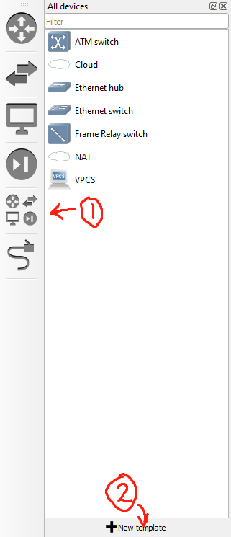
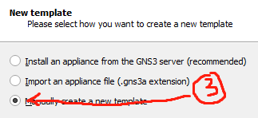
Create the router
Click a tab on the left
At the bottom of the list, click new template
Choose manually create a new template
Choose Dynamips/IOS routers
Choose new on the bottom

Slide 5
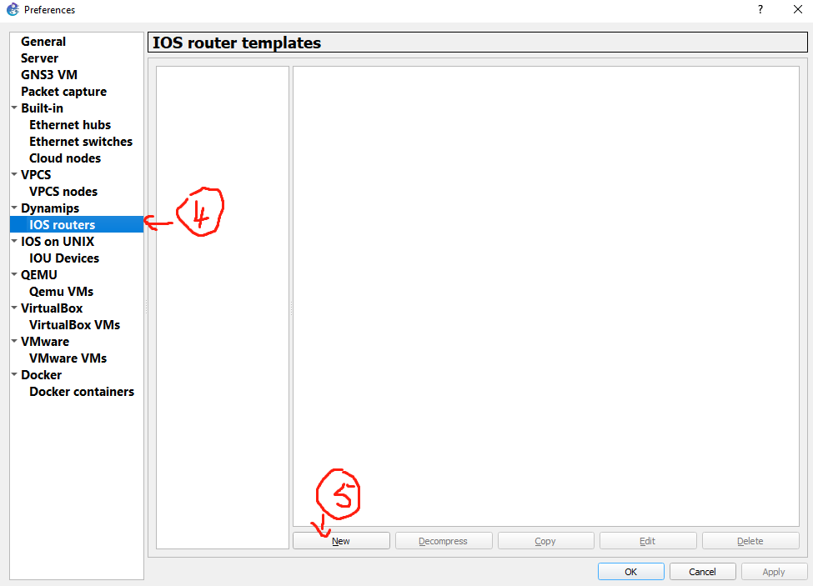
Create the router (Cont.)
Choose new Image
Use image provided
Only for educational use
Delete after using
Set idle-pc to 0x6050b114

Slide 6

Create and config network
Drag and drop to create new elements
Click to create connection
Click a element and choose the port
Click another element and pick a port to connect them.
Right click the element and start it
Right click then open the console
Follow the instructions to finish config

Slide 7
Submission
Text file recording the observations with description fo your steps

