Slide 1

XML VALIDATION

Slide 2
XML VALIDATION
The current implementation of the XML Validator will be a switch based approach. The validator checks for well formedness, missing tags, improper data type and validates the XML properly against the XSD . In the current implementation we would be checking the single xml as and when it is generated. The earlier implementation skipped this validation check and wrote the contents directly to the temporary location.
The following switches would be added in correspondence.properties
ENABLE_VALIDATE_XML = Y
Determines whether or not to use the Validator.
Invalidates the XML if it is invalid or faulty.
If the value of switch is Y and a faulty XML is found, exception would be thrown and that particular XML would be skipped for further processing.
In case value of switch is N, we would go ahead with the existing implementation of passing the XML String to HPE and failing PDF creation at HPE level.
SUPPRESS_TRIGGER = Y

Slide 3
CoCommonBatchDriver Started
Generate XML
Picks up next Record
Throws exception
YES
ENABLE_VALIDATE_XML = Y
SUPPRESS_TRIGGER=Y
YES
XML Validation
NO
XML is Valid
YES
NO
Logs Invalid XML File
NO
Write to temporary location to be picked up by HPE

Slide 4
Scenarios

Slide 5
Scenario 1
All XML’s Valid with ENABLE_VALIDATE_XML=Y and SUPPRESS_TRIGGER = Y
The XML’s were written to the temporary location to be picked up by HPE for further processing.
All XML’s Valid with ENABLE_VALIDATE_XML=Y and SUPPRESS_TRIGGER = N
The same behavior as the previous case was encountered.

Slide 6
Scenario 2
All or few XML’s Invalid with ENABLE_VALIDATE_XML=Y and SUPPRESS_TRIGGER = Y
The invalid XML’s along with the Exception Description, DocId, Version and Time Stamp would be logged in the logs. The XML would be skipped for further processing(will not be written to temporary location from where HPE picks it up). Further processing can be done on the XML by picking it up from the logs and examining it.
All or few XML’s Invalid with ENABLE_VALIDATE_XML=Y and SUPPRESS_TRIGGER = N
The invalid XML’s along with the Exception Description, DocId, Version and Time Stamp would be logged in the logs. The XML would however be eligible and passed on for further processing. The PDF creation would be failed at the HPE level.

Slide 7
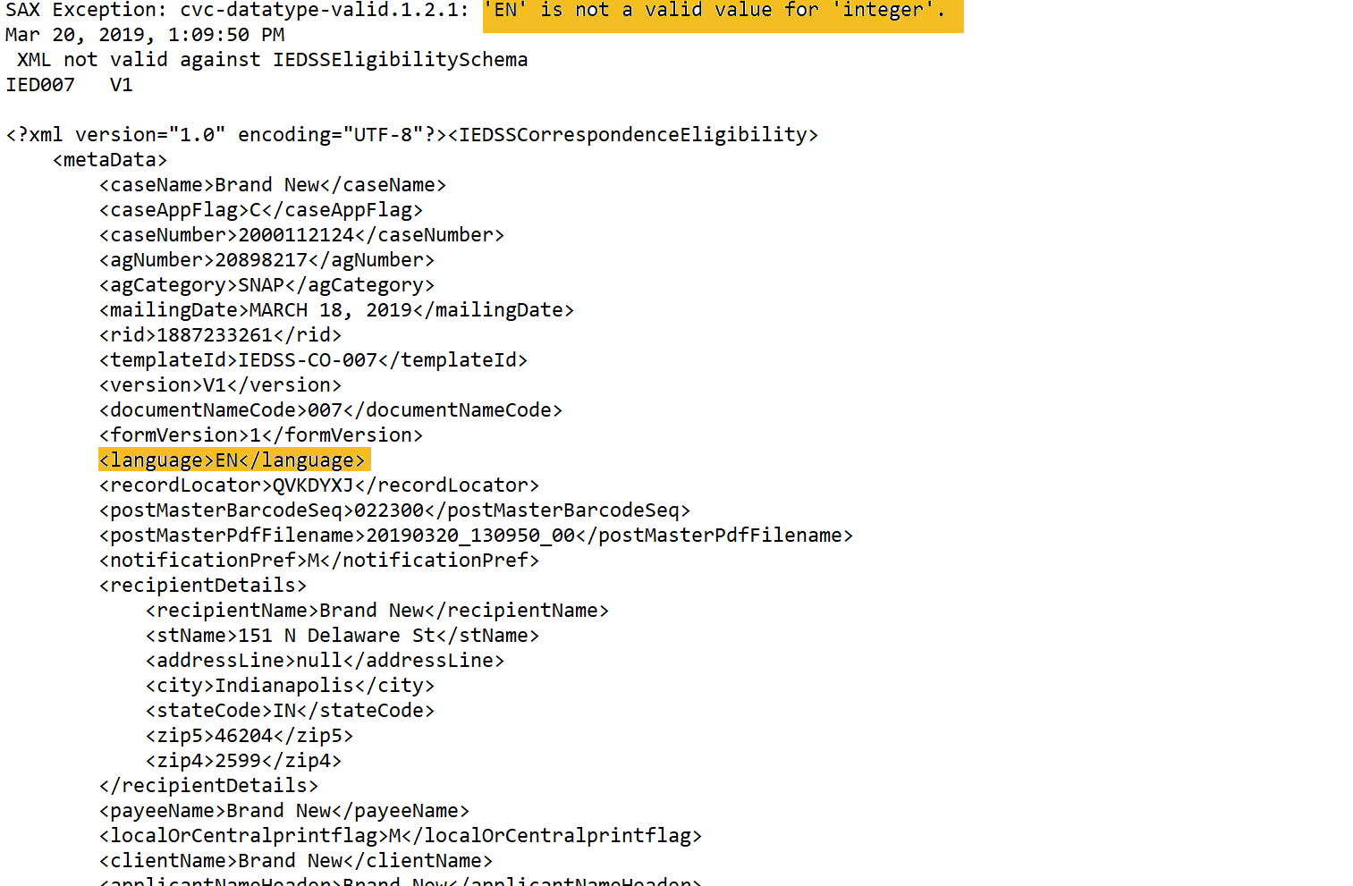

Slide 8
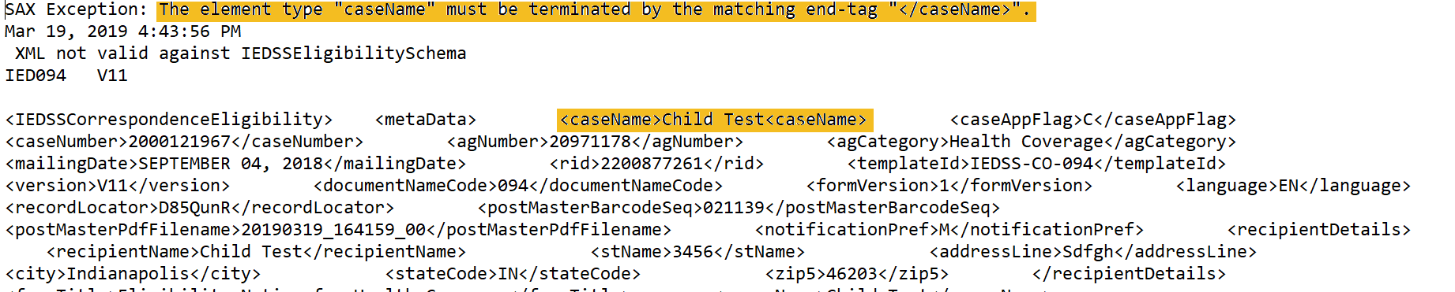

Slide 9
TEST TIME AND ANALYSIS

Slide 10
Validator run time in secs | No Of Records | Time taken per XML(secs) | % of entire batch run time
1.850065744 | 326 | 0.006 | 1.32
4.560706585 | 538 | 0.0085 | 1.26
9.889626408 | 1137 | 0.0087 | 1.18
86.9832894 | 10,000 | 0.0087 | 1.16
434.916447 | 50,000 | 0.0086 | 1.15
869.832894 | 100,000 | 0.0085 | 1.15
290.14146 | 33,356 | 0.0086 | 1.46 (If all xml’s are invalid)
The average time taken per xml is 0.0086 second and the total % of the validator code corresponding to the batch run time is 1.27%. There is always a fixed ~60 second load schema which occurs for all the notices having at least one trigger.

Slide 11
Thank You!!!

