Slide 1




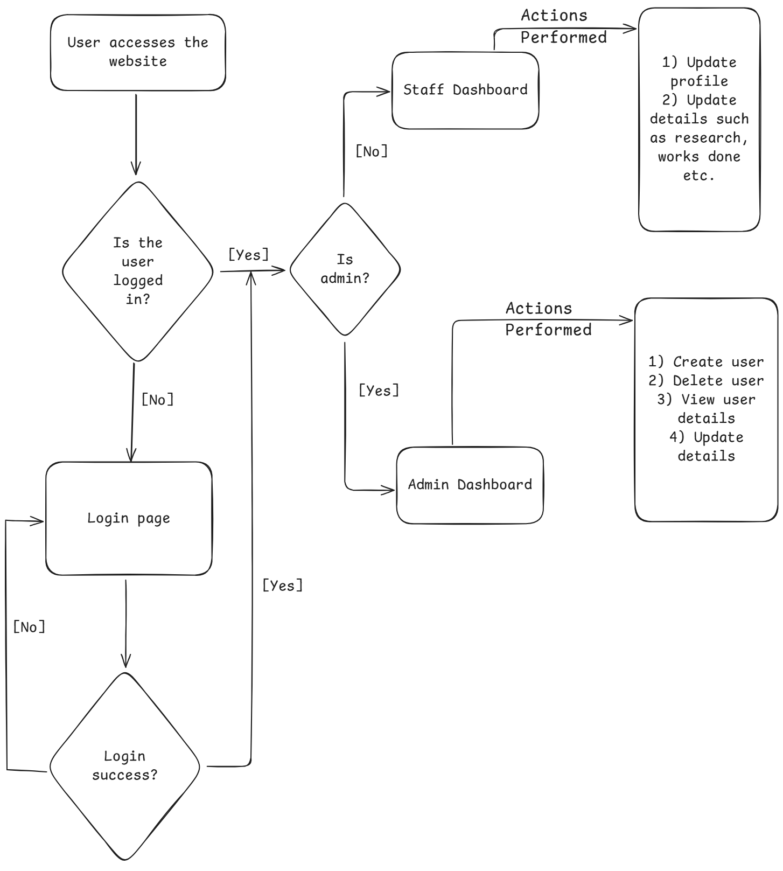
Faculty Appraisal Application
Jnanesh
Department of Computer Science & Engineering
A J Institute of Engineering and Technology
Abstract
Methodology
Results
Conclusion
The Faculty Appraisal System uses a modern tech stack to ensure efficiency, security, and scalability:
Next.js: For building fast, server-rendered web applications.
MongoDB with Mongoose: A flexible database solution for managing appraisal data.
Firebase: Used for secure authentication and file storage.
NextAuth.js: Seamlessly integrates authentication into Next.js.
CSS: For responsive, user-friendly interface design.
Git/GitHub: For version control and collaborative development.
This stack ensures a robust, scalable platform tailored to institutional needs.
In conclusion, the Faculty Appraisal System plays a vital role in ensuring the continuous growth and development of faculty members within educational institutions. By systematically evaluating teaching effectiveness, research contributions, and professional development, the system provides valuable feedback that helps enhance performance and align individual goals with institutional objectives. It fosters a culture of accountability, improvement, and excellence. Furthermore, the insights gained from the appraisal process support informed decision-making for promotions, development opportunities, and overall institutional progress, ultimately contributing to the delivery of high-quality education and research.
The results of the Faculty Appraisal System would include comprehensive evaluations of faculty performance based on various criteria such as teaching effectiveness, research contributions, professional development, and involvement in departmental activities. These results are typically compiled into a report that highlights strengths, areas for improvement, and progress over time. Faculty members receive constructive feedback that guides their career growth and aligns their goals with the institution's objectives. Additionally, results from appraisals contribute to decisions regarding promotions, tenure, and development programs, helping the institution maintain high standards of teaching and research excellence.
The Faculty Appraisal System evaluates faculty performance in teaching, research, and academic contributions. It focuses on continuous improvement through feedback, self-assessment, and performance reviews, aligning individual goals with institutional objectives to ensure quality education and accountability.
Introduction
The Faculty Appraisal System is a systematic approach to evaluating the performance and contributions of faculty members in educational institutions. It serves as a tool for measuring effectiveness in teaching, research, administration, and professional development. By assessing various facets of a faculty member's role, the system ensures alignment with institutional objectives and promotes a culture of excellence. Faculty appraisal also provides valuable feedback to educators, guiding their growth while maintaining accountability and transparency within the organization. This process not only enhances faculty performance but also strengthens the institution’s commitment to delivering quality education..
References
Next.js Documentation: https://nextjs.org/docs
MongoDB Documentation: https://www.mongodb.com/docs/
Firebase Documentation: https://firebase.google.com/docs
NextAuth.js Documentation: https://next-auth.js.org/docs
Mongoose Documentation: https://mongoosejs.com/docs/
GitHub Documentation: https://docs.github.com/en/github

