Slide 1
Molecular Clock Analysis of Caninae Species
Jade Tummino

Slide 2
Family: Canidae
Subfamilies:
Hesperocyoninae (20 million years)
Most basal
Duchesnean, Late Eocene (42 - 38 mya)
Early Barstovian, Miocene (16.3 - 13.6 mya)
10 genera, 26 species
Borophaginae (33.5 million years)
Oligocene (33.9 - 23 mya)
Pliocene (5.3 - 2.58 mya)
66 species
Caninae
Rupelian (33.9 - 28.1 mya)
Many fossil species: 34 - 0.011 mya
Kingdom: Animalia
Phylum: Chordata
Class: Mammalia
Order: Carnivora
Suborder: Caniformia
Family: Canidae

Slide 3
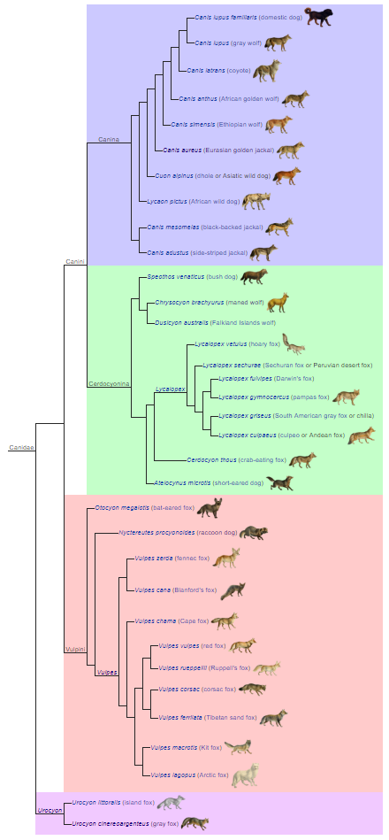
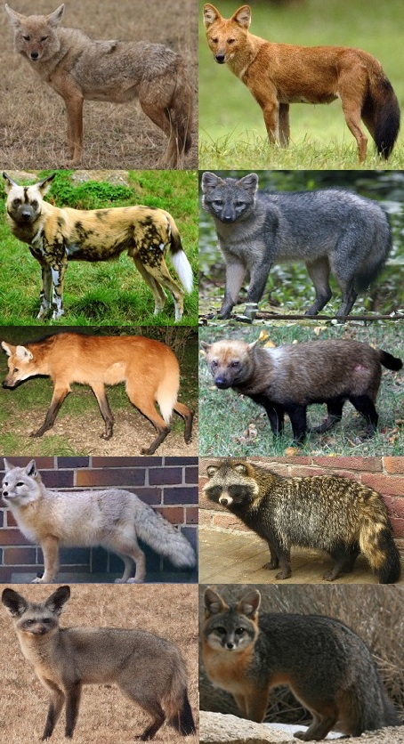
Subfamily: Caninae
3 main clades:
Genus Urocyon
True foxes (Tribe Vulpini)
True dogs (Tribe Canini)
Currently 34 species
Endemic to North America

Slide 4

Genus Urocyon: Taxa of Study
Extinct
Eucyon davisi (8.3 mya)
Leptocyon vulpinus (18.2 mya)
Extant
Urocyon cinereoargenteus (Gray fox)

Slide 5
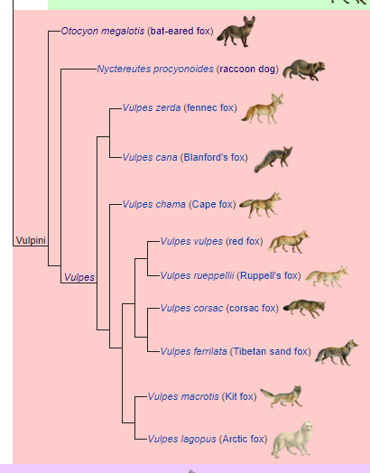
Tribe Vulpini: Taxa of Study
Extinct
Nyctereutes donnezani (6.2 mya)
Vulpes riffautae (7 mya)
Vulpes qiuzhudingi (4.34 mya)
Vulpes stenognathus (2 mya)
Extant
Nyctereutes procyonoides (Raccoon dog)
Otocyon megalotis (Bat -eared fox)
Vulpes corsac (Corsac fox)
Vulpes ferrilata (Tibetan sand fox)
Vulpes lagopus (Arctic fox)
Vulpes vulpes (Red fox)
Vulpes zerda (Fennec fox)

Slide 6
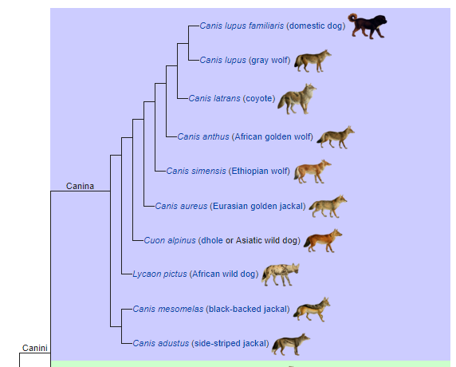
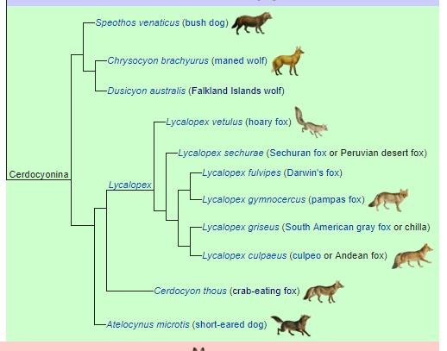
Tribe Canini

Slide 7
Tribe Canini: Taxa of Study
Extinct
Canis lepophagus (8 mya)
Canis cedazoensis (1.05 mya)
Canis apolloniensis (1.1 mya)
Canis dirus (0.067 mya)
Canis (Xenocyon) falconeri (1.75 mya)
Extant
Canis anthus (African golden wolf)
Canis latrans (Coyote)
Canis lupus (Gray wolf)
Canis lupus chanco (Mongolian wolf)
Canis lupus familiaris (Domestic dog)
Canis lupus laniger (Tibetan wolf)
Canis lupus lupus (Eurasian wolf)
Chrysocyon brachyurus (Maned wolf)
Cuon alpinus (Dhole)
Lycaon pictus (African wild dog)

Slide 8
Objective
Construct a phylogenetic tree of Caninae species with a molecular clock
Make inferences of their divergence based on the ecology of the predicted time periods

Slide 9
Methods
Align nucleotide sequences of 3 genes (COB, COX1, COX2, COX3) for 18 species
Use RaxML to produce the best maximum likelihood phylogenetic tree
Choose 11 fossil species
Use BEAST to construct a phylogenetic tree with a molecular clock

Slide 10
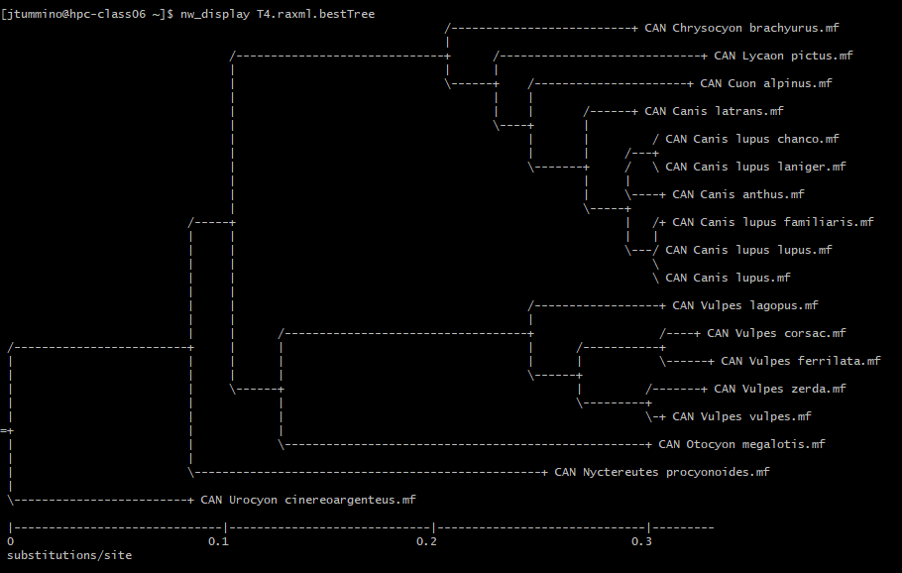
Results: RaxML Tree
Final LogLikelihood = -20320.864
Parameters:
GTR+G
all-in-one = ML search + bootstrapping
bs-metric fbp, tbe
Transfer Bootstrap Expectation:
Maps the BS support values onto best ML tree

Slide 11
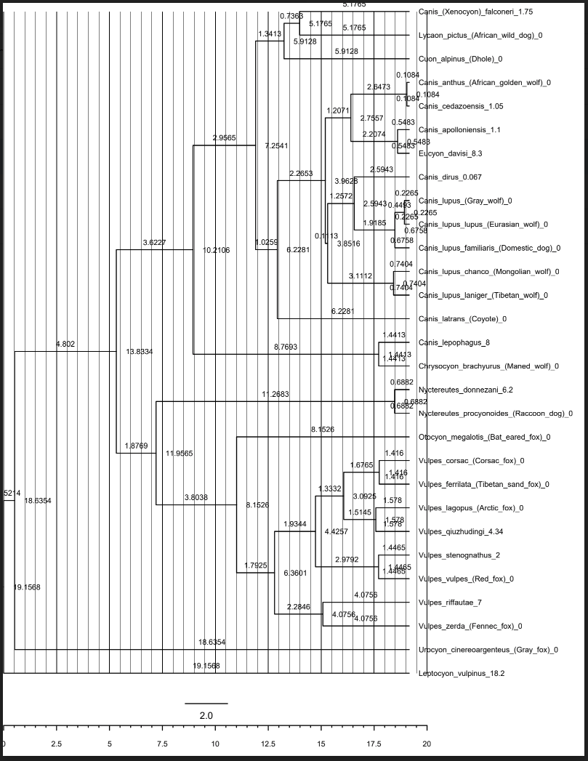
Results: BEAST Tree
BEAUti parameters:
Dr. Tracy Heath’s BEAST v2 Tutorial
Origin time = 18.2 mya (average of Leptocyon vulpinus)
2 independent runs; 10,000,000 chain lengths each
LogCombiner to combine both runs
Combined tree imported into TreeAnnotator
Maximum clade credibility tree
Median heights
Summary file open and viewed in FigTree

Slide 12
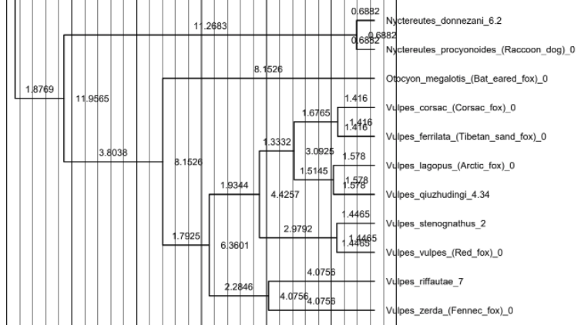
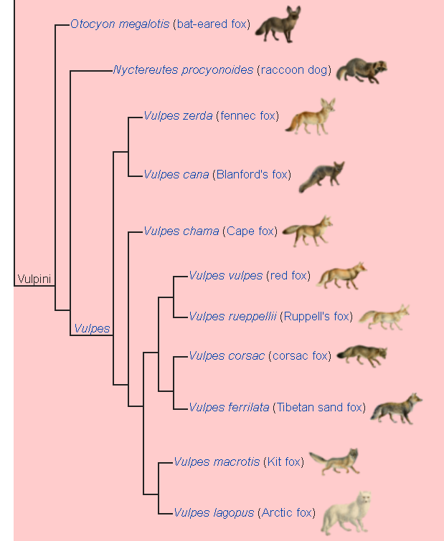
Differences
Nyctereutes and Otocyon swapped basality
V. corsac and V. ferrilata are sister to V. lagopus, instead of V. vulpes.

Slide 13
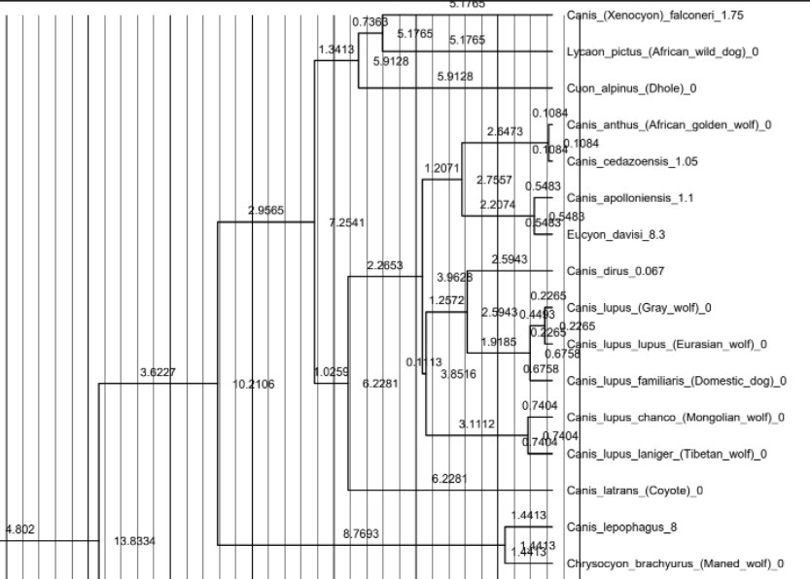
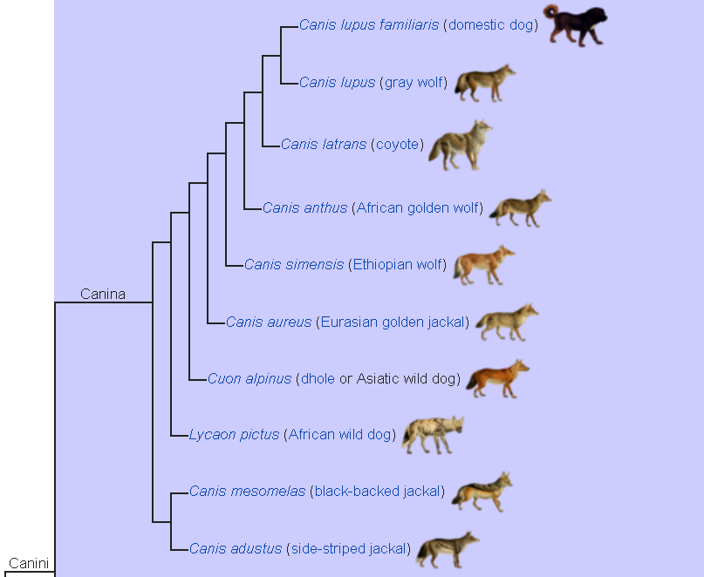
Differences
C. latrans is more basal than C. anthus
Not a step-wise divergence pattern

Slide 14
Further Studies
Choose a more distantly related outgroup
Find a relevant fossil species for each extant taxa
Find more fossil species that represent points of divergence
Follow the locations that extinct species have been found or known to migrate to/from
Determine the ecology of those time periods
Geography
Competing species
Prey item, resource abundance
Make inferences about their divergence

Slide 15
References
De Bonis, L.; Peigné, S.; Likius, A.; MacKaye, H.T.; Vignaud, P.; Brunet, M. (2007). "The oldest African fox (Vulpes riffautae n. sp., Canidae, Carnivora) recovered in late Miocene deposits of the Djurab desert, Chad"(PDF). Naturwissenschaften. 94 (7): 575–580. doi:10.1007/s00114-007-0230-6
Ikeda, Hiroshi (August 1986). "Old, new tricks: Asia's raccoon, a venerable member of the canid family is pushing into new frontiers". Natural History. 95 (8): 40, 44.
Kirkness, Ewen; Alvarez, Pablo; Biagi, Tara; Brockman, William; Butler, Jonathan; Chin, Chee-Wye; Cook, April; Cuff, James; Daly, Mark J.; Decaprio, David; et al. (2005). "Genome sequence, comparative analysis and haplotype structure of the domestic dog". Nature. 438 (#7069): 803 in 803–19. Bibcode:2005Natur.438..803L. doi:10.1038/nature04338. PMID 16341006
Lindblad-Toh, Kerstin; Wade, Claire M; Mikkelsen, Tarjei S.; Karlsson, Elinor K.; Jaffe, David B.; Kamal, Michael; Clamp, Michele; Chang, Jean L.; Kulbokas, Edward J.; Zody, Michael C.; Mauceli, Evan; Xie, Xiaohui; Breen, Matthew; Wayne, Robert K.; Ostrander, Elaine A.; Ponting, Chris P.; Galibert, Francis; Smith, Douglas R.; Dejong, Pieter J.; Cherin, Marco; Bertè, Davide F.; Rook, Lorenzo; Sardella, Raffaele (2013). "Re-Defining Canis etruscus (Canidae, Mammalia): A New Look into the Evolutionary History of Early Pleistocene Dogs Resulting from the Outstanding Fossil Record from Pantalla (Italy)". Journal of Mammalian Evolution. 21: 95. doi:10.1007/s10914-013-9227-4
""Out of Tibet" hypothesis: Cradle of evolution for cold-adapted mammals is in Tibet". National Science Foundation. June 11, 2014. Retrieved 8 July 2014.
Savage, D. E. 1941. American Midland Naturalist 25
Tedford, Richard; Wang, Xiaoming; Taylor, Beryl E. (2009). "Phylogenetic systematics of the North American fossil Caninae (Carnivora: Canidae)" . Bulletin of the American Museum of Natural History. 325: 1–218. doi:10.1206/574.1
Wang, Xiaoming; Tedford, Richard H. (2008). Dogs, Their Fossil Relatives and Evolutionary History. Columbia. p. 53. ISBN 978-0-231-13528-3.
Wayne, et al. (1997). “Molecular Systematics of the Canidae”
http://fossilworks.org/?a=taxonInfo&taxon_no=47574
https://taming-the-beast.org/tutorials/FBD-tutorial/

