Slide 1



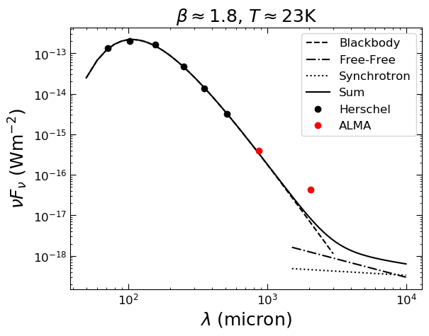
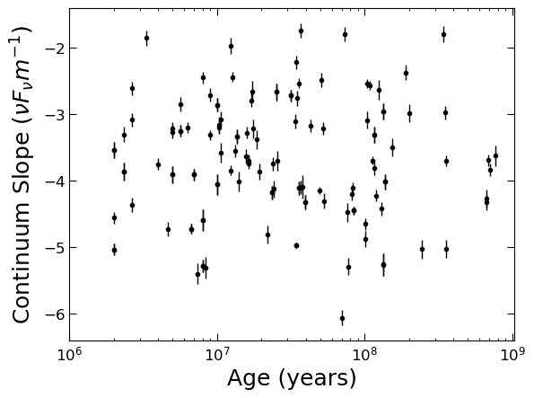
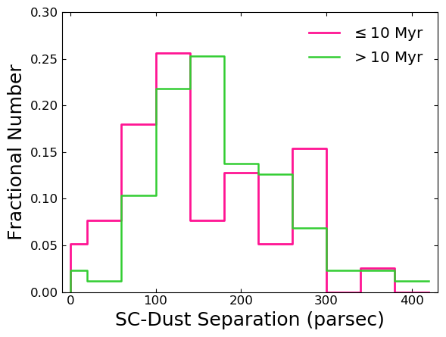
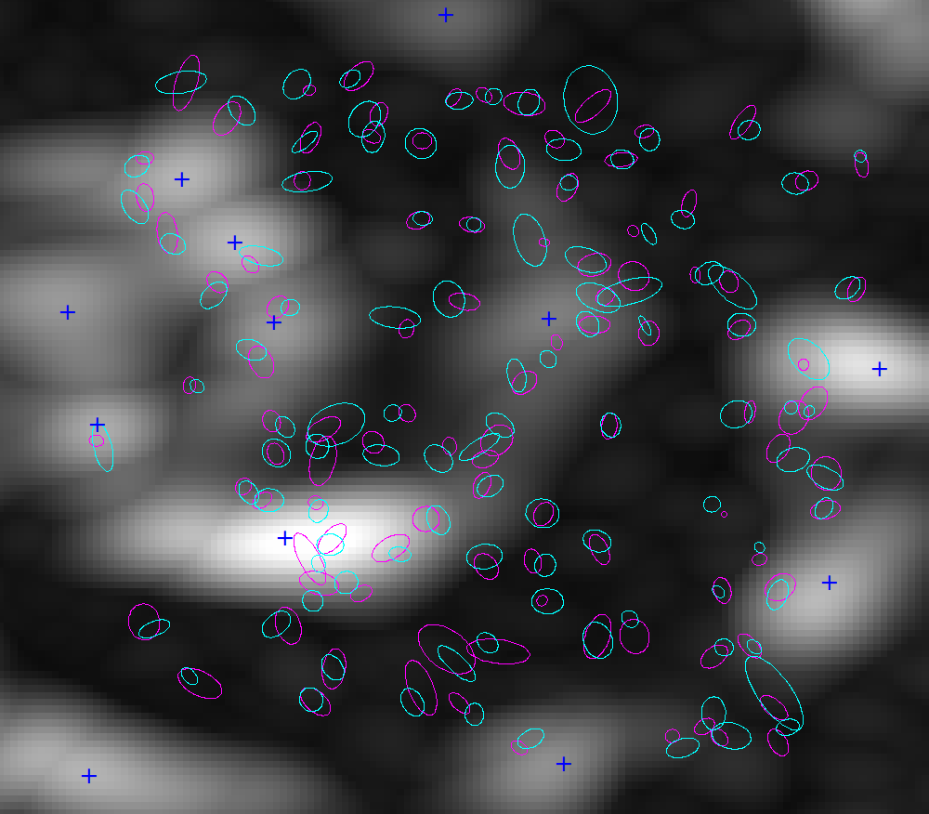
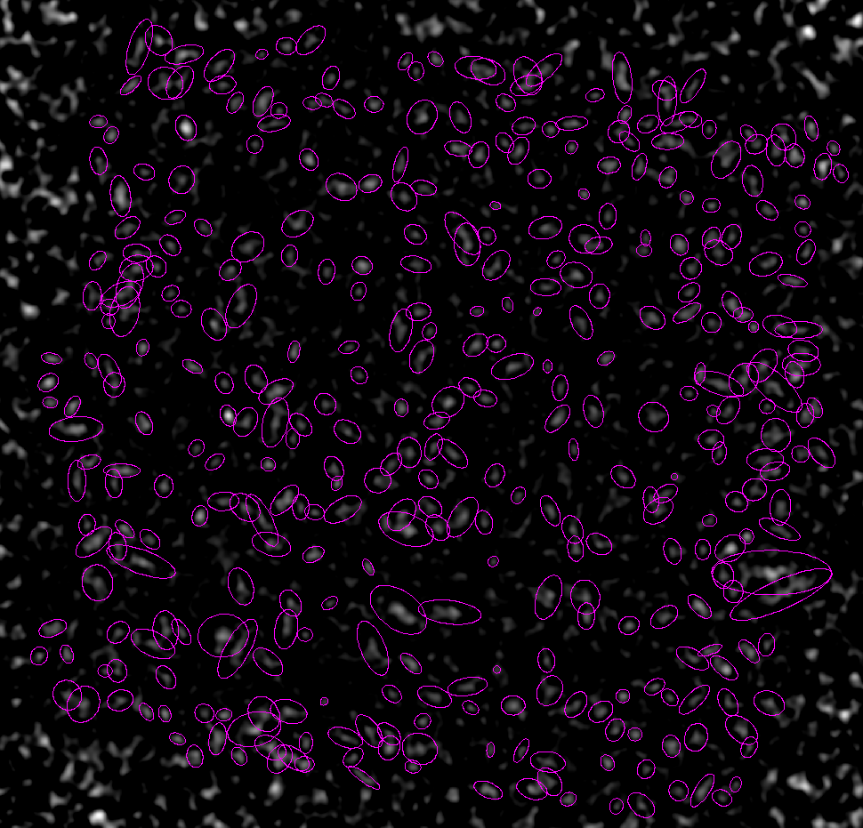
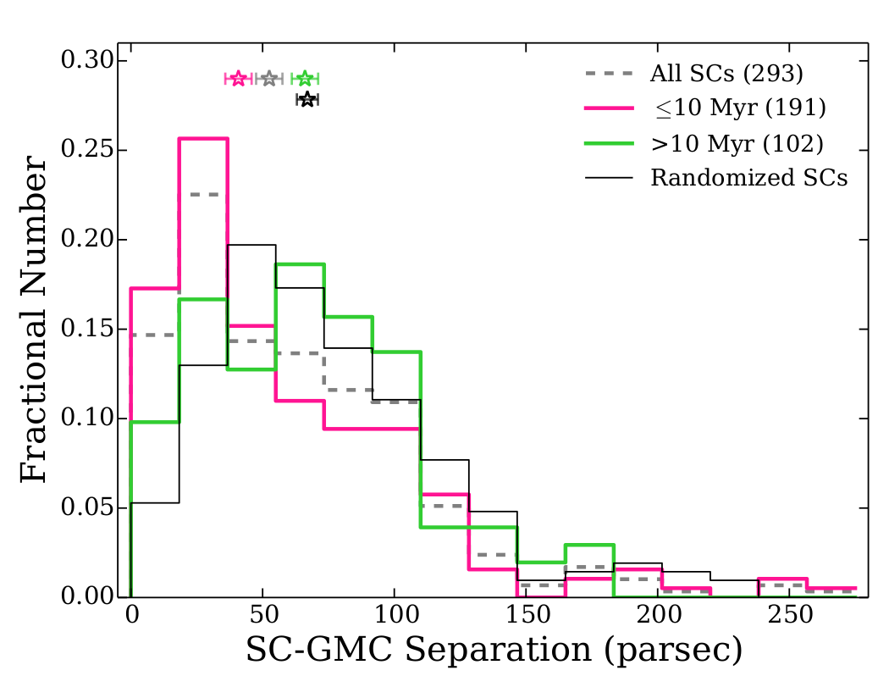
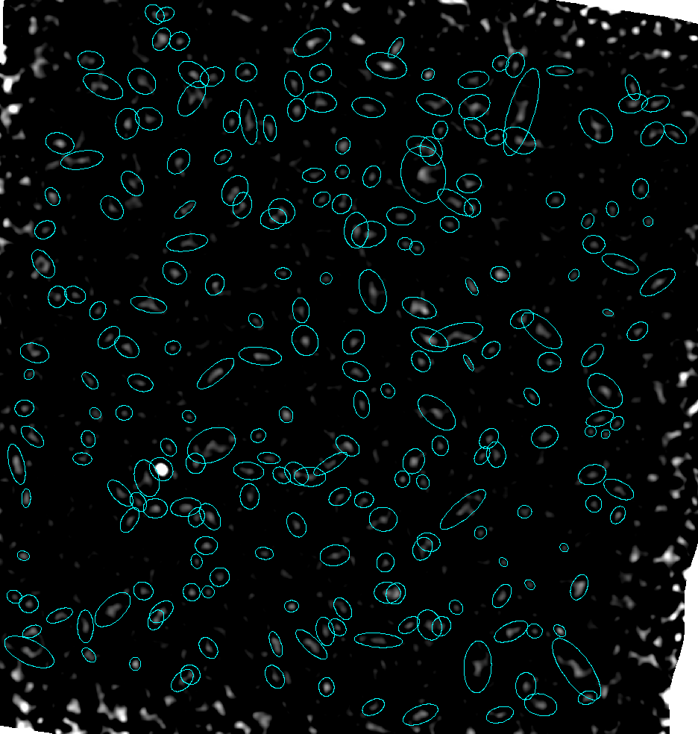
An ALMA-HST Study of
Cold Dust Emission and Star Clusters
Daniel Dale, Jordan Turner (U. of Wyoming), and the LEGUS Team
Summary
We present results from a joint ALMA-HST study of the nearby galaxy NGC628. A comprehensive database for 1000+ star clusters is combined with new ALMA observations of the cold dust continuum in NGC628. We find evidence for excess dust emission at millimeter/sub-millimeter wavelengths. The excellent resolution of the ALMA maps--approximately 20 pc at the distance of NGC628--allows us to constrain the spatial variations in the slope of the cold dust emission with the ages and masses of the nearby star clusters.
Modified blackbody fit to Herschel PACS & SPIRE photometry yields T~23K and β~1.8. Based on extrapolations of the Herschel data, the excess of emission can easily be seen at 2.1 mm. Free-Free and synchrotron emission cannot account for the excess.
The submm/mm dust continuum slope versus the average age of the three nearest star clusters. We find no correlation between dust continuum slope and cluster age.
ALMA 2.1 mm
Archival ALMA NGC628 observations of CO
1-0 are used to constrain the CO-dark fraction. Using CPROPS (William, de Geus, & Blitz 1994; Rosolowsky & Leroy 2006), we identified peak cloud centroids (blue crosses). The inferred ISM mass from our ALMA data in conjunction with the THINGS HI mass gives an H2 mass of 95 Million M_{Sun}. The CO map gives a mass of 61 million M_{Sun}, implying a CO-Dark fraction of 36%.
ALMA 0.87 mm
Results
Find an excess in emission at the millimeter wavelengths in NGC628.
Younger star clusters lie closer to the dust regions which provides a link between star clusters and their formation sites.
Consistent with results from Grasha+2018 for star clusters and GMCs.
No obvious correlation between dust continuum slope and star cluster ages.
CO-Dark fraction of 36%.
Top: Distribution of the separations between the closest clusters and the dust regions split into two age bins for the clusters.
Bottom: A comparable plot from Grasha+2018, who plot the nearest star clusters to giant molecular clouds observed by ALMA in NGC 7793. They find younger clusters closer to the GMCs. Our data suggests a similar result for the cold dust.

