Slide 1
Python and Clear Code
Eonics Open Hack Night 2017-11-22
Jeroen Vermeulen

Slide 2
Python in 20 seconds
Dynamic, interpreted language
Batteries included
Execution model just like JavaScript
...But with a different culture

Slide 3
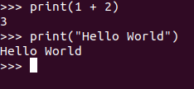
Back to BASICs

Slide 4
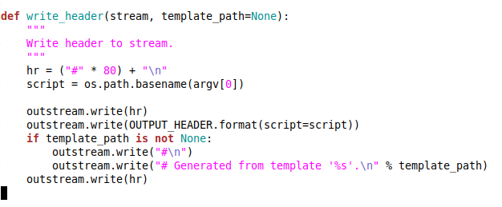
Syntax — indentation, not braces!

Slide 5
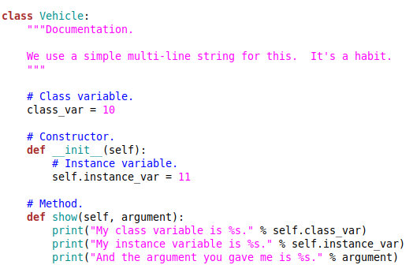
Classes
“Duck Typing.”
The class is your factory.
“self” (this) is a parameter.
Fields are not in scope!

Slide 6


Those cultural differences...
KISS.
Explicit is better than implicit.
Just say what you mean.
We’re all adults.

Slide 7
Live examples...

Slide 8
Code Clarity
“Programming is explaining the solution to a problem.”
Keep it simple and direct:
Function, not class.
Class, not factory.
Yes, even global variable not Singleton!

Slide 9
Documenting: Docstrings
Put one on every module, class, and function.
Write in the imperative.
Start with a one-liner. Elaborate afterwards.

Slide 10
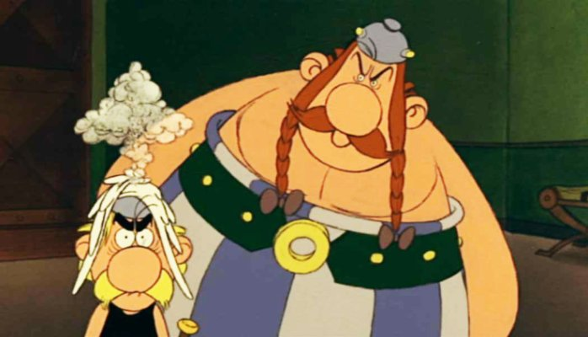
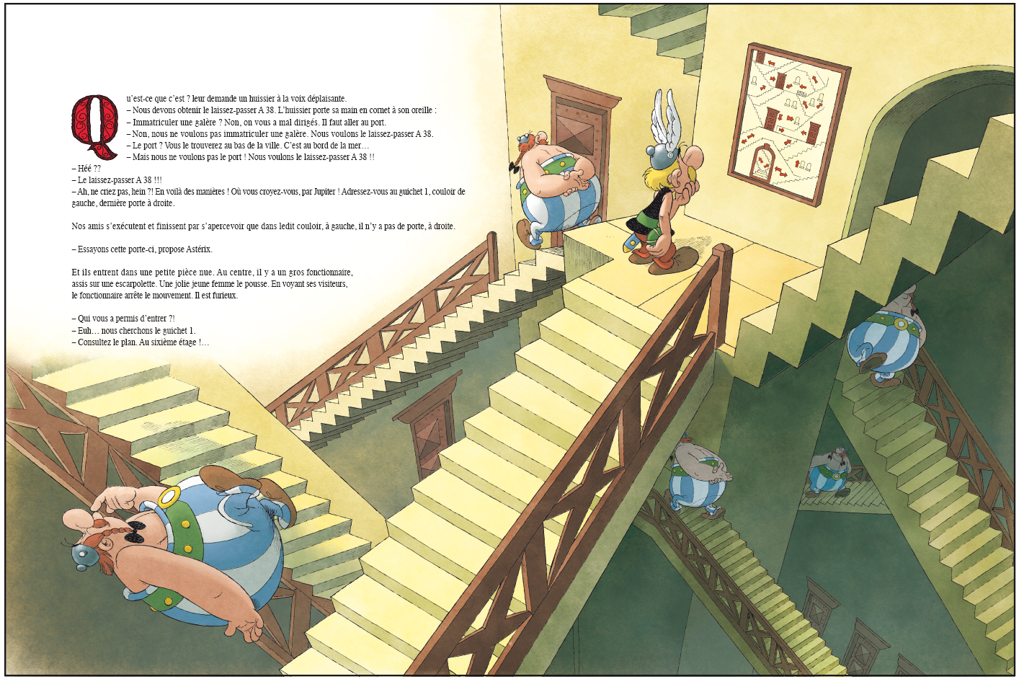
Le Maison Qui Rend Fou
TFW you can’t understand the
code…
...without understanding the
code first!

Slide 11
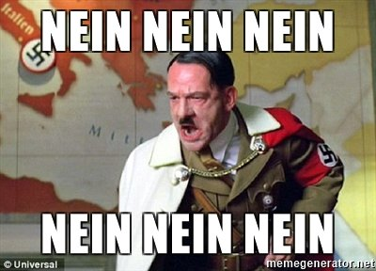
Stop! Step back.
You’re halfway through documenting a function.
Ah, there’s another important thing!
Just add it at the end..?

Slide 12
My Code Tips
You’ve probably read the books, the blog posts,
the advice scrawled on bathroom walls at petrol pumps.
I won’t try to rehash those. This is what I do.

Slide 13
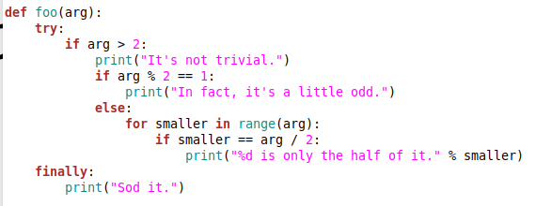
Nesting
Size doesn’t always matter.
Sometimes it’s depth of nesting that matters.

Slide 14
“Find” loops
“Find item X.”
“Find all items that Y.”
Extract, extract, extract, extract.
Really. You’ll be happier.

Slide 15
Deep call trees
root
root
get
find
get
find
obtain
figure out
obtain
transform
figure out
transform

Slide 16
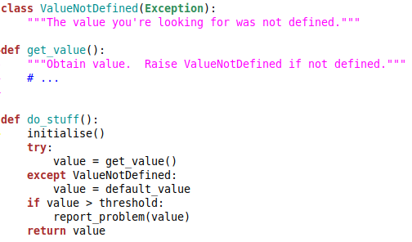
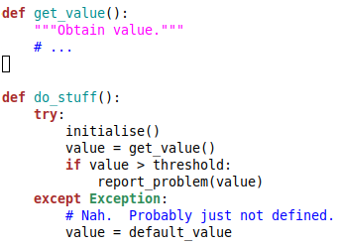
Try blocks. Don’t trust them.

Slide 17
Inheritance has its place.
Interfaces & abstract base classes.
Exception taxonomies.
What else..?

