Slide 1
Text Classification Assignment
Data8003: Unstructured Data and Visualisation
Higher Diploma in Data Science and Analytics (2007-2008)
Cork Institute of Technology
Joao Viegas (R00157699)
03.12.2017

Slide 2
Text Classification
The challenge
Approach:
Naïve Bayes
Support Vector Machine – Linear Kernel
The experiments:
The Naïve Bayes approach
Support Vector Matrices (SVM)
Conclusion

Slide 3
The challenge
Classify text messages:
Spam
Ham
ham,Ok lar... Joking wif u oni...
spam,Are you unique enough? Find out from 30th August. www.areyouunique.co.uk
ham,U dun say so early hor... U c already then say...
ham,"Nah I don't think he goes to usf, he lives around here though"
ham,Even my brother is not like to speak with me. They treat me like aids patent.
ham,I HAVE A DATE ON SUNDAY WITH WILL!!
ham,Oh k...i'm watching here:)
spam,"Did you hear about the new ""Divorce Barbie""? It comes with all of Ken's stuff!"

Slide 4
Naïve Bayes (Supervised learning)
P(spam ∩ <word>)
non-mutually exclusive events: some words might be part of ham and spam messages;
dependent events: P(<word>) and P(spam) are likely highly dependent;
prior probability: P(spam)
marginal Likelihood: P(<word>)
likelihood: P(<word> ∩ spam)
posterior probability =
likelihood ∗prior probability /marginal likelihood
P(<word> ∩ spam) * P(spam) / P(<word>)
Strengths:
de facto standard for text classification;
simple, fast and effective;
good with noisy or missing data;
requires few examples for training
Weaknesses:
not well suited to lots of numeric data (these have to be bucketed as factors)
resultant estimated probabilities aren’t as accurate as its classification results

Slide 5
Support Vector Machine – Linear Kernel (Supervised learning)
Rationale:
Every text is a vector in a multidimensional space;
Finds an optimal hyperplane that divides the vectors/separates the data;
That hyperplane is a vector and the angle between the text vector and the hyperplane defines the classification;
Performs well with sparse data (think doc term matrix sparsity) ;
Good in non-separable data;
Large data sets;
Fast;

Slide 6
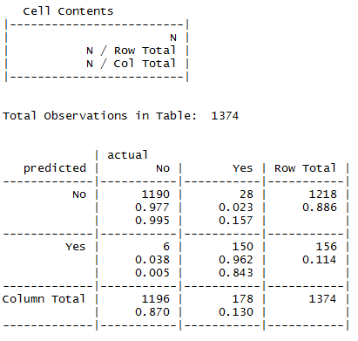
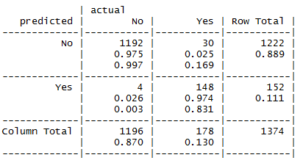
Experiment Naïve Bayes
with Laplace smoothing:
total cases : 1374
false positives: 30
false negatives: 4
total cases : 1374
false positives: 28
false negatives: 6

Slide 7
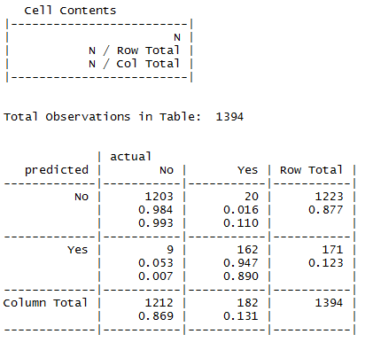
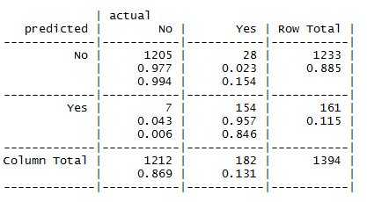
Experiment Naïve Bayes (continuation) 75% test data partition and word stemming
with Laplace smoothing:
total cases : 1394
false positives: 28
false negatives: 7
total cases : 1394
false positives: 20
false negatives: 9

Slide 8
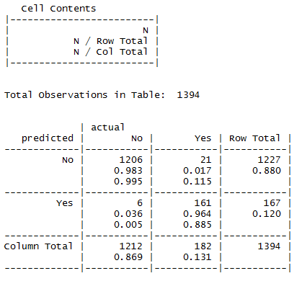
Experiment Support Vector Machine – Linear Kernel
total cases : 1394
false positives: 21
false negatives: 6

Slide 9
Conclusion
 | total cases | false negatives | false positives | total false
Naïve Bayes | 1374 | 28 | 6 | 34
Naïve Bayes w/ Laplace smoothing | 1374 | 30 | 4 | 34
Naïve Bayes + 75% partition + stemming | 1394 | 20 | 9 | 29
Naïve Bayes + 75% partition + stemming + Laplace smoothing | 1394 | 28 | 7 | 35
Support Vector Machine – Linear Kernel | 1394 | 21 | 6 | 27

Slide 10
This is not the end this is the beginning
thank you

