Slide 1
Cork Tech Days 20150217
Bluemix custom R buildpack
Joao Tiago Viegas

Slide 2
Cork Tech Days 20150217 - Bluemix custom R buildpack toc
      why?
      why R?
      what's a buildpack ?
      custom R buildpack example
      application example
      stage application use case;

Slide 3
Cork Tech Days 20150217 - Bluemix custom R buildpack why ?
Bluemix service allowing us to:
  dump data;
  data processing with R;
  retrieve processing results;
  scale;
Related Bluemix services:
  DashDB – virtual desktop experience;
Other solutions
  Cloudfoundry community [cloudfoundry & cloudfoundry-community @ github]:
    Lots of custom buildpacks;
    established buildpack development architecture – ruby based;
    no R, though;
  Public account github – failed to load on Bluemix;

Slide 4

Cork Tech Days 20150217 - Bluemix custom R buildpack why R?
http://www.r-project.org/
Powerful language and environment for statistical computing and graphics;
Open source alternative implementation of the S language (commercial);
Becoming considered as the statistics lingua franca;
Quickly analyse and plot data;
Amazing IDE – Rstudio;
Open Source, free;
Extensible via packages;
for computationally-intensive tasks, C, C++ and Fortran code can be linked and called at run time;

Slide 5
Cork Tech Days 20150217 - Bluemix custom R buildpack what's a buildpack ? 1/4
"platform" part of a Bluemix application – any deployable solution must define its buildpack;
Defined by 3 scripts: Detect, Compile and Release;
coded in ruby, but also bash.
Detect script
When staging an application in bluemix, the cloud controller will run the buildpack detect script;
The detect script validates the application, enforcing some specific requirement and returns 0 or non 0 accordingly;

Slide 6
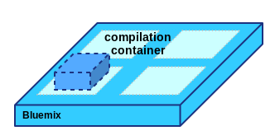
Cork Tech Days 20150217 - Bluemix custom R buildpack what's a buildpack ? 2/4
Compile script
After the buildpack is selected, its compile script will be invoked in a compilation container, this script receives a parameter with a build folder location. In that folder it should setup its execution environment:
  sources and/or binaries are downloaded;
  compilation can also take place;
  all required assets to run this "platform" should be stored as they will be found in the execution environment later on;

Slide 7
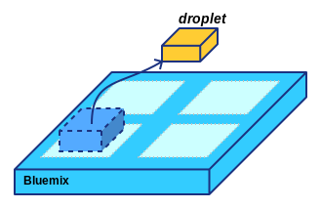
Cork Tech Days 20150217 - Bluemix custom R buildpack what's a buildpack ? 3/4
...after the compilation, this build folder will be archived as a tarball called "droplet":

Slide 8
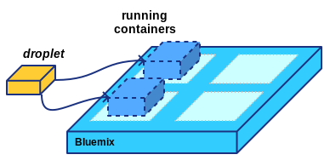
Cork Tech Days 20150217 - Bluemix custom R buildpack what's a buildpack ? 4/4
Release script
should provide configuration parameters to run the application, printing it to STDOUT in YAML format:
  Start script/binary;
  Environment variables;
...Bluemix provides then the containers and the droplet, and kicks-off the application accordingly:

Slide 9
Cork Tech Days 20150217 - Bluemix custom R buildpack custom R buildpack example
Detect:
if [ -f $1/startR.sh ]; then
echo "R" && exit 0
else
echo "no" && exit 1
fi
Compile:
...
cd $CACHE_DIR
echo "Downloading and unpacking bundles to cache dir"
if [[ ! -f $VENDOR_BUNDLE ]]; then
wget --no-check-certificate $VENDOR_URI/$VENDOR_BUNDLE
fi
if [[ ! -f $JAVA_BUNDLE ]]; then
wget --no-check-certificate $JAVA_URI/$JAVA_BUNDLE
fi
cd $BUILD_DIR
tar xjpvf $CACHE_DIR/$JAVA_BUNDLE &> /dev/null
tar xjpvf $CACHE_DIR/$VENDOR_BUNDLE &> /dev/null
chmod 0755 startR.sh
...
Release:
cat <<EOF
config_vars:
DEPLOY_DIR: /app
default_process_types: {
web: ./startR.sh
}
EOF

Slide 10
Cork Tech Days 20150217 - Bluemix custom R buildpack application example
startR.sh script
. ./vars.sh
$R_HOME/bin/R --save <<RPROG
setwd("$TASKS_DIR")
r <- getOption("repos")
r["CRAN"] <- "$CRAN_MIRROR"
options(repos=r)
print('R is ready!')
RPROG
while true; do
for entry in "$TASKS_DIR"/*.r
Do
echo "going to process file $entry"
$R_HOME/bin/R --gui-none --no-save -f "$entry"
done
sleep 5
done

Slide 11

Cork Tech Days 20150217 - Bluemix custom R buildpack stage application use case
deploy script
MONGO_SERVICE=mongolab
MONGO_PLAN=sandbox
MONGO_INSTANCE=mongo
R_APP=ronbluemix
cf push $R_APP -b https://github.com/jtviegas/bluemix-R-buildpack.git --no-route
cf create-service $MONGO_SERVICE $MONGO_PLAN $MONGO_INSTANCE
cf bind-service $R_APP $MONGO_INSTANCE
cf restage $R_APP
Manifest.yml:
applications:
- disk_quota: 1024M
name: ronbluemix
instances: 1
memory: 1024M

Slide 12
Cork Tech Days 20150217 - Bluemix custom R buildpack
? & Thank You
References:
https://github.com/jtviegas/bluemix-R-buildpack
https://github.com/jtviegas/bluemix/tree/master/rOnBluemix
http://docs.cloudfoundry.org/buildpacks/
http://docs.cloudfoundry.org/buildpacks/custom.html
https://github.com/cloudfoundry-community
https://github.com/cloudfoundry
http://www.r-project.org/

