Slide 1
Obvious Strategy-Proof Mechanisms
Alon Eden
Harvard University

Slide 2
Overview of this talk
Motivation
Defining Obvious Strategy-Proofness (OSP) [Li]
Demonstration and characterization
Refinement of Obviousness [Pycia Troyan]
Experimental evidence of limitation of theory [Breitmoser Schweighofer-Korditsch]

Slide 3
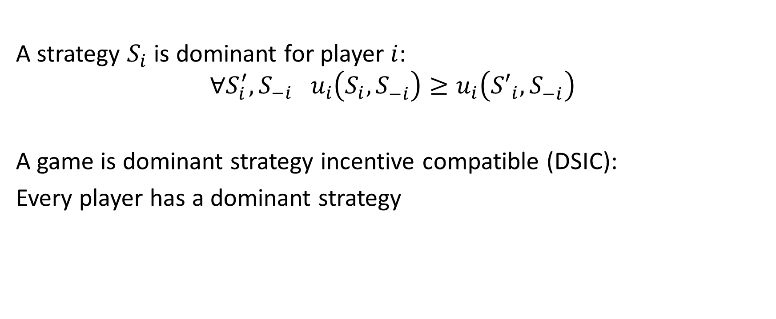
Dominant strategy
A strategy $S_{i}$ is dominant for player $i$:
$$∀S_{i}^{′}, S_{−i} u_{i}\left(S_{i},S_{−i}^{}\right)≥u_{i}\left({S′}_{i},S_{−i}^{}\right)$$
A game is dominant strategy incentive compatible (DSIC):
Every player has a dominant strategy

Slide 4
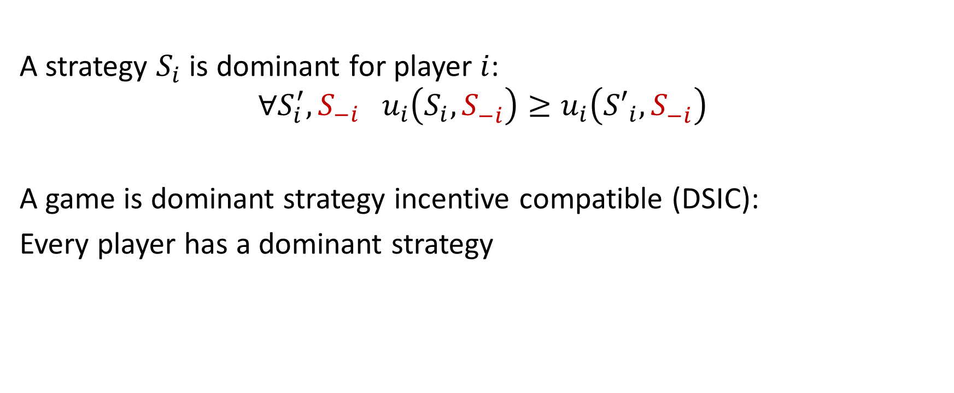
Dominant strategy
A strategy $S_{i}$ is dominant for player $i$:
$$∀S_{i}^{′}, S_{−i} u_{i}\left(S_{i},S_{−i}^{}\right)≥u_{i}\left({S′}_{i},S_{−i}^{}\right)$$
A game is dominant strategy incentive compatible (DSIC):
Every player has a dominant strategy

Slide 5

Second price auction
One item for sale
Players bid $(b_{1},…, b_{n})$
Highest bidder wins
Pays second highest bid
Dominant strategy: $b_{i}=v_{i}$

Slide 6


Ascending (clock) auction
One item for sale
All players are initially in
Prices ascends slowly
Players dropout until one player remains
Pays the price in which the last agent dropped out
Dominant strategy:
$v_{i}<$ Price: stay
$v_{i}≤$ Price: dropout
Strategically equivalent to second price auction
(same winner and payment, same normal form)

Slide 7
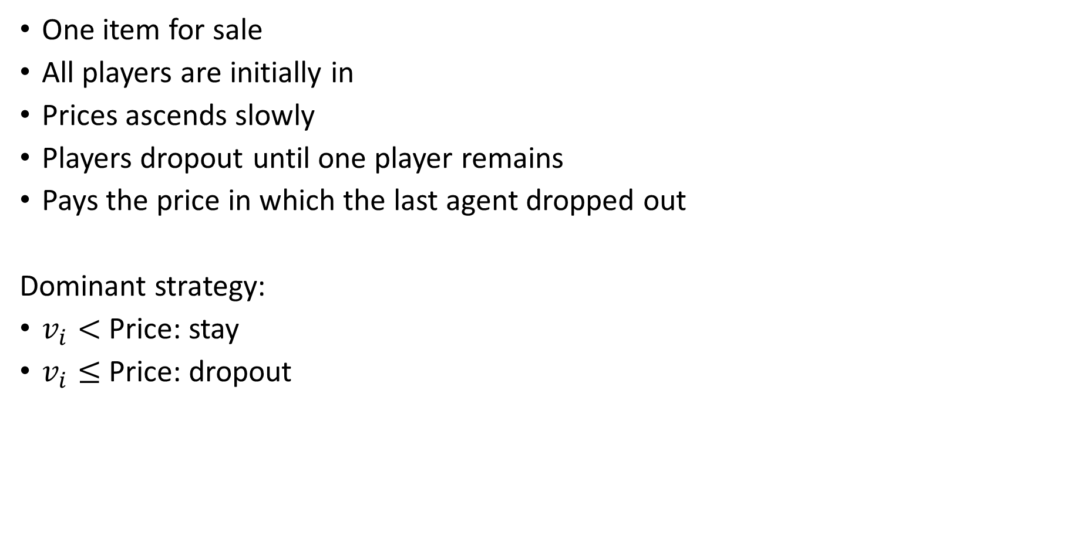
Ascending (clock) auction
One item for sale
All players are initially in
Prices ascends slowly
Players dropout until one player remains
Pays the price in which the last agent dropped out
Dominant strategy:
$v_{i}<$ Price: stay
$v_{i}≤$ Price: dropout
Strategically equivalent to second price auction
(same winner and payment, same normal form)

Slide 8
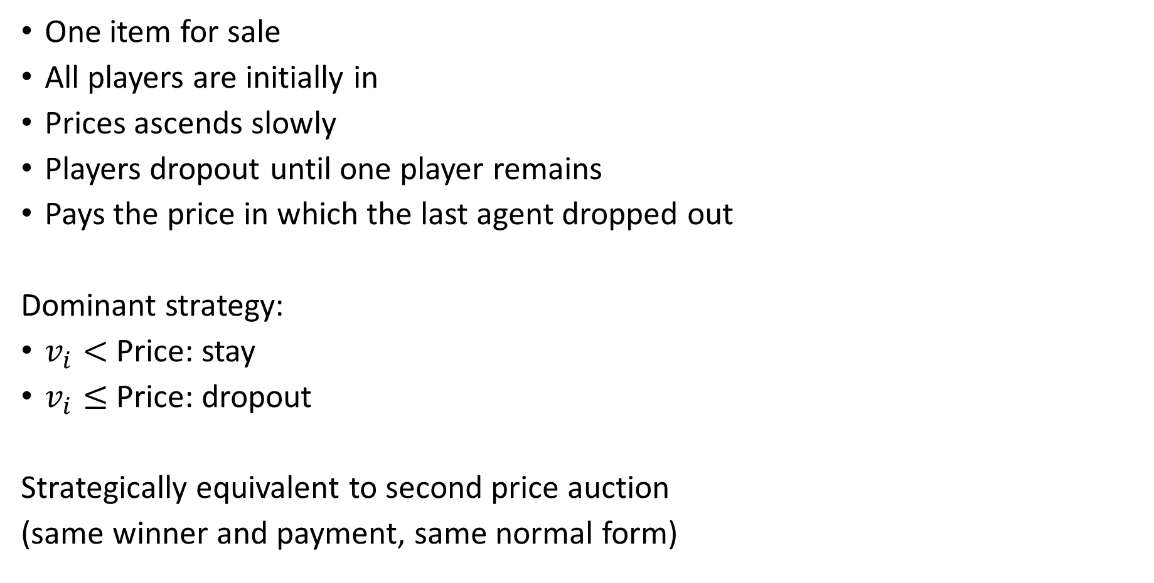
Ascending (clock) auction
One item for sale
All players are initially in
Prices ascends slowly
Players dropout until one player remains
Pays the price in which the last agent dropped out
Dominant strategy:
$v_{i}<$ Price: stay
$v_{i}≤$ Price: dropout
Strategically equivalent to second price auction
(same winner and payment, same normal form)

Slide 9
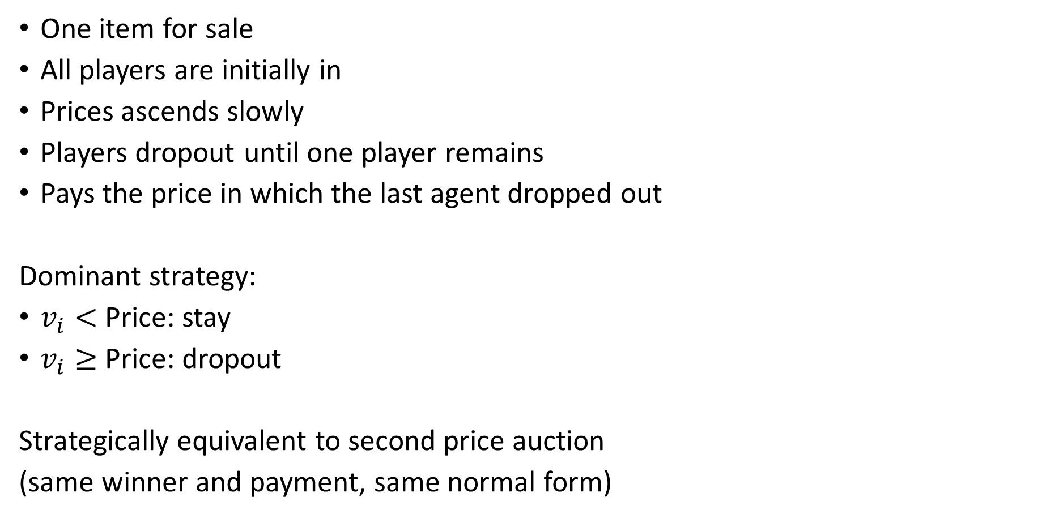
Ascending (clock) auction
One item for sale
All players are initially in
Prices ascends slowly
Players dropout until one player remains
Pays the price in which the last agent dropped out
Dominant strategy:
$v_{i}<$ Price: stay
$v_{i}≥$ Price: dropout
Strategically equivalent to second price auction
(same winner and payment, same normal form)
second price auctions are harder in practice [Kagel Harstad Levin ‘87]

Slide 10
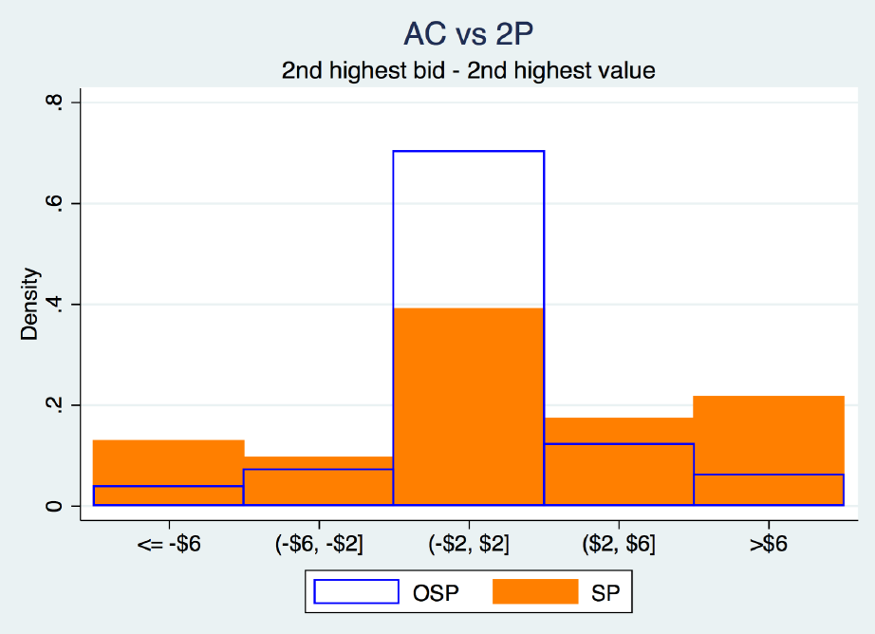
Ascending auctions are easier
[Li]:

Slide 11
Ascending auctions are easier
[Li]:
31%

Slide 12

























Extensive form games
$$i$$
$$j$$
$$j$$
$$j$$
$$x$$
$$y$$
$$w$$
$$i$$
$$y$$
$$i$$
$$i$$
$$j$$
$$w$$
$$j$$
$$y$$
$$z$$
$$j$$
$$i$$
$$y$$
$$w$$
$$z$$
$$w$$
$$z$$
$$x$$
$$w$$

Slide 13

Extensive form games
$$i$$
$$j$$
$$j$$
$$j$$
Player $i$ node
$$x$$
$$y$$
$$w$$
$$i$$
$$y$$
$$i$$
$$i$$
$$j$$
$$w$$
$$j$$
$$y$$
$$z$$
$$j$$
$$i$$
$$y$$
$$w$$
$$z$$
$$w$$
$$z$$
$$x$$
$$w$$

Slide 14

Extensive form games
$$i$$
$$j$$
$$j$$
$$j$$
Player $j$ node
$$x$$
$$y$$
$$w$$
$$i$$
$$y$$
$$i$$
$$i$$
$$j$$
$$w$$
$$j$$
$$y$$
$$z$$
$$j$$
$$i$$
$$y$$
$$w$$
$$z$$
$$w$$
$$z$$
$$x$$
$$w$$

Slide 15








Extensive form games
$$i$$
$$j$$
$$j$$
$$j$$
$$x$$
$$y$$
$$w$$
$$i$$
$$y$$
$$i$$
$$i$$
outcome
$$j$$
$$w$$
$$j$$
$$y$$
$$z$$
$$j$$
$$i$$
$$y$$
$$w$$
$$z$$
$$w$$
$$z$$
$$x$$
$$w$$

Slide 16
Extensive form games
$$i$$
$$j$$
$$j$$
$$j$$
$$x$$
$$y$$
$$w$$
$$i$$
$$y$$
$$i$$
$$i$$
$$j$$
$$w$$
$$j$$
$$y$$
$$z$$
$$j$$
$$i$$
$$y$$
$$w$$
$$z$$
$$w$$
$$z$$
$$x$$
$$w$$

Slide 17


Extensive form games
Strategy $S$
$$i$$
$$j$$
$$j$$
$$j$$
$$x$$
$$y$$
$$w$$
$$i$$
$$y$$
$$i$$
$$i$$
$$j$$
$$w$$
$$j$$
$$x$$
$$z$$
$$j$$
$$i$$
$$y$$
$$w$$
$$z$$
$$w$$
$$z$$
$$x$$
$$w$$

Slide 18
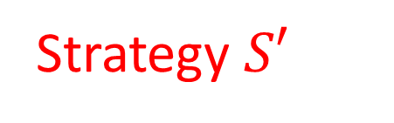
Extensive form games
Strategy $S$
$$i$$
Strategy $S′$
$$j$$
$$j$$
$$j$$
$$x$$
$$y$$
$$w$$
$$i$$
$$y$$
$$i$$
$$i$$
$$j$$
$$w$$
$$j$$
$$x$$
$$z$$
$$j$$
$$i$$
$$y$$
$$w$$
$$z$$
$$w$$
$$z$$
$$x$$
$$w$$

Slide 19
Earliest points of departure
Strategy $S$
$$i$$
Strategy $S′$
$$j$$
$$j$$
$$j$$
$$x$$
$$y$$
$$w$$
$$i$$
$$y$$
$$i$$
$$i$$
$$j$$
$$w$$
$$j$$
$$x$$
$$z$$
$$j$$
$$i$$
$$y$$
$$w$$
$$z$$
$$w$$
$$z$$
$$x$$
$$w$$

Slide 20
Earliest points of departure
Strategy $S$
$$i$$
Strategy $S′$
$$j$$
$$j$$
$$j$$
$$x$$
$$y$$
$$w$$
$$i$$
$$y$$
$$i$$
$$i$$
$$j$$
$$w$$
$$j$$
$$x$$
$$z$$
$$j$$
$$i$$
$$y$$
$$w$$
$$z$$
$$w$$
$$z$$
$$x$$
$$w$$

Slide 21
Earliest points of departure
Strategy $S$
$$i$$
Strategy $S′$
$$j$$
$$j$$
$$j$$
$$x$$
$$y$$
$$w$$
$$i$$
$$y$$
$$i$$
$$i$$
$$j$$
$$w$$
$$j$$
$$x$$
$$z$$
$$j$$
$$i$$
$$y$$
$$w$$
$$z$$
$$w$$
$$z$$
$$x$$
$$w$$

Slide 22




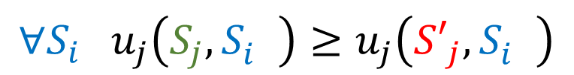




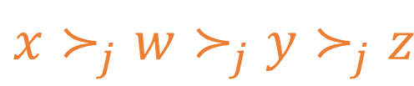








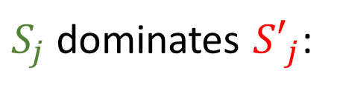
Obviously dominates [Li]
$$x≻_{j}w≻_{j}y≻_{j}z$$
$$i$$
$S_{j}$ dominates ${S′}_{j}$:
$$j$$
$$j$$
$$j$$
$$∀S_{i} u_{j}\left(S_{j},S_{i}^{}\right)≥u_{j}\left({S′}_{j},S_{i}^{}\right)$$
$$x$$
$$y$$
$$i$$
$$y$$
$$i$$
$$z$$
$$j$$
$$w$$
$$j$$
$$x$$
$$x$$
$$y$$
$$w$$
$$z$$

Slide 23

Obviously dominates [Li]
$$x≻_{j}w≻_{j}y≻_{j}z$$
$$i$$
$S_{j}$ dominates ${S′}_{j}$:
$$j$$
$$j$$
$$j$$
$$∀S_{i} u_{j}\left(S_{j},S_{i}^{}\right)≥u_{j}\left({S′}_{j},S_{i}^{}\right)$$
$$x$$
$$y$$
$$i$$
$$y$$
$$i$$
$$z$$
$$j$$
$$w$$
$$j$$
$$x$$
$$x$$
$$y$$
$$w$$
$$z$$

Slide 24

Obviously dominates [Li]
$$x≻_{j}w≻_{j}y≻_{j}z$$
$$i$$
$S_{j}$ dominates ${S′}_{j}$:
$$j$$
$$j$$
$$j$$
$$∀S_{i} u_{j}\left(S_{j},S_{i}^{}\right)≥u_{j}\left({S′}_{j},S_{i}^{}\right)$$
$$x$$
$$y$$
$$i$$
$$y$$
$$i$$
$$z$$
$$j$$
$$w$$
$$j$$
$$x$$
$$x$$
$$y$$
$$w$$
$$z$$

Slide 25

Obviously dominates [Li]
$$x≻_{j}w≻_{j}y≻_{j}z$$
$$i$$
$S_{j}$ dominates ${S′}_{j}$:
$$j$$
$$j$$
$$j$$
$$∀S_{i} u_{j}\left(S_{j},S_{i}^{}\right)≥u_{j}\left({S′}_{j},S_{i}^{}\right)$$
$$x$$
$$y$$
$$i$$
$$y$$
$$i$$
$$z$$
$$j$$
$$w$$
$$j$$
$$x$$
$$x$$
$$y$$
$$w$$
$$z$$

Slide 26


Obviously dominates [Li]
$$x≻_{j}w≻_{j}y≻_{j}z$$
$$i$$
$S_{j}$ dominates ${S′}_{j}$:
$$j$$
$$j$$
$$j$$
$$∀S_{i} u_{j}\left(S_{j},S_{i}^{}\right)≥u_{j}\left({S′}_{j},S_{i}^{}\right)$$
$$x$$
$$y$$
$$i$$
$$y$$
$$i$$
$$z$$
$$j$$
$$w$$
$$j$$
$$x$$
$$x$$
$$y$$
$$w$$
$$z$$

Slide 27

Obviously dominates [Li]
$$x≻_{j}w≻_{j}y≻_{j}z$$
$$i$$
$S_{j}$ dominates ${S′}_{j}$:
$$j$$
$$j$$
$$j$$
$$∀S_{i} u_{j}\left(S_{j},S_{i}^{}\right)≥u_{j}\left({S′}_{j},S_{i}^{}\right)$$
$$x$$
$$y$$
$$i$$
$$y$$
$$i$$
$$z$$
$$j$$
$$w$$
$$j$$
$$x$$
$$x$$
$$y$$
$$w$$
$$z$$

Slide 28

Obviously dominates [Li]
$$x≻_{j}w≻_{j}y≻_{j}z$$
$$i$$
$S_{j}$ dominates ${S′}_{j}$:
$$j$$
$$j$$
$$j$$
$$∀S_{i} u_{j}\left(S_{j},S_{i}^{}\right)≥u_{j}\left({S′}_{j},S_{i}^{}\right)$$
$$x$$
$$y$$
$$i$$
$$y$$
$$i$$
$$z$$
$$j$$
$$w$$
$$j$$
$$x$$
$$x$$
$$y$$
$$w$$
$$z$$

Slide 29

Obviously dominates [Li]
$$x≻_{j}w≻_{j}y≻_{j}z$$
$$i$$
$S_{j}$ dominates ${S′}_{j}$:
$$j$$
$$j$$
$$j$$
$$∀S_{i} u_{j}\left(S_{j},S_{i}^{}\right)≥u_{j}\left({S′}_{j},S_{i}^{}\right)$$
$$x$$
$$y$$
$$i$$
$$y$$
$$i$$
$$z$$
$$j$$
$$w$$
$$j$$
$$x$$
$$x$$
$$y$$
$$w$$
$$z$$

Slide 30


Obviously dominates [Li]
$$x≻_{j}w≻_{j}y≻_{j}z$$
$$i$$
$S_{j}$ dominates ${S′}_{j}$:
$$j$$
$$j$$
$$j$$
$$∀S_{i} u_{j}\left(S_{j},S_{i}^{}\right)≥u_{j}\left({S′}_{j},S_{i}^{}\right)$$
$$x$$
$$y$$
$$i$$
$$y$$
$$i$$
$$z$$
$$j$$
$$w$$
$$j$$
$$x$$
$$x$$
$$y$$
$$w$$
$$z$$

Slide 31

Obviously dominates [Li]
$$x≻_{j}w≻_{j}y≻_{j}z$$
$$i$$
$S_{j}$ dominates ${S′}_{j}$:
$$j$$
$$j$$
$$j$$
$$∀S_{i} u_{j}\left(S_{j},S_{i}^{}\right)≥u_{j}\left({S′}_{j},S_{i}^{}\right)$$
$$x$$
$$y$$
$$i$$
$$y$$
$$i$$
$$z$$
$$j$$
$$w$$
$$j$$
$$x$$
$$x$$
$$y$$
$$w$$
$$z$$

Slide 32
Obviously dominates [Li]
$$x≻_{j}w≻_{j}y≻_{j}z$$
$$i$$
$$j$$
$$j$$
$$j$$
$$x$$
$$y$$
$$i$$
$$y$$
$$i$$
$$z$$
$$j$$
$$w$$
$$j$$
$$x$$
$$x$$
$$y$$
$$w$$
$$z$$

Slide 33
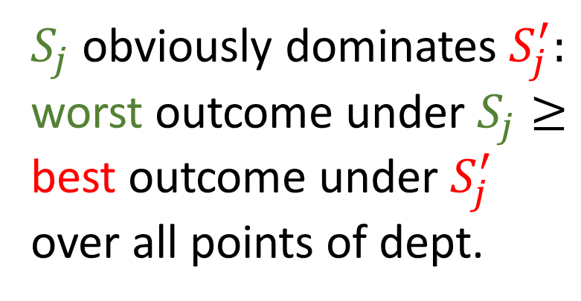
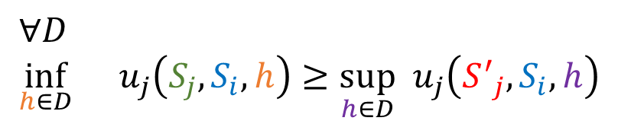
Obviously dominates [Li]
$$x≻_{j}w≻_{j}y≻_{j}z$$
$$i$$
$S_{j}$ obviously dominates $S_{j}^{′}:$ worst outcome under $S_{j}≥$
best outcome under $S_{j}^{′}$
over all points of dept.
$$j$$
$$j$$
$$j$$
$$x$$
$$y$$
$$i$$
$$y$$
$$i$$
$$z$$
$$j$$
$$w$$
$$j$$
$$x$$
$$∀D \\ \inf_{h∈D}{}u_{j}\left(S_{j},S_{i},h\right)≥\sup_{h∈D} u_{j}\left({S^{′}}_{j},S_{i},h\right)$$
$$x$$
$$y$$
$$w$$
$$z$$

Slide 34


Obviously dominates [Li]
$$x≻_{j}w≻_{j}y≻_{j}z$$
$$i$$
$S_{j}$ obviously dominates $S_{j}^{′}:$ worst outcome under $S_{j}≥$
best outcome under $S_{j}^{′}$
over all points of dept.
$$j$$
$$j$$
$$j$$
$$x$$
$$y$$
$$i$$
$$y$$
$$i$$
$$z$$
$$j$$
$$w$$
$$j$$
$$x$$
$$∀D \\ \inf_{h∈D}{}u_{j}\left(S_{j},S_{i},h\right)≥\sup_{h∈D} u_{j}\left({S^{′}}_{j},S_{i},h\right)$$
$$x$$
$$y$$
$$w$$
$$z$$

Slide 35


Obviously dominates [Li]
$$x≻_{j}w≻_{j}y≻_{j}z$$
$$i$$
$S_{j}$ obviously dominates $S_{j}^{′}:$ worst outcome under $S_{j}≥$
best outcome under $S_{j}^{′}$
over all points of dept.
$$j$$
$$j$$
$$j$$
$$x$$
$$y$$
$$i$$
$$y$$
$$i$$
$$z$$
$$j$$
$$w$$
$$j$$
$$x$$
$$∀D \\ \inf_{h∈D}{}u_{j}\left(S_{j},S_{i},h\right)≥\sup_{h∈D} u_{j}\left({S^{′}}_{j},S_{i},h\right)$$
$$x$$
$$y$$
$$w$$
$$z$$

Slide 36
Obviously dominates [Li]
$$x≻_{j}w≻_{j}y≻_{j}z$$
$$i$$
$S_{j}$ obviously dominates $S_{j}^{′}:$ worst outcome under $S_{j}≥$
best outcome under $S_{j}^{′}$
over all points of dept.
$$j$$
$$j$$
$$j$$
$$x$$
$$y$$
$$i$$
$$y$$
$$i$$
$$z$$
$$j$$
$$w$$
$$j$$
$$x$$
$$∀D \\ \inf_{h∈D}{}u_{j}\left(S_{j},S_{i},h\right)≥\sup_{h∈D} u_{j}\left({S^{′}}_{j},S_{i},h\right)$$
$$x$$
$$y$$
$$w$$
$$z$$
best outcome made possible by dev $≤$ worst outcome by not dev

Slide 37
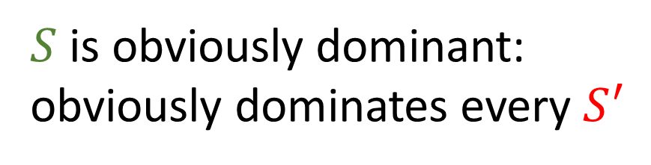
Obviously dominates [Li]
$$x≻_{j}w≻_{j}y≻_{j}z$$
$$i$$
$S_{j}$ obviously dominates $S_{j}^{′}:$ worst outcome under $S_{j}≥$
best outcome under $S_{j}^{′}$
over all points of dept.
$$j$$
$$j$$
$$j$$
$$x$$
$$y$$
$$i$$
$$y$$
$$i$$
$$z$$
$S$ is obviously dominant:
obviously dominates every $S^{′}$
$$j$$
$$w$$
$$j$$
$$x$$
$$x$$
$$y$$
$$w$$
$$z$$

Slide 38

Obviously dominates [Li]
$$x≻_{j}w≻_{j}y≻_{j}z$$
$$i$$
$S_{j}$ obviously dominates $S_{j}^{′}:$ worst outcome under $S_{j}≥$
best outcome under $S_{j}^{′}$
over all points of dept.
$$j$$
$$j$$
$$j$$
$$x$$
$$y$$
$$i$$
$$y$$
$$i$$
$$z$$
$S$ is obviously dominant:
obviously dominates every $S^{′}$
$$j$$
$$w$$
$$j$$
$$x$$
$$x$$
$$y$$
$$w$$
$$z$$

Slide 39
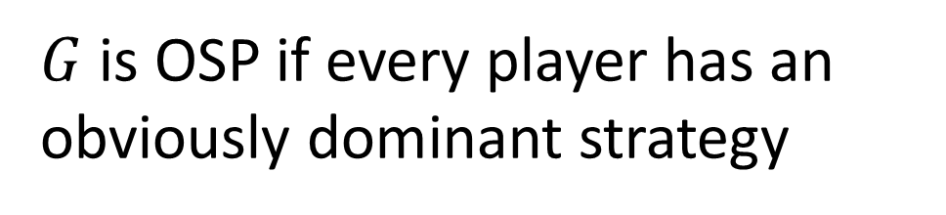
Obviously dominates [Li]
$$x≻_{j}w≻_{j}y≻_{j}z$$
$$i$$
$S_{j}$ obviously dominates $S_{j}^{′}:$ worst outcome under $S_{j}≥$
best outcome under $S_{j}^{′}$
over all points of dept.
$$j$$
$$j$$
$$j$$
$$x$$
$$y$$
$$i$$
$$y$$
$$i$$
$$z$$
$S$ is obviously dominant:
obviously dominates every $S^{′}$
$$j$$
$$w$$
$$j$$
$$x$$
$$x$$
$$y$$
$$w$$
$$z$$
$G$ is OSP if every player has an obviously dominant strategy

Slide 40








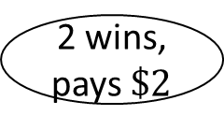
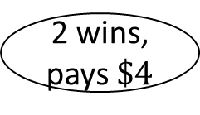
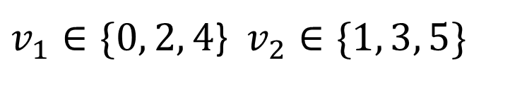








Second price auction is not OSP
$v_{1}∈\{0, 2, 4$} $v_{2}∈\{1, 3, 5\}$
$$1$$
$$\$0$$
$$\$4$$
$$\$2$$
$$2$$
$$2$$
$$2$$
$$\$1$$
$$\$3$$
$$\$5$$
$$\$1$$
$$\$5$$
$$\$1$$
$$\$5$$
$$\$3$$
$$\$3$$
2 wins, pays nothing
2 looses
2 wins, pays $\$2$
2 looses
2 wins, pays $\$4$

Slide 41
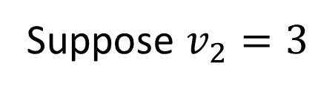
Second price auction is not OSP
$v_{1}∈\{0, 2, 4$} $v_{2}∈\{1, 3, 5\}$
$$1$$
$$\$0$$
$$\$4$$
$$\$2$$
Suppose $v_{2}=3$
$$2$$
$$2$$
$$2$$
$$\$1$$
$$\$3$$
$$\$5$$
$$\$1$$
$$\$5$$
$$\$1$$
$$\$5$$
$$\$3$$
$$\$3$$
2 wins, pays nothing
2 looses
2 wins, pays $\$2$
2 looses
2 wins, pays $\$4$

Slide 42
Second price auction is not OSP
$v_{1}∈\{0, 2, 4$} $v_{2}∈\{1, 3, 5\}$
$$1$$
$$\$0$$
$$\$4$$
$$\$2$$
Suppose $v_{2}=3$
$$2$$
$$2$$
$$2$$
$$\$5$$
truth-telling
$$\$1$$
$$\$3$$
$$\$1$$
$$\$5$$
$$\$1$$
$$\$5$$
$$\$3$$
$$\$3$$
2 wins, pays nothing
2 looses
2 wins, pays $\$2$
2 looses
2 wins, pays $\$4$

Slide 43
Second price auction is not OSP
$v_{1}∈\{0, 2, 4$} $v_{2}∈\{1, 3, 5\}$
$$1$$
$$\$0$$
$$\$4$$
$$\$2$$
Suppose $v_{2}=3$
$$2$$
$$2$$
$$2$$
$$\$5$$
truth-telling
$$\$1$$
$$\$3$$
$$\$1$$
$$\$5$$
$$\$1$$
$$\$5$$
$$\$3$$
$$\$3$$
deviation
2 wins, pays nothing
2 looses
2 wins, pays $\$2$
2 looses
2 wins, pays $\$4$

Slide 44
Second price auction is not OSP
$v_{1}∈\{0, 2, 4$} $v_{2}∈\{1, 3, 5\}$
$$1$$
$$\$0$$
$$\$4$$
$$\$2$$
Suppose $v_{2}=3$
$$2$$
$$2$$
$$2$$
$$\$5$$
truth-telling
$$\$1$$
$$\$3$$
$$\$1$$
$$\$5$$
$$\$1$$
$$\$5$$
$$\$3$$
$$\$3$$
deviation
2 wins, pays nothing
2 looses
2 wins, pays $\$2$
2 looses
2 wins, pays $\$4$

Slide 45
Second price auction is not OSP
$v_{1}∈\{0, 2, 4$} $v_{2}∈\{1, 3, 5\}$
$$1$$
$$\$0$$
$$\$4$$
$$\$2$$
Suppose $v_{2}=3$
$$2$$
$$2$$
$$2$$
$$\$5$$
truth-telling
$$\$1$$
$$\$3$$
$$\$1$$
$$\$5$$
$$\$1$$
$$\$5$$
$$\$3$$
$$\$3$$
deviation
2 wins, pays nothing
2 looses
2 wins, pays $\$2$
2 looses
2 wins, pays $\$4$

Slide 46
Second price auction is not OSP
$v_{1}∈\{0, 2, 4$} $v_{2}∈\{1, 3, 5\}$
$$1$$
$$\$0$$
$$\$4$$
$$\$2$$
Suppose $v_{2}=3$
$$2$$
$$2$$
$$2$$
$$\$5$$
truth-telling
$$\$1$$
$$\$3$$
$$\$1$$
$$\$5$$
$$\$1$$
$$\$5$$
$$\$3$$
$$\$3$$
deviation
2 wins, pays nothing
2 looses
2 wins, pays $\$2$
2 looses
2 wins, pays $\$4$

Slide 47












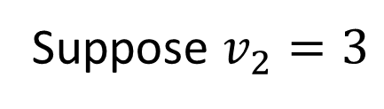
Ascending price auction is OSP
price
$$\$0$$
$$\$1$$
$$\$2$$
$$\$3$$
$$\$4$$
$$\$5$$
Suppose $v_{2}=3$
in
in
in
in
in
in
$$1$$
$$2$$
$$1$$
$$2$$
$$1$$
$$2$$
out
out
out
out
out
out

Slide 48
Ascending price auction is OSP
price
$$\$0$$
$$\$1$$
$$\$2$$
$$\$3$$
$$\$4$$
$$\$5$$
Suppose $v_{2}=3$
in
in
in
in
in
in
$$1$$
$$2$$
$$1$$
$$2$$
$$1$$
$$2$$
out
out
out
out
out
out
truth-telling

Slide 49
Ascending price auction is OSP
price
$$\$0$$
$$\$1$$
$$\$2$$
$$\$3$$
$$\$4$$
$$\$5$$
Suppose $v_{2}=3$
in
in
in
in
in
in
$$1$$
$$2$$
$$1$$
$$2$$
$$1$$
$$2$$
out
out
out
out
out
out
truth-telling
deviation

Slide 50
Ascending price auction is OSP
price
$$\$0$$
$$\$1$$
$$\$2$$
$$\$3$$
$$\$4$$
$$\$5$$
Suppose $v_{2}=3$
in
in
in
in
in
in
$$1$$
$$2$$
$$1$$
$$2$$
$$1$$
$$2$$
out
out
out
out
out
out
truth-telling
deviation

Slide 51
Ascending price auction is OSP
price
$$\$0$$
$$\$1$$
$$\$2$$
$$\$3$$
$$\$4$$
$$\$5$$
Suppose $v_{2}=3$
in
in
in
in
in
in
$$1$$
$$2$$
$$1$$
$$2$$
$$1$$
$$2$$
out
out
out
out
out
out
truth-telling
w.c. under truth-telling ➔ 2 dropouts
deviation

Slide 52
Ascending price auction is OSP
price
$$\$0$$
$$\$1$$
$$\$2$$
$$\$3$$
$$\$4$$
$$\$5$$
Suppose $v_{2}=3$
in
in
in
in
in
in
$$1$$
$$2$$
$$1$$
$$2$$
$$1$$
$$2$$
out
out
out
out
out
out
truth-telling
w.c. under truth-telling ➔ 2 dropouts
deviation
b.c. under deviation ➔ 2 dropouts

Slide 53
Ascending price auction is OSP
price
$$\$0$$
$$\$1$$
$$\$2$$
$$\$3$$
$$\$4$$
$$\$5$$
Suppose $v_{2}=3$
in
in
in
in
in
in
$$1$$
$$2$$
$$1$$
$$2$$
$$1$$
$$2$$
out
out
out
out
out
out
truth-telling
deviation

Slide 54
Ascending price auction is OSP
price
$$\$0$$
$$\$1$$
$$\$2$$
$$\$3$$
$$\$4$$
$$\$5$$
Suppose $v_{2}=3$
in
in
in
in
in
in
$$1$$
$$2$$
$$1$$
$$2$$
$$1$$
$$2$$
out
out
out
out
out
out
truth-telling
deviation

Slide 55
Ascending price auction is OSP
price
$$\$0$$
$$\$1$$
$$\$2$$
$$\$3$$
$$\$4$$
$$\$5$$
Suppose $v_{2}=3$
in
in
in
in
in
in
$$1$$
$$2$$
$$1$$
$$2$$
$$1$$
$$2$$
out
out
out
out
out
out
truth-telling
w.c. under truth-telling ➔ 2 dropouts
deviation
b.c. under deviation ➔ 2 dropouts

Slide 56
Random serial dictatorship (RSD)
A set of items to be allocated
Order agents in a random order
Each agent clinches its favorite remaining item

Slide 57
Random serial dictatorship (RSD)
A set of items to be allocated
Order agents in a random order
Each agent clinches its favorite remaining item
RSD is OSP

Slide 58
Random serial dictatorship (RSD)
A set of items to be allocated
Order agents in a random order
Each agent clinches its favorite remaining item
RSD is OSP
RSD is not OSP

Slide 59
Random serial dictatorship (RSD)
A set of items to be allocated
Order agents in a random order
Each agent clinches its favorite remaining item
RSD is OSP
RSD is not OSP when bidders submit preference list in advance

Slide 60
Random serial dictatorship (RSD)
A set of items to be allocated
Order agents in a random order
Each agent clinches its favorite remaining item
RSD is OSP
RSD is not OSP when bidders submit preference list in advance
[Li] people are more prone to in RSD when preferences are given in advance

Slide 61
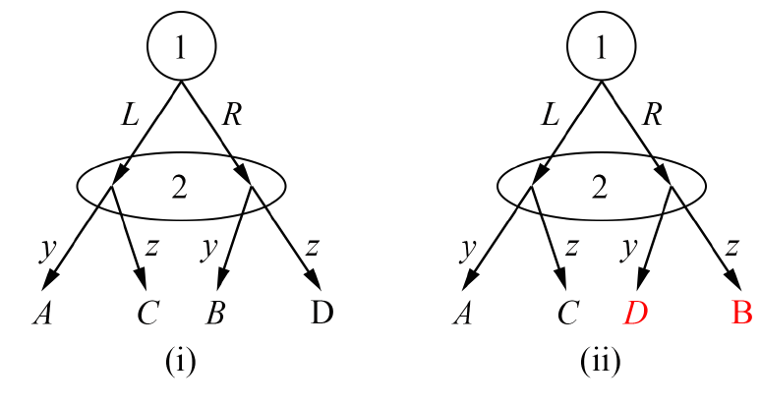

Experience
Playing $L$ is a dominant strategy at (i) but not at (ii)

Slide 62
Experience
Playing $L$ is a dominant strategy at (i) but not at (ii)
Player 1’s experience is very similar

Slide 63
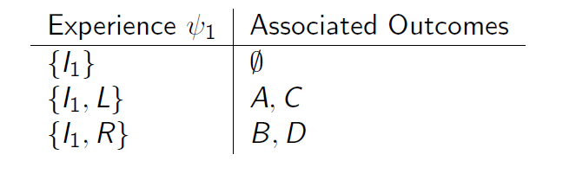
Experience

Slide 64
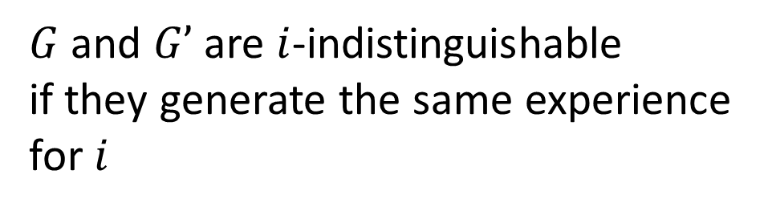
Experience
$G$ and $G’$ are $i$-indistinguishable
if they generate the same experience for $i$

Slide 65
Equivalence classes

Slide 66
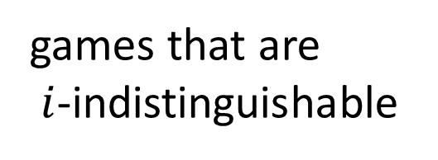
Equivalence classes
games that are
$i$-indistinguishable

Slide 67

Equivalence classes
games that are
$i$-indistinguishable
$S_{i}$ is dominant

Slide 68
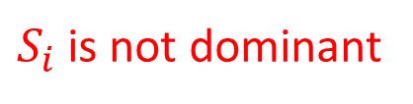

Equivalence classes
games that are
$i$-indistinguishable
$S_{i}$ is dominant
$S_{i}$ is not dominant
$S_{i}$ is not dominant

Slide 69
Equivalence classes
games that are
$i$-indistinguishable
$S_{i}$ is dominant
$S_{i}$ is not dominant
$S_{i}$ is not dominant

Slide 70
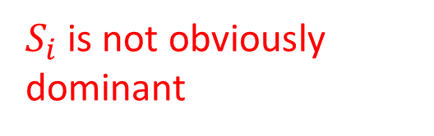
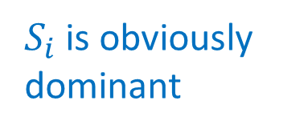
Equivalence classes
games that are
$i$-indistinguishable
$S_{i}$ is dominant
$S_{i}$ is obviously dominant
$S_{i}$ is not dominant
$S_{i}$ is not dominant
$S_{i}$ is not obviously dominant

Slide 71
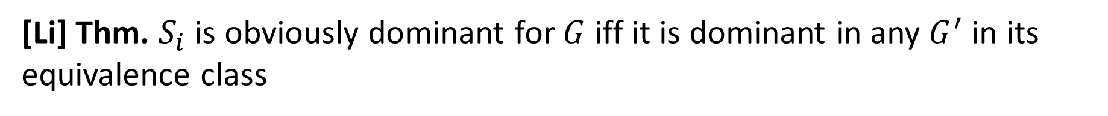
Equivalence classes
games that are
$i$-indistinguishable
$S_{i}$ is dominant
$S_{i}$ is obviously dominant
$S_{i}$ is not dominant
$S_{i}$ is not dominant
$S_{i}$ is not obviously dominant
[Li] Thm. $S_{i}$ is obviously dominant for $G$ iff it is dominant in any $G^{′}$ in its equivalence class

Slide 72
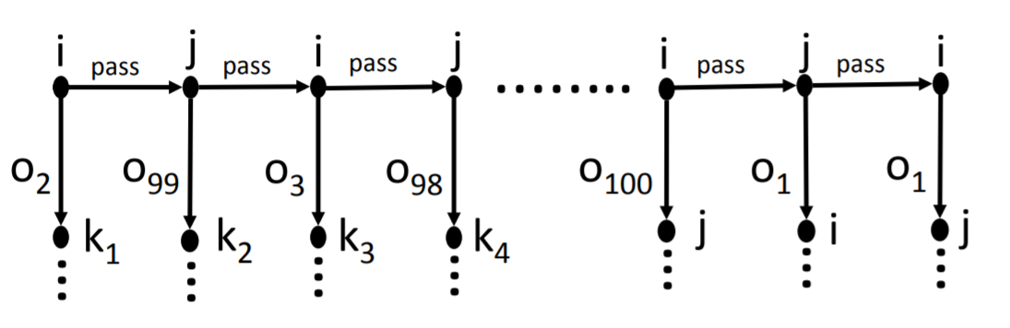

Is this game “obvious”? [Pycia Troyan]
$$o_{1}≻_{i}o_{2}≻_{i}…≻_{i}o_{99}≻_{i}o_{100}$$

Slide 73
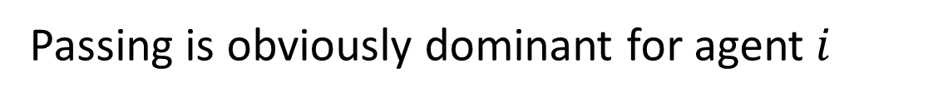
Is this game “obvious”? [Pycia Troyan]
$$o_{1}≻_{i}o_{2}≻_{i}…≻_{i}o_{99}≻_{i}o_{100}$$
Passing is obviously dominant for agent $i$

Slide 74
Is this game “obvious”? [Pycia Troyan]
$$o_{1}≻_{i}o_{2}≻_{i}…≻_{i}o_{99}≻_{i}o_{100}$$
Passing is obviously dominant for agent $i$
Is chess obvious to the white player?

Slide 75
Is this game “obvious”? [Pycia Troyan]
$$o_{1}≻_{i}o_{2}≻_{i}…≻_{i}o_{99}≻_{i}o_{100}$$
Passing is obviously dominant for agent $i$
Is chess obvious to the white player?
Some complexity notion is not captured by OSP theory

Slide 76
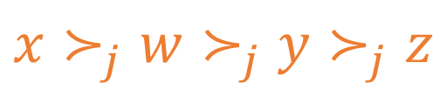

Strong OSP [Pycia Troyan]
$$i$$
OSP:
the player has a complete strategic plan
$$j$$
$$j$$
$$j$$
$$x$$
$$y$$
$$i$$
$$y$$
$$i$$
$$z$$
$$j$$
$$w$$
$$j$$
$$x$$
$$x$$
$$z$$
$$w$$
$$z$$
$$x≻_{j}w≻_{j}y≻_{j}z$$

Slide 77

Strong OSP [Pycia Troyan]
$$i$$
OSP:
the player has a complete strategic plan
$$j$$
$$j$$
$$j$$
$$x$$
$$y$$
$$i$$
$$y$$
$$i$$
$$z$$
$$j$$
$$w$$
$$j$$
$$x$$
$$x$$
$$z$$
$$w$$
$$z$$
$$x≻_{j}w≻_{j}y≻_{j}z$$

Slide 78

Strong OSP [Pycia Troyan]
$$i$$
SOSP:
Player cannot plan ahead
$$j$$
$$j$$
$$j$$
$$x$$
$$y$$
$$i$$
$$y$$
$$i$$
$$z$$
$$j$$
$$w$$
$$j$$
$$x$$
$$x$$
$$z$$
$$w$$
$$z$$
$$x≻_{j}w≻_{j}y≻_{j}z$$

Slide 79

Strong OSP [Pycia Troyan]
$$i$$
SOSP:
Player cannot plan ahead
$$j$$
$$j$$
$$j$$
$$x$$
$$y$$
$$i$$
$$y$$
$$i$$
$$z$$
$$j$$
$$w$$
$$j$$
$$x$$
$$x$$
$$z$$
$$w$$
$$z$$
$$x≻_{j}w≻_{j}y≻_{j}z$$

Slide 80
Strong OSP [Pycia Troyan]
$$i$$
SOSP:
Player cannot plan ahead
Important special cases:
Random serial dictatorship
Posted price mechanisms
$$j$$
$$j$$
$$j$$
$$x$$
$$y$$
$$i$$
$$y$$
$$i$$
$$z$$
$$j$$
$$w$$
$$j$$
$$x$$
$$x$$
$$z$$
$$w$$
$$z$$
$$x≻_{j}w≻_{j}y≻_{j}z$$

Slide 81
Ascending price auctions are not SOSP
price
$$\$0$$
$$\$1$$
$$\$2$$
$$\$3$$
$$\$4$$
$$\$5$$
Suppose $v_{2}=3$
in
in
in
in
in
in
$$1$$
$$2$$
$$1$$
$$2$$
$$1$$
$$2$$
out
out
out
out
out
out
truth-telling

Slide 82

Ascending price auctions are not SOSP
price
$$\$0$$
$$\$1$$
$$\$2$$
$$\$3$$
$$\$4$$
$$\$5$$
Suppose $v_{2}=3$
in
in
in
in
in
in
$$1$$
$$2$$
$$1$$
$$2$$
$$1$$
$$2$$
out
out
out
out
out
out
truth-telling

Slide 83
Ascending price auctions are not SOSP
price
$$\$0$$
$$\$1$$
$$\$2$$
$$\$3$$
$$\$4$$
$$\$5$$
Suppose $v_{2}=3$
in
in
in
in
in
in
$$1$$
$$2$$
$$1$$
$$2$$
$$1$$
$$2$$
out
out
out
out
out
out

Slide 84
Ascending price auctions are not SOSP
price
$$\$0$$
$$\$1$$
$$\$2$$
$$\$3$$
$$\$4$$
$$\$5$$
Suppose $v_{2}=3$
in
in
in
in
in
in
$$1$$
$$2$$
$$1$$
$$2$$
$$1$$
$$2$$
out
out
out
out
out
out

Slide 85
Ascending price auctions are not SOSP
price
$$\$0$$
$$\$1$$
$$\$2$$
$$\$3$$
$$\$4$$
$$\$5$$
Suppose $v_{2}=3$
in
in
in
in
in
in
$$1$$
$$2$$
$$1$$
$$2$$
$$1$$
$$2$$
out
out
out
out
out
out

Slide 86










One Step Foresight (OSF) [Pycia Troyan]
[Bade Gonczarowski]
OSF:
Players are able to plan one step ahead
i.e. have a strategic plan for the current and next node
pass
pass
pass
$$1$$
$$2$$
$$3$$
$$1$$
x
z
x
y
x
z
x
z
y
y
y
$$1$$
$$1$$
$$1$$
$$1$$
$$1$$
w
w
w
w
w
$$w≻_{1}x≻_{1}y≻_{1}z$$

Slide 87
One Step Foresight (OSF) [Pycia Troyan]
[Bade Gonczarowski]
OSF:
Players are able to plan one step ahead
i.e. have a strategic plan for the current and next node
pass
pass
pass
$$1$$
$$2$$
$$3$$
$$1$$
x
z
x
y
x
z
x
z
y
y
y
$$1$$
$$1$$
$$1$$
$$1$$
$$1$$
w
w
w
w
w
$$w≻_{1}x≻_{1}y≻_{1}z$$

Slide 88






One Step Foresight (OSF) [Pycia Troyan]
[Bade Gonczarowski]
OSF:
Players are able to plan one step ahead
i.e. have a strategic plan for the current and next node
pass
pass
pass
$$1$$
$$2$$
$$3$$
$$1$$
x
z
x
y
x
z
x
z
y
y
y
$$1$$
$$1$$
$$1$$
$$1$$
$$1$$
w
w
w
w
w
$$w≻_{1}x≻_{1}y≻_{1}z$$

Slide 89
One Step Foresight (OSF) [Pycia Troyan]
[Bade Gonczarowski]
OSF:
Players are able to plan one step ahead
i.e. have a strategic plan for the current and next node
pass
pass
pass
$$1$$
$$2$$
$$3$$
$$1$$
x
z
x
y
x
z
x
z
y
y
y
$$1$$
$$1$$
$$1$$
$$1$$
$$1$$
w
w
w
w
w
$$w≻_{1}x≻_{1}y≻_{1}z$$
Pycia and Troyan enable varying the amount of foresight of an agent

Slide 90
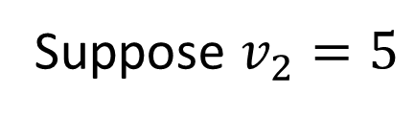
Ascending price auctions OSF obvious
price
$$\$0$$
$$\$1$$
$$\$2$$
$$\$3$$
$$\$4$$
$$\$5$$
Suppose $v_{2}=5$
in
in
in
in
in
in
$$1$$
$$2$$
$$1$$
$$2$$
$$1$$
$$2$$
out
out
out
out
out
out
One Step strategy plan:
If price < v: stay in, drop out next turn
If price >= v: drop out

Slide 91

Ascending price auctions OSF obvious
price
$$\$0$$
$$\$1$$
$$\$2$$
$$\$3$$
$$\$4$$
$$\$5$$
Suppose $v_{2}=5$
in
in
in
in
in
in
$$1$$
$$2$$
$$1$$
$$2$$
$$1$$
$$2$$
out
out
out
out
out
out
One Step strategy plan:
If price < v: stay in, drop out next turn
If price >= v: drop out

Slide 92
Ascending price auctions OSF obvious
price
$$\$0$$
$$\$1$$
$$\$2$$
$$\$3$$
$$\$4$$
$$\$5$$
Suppose $v_{2}=5$
in
in
in
in
in
in
$$1$$
$$2$$
$$1$$
$$2$$
$$1$$
$$2$$
out
out
out
out
out
out
One Step strategy plan:
If price < v: stay in, drop out next turn
If price >= v: drop out

Slide 93

Ascending price auctions OSF obvious
price
$$\$0$$
$$\$1$$
$$\$2$$
$$\$3$$
$$\$4$$
$$\$5$$
Suppose $v_{2}=5$
in
in
in
in
in
in
$$1$$
$$2$$
$$1$$
$$2$$
$$1$$
$$2$$
out
out
out
out
out
out
One Step strategy plan:
If price < v: stay in, drop out next turn
If price >= v: drop out

Slide 94
Ascending price auctions OSF obvious
price
$$\$0$$
$$\$1$$
$$\$2$$
$$\$3$$
$$\$4$$
$$\$5$$
Suppose $v_{2}=5$
in
in
in
in
in
in
$$1$$
$$2$$
$$1$$
$$2$$
$$1$$
$$2$$
out
out
out
out
out
out
One Step strategy plan:
If price < v: stay in, drop out next turn
If price >= v: drop out

Slide 95


Ascending price auctions OSF obvious
price
$$\$0$$
$$\$1$$
$$\$2$$
$$\$3$$
$$\$4$$
$$\$5$$
Suppose $v_{2}=5$
in
in
in
in
in
in
$$1$$
$$2$$
$$1$$
$$2$$
$$1$$
$$2$$
out
out
out
out
out
out
One Step strategy plan:
If price < v: stay in, drop out next turn
If price >= v: drop out

Slide 96
Ascending price auctions OSF obvious
price
$$\$0$$
$$\$1$$
$$\$2$$
$$\$3$$
$$\$4$$
$$\$5$$
Suppose $v_{2}=5$
in
in
in
in
in
in
$$1$$
$$2$$
$$1$$
$$2$$
$$1$$
$$2$$
out
out
out
out
out
out
One Step strategy plan:
If price < v: stay in, drop out next turn
If price >= v: drop out

Slide 97
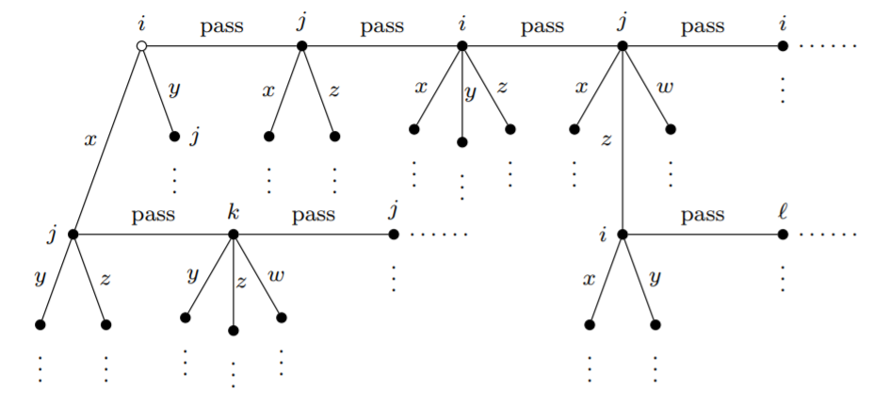
Millipede games
Each player can:
Clinch one of several options, and leave the game
Pass, and may play again

Slide 98
Millipede games
Each player can:
Clinch one of several options, and leave the game
Pass, and may play again

Slide 99
Millipede games
Each player can:
Clinch one of several options, and leave the game
Pass, and may play again

Slide 100
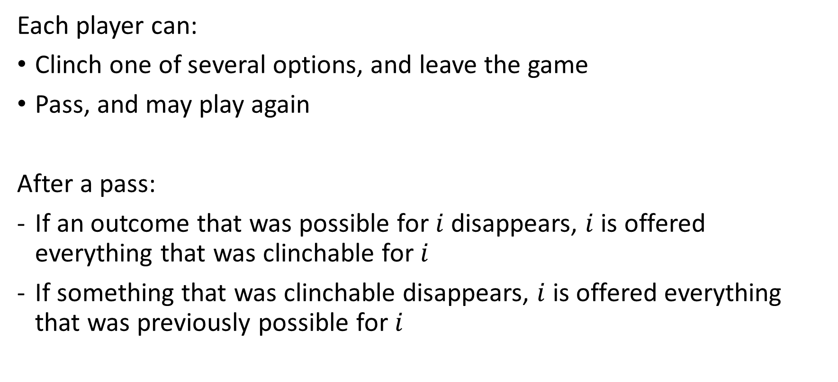
Millipede games cont.
Each player can:
Clinch one of several options, and leave the game
Pass, and may play again
After a pass:
If an outcome that was possible for $i$ disappears, $i$ is offered everything that was clinchable for $i$
If something that was clinchable disappears, $i$ is offered everything that was previously possible for $i$

Slide 101
Equivalence [Pycia Troyan]
Thm. a game with no transfers is OSP iff it is equivalent to a millipede game

Slide 102
Not all about the normal form
[Breitmoser Schweighofer-Kodritsch] compare 5 conditions:
2P auction
2P auction + simulation of ascending auction w/o dropout info
2P + simulation of ascending auction w. dropout info
Ascending auction w/o dropout info
Ascending auction w. dropout info

Slide 103
Not all about the normal form
[Breitmoser Schweighofer-Kodritsch] compare 5 conditions:
2P auction
2P auction + simulation of ascending auction w/o dropout info
2P + simulation of ascending auction w. dropout info
Ascending auction w/o dropout info
Ascending auction w. dropout info
Not simple
simple

Slide 104
Not all about the normal form
[Breitmoser Schweighofer-Kodritsch] compare 5 conditions:
2P auction
2P auction + simulation of ascending auction w/o dropout info
2P + simulation of ascending auction w. dropout info
Ascending auction w/o dropout info
Ascending auction w. dropout info
Worst performance
Best performance

Slide 105
Not all about the normal form
[Breitmoser Schweighofer-Kodritsch] compare 5 conditions:
2P auction
2P auction + simulation of ascending auction w/o dropout info
2P + simulation of ascending auction w. dropout info
Ascending auction w/o dropout info
Ascending auction w. dropout info
Worst performance
?
Best performance

Slide 106
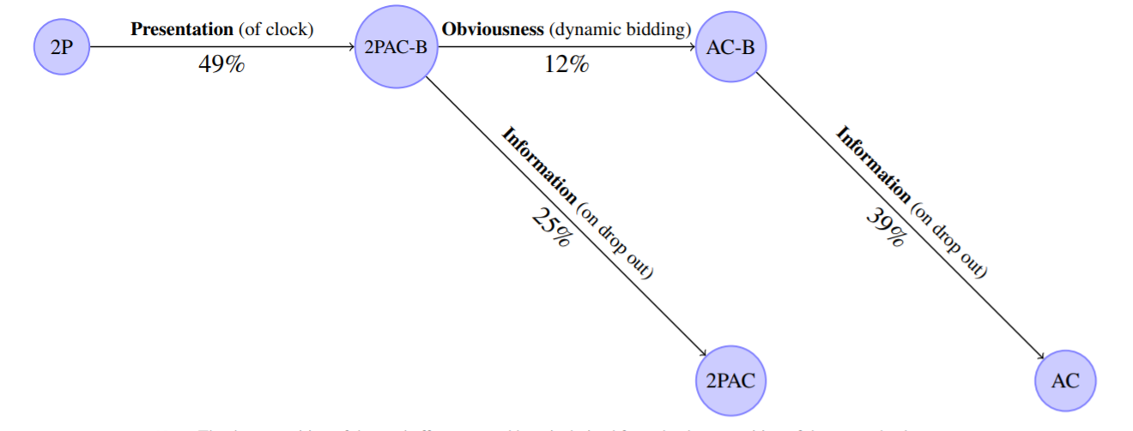
[Breitmoser Schweighofer-Kodritsch] results

Slide 107
[Breitmoser Schweighofer-Kodritsch] results
Other ways to make a game easier

Slide 108
[Breitmoser Schweighofer-Kodritsch] results
Other ways to make a game easier

