Slide 1
About the reading group
4~5 meetings the rest of the semester
Topics:
Obviously strategy-proof mechanisms (Alon, next Wednesday)
Gali’s series of works (Auction and regret quantal response)
level-k reasoning
Endowment Effect
Planning
We are open to any suggestions. Whoever wants to lead a session is very invited (and can bring her/his own topic).

Slide 2
Expectation-based Reference-dependent Utility
Juntao Wang
Harvard University
Oct 26, 2019

Slide 3
Outline
Paradoxes under EU model
Reference-dependent models
Expectations-based models and solution concepts
Applications
Overbid in Auction

Slide 4

Preliminaries
Payoff: a lottery $L=\left(x_{1},p_{1};x_{2},p_{2};…;x_{n},p_{n}\right)$
A decision problem: choice one out of a set of lotteries

Slide 5

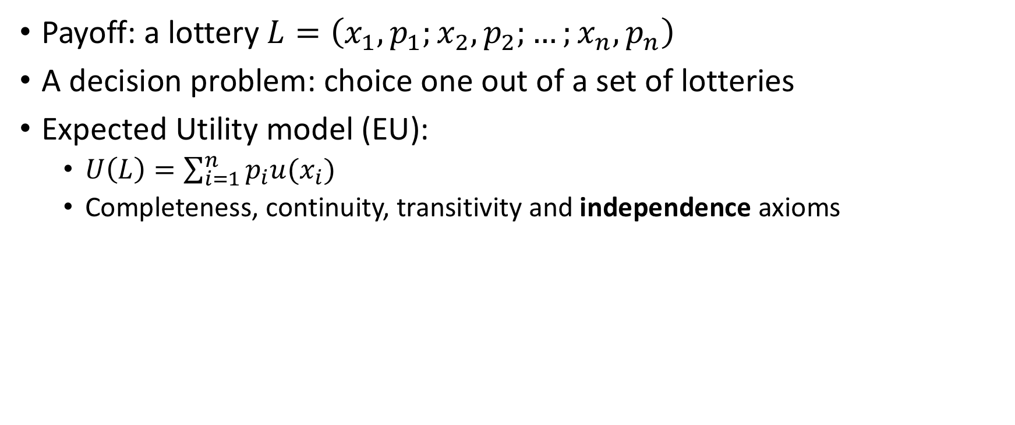
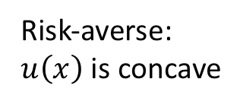

Preliminaries
Payoff: a lottery $L=\left(x_{1},p_{1};x_{2},p_{2};…;x_{n},p_{n}\right)$
A decision problem: choice one out of a set of lotteries
Expected Utility model (EU):
$U\left(L\right)=\sum_{i=1}^{n}{p_{i}u(x_{i})}$
Completeness, continuity, transitivity and independence axioms
$$u(x)$$
Risk-averse:
$u\left(x\right)$ is concave
Utility
Wealth $x$

Slide 6
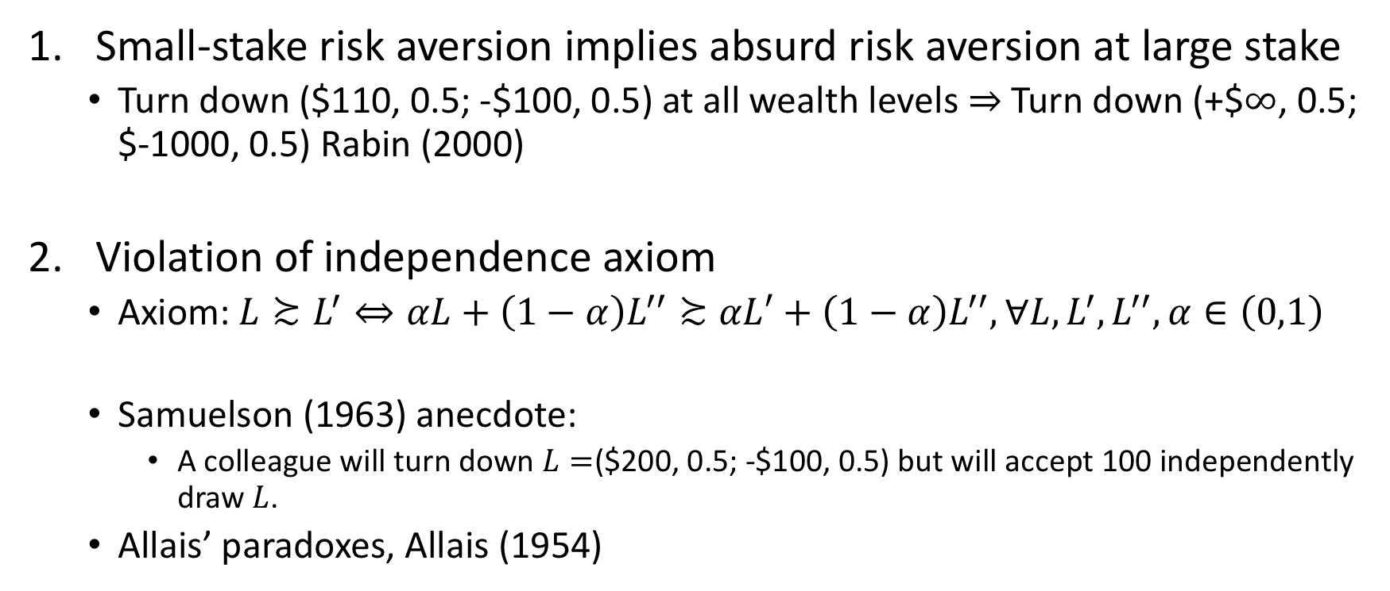
Paradoxes under Expected Utility Model
Small-stake risk aversion implies absurd risk aversion at large stake
Turn down $\text{(\$110, 0.5; −\$100, 0.5)}$ at all wealth levels $⇒$Turn down (+$$∞$, 0.5; $-1000, 0.5) Rabin (2000)
Violation of independence axiom
Axiom: $L≿L^{′}⇔αL+\left(1−α\right)L^{′′}≿αL′+\left(1−α\right)L^{′′},∀L, L^{′}, L^{′′}, α∈\left(0,1\right)$
Samuelson (1963) anecdote:
A colleague will turn down $L=$($200, 0.5; -$100, 0.5) but will accept 100 independently draw $L$.
Allais’ paradoxes, Allais (1954)

Slide 7
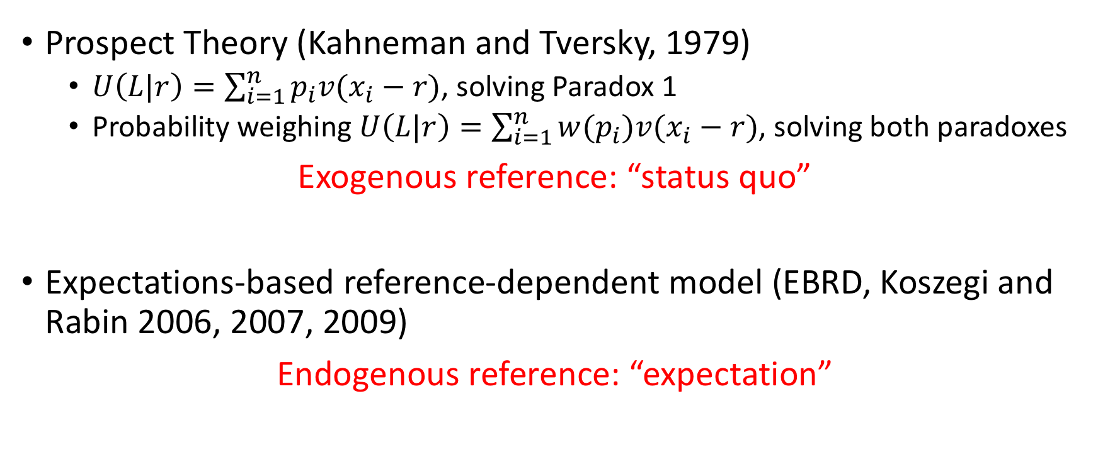
Reference-dependent Models
Prospect Theory (Kahneman and Tversky, 1979)
$U\left(L|r\right)=\sum_{i=1}^{n}{p_{i}v(x_{i}−r)}$, solving Paradox 1
Probability weighing $U\left(L|r\right)=\sum_{i=1}^{n}{{w(p}_{i})v(x_{i}−r)}$, solving both paradoxes
Exogenous reference: “status quo”
Expectations-based reference-dependent model (EBRD, Koszegi and Rabin 2006, 2007, 2009)
Endogenous reference: “expectation”

Slide 8
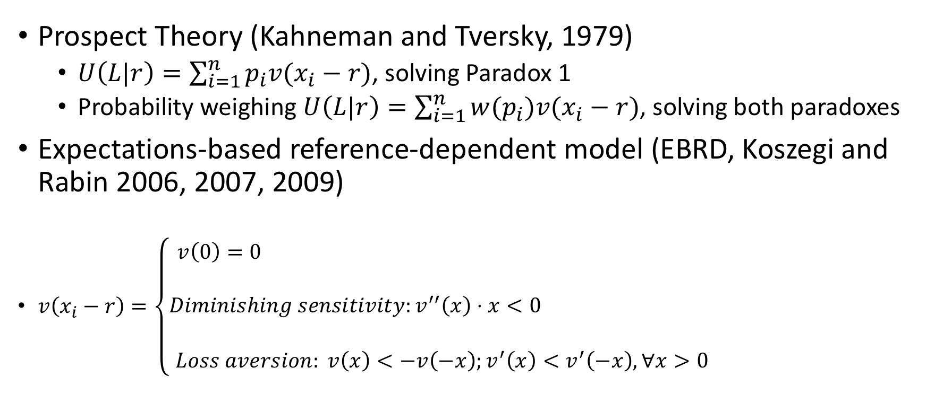
Reference-dependent Models
Prospect Theory (Kahneman and Tversky, 1979)
$U\left(L|r\right)=\sum_{i=1}^{n}{p_{i}v(x_{i}−r)}$, solving Paradox 1
Probability weighing $U\left(L|r\right)=\sum_{i=1}^{n}{{w(p}_{i})v(x_{i}−r)}$, solving both paradoxes
Expectations-based reference-dependent model (EBRD, Koszegi and Rabin 2006, 2007, 2009)
$v\left(x_{i}−r\right)=\left\{\begin{aligned}v\left(0\right)=0 \\ \\ Diminishing sensitivity:v^{′′}\left(x\right)⋅x<0 \\ \\ Loss aversion: v\left(x\right)<−v\left(−x\right);v^{′}\left(x\right)<v^{′}\left(−x\right),∀x>0\end{aligned}\right.$

Slide 9
Why use expectation as reference point
When facing a lottery choice problem, one forms a prior expectation of its outcome, and then after the uncertainty is resolved one experiences elation or disappointment (“Disappointment aversion”, Loomes and Sugden, 1986).
Impose some discipline on models of reference dependence.

Slide 10
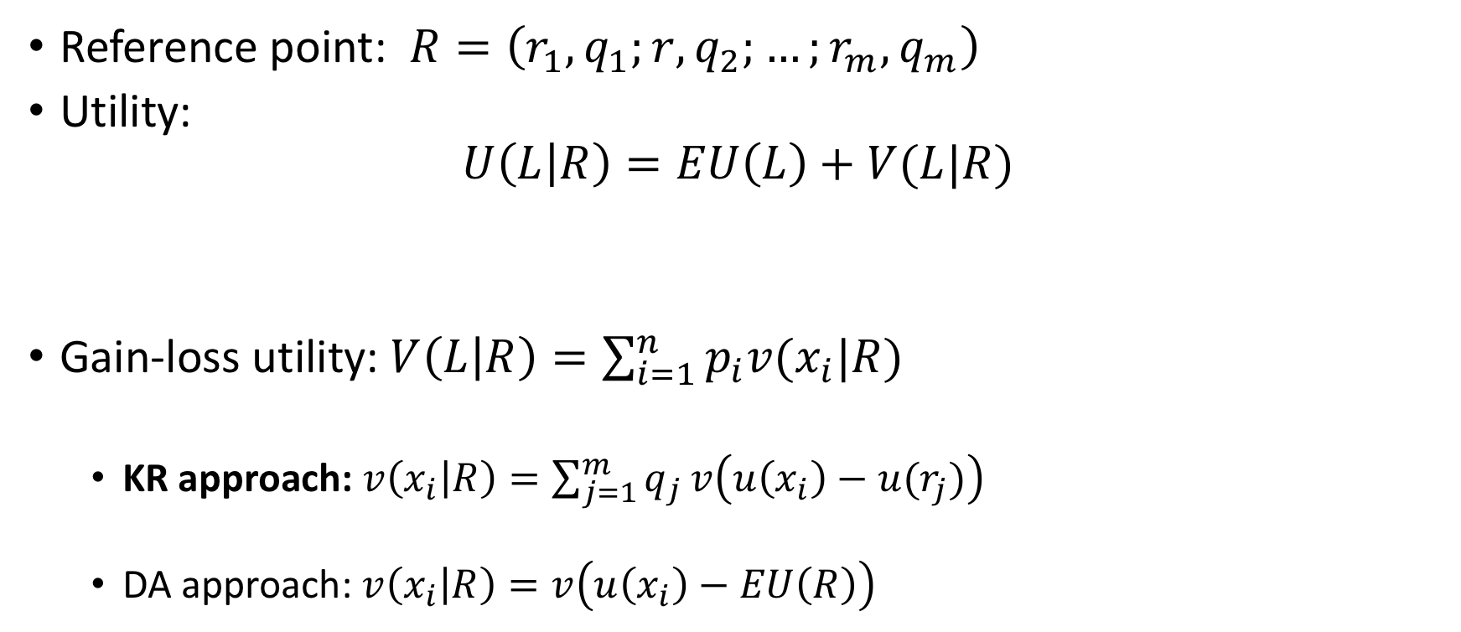
EBRD Framework (This slide: given the reference, next slide: how to set the reference)
Reference point: $R=\left(r_{1},q_{1};r,q_{2};…;r_{m},q_{m}\right)$
Utility:
$$U\left(L | R\right)=EU\left(L\right)+V(L|R)$$
Gain-loss utility: $V\left(L | R\right)=\sum_{i=1}^{n}{p_{i}v(x_{i}|R)}$
KR approach:$v\left(x_{i} | R\right)=\sum_{j=1}^{m}{q_{j}}v\left(u\left(x_{i}\right)−u(r_{j})\right)$
DA approach: $v\left(x_{i} | R\right)=v\left(u\left(x_{i}\right)−EU\left(R\right)\right)$
Monetary/Intrinsic/
Instrumental utility
Gain-loss utility

Slide 11
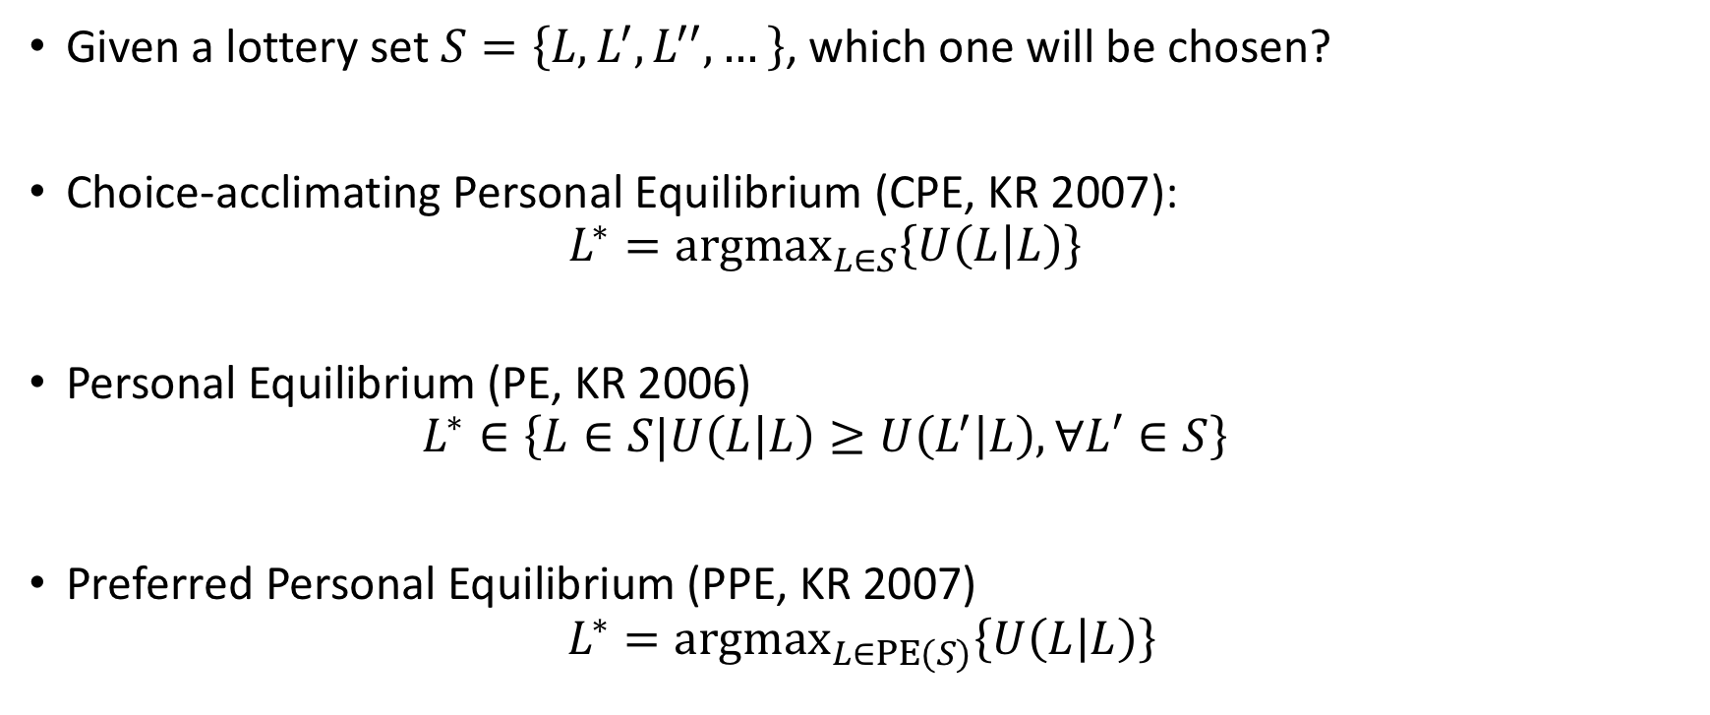
Solution Concepts
Given a lottery set $S=\left\{L,L^{′},L^{′′},…\right\}$, which one will be chosen?
Choice-acclimating Personal Equilibrium (CPE, KR 2007):
$$L^{∗}={argmax}_{L∈S}\left\{U\left(L | L\right)\right\}$$
Personal Equilibrium (PE, KR 2006)
$$L^{∗}∈\left\{L∈S|U\left(L | L\right)≥U\left(L^{′} | L\right), ∀L′∈S\right\}$$
Preferred Personal Equilibrium (PPE, KR 2007)
$$L^{∗}={argmax}_{L∈PE(S)}\left\{U\left(L | L\right)\right\}$$
Most tractable one!
Notes:
If a person commits to a lottery well in advance of the resolution of the uncertainty, then by the time of resolution, the person will have come to expect the lottery L.
When facing the choice, a person can take a time to form a planed choice, but is not required to commit to the her choice until shortly before the resolution

Slide 12
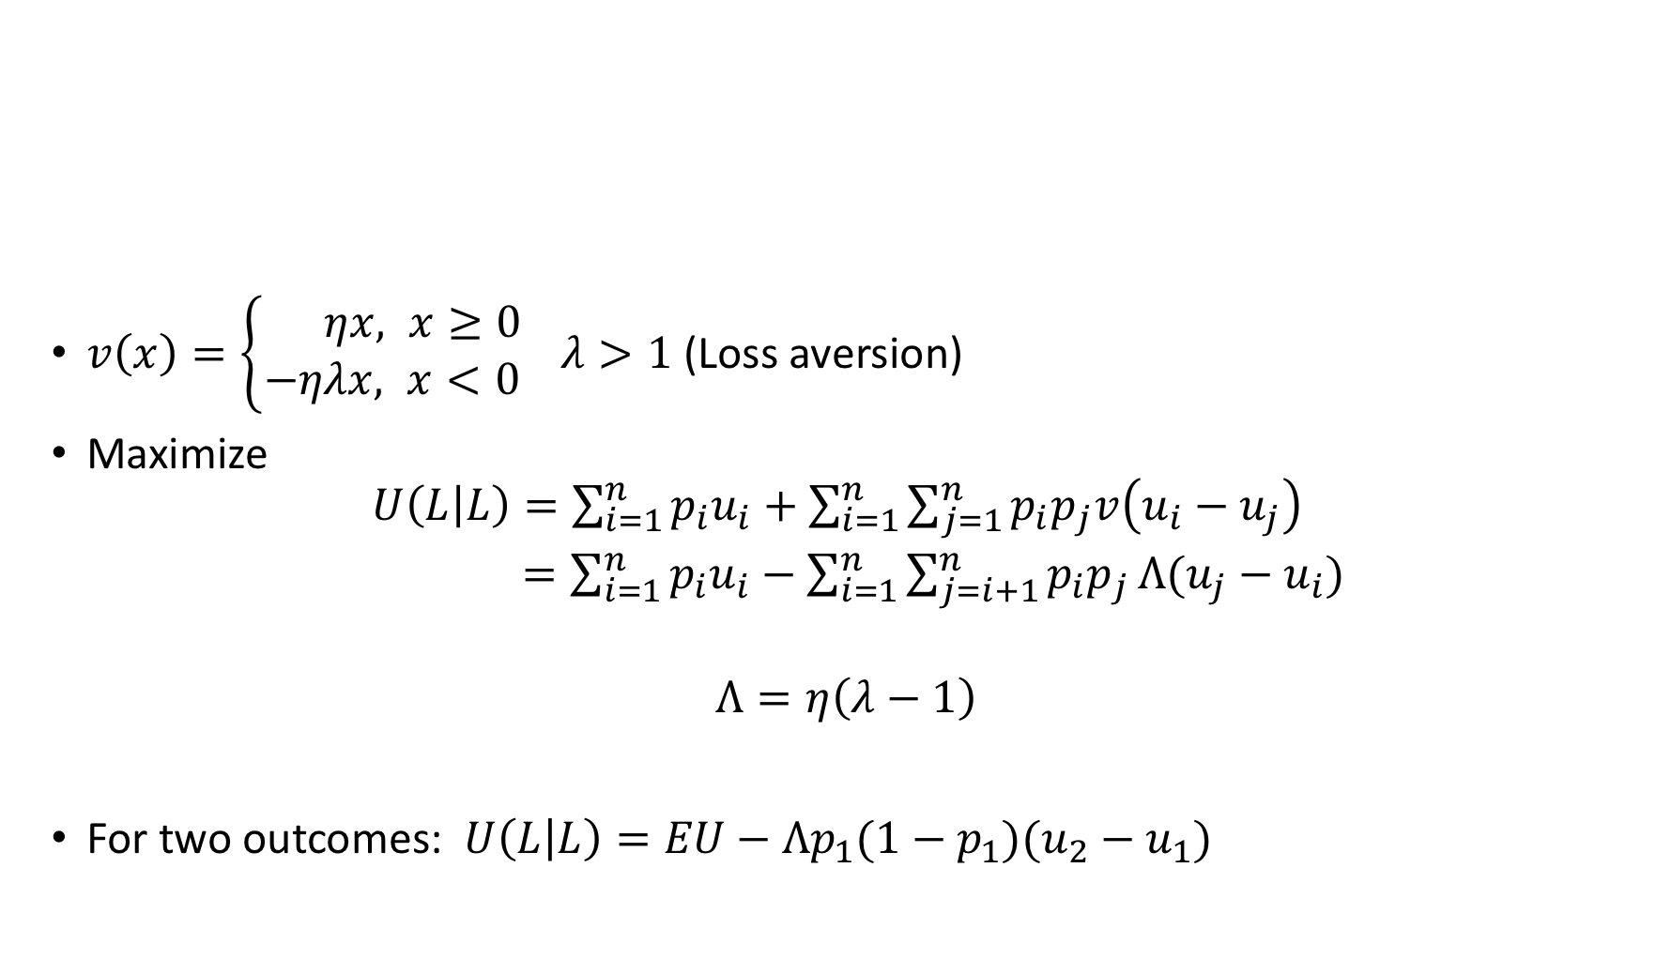
CPE
$v\left(x\right)=\left\{\begin{aligned} ηx, x≥0 \\ −ηλx, x<0&\end{aligned}\right. λ>1$ (Loss aversion)
Maximize
$${U\left(L | L\right)=\sum_{i=1}^{n}{p_{i}u_{i}}+\sum_{i=1}^{n}{\sum_{j=1}^{n}{p_{i}p_{j}v\left(u_{i}−u_{j}\right)}} \atop =\sum_{i=1}^{n}{p_{i}u_{i}}−\sum_{i=1}^{n}{\sum_{j=i+1}^{n}{p_{i}p_{j}}}Λ(u_{j}−u_{i})}$$
$$Λ=η\left(λ−1\right)$$
For two outcomes: $U\left(L | L\right)=EU−{Λp}_{1}(1−p_{1})(u_{2}−u_{1})$

Slide 13
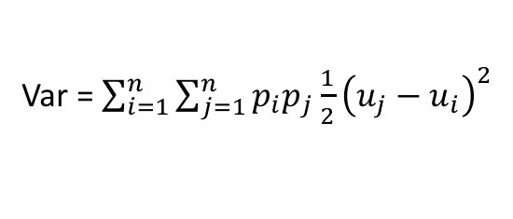
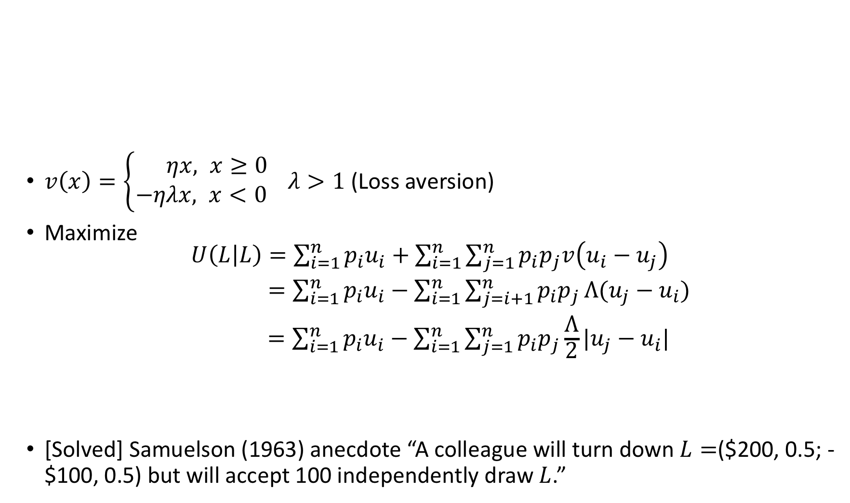
CPE
$v\left(x\right)=\left\{\begin{aligned} ηx, x≥0 \\ −ηλx, x<0&\end{aligned}\right. λ>1$ (Loss aversion)
Maximize
$${U\left(L | L\right)=\sum_{i=1}^{n}{p_{i}u_{i}}+\sum_{i=1}^{n}{\sum_{j=1}^{n}{p_{i}p_{j}v\left(u_{i}−u_{j}\right)}} \atop \begin{aligned} =\sum_{i=1}^{n}{p_{i}u_{i}}−\sum_{i=1}^{n}{\sum_{j=i+1}^{n}{p_{i}p_{j}}}Λ(u_{j}−u_{i}) \\ =\sum_{i=1}^{n}{p_{i}u_{i}}−\sum_{i=1}^{n}{\sum_{j=1}^{n}{p_{i}p_{j}}}\frac{Λ}{2}|u_{j}−u_{i}|\end{aligned}}$$
[Solved] Samuelson (1963) anecdote “A colleague will turn down $L=$($200, 0.5; -$100, 0.5) but will accept 100 independently draw $L$.”
Var = $\sum_{i=1}^{n}{\sum_{j=1}^{n}{p_{i}p_{j}}}\frac{1}{2}{\left(u_{j}−u_{i}\right)}^{2}$

Slide 14
CPE
$v\left(x\right)=\left\{\begin{aligned} ηx, x≥0 \\ −ηλx, x<0&\end{aligned}\right. λ>1$ (Loss aversion)
Maximize
$${U\left(L | L\right)=\sum_{i=1}^{n}{p_{i}u_{i}}+\sum_{i=1}^{n}{\sum_{j=1}^{n}{p_{i}p_{j}v\left(u_{i}−u_{j}\right)}} \atop \begin{aligned} =\sum_{i=1}^{n}{p_{i}u_{i}}−\sum_{i=1}^{n}{\sum_{j=i+1}^{n}{p_{i}p_{j}}}Λ(u_{j}−u_{i}) \\ =\sum_{i=1}^{n}{p_{i}u_{i}}−\sum_{i=1}^{n}{\sum_{j=1}^{n}{p_{i}p_{j}}}\frac{Λ}{2}|u_{j}−u_{i}|\end{aligned}}$$
[Solved] Samuelson (1963) anecdote “A colleague will turn down $L=$($200, 0.5; -$100, 0.5) but will accept 100 independently draw $L$.”
Var = $\sum_{i=1}^{n}{\sum_{j=1}^{n}{p_{i}p_{j}}}\frac{1}{2}{\left(u_{j}−u_{i}\right)}^{2}$

Slide 15

CPE and first-order stochastic dominance
First-order stochastic dominance (FOSD):
$L^{′}=\left(\$10, 0.9, \$11, 0.1\right)≿L=(\$10, 1)$
CPE violates FOSD, but EU, PE and PPE not.
Experimental result: people violate FOSD when it is not obvious.

Slide 16
Applications
Overbid in auction (Theory: Lange and Ratan 2010; Experiments: Banerji and Gupta)

Slide 17
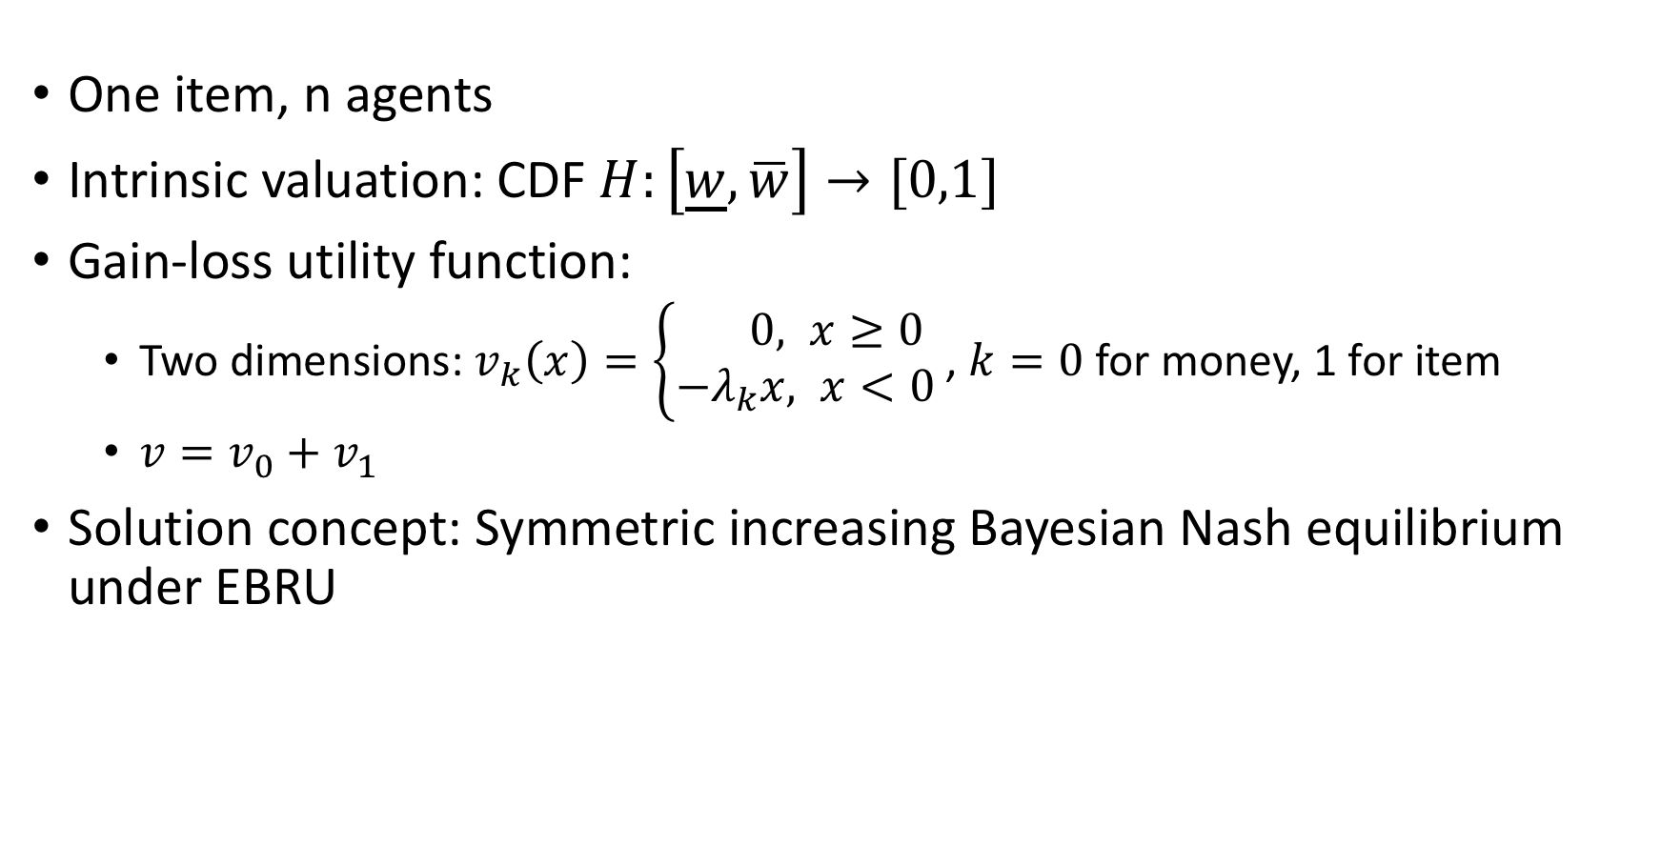
First-price auction
One item, n agents
Intrinsic valuation: CDF $H:\left[\underline{w}, \overline{w}\right]→[0,1]$
Gain-loss utility function:
Two dimensions: $v_{k}\left(x\right)=\left\{\begin{aligned} 0, x≥0 \\ −λ_{k}x, x<0&\end{aligned}\right.$, $k=0$ for money, 1 for item
$v=v_{0}+v_{1}$
Solution concept: Symmetric increasing Bayesian Nash equilibrium under EBRU

Slide 18
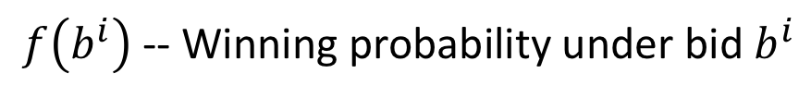
First-price auction
U(L|L):
Intrinsic utility
Gain-loss utility
$f\left(b^{i}\right)$ -- Winning probability under bid $b^{i}$

Slide 19

Solving the equilibrium
First-order derivative equation:
-variable $b\left(w^{i}\right)$
-$f\left(b\left(w^{i}\right)\right)=H^{n−1}\left(b^{−1}\left(b(w^{i})\right)\right)$
Meanwhile, at the equilibrium, $b^{−1}\left(b(w^{i})\right)=w^{i}$
Therefore,$f′\left(b^{i}\right)=$ ${(H}^{n−1}(w^{i}))′/b′(w^{i})$

Slide 20
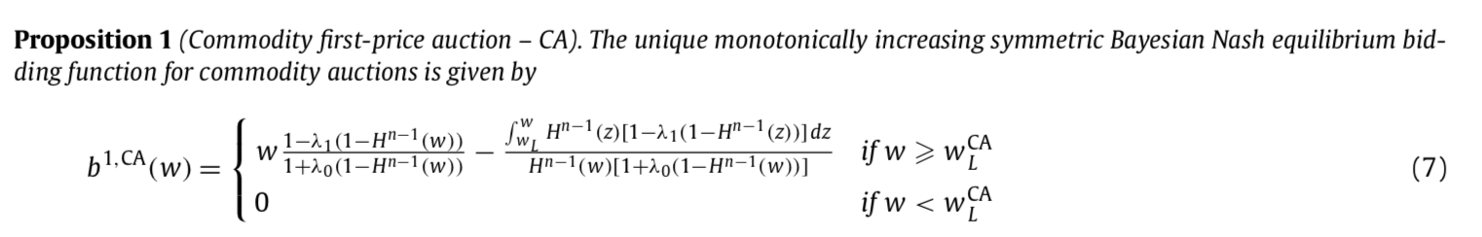

Equilibrium Bid
For large $w$, an agent overbids w.r.t. BNE
For small $w$ (some $w$ with winning probability < 0.5), an agent underbids w.r.t. BNE.
Intuition: People tend to reduce the uncertainty.

Slide 21
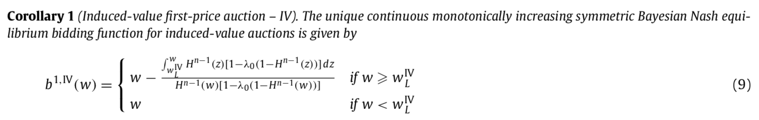

Equilibrium Bid (induced-value)
One-dimension gain-loss utility $v$
Induced-value, lab experiments
People should always overbid w.r.t. BNE

Slide 22
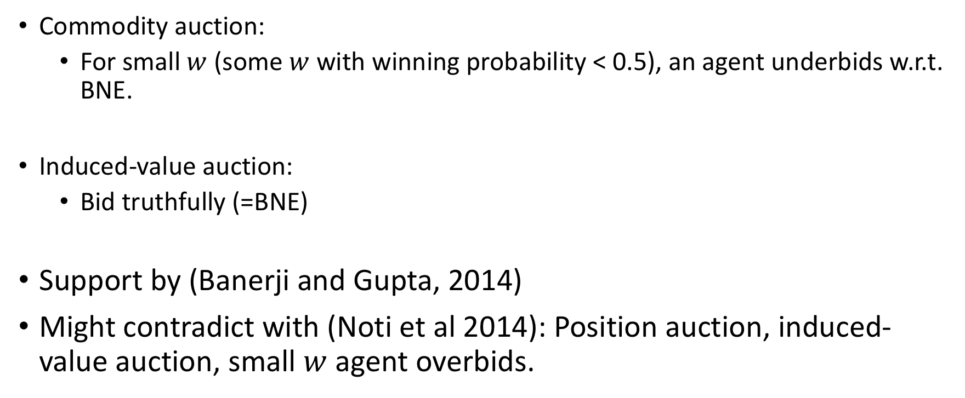
Second-price auction
Commodity auction:
For small $w$ (some $w$ with winning probability < 0.5), an agent underbids w.r.t. BNE.
Induced-value auction:
Bid truthfully (=BNE)
Support by (Banerji and Gupta, 2014)
Might contradict with (Noti et al 2014): Position auction, induced-value auction, small $w$ agent overbids.

Slide 23
Applications
Endowment Effects
Labor Supply (Farber, 2005)
…

Slide 24
Q&A

