Slide 1
Inferring players’ values from their actions
Xiang Yan
Harvard University
Nov 21, 2019

Slide 2
Content
Example of inferring values in a 2x2 game
Equilibrium-based players assumptions
No-regret players assumption
Quantal regret players assumption
Application to ad auctions
Based on:
Stationary Concepts for Experimental 2x2-Games by Selten and Chmura
Econometrics for Learning Agents by Nekipelov et, al.
A “quantal regret” method for structural econometrics in repeated games by Nisan and Noti

Slide 3
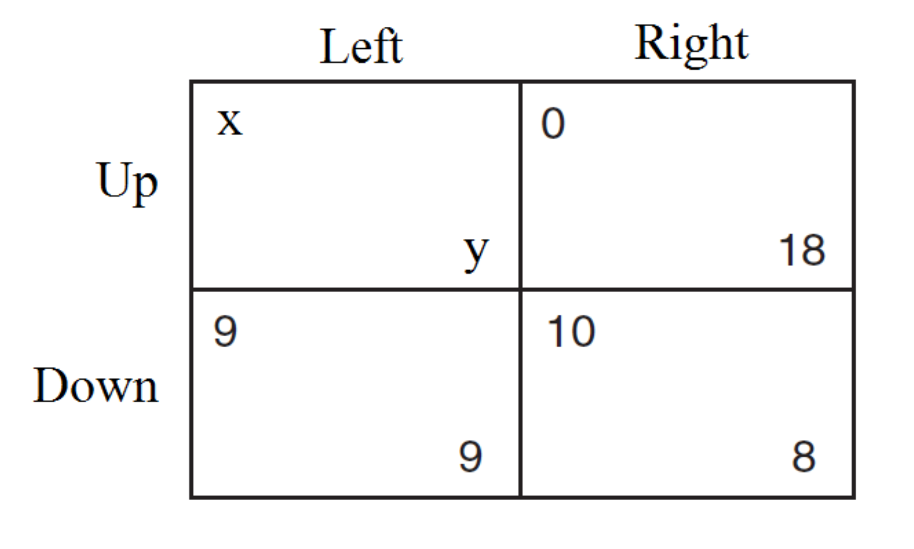

Estimation Task in a 2x2 Game
How to infer x and y if we
know how the game is played?
No dominant strategy
e.g. $p_{U}=0.11,q_{L}=0.68$
Assume Nash Equilibrium:
$q_{L}=10/(x+1)$
$x≈13.7$

Slide 4
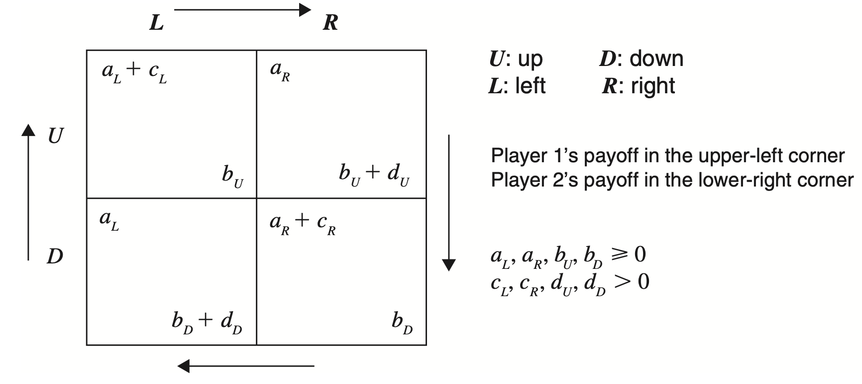

Equilibrium-based Model
NE:
$$p_{U}=\frac{d_{D}}{d_{U}+d_{D}},$$
$$q_{L}=\frac{c_{R}}{c_{L}+c_{R}}$$
In practice, NE is hard for players to compute
In the experiments, players are informed with their payoff after each play and their opponents’ actions and total payoffs after 200 repeats.

Slide 5
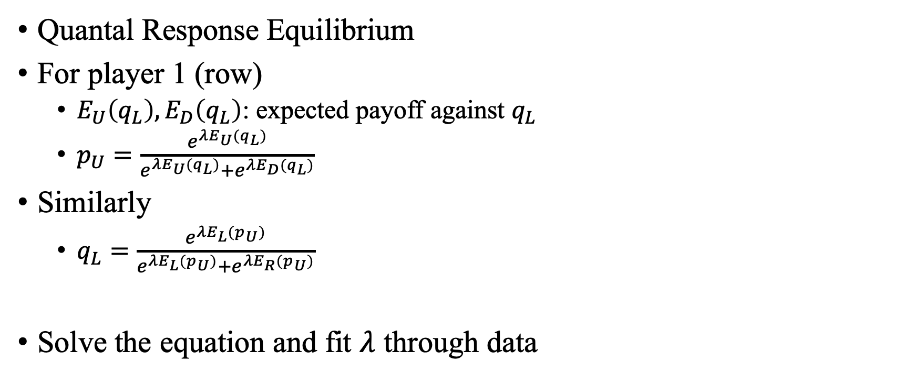
Equilibrium-based Model
Quantal Response Equilibrium
For player 1 (row)
$E_{U}\left(q_{L}\right),E_{D}\left(q_{L}\right)$: expected payoff against $q_{L}$
$p_{U}=\frac{e^{λE_{U}(q_{L})}}{e^{λE_{U}(q_{L})}+e^{λE_{D}(q_{L})}}$
Similarly
$q_{L}=\frac{e^{λE_{L}(p_{U})}}{e^{λE_{L}(p_{U})}+e^{λE_{R}(p_{U})}}$
Solve the equation and fit $λ$ through data

Slide 6
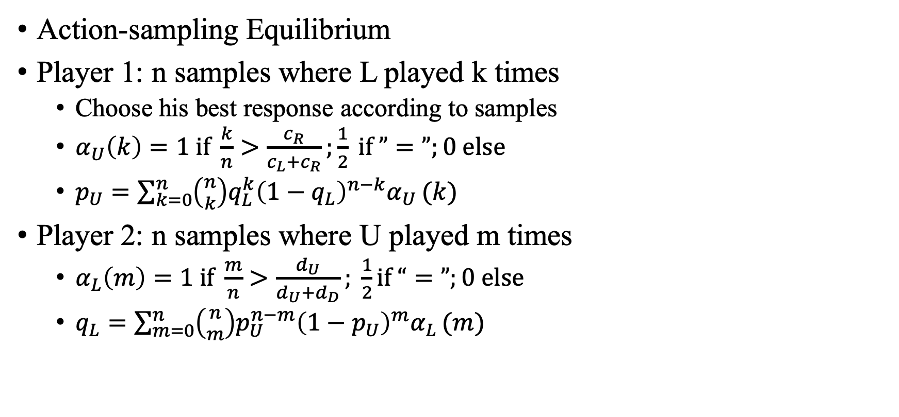
Equilibrium-based Model
Action-sampling Equilibrium
Player 1: n samples where L played k times
Choose his best response according to samples
$α_{U}\left(k\right)=1 if \frac{k}{n}>\frac{c_{R}}{c_{L}+c_{R}};\frac{1}{2} if ”=”;0 else$
$p_{U}=\sum_{k=0}^{n}{\left({n \atop k}\right)q_{L}^{k}{\left(1−q_{L}\right)}^{n−k}α_{U}}(k)$
Player 2: n samples where U played m times
$α_{L}\left(m\right)=1 if \frac{m}{n}>\frac{d_{U}}{d_{U}+d_{D}}; \frac{1}{2}if “=”;0 else$
$q_{L}=\sum_{m=0}^{n}{\left({n \atop m}\right)p_{U}^{n−m}{\left(1−p_{U}\right)}^{m}α_{L}}(m)$

Slide 7
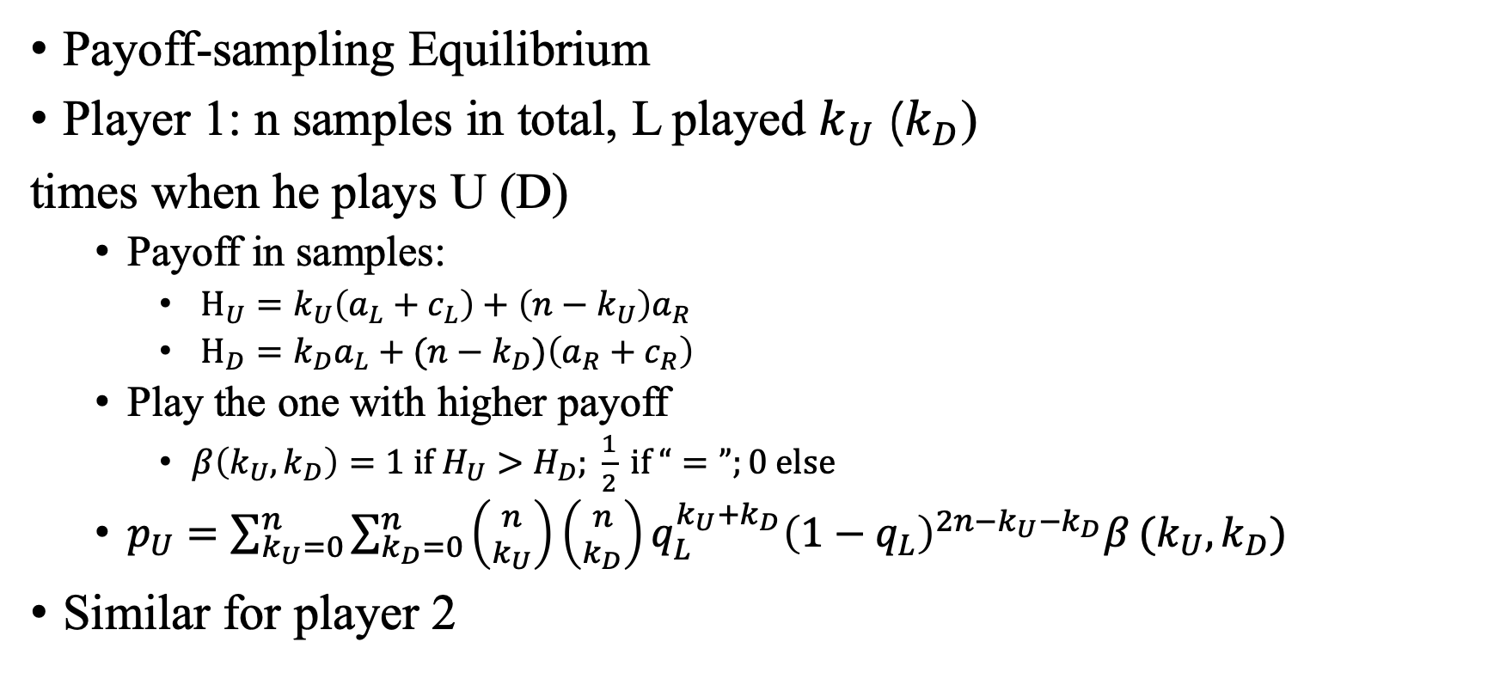
Equilibrium-based Model
Payoff-sampling Equilibrium
Player 1: n samples in total, L played $k_{U}$ ($k_{D}$)
times when he plays U (D)
Payoff in samples:
$H_{U}=k_{U}\left(a_{L}+c_{L}\right)+\left(n−k_{U}\right)a_{R}$
$H_{D}={k_{D}a_{L}+(n−k}_{D})\left(a_{R}+c_{R}\right)$
Play the one with higher payoff
$β\left(k_{U},k_{D}\right)=1 if H_{U}>H_{D}; \frac{1}{2} if “=”;0 else$
$p_{U}=\sum_{k_{U}=0}^{n}{\sum_{k_{D}=0}^{n}{\left({n \atop k_{U}}\right)\left({n \atop k_{D}}\right)}q_{L}^{k_{U}+k_{D}}{\left(1−q_{L}\right)}^{2n−k_{U}−k_{D}}β}(k_{U},k_{D})$
Similar for player 2

Slide 8
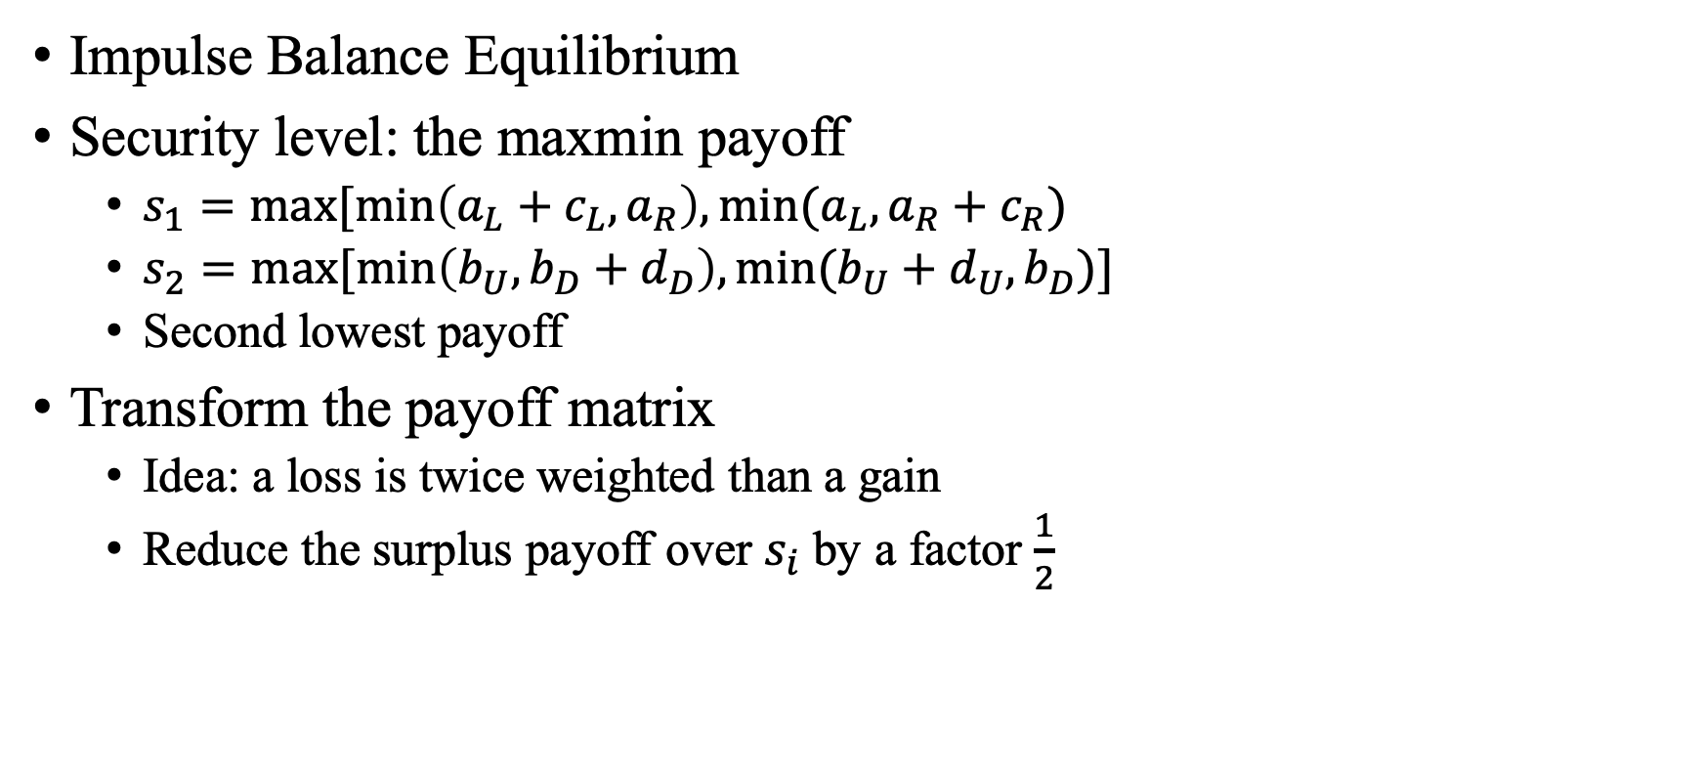
Equilibrium-based Model
Impulse Balance Equilibrium
Security level: the maxmin payoff
$s_{1}=max[min\left(a_{L}+c_{L},a_{R}\right),min(a_{L},a_{R}+c_{R})$
$s_{2}=max[min\left(b_{U},b_{D}+d_{D}\right),min(b_{U}+d_{U},b_{D})]$
Second lowest payoff
Transform the payoff matrix
Idea: a loss is twice weighted than a gain
Reduce the surplus payoff over $s_{i}$ by a factor $\frac{1}{2}$

Slide 9
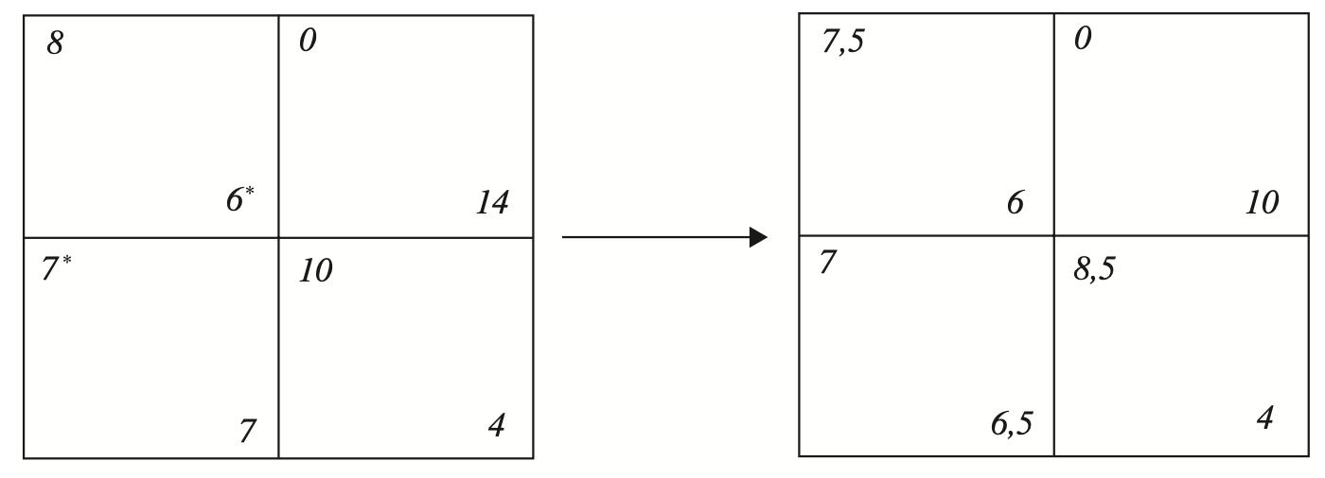
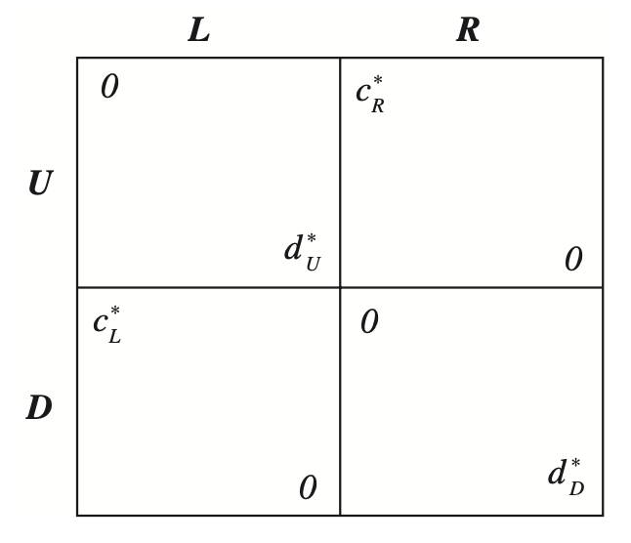

Slide 10
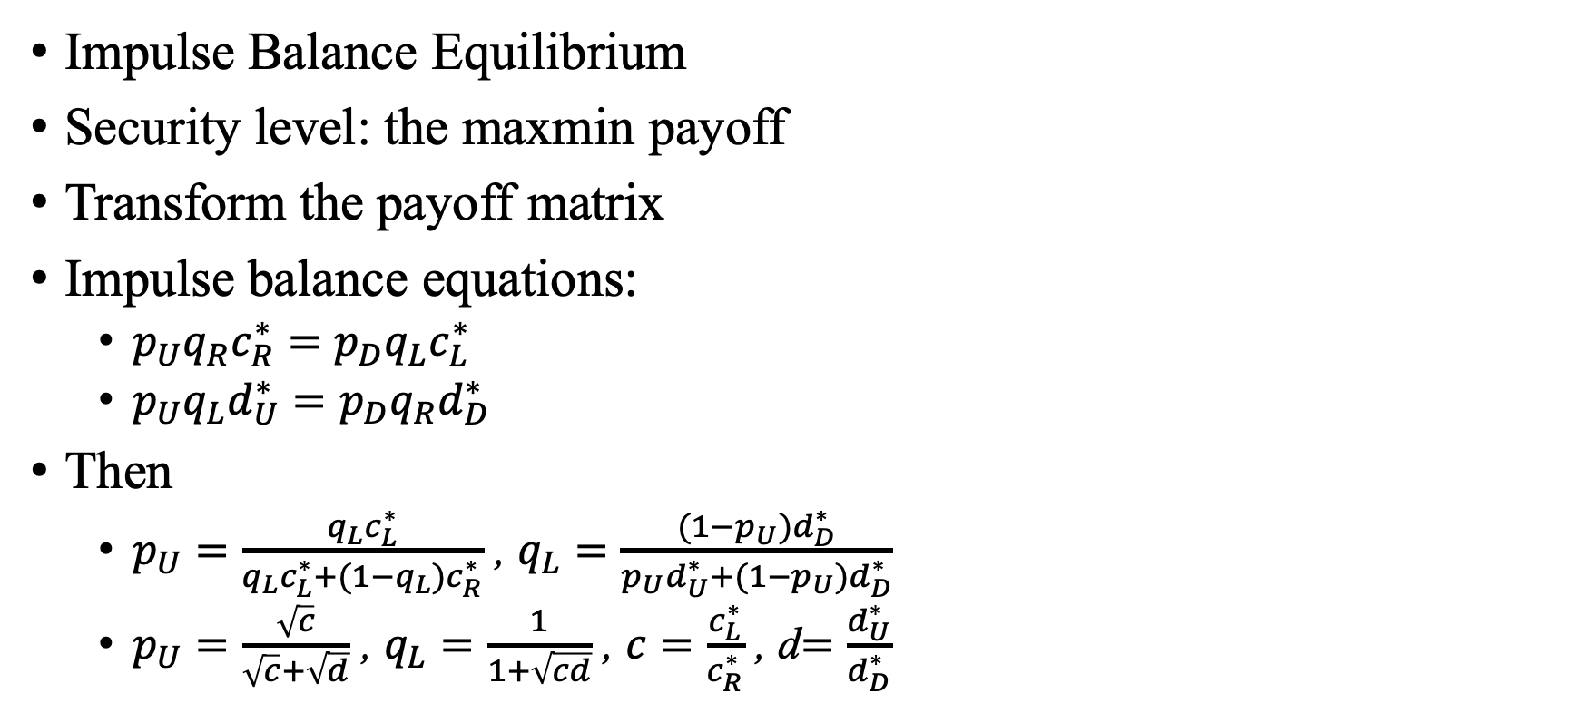
Equilibrium-based Model
Impulse Balance Equilibrium
Security level: the maxmin payoff
Transform the payoff matrix
Impulse balance equations:
$p_{U}q_{R}c_{R}^{∗}=p_{D}q_{L}c_{L}^{∗}$
$p_{U}q_{L}d_{U}^{∗}=p_{D}q_{R}d_{D}^{∗}$
Then
$p_{U}=\frac{q_{L}c_{L}^{∗}}{q_{L}c_{L}^{∗}+(1−q_{L})c_{R}^{∗}}$ , $q_{L}=\frac{{(1−p}_{U})d_{D}^{∗}}{p_{U}d_{U}^{∗}+(1−p_{U})d_{D}^{∗}}$
$p_{U}=\frac{\sqrt{c}}{\sqrt{c}+\sqrt{d}}$ , $q_{L}=\frac{1}{1+\sqrt{cd}}$ , $c=\frac{c_{L}^{∗}}{c_{R}^{∗}}$ , d$=\frac{d_{U}^{∗}}{d_{D}^{∗}}$

Slide 11
Estimation Task in a 2x2 Game
Infer one element of the payoff matrix
through repeatedly playing samples
Performance:
Impulse balance equilibrium
Payoff-sampling equilibrium
Action-sampling equilibrium
Quantal response equilibrium
Nash equilibrium

Slide 12
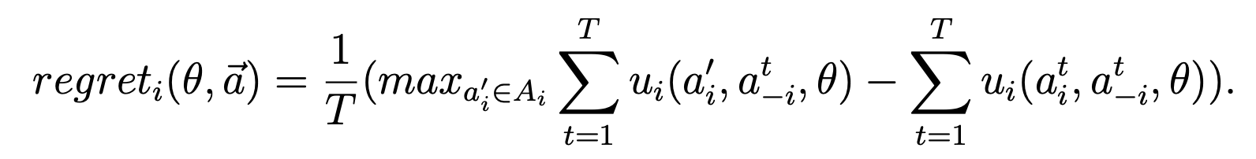
Estimation Task in a 2x2 Game
Other equilibrium is still hard to compute.
What if players are using no-regret learning?
An algorithm is a no-regret learning if the regret goes to 0 as T increase to infinity.

Slide 13
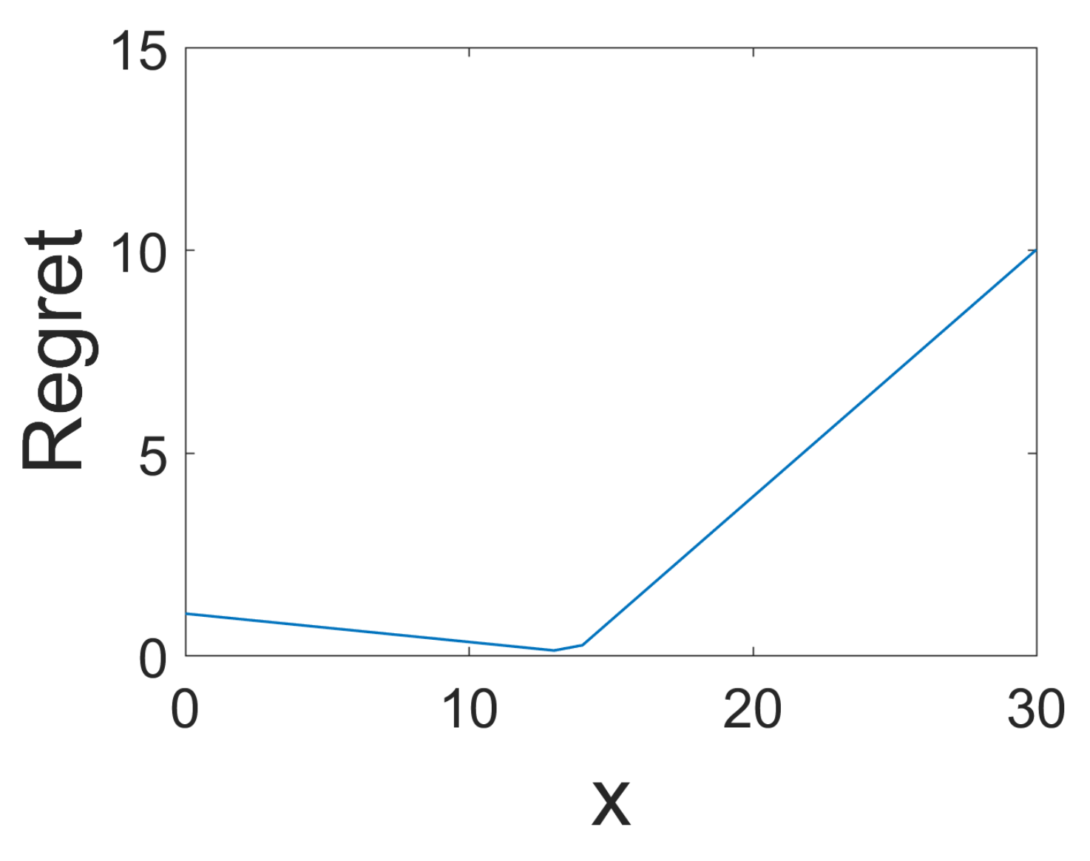

Estimation Task in a 2x2 Game
$p_{U}=0.11,q_{L}=0.68$
$x≈13$ for the lowest regret
Recall NE leads to $13.7$

Slide 14
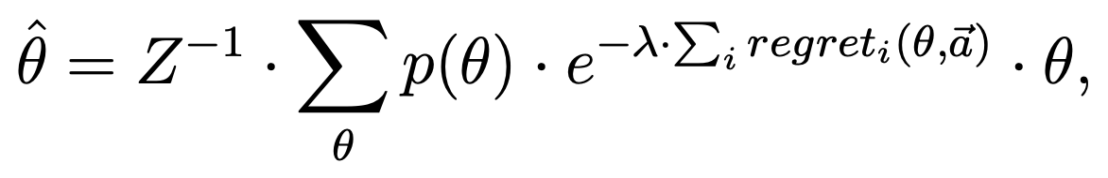
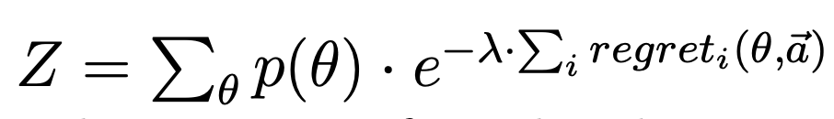
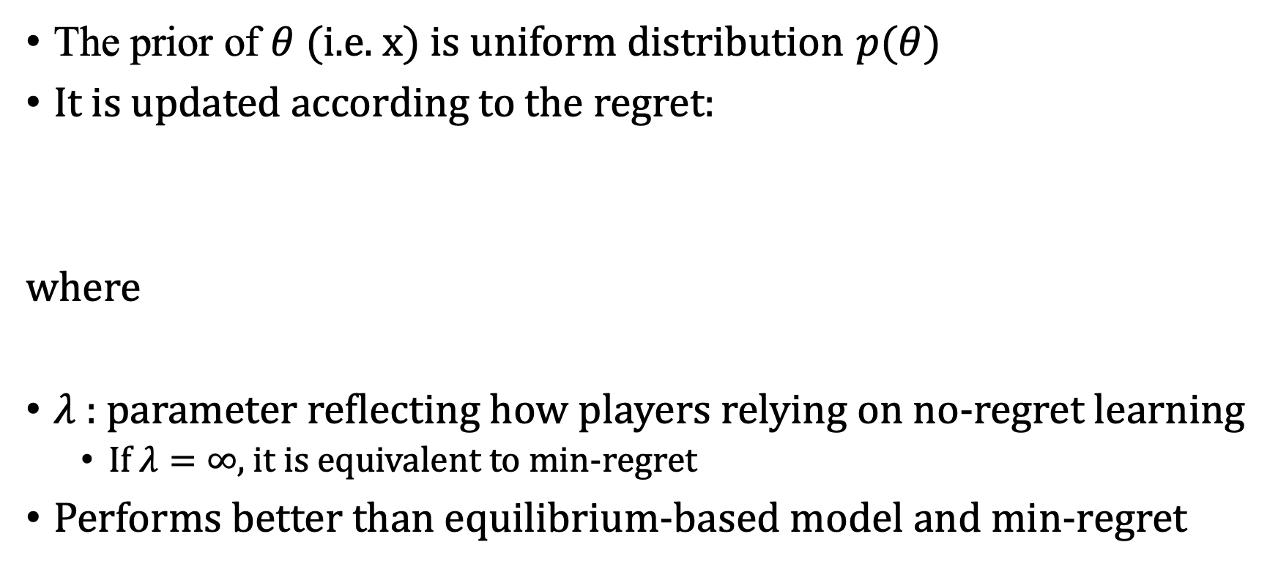
Quantal Regret Model
The prior of $θ$(i.e. x) is uniform distribution $p(θ)$
It is updated according to the regret:
where
$λ$ : parameter reflecting how players relying on no-regret learning
If $λ=∞$, it is equivalent to min-regret
Performs better than equilibrium-based model and min-regret

Slide 15
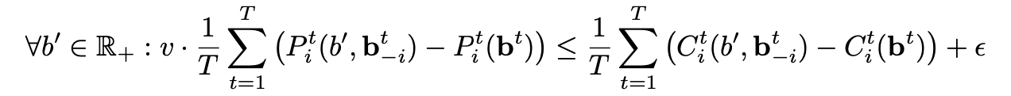
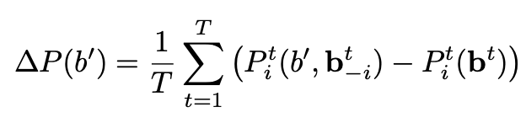
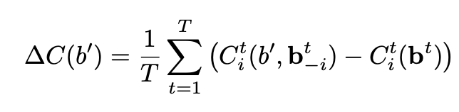


Application to Auctions
For given bidding ${b^{t}=(b}_{i}^{t},b_{−i}^{t}), t=1,…,T, (v,ε)$ is no-regret pair if
where $P(⋅)$ is winning probability, $C(⋅)$is the payment function
Define deviation function:
Rationalizable Set $𝒩ℛ=\left\{\left(v,ε\right)\right| \}$

Slide 16
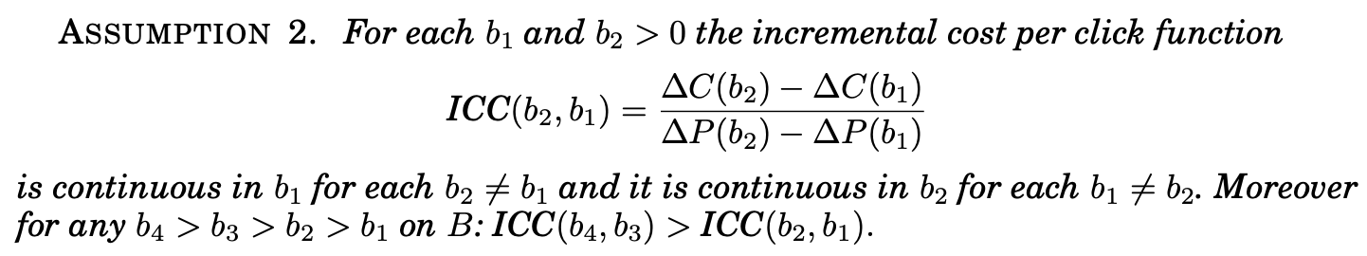
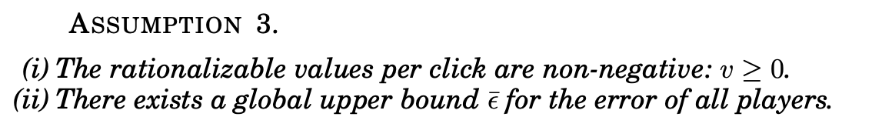
Application to Auctions
With some assumptions

Slide 17
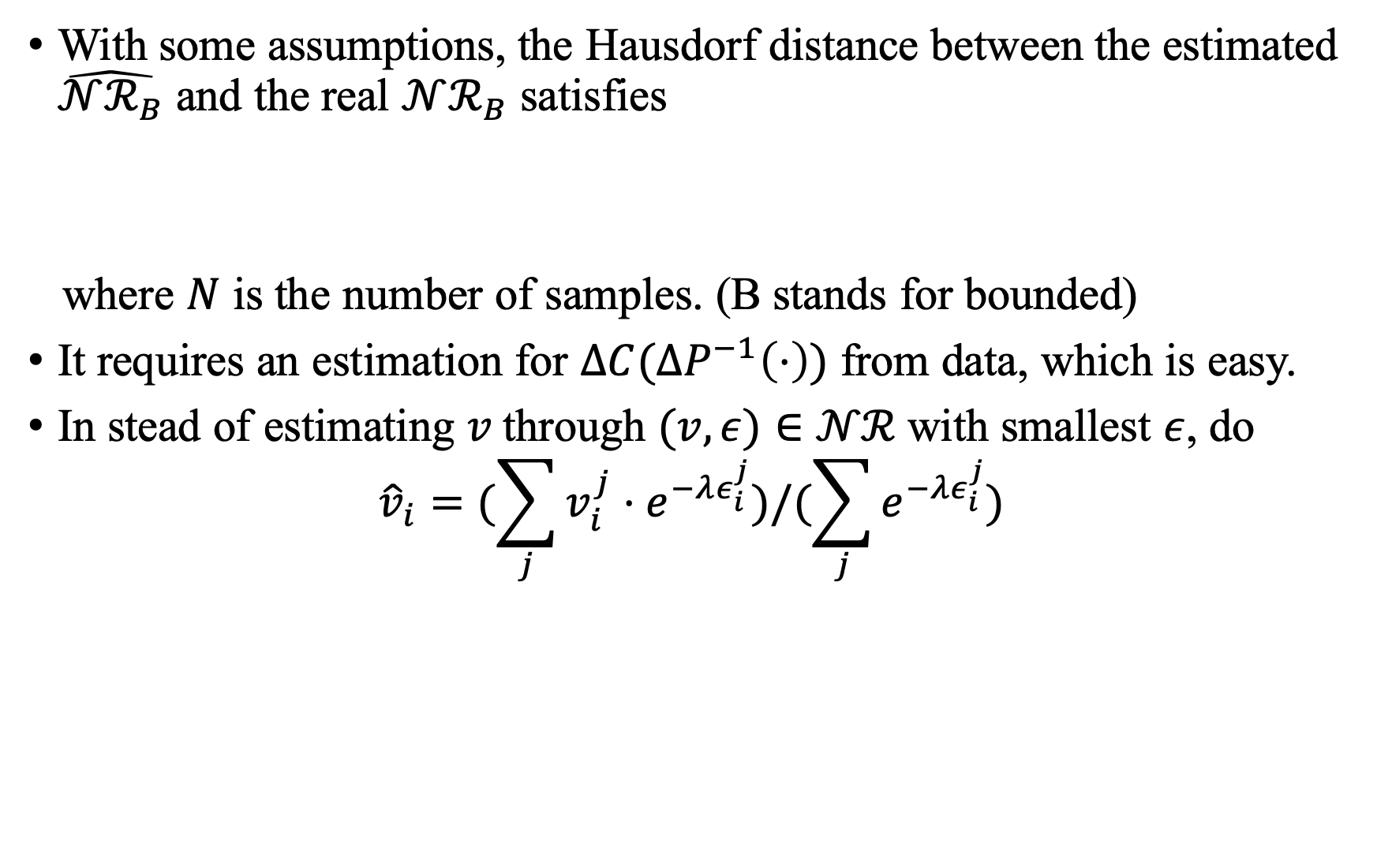
Application to Auctions
With some assumptions, the Hausdorf distance between the estimated $\hat{𝒩ℛ_{B}}$ and the real $𝒩ℛ_{B}$ satisfies
where $N$ is the number of samples. (B stands for bounded)
It requires an estimation for $ΔC(ΔP^{−1}\left(⋅\right))$ from data, which is easy.
In stead of estimating $v$through $(v,ε)∈𝒩ℛ$ with smallest $ε$, do
$${\hat{v}}_{i}=(\sum_{j}{v_{i}^{j}⋅e^{−λε_{i}^{j}}})/(\sum_{j}{e^{−λε_{i}^{j}}})$$

Slide 18
Thank You

