Slide 1

A Machine Learning Approach for Prediction of Protein Structure and Function
Tom Wilson
HCI 5903 Capstone
2019.04.15

Slide 2
Objectives
Become familiar with traditional methods of protein structure and function determination
Recognize the utility of protein characterization for potential medical therapies
Understand the computational challenge of brute force protein structural prediction
Understand the role of machine learning in protein structure and function prediction

Slide 3
Project Inspiration
Deweese Laboratory
Topoisomerase II isoform comparison
C-terminus is not conserved between the two isoforms¹
C-terminus has been resistant to structural determination¹
Structure and function determination of the C-terminus for each isoform may allow targeted drug therapies with reduced adverse reactions
Secondary leukemias

Slide 4
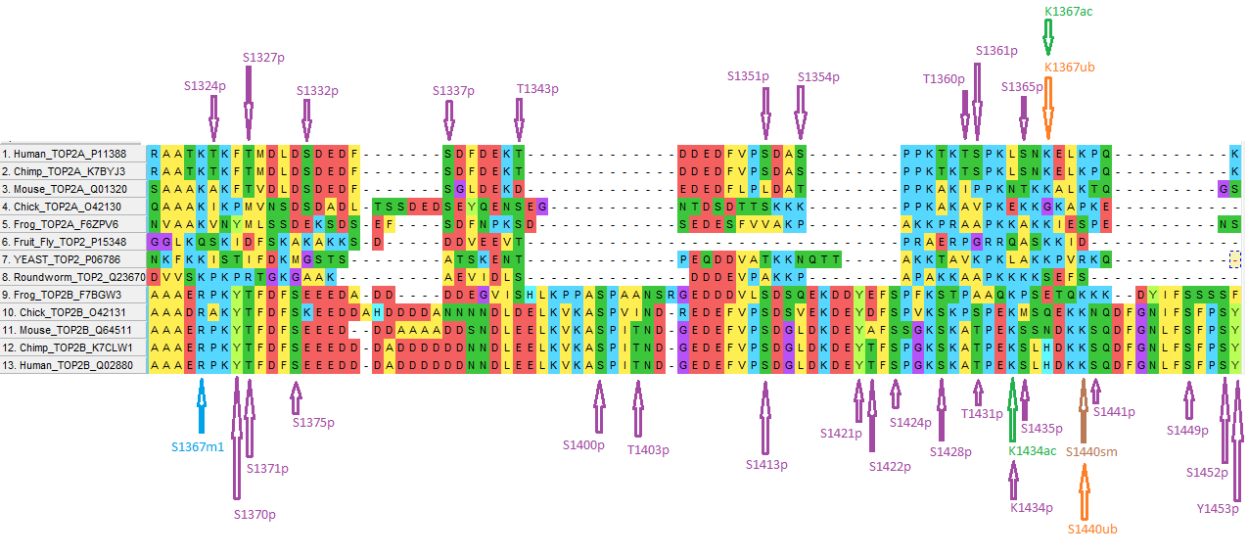
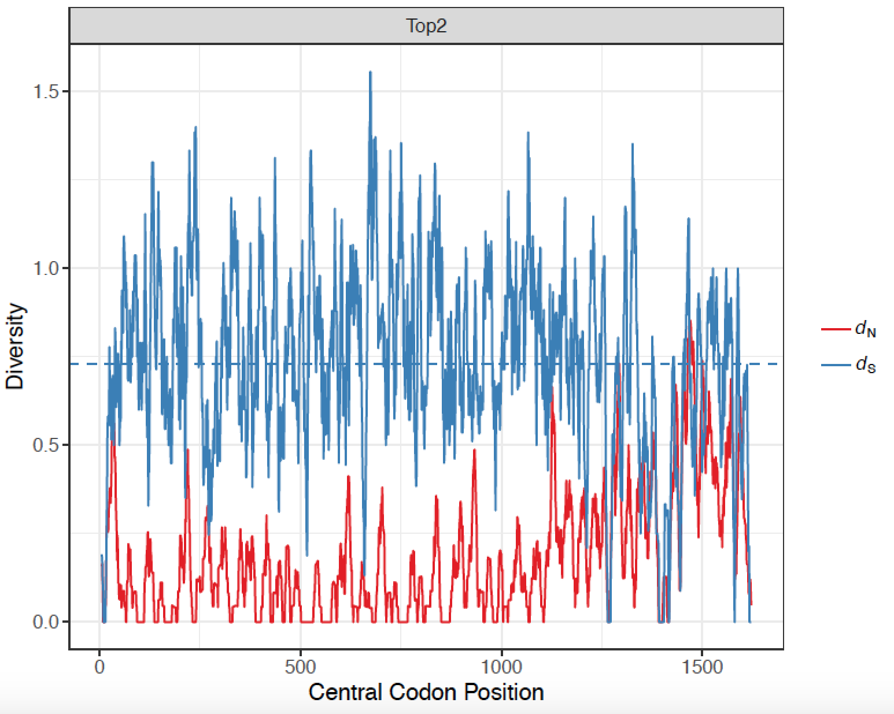
Differences in C-termini of Topoisomerase II¹
Notes:
Comparison of the codons in the human isoforms of topoisomerase II indicates most of the differences outside of the C-terminal domain do not change the amino acid sequence. However, in the C-terminal domain, there is an increase in the proportion of codon differences that lead to changes in the amino acid sequence.

Slide 5
Traditional Methods of Protein Characterization^{2,3}
X-ray crystallography
NMR Spectroscopy
Activity assays
Agonists vs antagonists

Slide 6

Computational Analysis⁴
Computational protein structure prediction (PSP) typically utilizes enumeration or searching strategies with optimization which involve enormous probability spaces
$U = \sum_{b}{K_{b}^{bond}{(l_{b} − l_{b}^{0})}^{2} }+ \sum_{a}{K_{a}^{angle}{(θ_{a} − θ_{a}^{0})}^{2} }+ \sum_{t}{K_{t}^{torsion} (1 − \cos{[n_{t}(φ_{t} − φ_{t}^{0})])} }+ \sum_{i > j}{K_{ij}^{nonlocal} f(r_{ij} / r_{ij}^{0}) }$
related optimization algorithm for the current method of PSP
Algorithm is NP-Hard

Slide 7
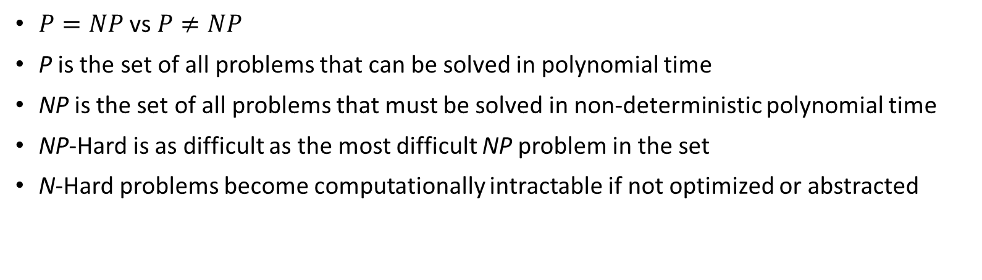
P, NP, and Computational Complexity⁵
$P=NP$ vs $P≠NP$
P is the set of all problems that can be solved in polynomial time
NP is the set of all problems that must be solved in non-deterministic polynomial time
NP-Hard is as difficult as the most difficult NP problem in the set
N-Hard problems become computationally intractable if not optimized or abstracted

Slide 8
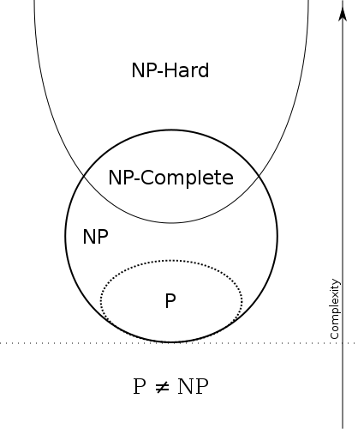
P, NP, and Computational Complexity^{5,9}

Slide 9
Levinthal Paradox
“In theory a protein is expected to require exponential time to fold, given an arbitrary starting configuration, whereas in practice proteins are observe to fold within seconds to minutes, independent of size… [where] exponential-time folding is expected because of the exponential size of the protein’s conformational space” ⁴
“Exhaustive search of a protein's conformational space is clearly not a feasible algorithmic strategy. The number of possible conformations is exponential in the length of the protein sequence, and powerful computational hardware would not be capable of searching this space for even moderately large proteins”⁶

Slide 10

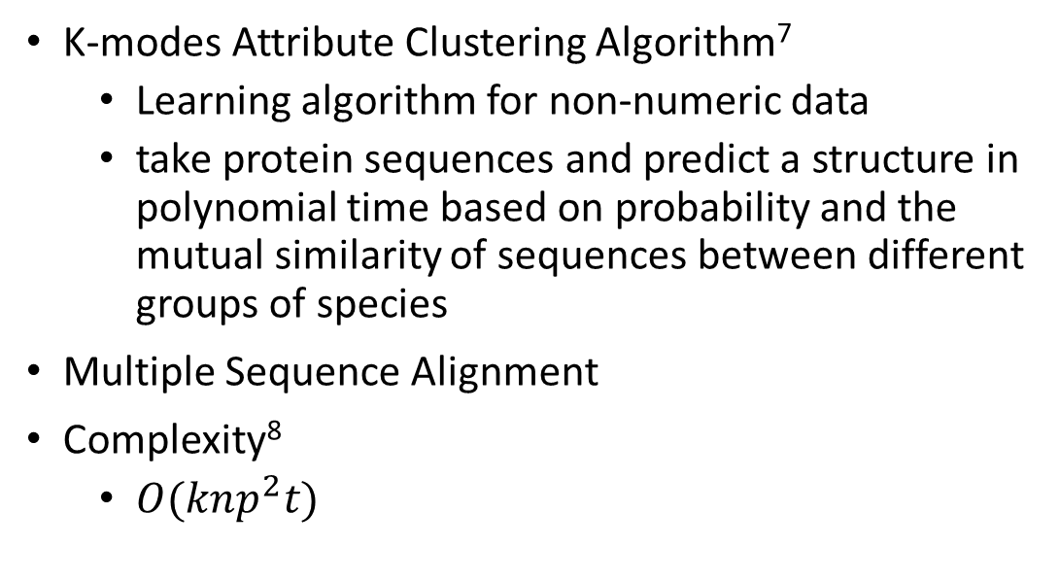
Machine Learning
K-modes Attribute Clustering Algorithm⁷
Learning algorithm for non-numeric data
take protein sequences and predict a structure in polynomial time based on probability and the mutual similarity of sequences between different groups of species
Multiple Sequence Alignment
Complexity⁸
$O(knp^{2}t)$

Slide 11
K-Modes Algorithm^{7,8}
Data-driven, machine learning algorithm for clustering similar data
Clusters based on how dependent one attribute is on another
Machine learning has immense potential for use in the biological and medical sciences, especially for process optimization and probabilistic prediction

Slide 12
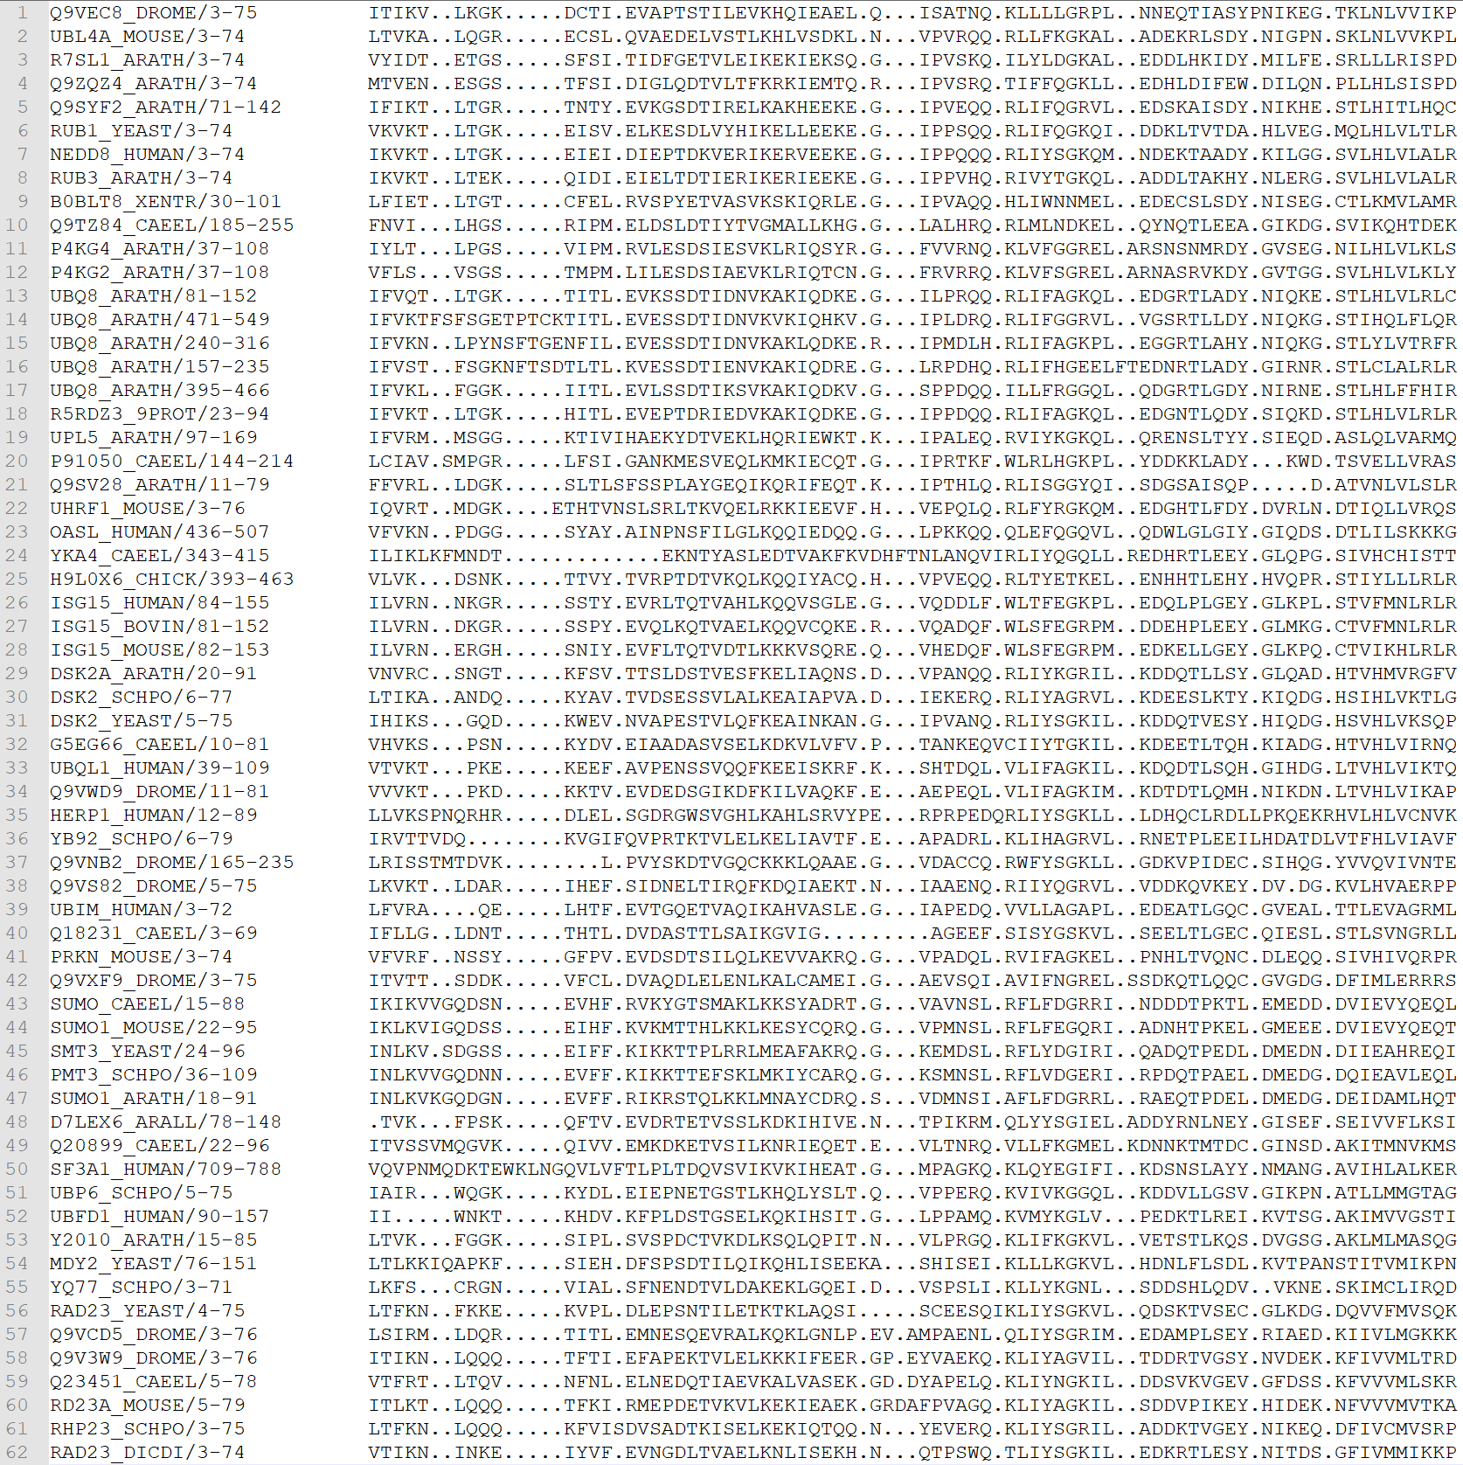
Multiple Sequence Alignments¹⁰
Alignment of a protein’s sequence across multiple organisms
Takes into consideration substitution, insertion, and deletion events
Necessary for probabilistic purposes
More sequences allows for better resolution of results

Slide 13
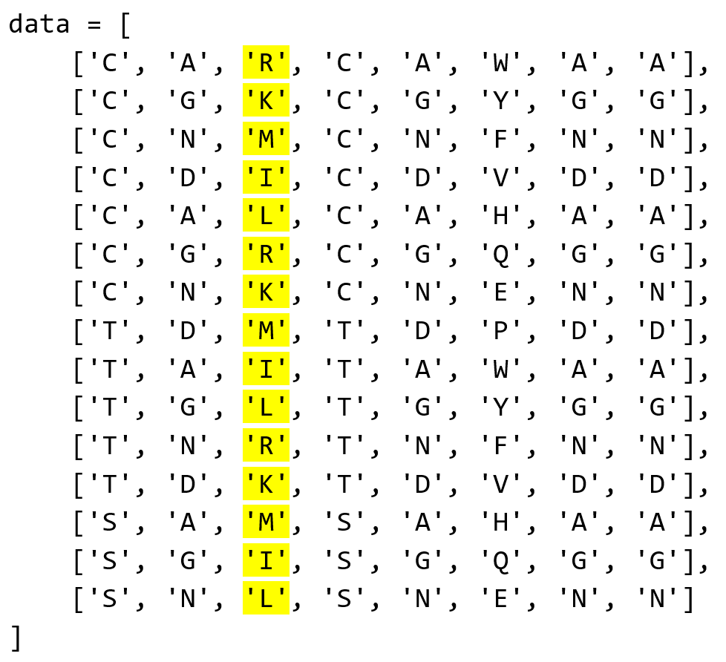
Attributes
Once the multiple sequence alignment data has been obtained, it needs to be parsed through and manipulated for prediction calculations
Array manipulation
Attributes within the data array
An attribute in this case is a column of amino acids within the aligned sequence array

Slide 14

Interdependence and Mutual Information^{7,11,12}
Mutual information is calculated to determine the interdependency relationship between two attributes
Mutual information is normalized by the joint entropy (Shannon entropy) of the sequences as well to yield a more interpretable result
$I(X_{i}, X_{j}) = \sum_{x∈X_{i}}{\sum_{y∈X_{j}}{p(x, y)log(\frac{p(x, y)}{p(x)p(y)})}}$
Mutual Information
$H(X_{i}, X_{j}) = −\sum_{x∈X_{i}}{\sum_{y∈X_{j}}{p(x, y)log(p(x, y))}}$
Shannon Entropy
$R_{ij} = \frac{ I(X_{i}, X_{j})}{H(X_{i}, X_{j})}$
Normalized Mutual Information
Interdependency Redundancy

Slide 15
Algorithmic Approach¹³
Python, Scikit-learn, and Numpy
Once a multiple sequence alignment has been input into the program, a number of steps take place in a loop-wise fashion until the prescribed value for k has been reached
algorithm will run for a number of iterations from k – 1 to k = 2
Output from each iteration will be stored in a file which is then used to construct a cluster tree graph

Slide 16
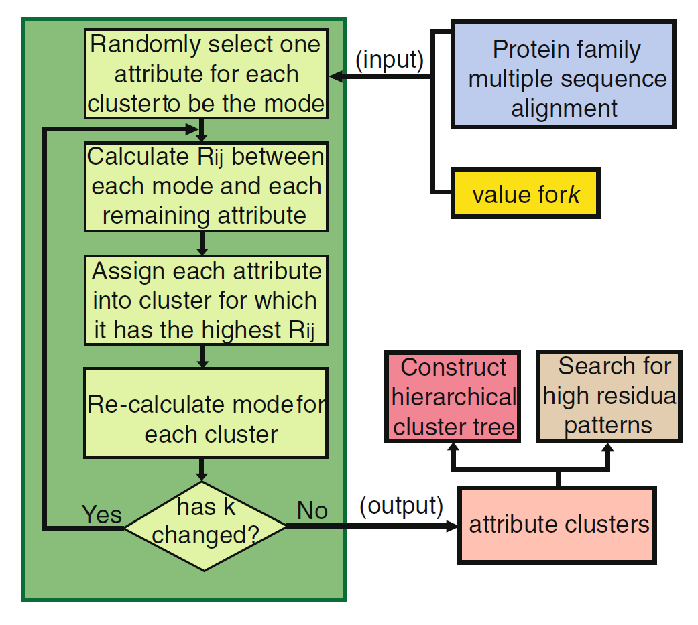
Algorithm⁷

Slide 17
Code
Hard-coded test sequence
In the future, would allow for upload of code via file parsing

Slide 18
Code
Computing the length of the data array to assign to k
Random attribute selection for first iteration

Slide 19
Code
Looping through the data array to calculate the interdependency redundancy between attributes

Slide 20
Code
Calculating the Normalized Interdependency Redundancy (NIR) and Average Normalized Interdependency Redundancy (ANIR)
Performing clustering again without random selection for remaining iterations

Slide 21
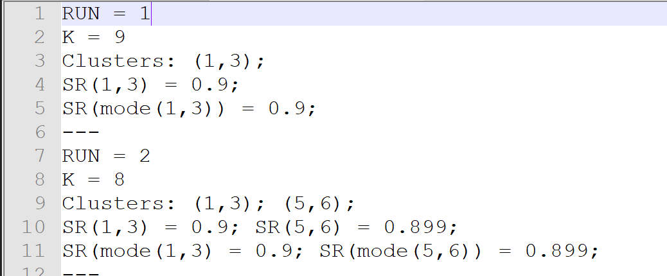
Code Output

Slide 22
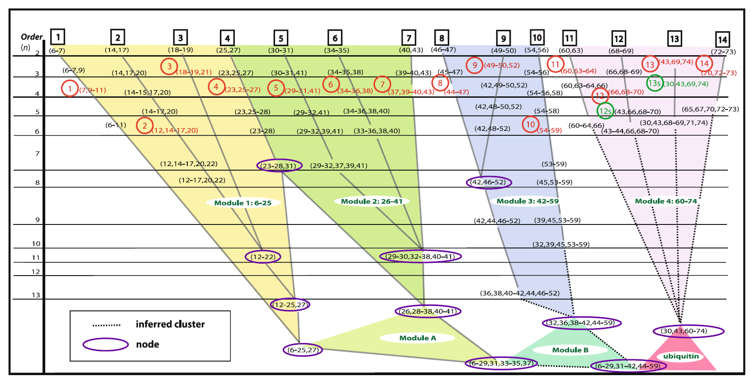
Cluster Trees⁷

Slide 23
Next Steps
Verification and repeatability are of the utmost importance if this tool is to be used by other researchers
Next steps should focus on validating this algorithm against protein sequences with known and verified crystallographic structures
Algorithmic scalability is also an area ripe for optimization
Protein sequence and probability space grows exponentially with the length of the sequence
Intractable program runtime
Computational Clusters

Slide 24
Reiteration
The importance of the scope of this project lies in the utility of proteins as medicinal targets for various therapeutic strategies
Having a tool that can accurately and efficiently predict protein structure and function from a sequence would be useful for new drug design and targeting techniques as well as understanding the pathophysiology of disease states

Slide 25
References
Deweese, J., et al. (2019). The variable C-terminal domain of human type II topoisomerases as a functionally relevant therapeutic target. American Society for Biochemistry and Molecular Biology, Orlando, FL.
Carpenter, E. P., et al. (2008). "Overcoming the challenges of membrane protein crystallography." Curr Opin Struct Biol 18(5): 581-586.
Lacapere, J. J., et al. (2007). "Determining membrane protein structures: still a challenge!" Trends Biochem Sci 32(6): 259-270.
Ngo, J. T., et al. (1994). "Computational Complexity, Protein Structure Prediction, and the Levinthal Paradox." The Protein Folding Problem and Tertiary Structure Prediction: 433-506.
Knuth, D. E. (1974). "Postscript about NP-hard problems." ACM SIGACT News 6(2): 15-16.
Newman, A. and W. E. Hart (2001). "The Computational Complexity of Protein Structure Prediction in Simple Lattice Models." CRC Press.
Durston, K. K., et al. (2012). "Statistical discovery of site inter-dependencies in sub-molecular hierarchical protein structuring." EURASIP J Bioinform Syst Biol 2012(1): 8.
Au, W. H., et al. (2005). "Attribute clustering for grouping, selection, and classification of gene expression data." IEEE/ACM Trans Comput Biol Bioinform 2(2): 83-101.
Esfahbod, B. (2007). N. Euler diagram for P, NP-Complete, and NP-Hard set of problems. Wikimedia Commons.
Laboratory, E. M. B. (2019). "Family: ubiquitin (PF00240)." 2019, from https://pfam.xfam.org/family/PF00240#tabview=tab3.
Wong, A. K. C. and G. C. L. Li (2008). "Simultaneous Pattern and Data Clustering for Pattern Cluster Analysis." IEEE Transactions on Knowledge and Data Engineering 20(7): 911-923.
Wong, A. K. C., et al. (1976). "Statistical analysis of residue variability in cytochrome c." Journal of Molecular Biology 102(2): 287-295.
Pedregosa, F., et al. (2013). "Scikit-learn: Machine Learning in Python." Journal of Machine Learning Research 12: 2825-2830.

Slide 26
Questions
A Machine Learning Approach for Prediction of Protein Structure and Function

