Slide 1



Slide 2

A public bicycle hire scheme in London, Swansea, Milton Keynes and Brunel University sponsored mainly by Santander UK
Launched on 30 July 2010, formerly known as Barclays Cycle Hire
Catered for short trips
£2 for unlimited journeys up to 30 minutes, within a 24 hour period. £2 for each additional 30 minutes
Annual membership at £90 with tax savings and student discounts available

Slide 3
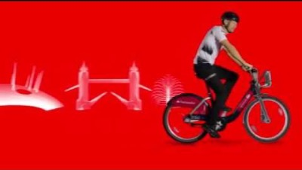
HOW IT WORKS

Slide 4
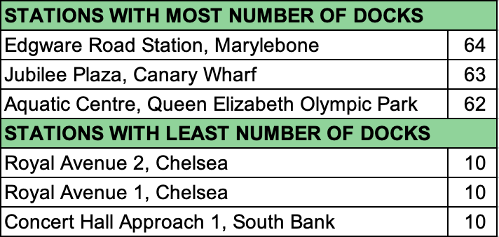
STUDY OBJECTIVE
Whether or not to provide more bikes / docks at certain stations at certain times of day
HYPOTHESIS
Should the number of bikes / docks be increased during the peak hours?
Peak hours are generally between 07:00 – 10:00 and 16:00 – 19:00
BACKGROUND STATS - 2019
Number of Transactions: 10,310,063 (28,247 transactions per day)
Number of Bikes: 12,943
Number of Docks: 20,572
Number of Stations: 783
Max Time Spent per Transaction: 6 days 11 hours 20 minutes
Min Time Spent per Transaction: 1 minute
Average Time Spent per Transaction: 19 minutes 32 seconds

Slide 5
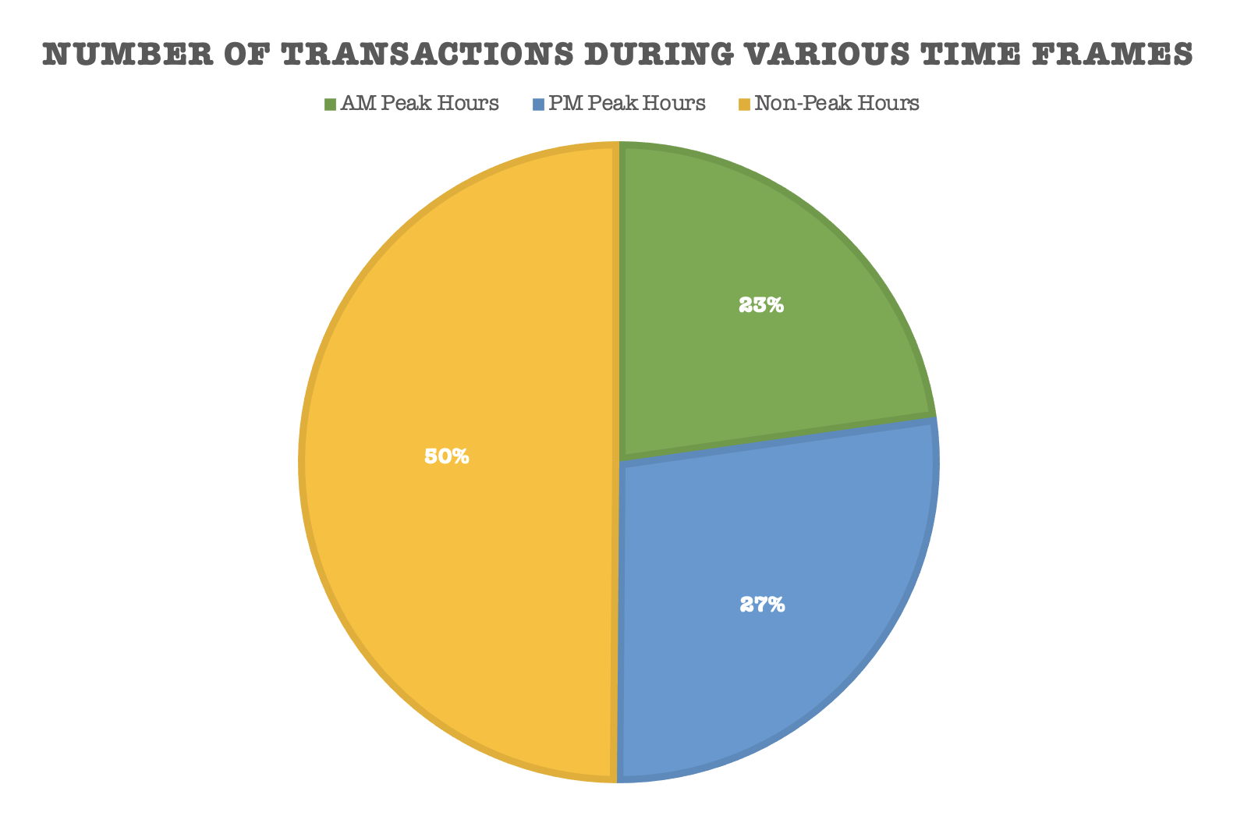
To be noted that total transactions over the non-peak hours is a cumulation over 18 hours as compared to the other two at 3 hours each
3% more transactions during PM peak period which may be attributed to the possibility of a more diverse demographic of users (i.e. college students finishing classes)

Slide 6
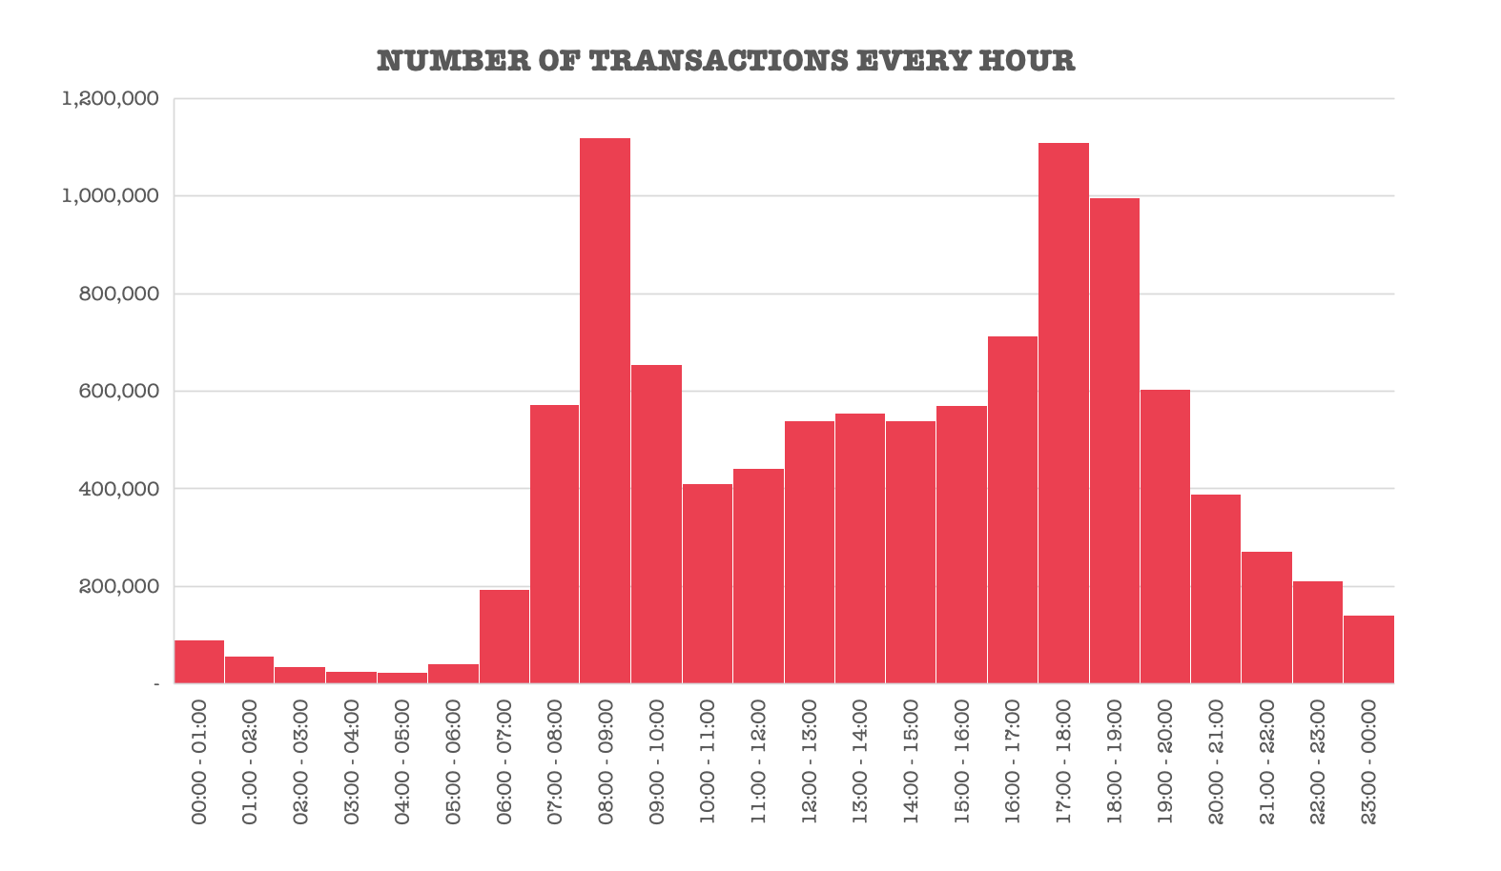
Compilation done based on start time of transactions without a ‘NULL’ end time (reflection of a complete transaction)
Significant peak at 08:00 – 09:00, 17:00 – 18:00 and 18:00 – 19:00 with average time spent per transaction at 15m44s, 18m28s and 18m31s respectively

Slide 7
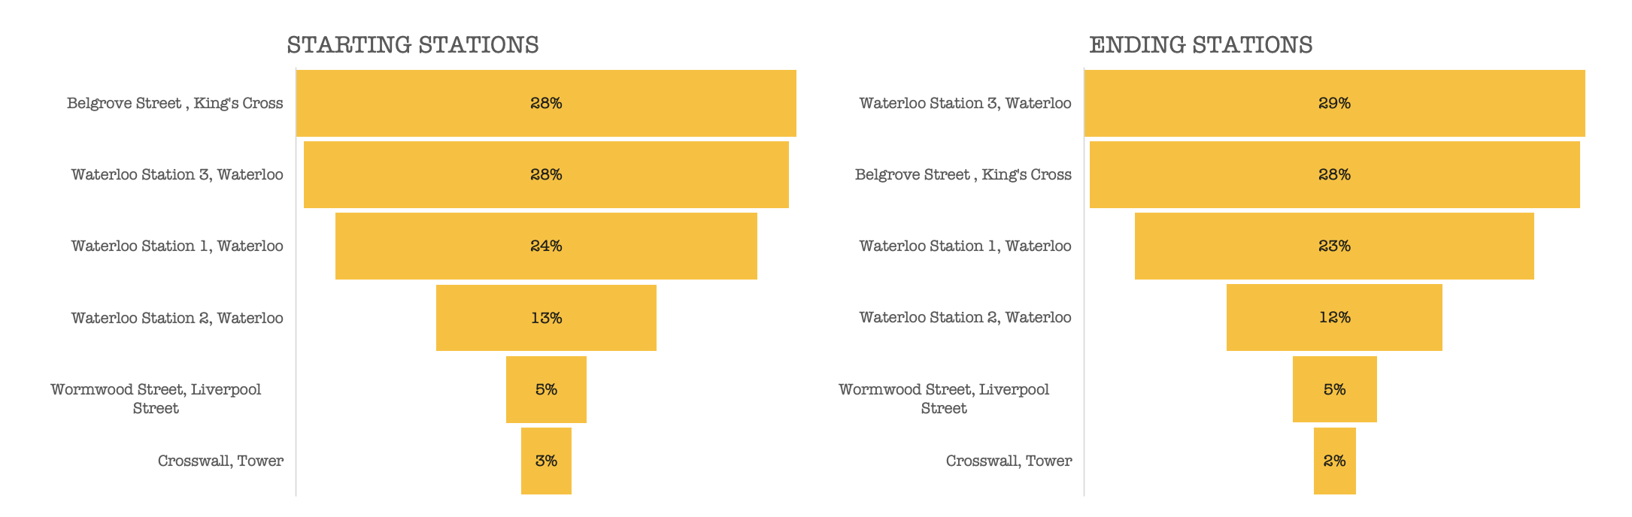
TOP STARTING & ENDING STATIONS (07:00 – 10:00)
For consideration of where more bikes / docks can be added to
% is the total number of transactions at the respective station against the total number of transactions from all stations over the 3 hours

Slide 8
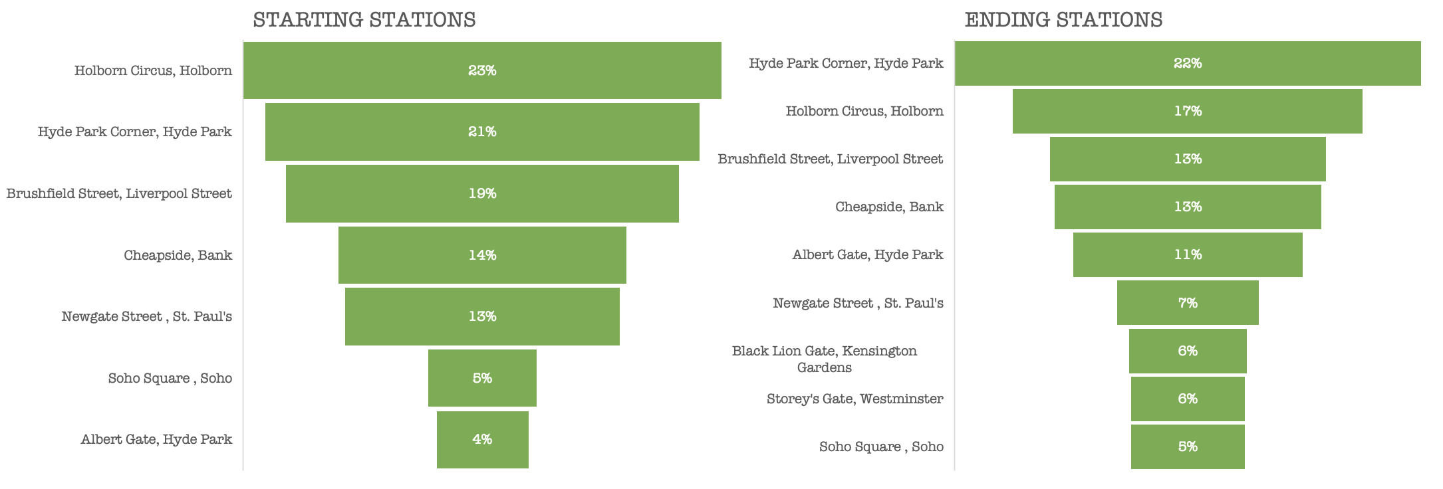
TOP STARTING & ENDING STATIONS (16:00 – 19:00)
For consideration of where more bikes / docks can be added to
% is the total number of transactions at the respective station against the total number of transactions from all stations over the 3 hours

Slide 9
HYPOTHESIS
Should the number of bikes / docks be increased during the peak hours?
The significant increase in transactions during the two three-hour pockets do justify the addition of bikes/docks to cater to the surge in demand
HOWEVER
Is it really necessary? Or are we actually doing just fine status quo?

Slide 10
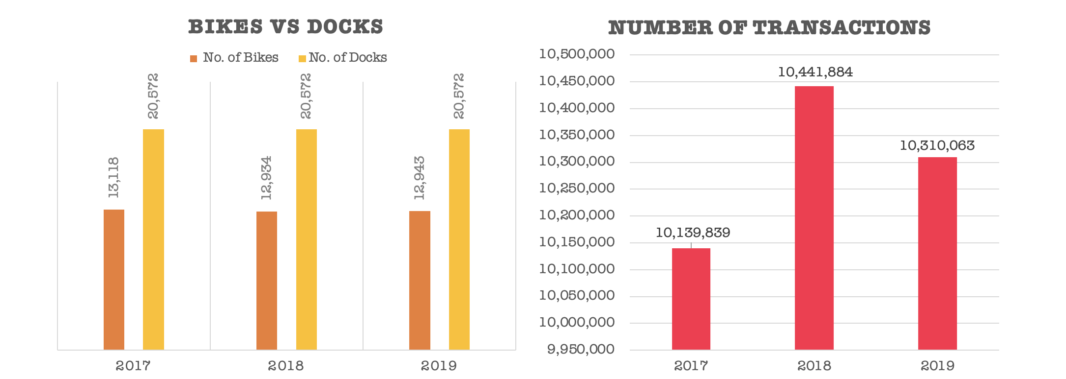
184 fewer bikes from 2017 - 2018 which might’ve been stolen given the many transactions with NULL end time in 2017 (omitted from tabulation)
Trend shows no correlation between number of bikes/docks vs number of transactions (i.e. having more bikes/docks will facilitate more usage)
Scheme also imposed surcharge for additional time after initial 30 minutes which may explain increase in transactions (1 rider for 30 minutes straight vs 3 riders at 10-minute interval each) and absence of incomplete transactions in 2018 and 2019

Slide 11
SO,
Should we increase the number of bikes/docks during rush hour?
Not a hard yes.
Not cost effective (nor practical) to add more bikes and set up more docks solely for a few hours everyday
More viable to do so over a prolonged period of time

Slide 12
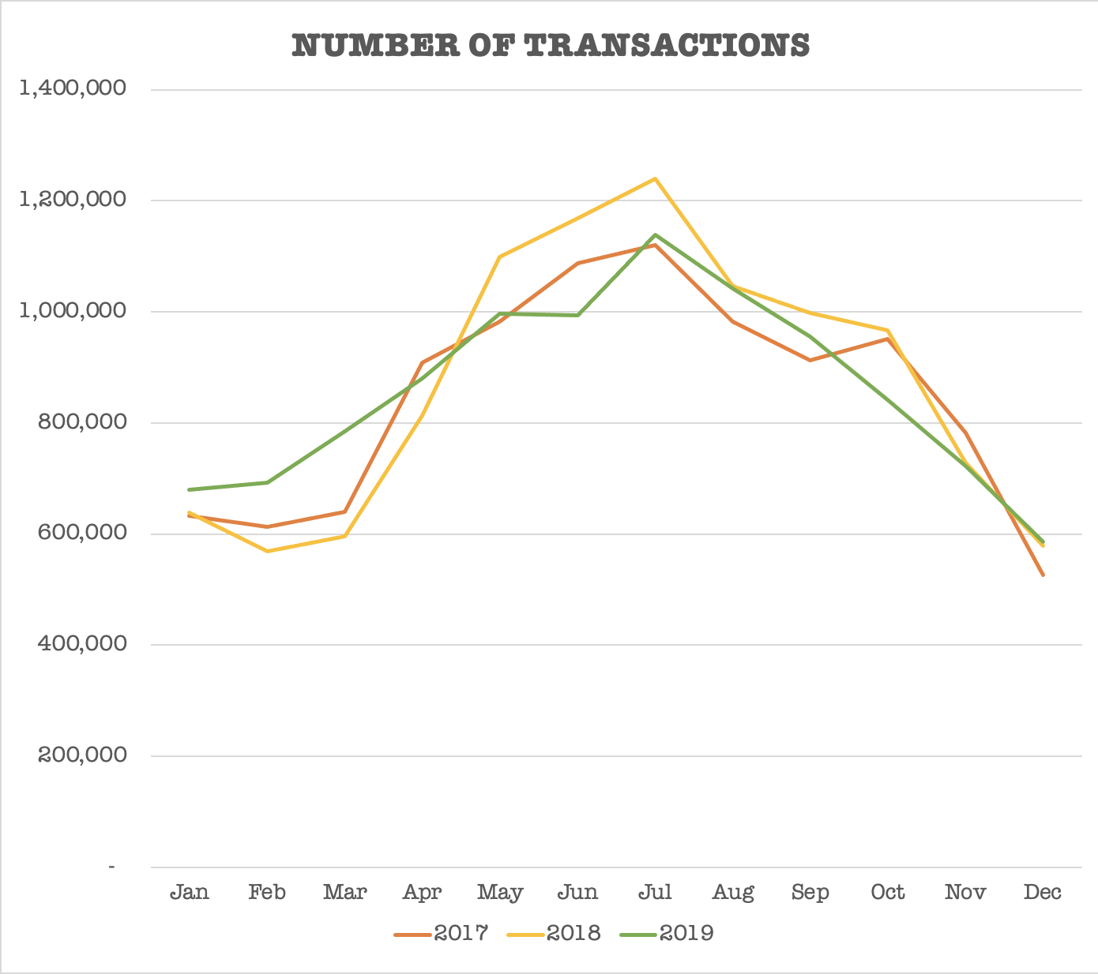
Peak months: May – Aug (Spring & Summer)
Recommendation 1: to start adding more bikes and setting up more docks from Apr onwards and slowly taper off from Aug, in conjunction with curated routes provided by Santander Cycles
Recommendation 2: to check calendar for any upcoming major event(s) that can trigger more usage and strategise locations to add more bikes and docks at

Slide 13
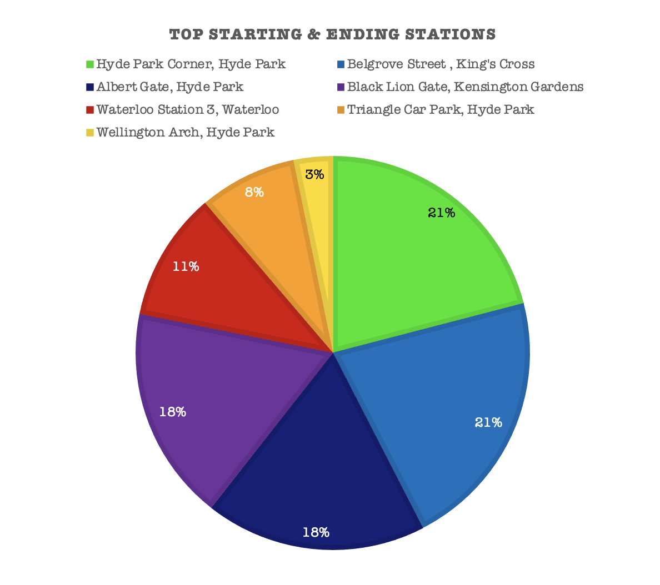
AREAS FOR CONSIDERATION OF WHERE MORE BIKES & DOCKS CAN BE ADDED TO

