Slide 1
CS665 Class Project JTChatroom
Jingtian Zou 04/28/2021

Slide 2
Design Goals
A simulated chatroom
User: create new & choose existed
Chatroom: create new & choose existed
Chat: send message to all users
Main Menu: choose from 6 actions
Database: SQLite
I/O: Console & database

Slide 3
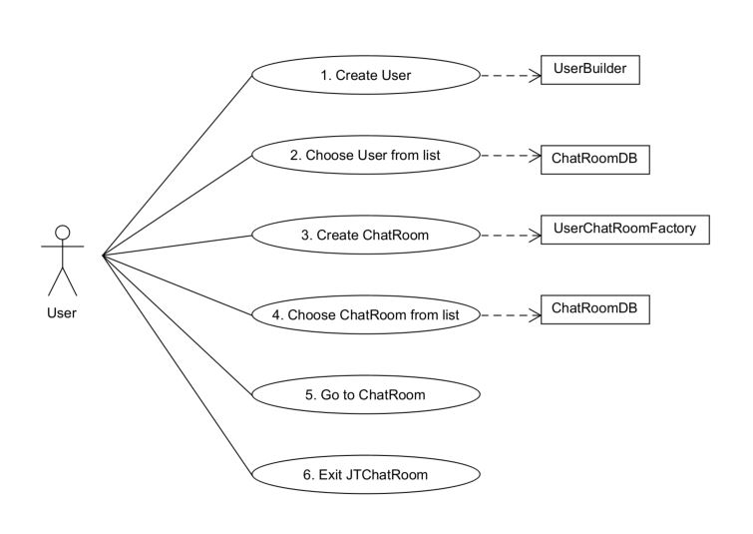
Use Case Scenario

Slide 4
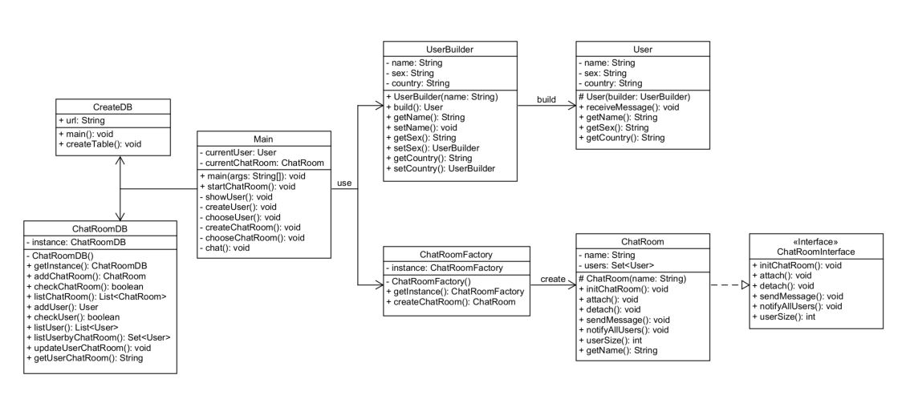
UML Class Diagram
noytify

Slide 5
Design Patterns
Factory Method
Singleton
Builder
Observer

Slide 6
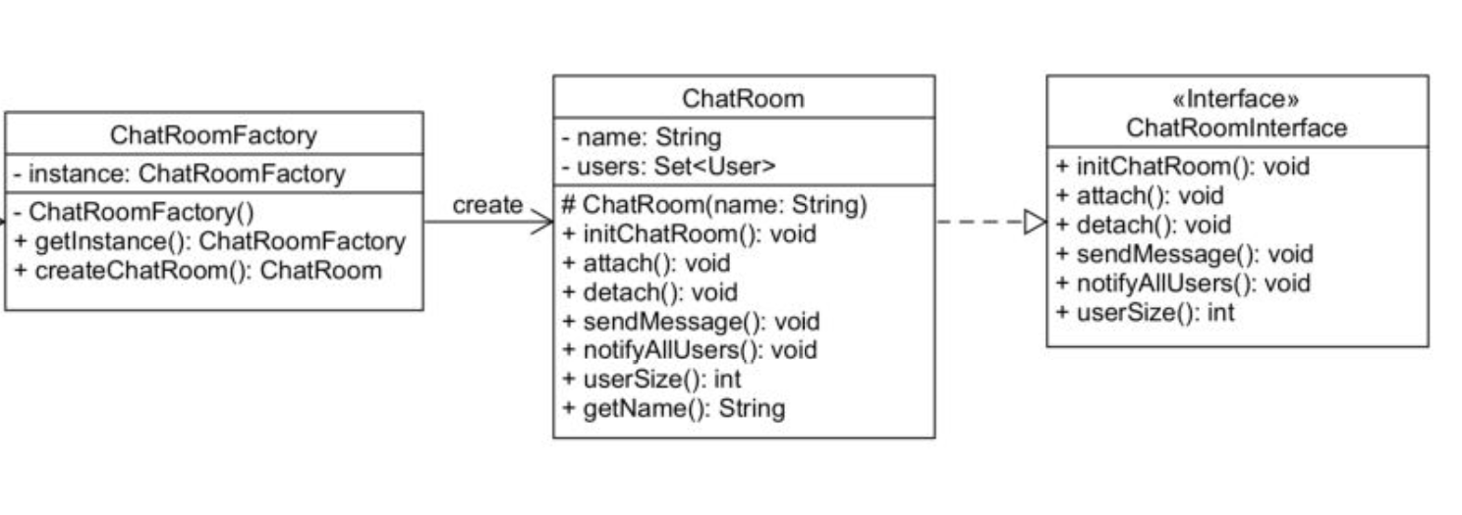
Factory Method Pattern

Slide 7
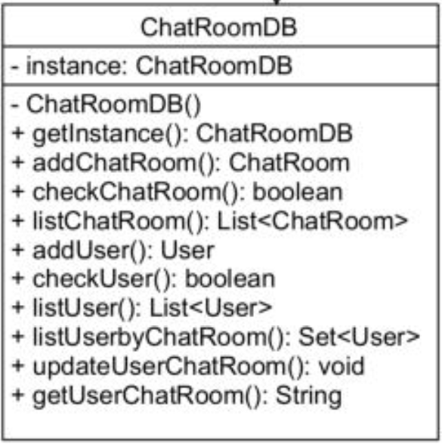
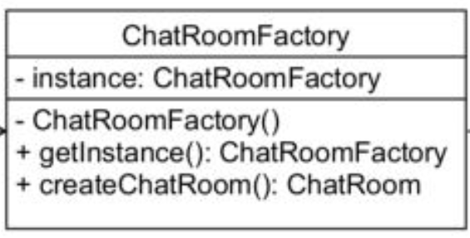
Singleton Pattern

Slide 8
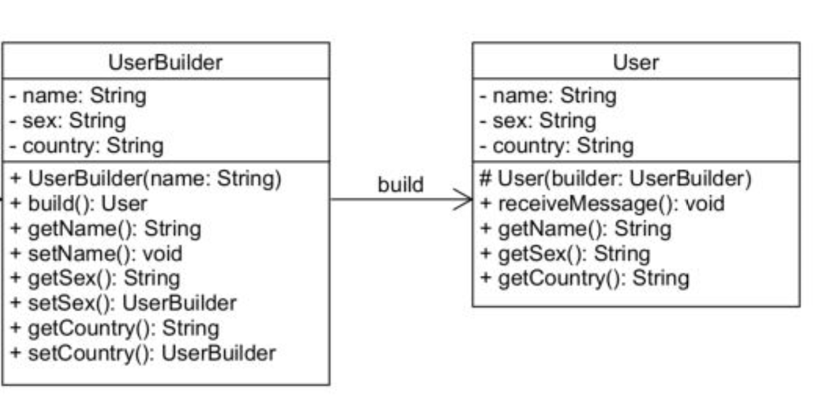
Builder Pattern

Slide 9
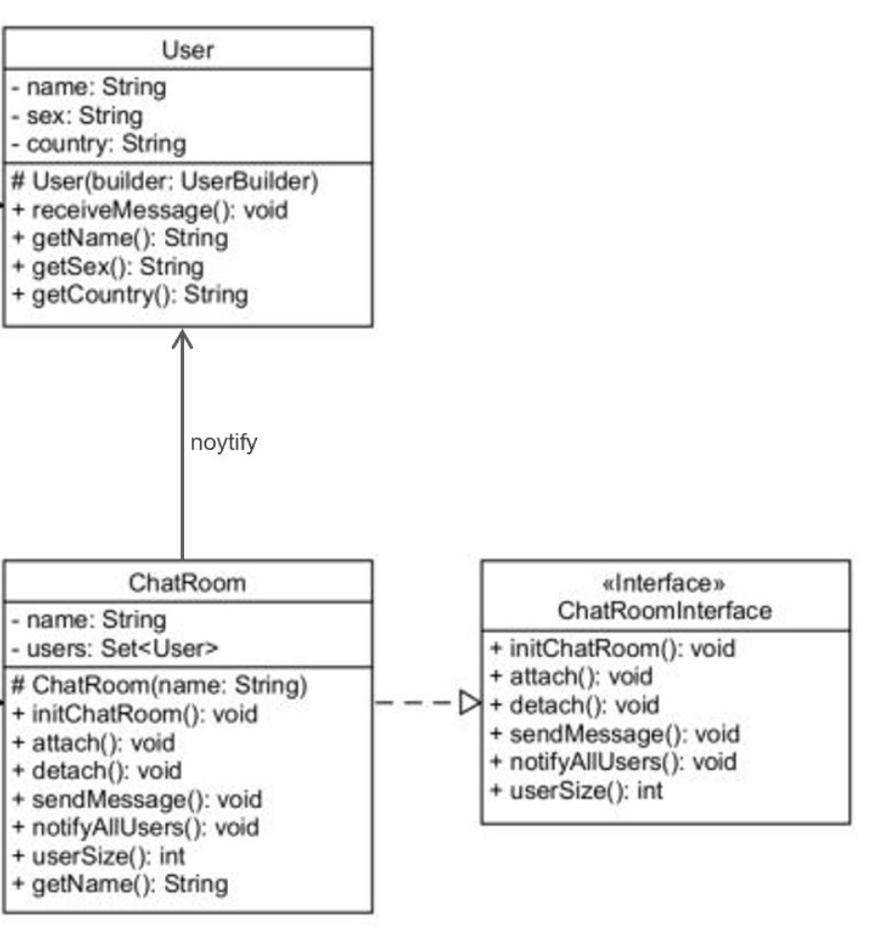
Observer Pattern

Slide 10

Design Concepts
Flexibility
Simplicity & Understandability
Security

Slide 11

Run Instructions
Add sqlite-jdbc-3.34.0.jar to Maven Dependencies
Run edu.bu.met.cs665.db / CreateDB.java to create the database
Run edu.bu.met.cs665 / Main.java to use JTChatroom

Slide 12


Thanks for your
instruction & facilitation!

