Slide 1
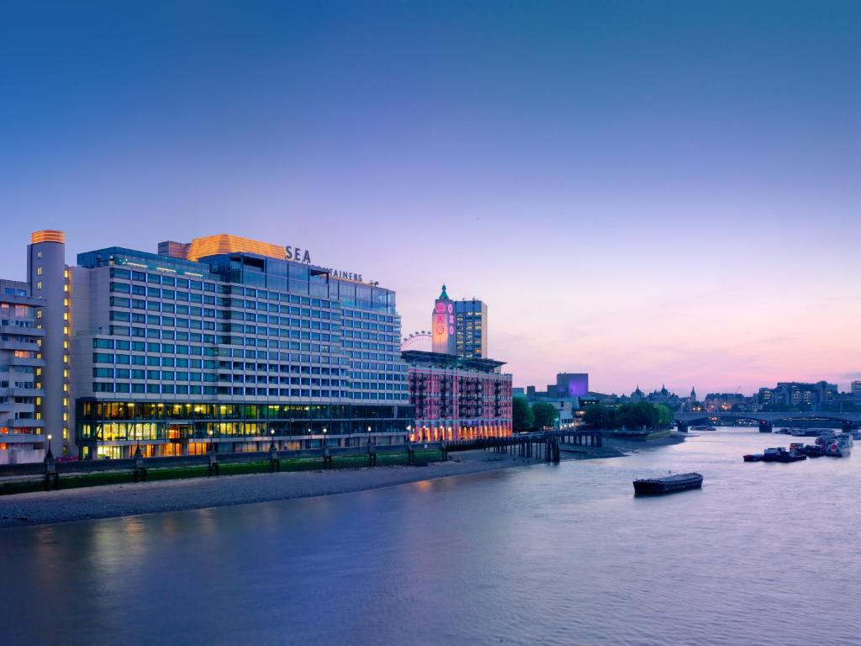
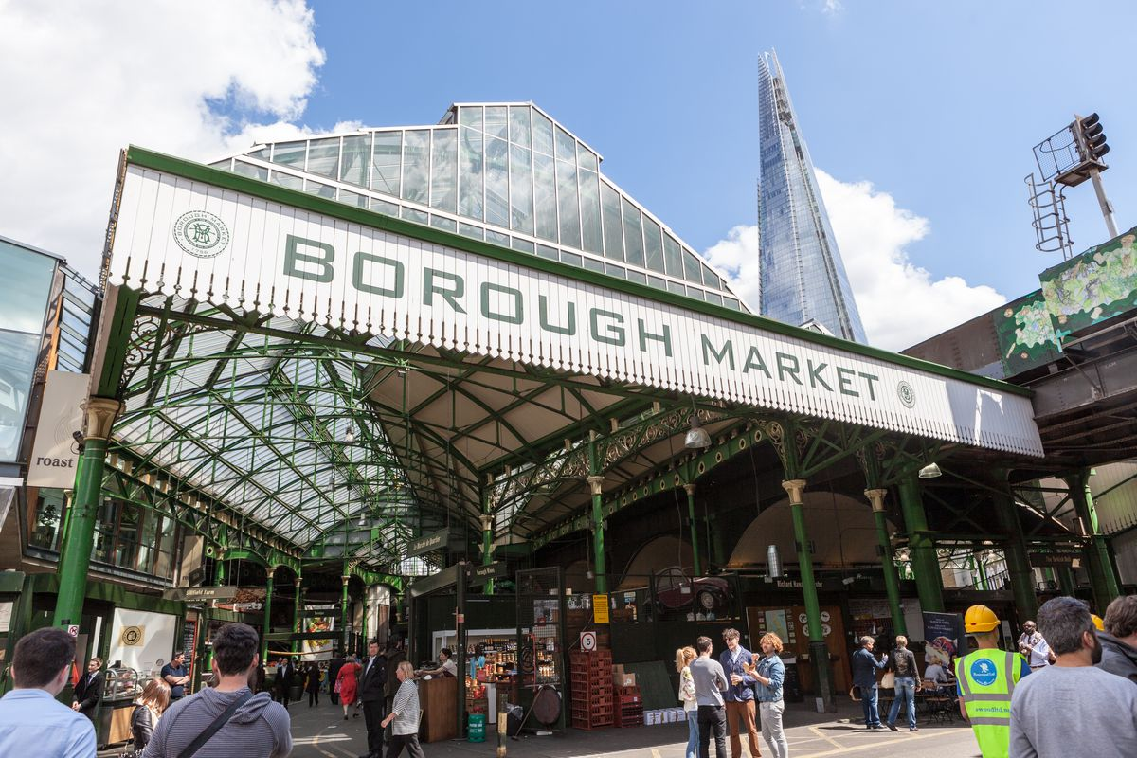
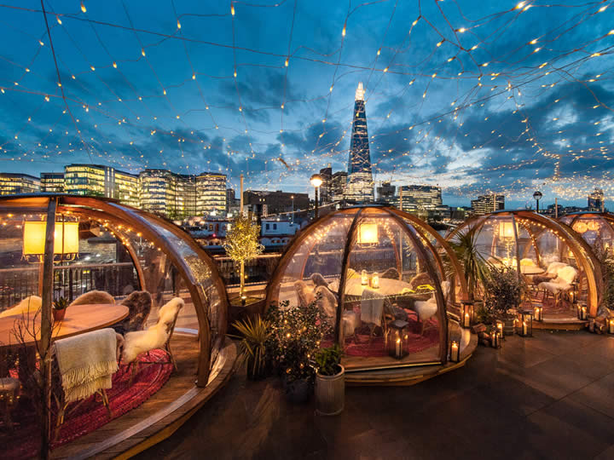
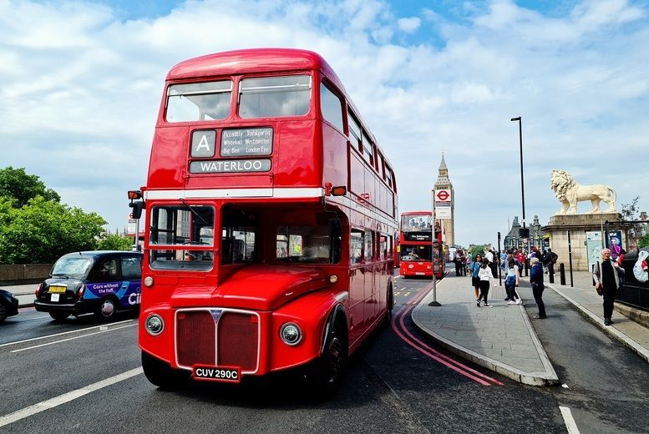



SEA CONTAINERS
MY TRIP
Near the tube, major attractions and the Thames
Prices range
From $200 - $500
Majestic view
of the Thames

Slide 2


MY TRIP
BOROUGH MARKET
SEA CONTAINERS
20 Minute walk from hotel
Not only delicacies but also groceries
Mo: CLOSED
Tu Fr:
10:00 – 5:00
Sa: 9:00 – 5:00
So: 10:00 – 4:00
Near the tube, major attractions and the Thames
Prices range
From $200 - $500
Majestic view
of the Thames

Slide 3

SEA CONTAINERS
Near the tube, major attractions and the Thames
Prices range
From $200 - $500
Majestic view
of the Thames
COPPA CLUB
BOROUGH MARKET
Near the Tower
of London
European cuisine
Majestic view
of the Thames
20 Minute walk from hotel
Not only delicacies but also groceries
Mo: CLOSED
Tu Fr:
10:00 – 5:00
Sa: 9:00 – 5:00
So: 10:00 – 4:00

Slide 4

BOROUGH MARKET
20 Minute walk from hotel
Not only delicacies but also groceries
Mo: CLOSED
Tu Fr:
10:00 – 5:00
Sa: 9:00 – 5:00
So: 10:00 – 4:00
Hop-on Hop-off
with guide
COPPA CLUB
The ride includes every
famous sight
The ticket lasts for 24h and you can hop on at all times
~$30
Near the Tower
of London
European cuisine
Majestic view
of the Thames

Slide 5
COPPA CLUB
Near the Tower
of London
European cuisine
Majestic view
of the Thames
Hop-on Hop-off
with guide
The ride includes every
famous sight
The ticket lasts for 24h and you can hop on at all times
~$30

