Slide 1
A practical introduction to RNA-seq
제 1회 KAIST genomics workshop
KJ Yi, YS Ju
KAIST

Slide 2
이 workshop의 목적
Transcriptome analysis에 대한 기본 지식을 전달
Analysis pipeline을 이해
Example data를 통한 실습

Slide 3
Schedule
Day 1
Day 2
Day 3
Day 4
Day 5
Introduction
Basic linux command
STAR alignment
Quantification
RSEM
IGV
Differential expression
Multiple test correction
DESeq2
Pathway analysis
GSEA
Visualization
Dimension reduction
Discussion

Slide 4
Transcriptome sequencing
제 1회 KAIST genomics workshop
1일차
Analysis pipeline
Basic linux commands
Will not cover:
Various sequencing methods (e.g. GRO-seq, CAGE-seq)
Transcriptome assembly

Slide 5
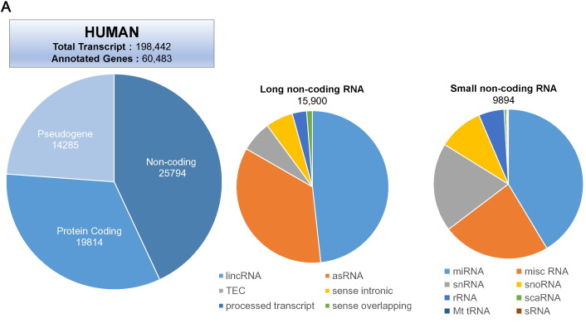
Human genome = 3.2 x 10⁹ base pairs
Coding region =~ 2%
Transcribed region = ~ 60%
Total discovered transcript =~ 200k
Annotated =~60k
Protein coding =~ 20k
Kashi, Kaori, et al. "Discovery and functional analysis of lncRNAs: Methodologies to investigate an uncharacterized transcriptome." Biochimica et Biophysica Acta (BBA)-Gene Regulatory Mechanisms 1859.1 (2016): 3-15.
Notes:
Mm10 = chr1~19 + XX/XY
2.7Gb

Slide 6
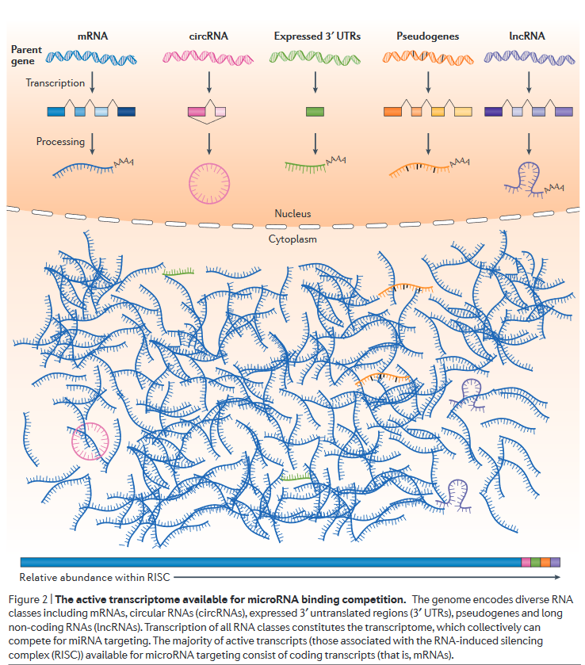
Transcription rate
Stability
Turnover rate
에 영향을 받음
Thomson, Daniel W., and Marcel E. Dinger. "Endogenous microRNA sponges: evidence and controversy." Nature Reviews Genetics 17.5 (2016): 272.

Slide 7
RNAs in transcriptome
Structural RNAs (tRNA, rRNA)
ncRNA
Small regulatory ncRNAs (microRNA, endogenous siRNA, piRNA)
snRNA, snoRNA
Long noncoding RNAs
With poly(A) tail (mRNA-like)
Circular RNA
lncRNA with triple-helix end
eRNA
Repeat-associated RNAs
From lecture note of Prof. Nam in Hanyang University

Slide 8
~10–30 pg total RNA in a mammalian cell (mostly rRNA, tRNA)
~300,000 mRNA (1~5% of total RNA)
~12,000 different transcripts, average length of 2000nt
Rare mRNA ~10copies / abundant mRNA ~10⁴~
https://www.qiagen.com/kr/resources/faq?id=06a192c2-e72d-42e8-9b40-3171e1eb4cb8&lang=en

Slide 9
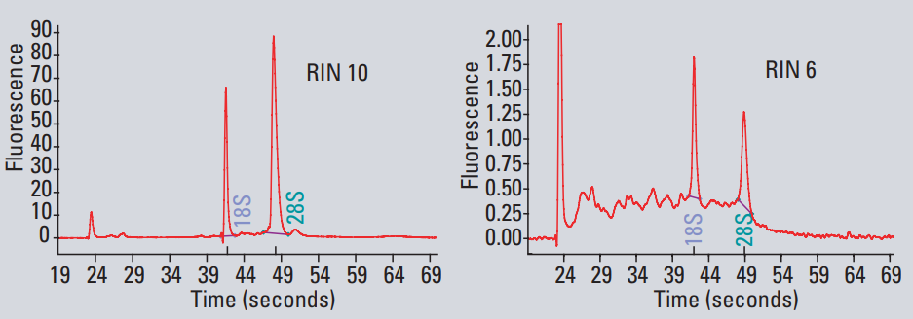

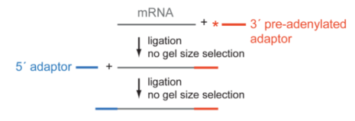

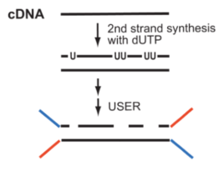
Checklist
Sample
RNA isolation, RNA integrity
RIN (RNA integrity number 1-10) > 6~7
Quantity >1ug
Library prep
rRNA-depletion vs. Poly-A tail capture
Size selection
Strand specificity, paired-end, long reads …
Quantitative standards
ERCC spike-in
Barcodes / Unique Molecular Identifier (UMI)
Notes:
RIN은 28S와 18S ribosomal band의비율로 알아낸다 (이들은 integrity가 높다)
External RNA Controls Consortium (ERCC)

Slide 10
Checklist (2)
Sequencing platform
Illumina platform (~150b, paired-end, 50gb/lane in HiSeq-4000)
PacBio SMRT (~10kb, 100,000~ reads, not proper for quantification)
10X single cell/ genome kit
Depth
>4Gb, ~20,000,000 reads for quantification
Depend on library quality, library complexity, sample …
Notes:
Adult mammalian cell mRNA=1million

Slide 11
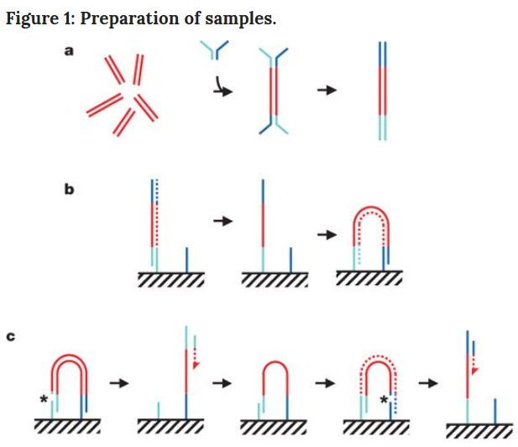
Illumina sequencing
https://www.youtube.com/watch?v=fCd6B5HRaZ8
Bentley, D. R., Balasubramanian, S., Swerdlow, H. P., Smith, G. P., Milton, J., Brown, C. G., ... & Boutell, J. M. (2008). Accurate whole human genome sequencing using reversible terminator chemistry. nature, 456(7218), 53.

Slide 12
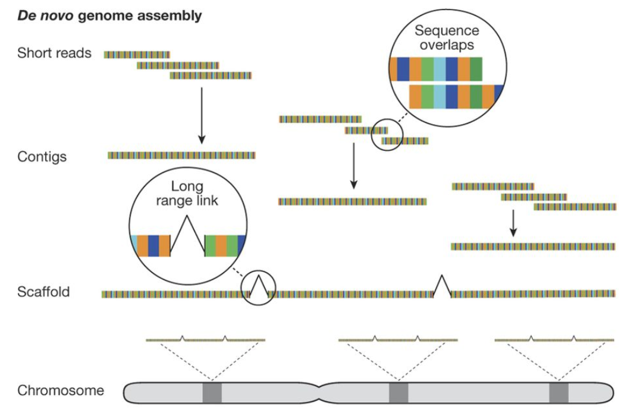
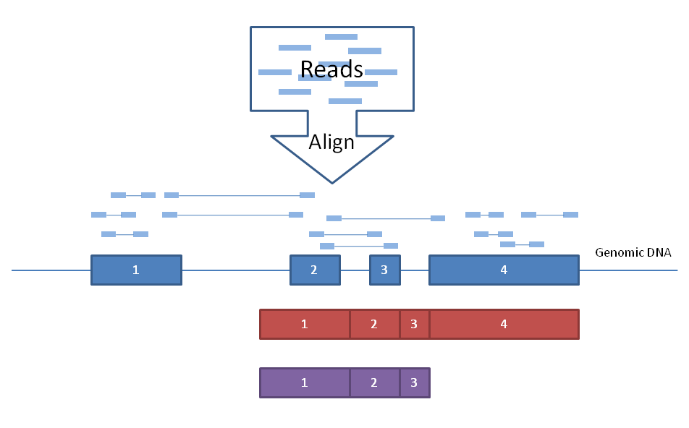
De novo genome assembly
Mapping (align)

Slide 13
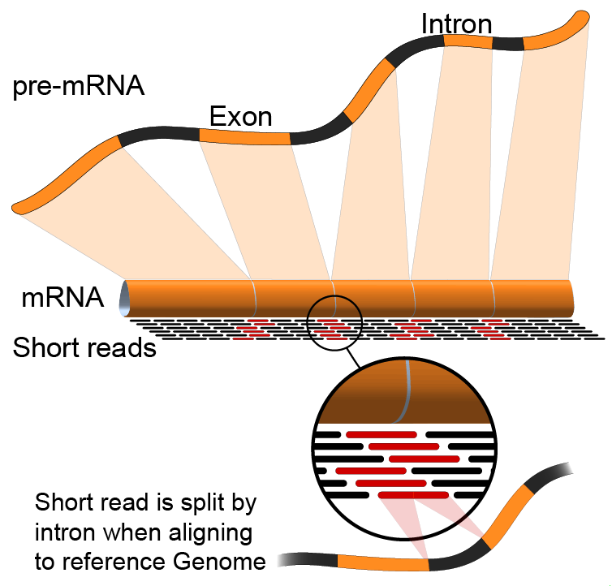

Slide 14
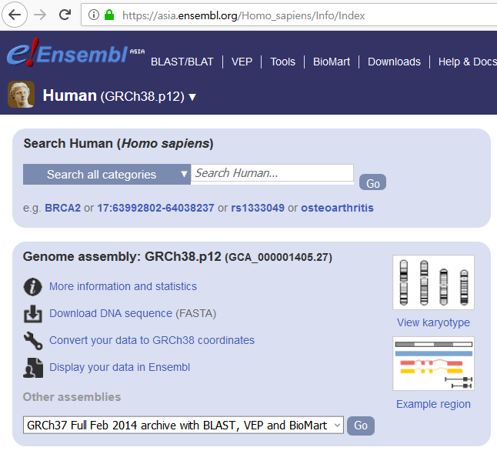
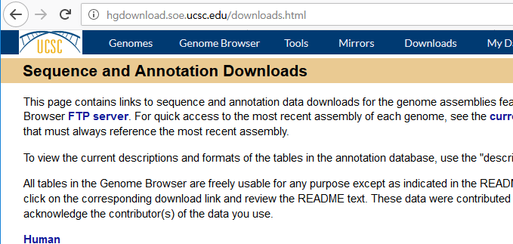
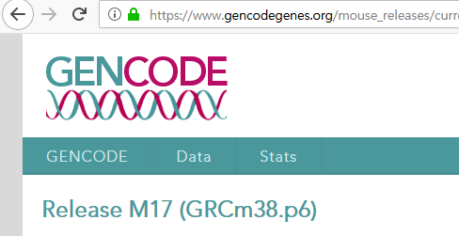
Reference genome
GRCh38
GRCh37 (hg19)
GRCm38 (m10)
NCBI37 (mm9)

Slide 15
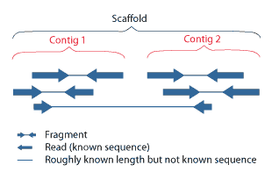
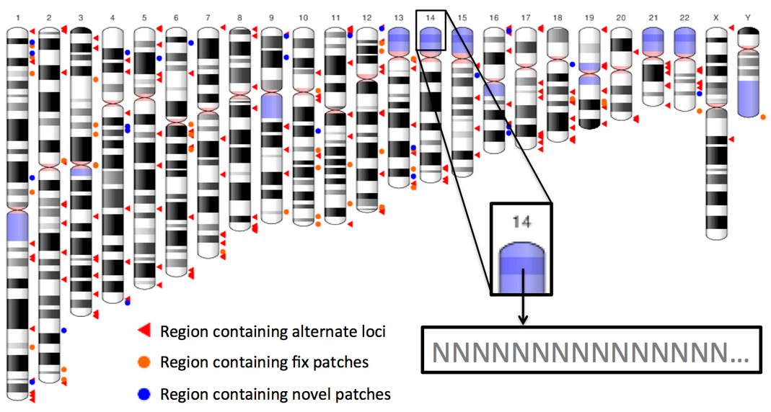
ALL = chromosomes, scaffolds, assembly patches and haplotypes
primary genome assembly = chromosomes and scaffolds
Mapping은 primary assembly를 이용해야 함
Contig names
Ensembl style
Gencode style
1
2
3
4
..
X
Y
MT
chr1
chr2
chr3
chr4
..
chrX
chrY
chrM
wikipedia
Scaffolding (bioinformatics)
ftp://ftp.ensembl.org/pub/release-92/fasta/homo_sapiens/dna/Homo_sapiens.GRCh38.dna.primary_assembly.fa.gz

Slide 16
Pipeline, tools, QC points
Sample preparation & Library generation
Quality assessment
RIN, yield
Alignment tools
BWA, Bowtie, STAR,
Tophat, GSNAP,
MapSplice …
Sequencing
Quality assessment
FastQC, FASTX-toolkit
Assembly tools
Cufflinks, StringTie,
Scripture,
Trinity, Velvet,
CAFÉ, TACO
Read alignment
(Transcript assembly)
Quality assessment
PCR Bottleneck Coefficient,
BamQC
Quantification
Other analysis
Quantification tools
Cuffdiff, DESSeq, edgeR,
DEGseq, baySeq, BitSeq, …
(non-redundant, uniquely mappable reads)
PBC =
(uniquely mappable reads)
~.5: severe, .5-.8: moderate, .8-.9: mild, .9-1: no bottlenecking

Slide 17
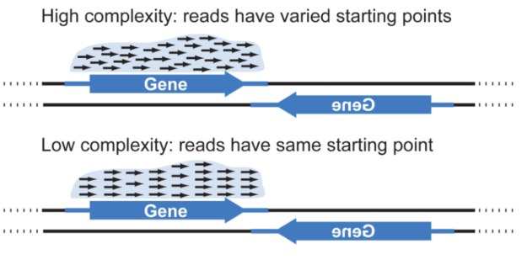
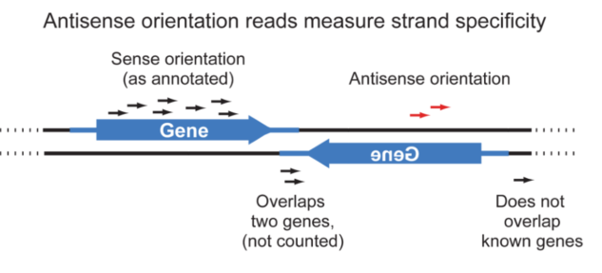
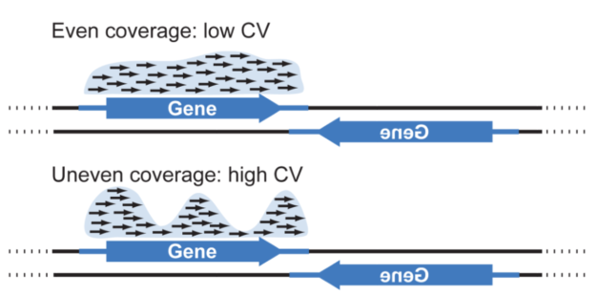
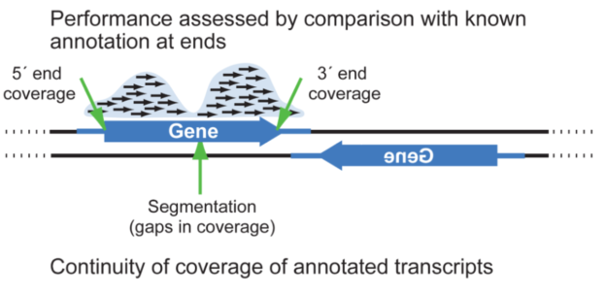
Quality of RNA-seq library
Levin, Joshua Z et al. “Comprehensive Comparative Analysis of Strand-specific RNA Sequencing Methods.” Nature Methods 7.9 (2010): 709–715

Slide 18
Various pipelines
Genome mapping
Transcriptome mapping
Reference-free assembly
Mapping-free
(quasi-alignment)
Tophat
STAR
Bowtie
(ungapped mapper)
Assembly (Trinity)
(Debrujin graphs)
FASTQ
Direct quantification
(kallisto, salmon)
Mapping (bowtie)
Transcript discovery
Cufflinks
Expression profile
Counting
Cufflinks
RSEM
Kallitos
BitSeq
Counting (RSEM)
Functional annotation (Blast2GO)
Functional annotation (Blast2GO)

Slide 19
FASTQ File format
@SEQ_ID
GATTTGGGGTTCAAAGCAGTATCGATCAAATAGTAAATCCATTTGTTCAACTCACAGTTT
+
!''*((((***+))%%%++)(%%%%).1***-+*''))**55CCF>>>>>>CCCCCCC65
@SEQ_ID_2
GATTTGGGGTTCAAAGCAGTATCGATCAAATAGTAAATCCATTTGTTCAACTCACAGTTT
+
!''*((((***+))%%%++)(%%%%).1***-+*''))**55CCF>>>>>>CCCCCCC65

Slide 20
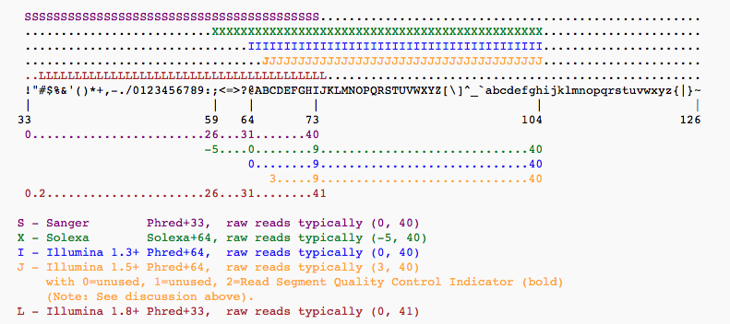
Phread quality score
P = 10^{-Q/10}
Q = -10 log₁₀(P)
https://en.wikipedia.org/wiki/FASTQ_format
https://en.wikipedia.org/wiki/Phred_quality_score
Q=0 means P=1, i.e. that the base call is certainly wrong, so this is rarely used, though might be appropriate for an undetermined base (often represented as 'N')

Slide 21
Further reading
Strand specific library
Levin, Joshua Z., et al. "Comprehensive comparative analysis of strand-specific RNA sequencing methods." Nature methods 7.9 (2010): 709.
polyA selection vs rRNA depletion
Zhao, Shanrong, et al. "Evaluation of two main RNA-seq approaches for gene quantification in clinical RNA sequencing: polyA+ selection versus rRNA depletion." Scientific reports 8.1 (2018): 4781.
Other transcriptome sequencing methods https://www.illumina.com/science/sequencing-method-explorer/kits-and-arrays/cage-seq.html
https://www.illumina.com/science/sequencing-method-explorer/kits-and-arrays.html
Pipeline resources
TCGA
https://docs.gdc.cancer.gov/Data/Bioinformatics_Pipelines/Expression_mRNA_Pipeline/
GTEx Consortium
https://github.com/broadinstitute/gtex-pipeline/tree/master/rnaseq
ENCODE project
https://www.encodeproject.org/rna-seq/

Slide 22
Transcriptome sequencing
Analysis pipeline
Basic linux commands

Slide 23
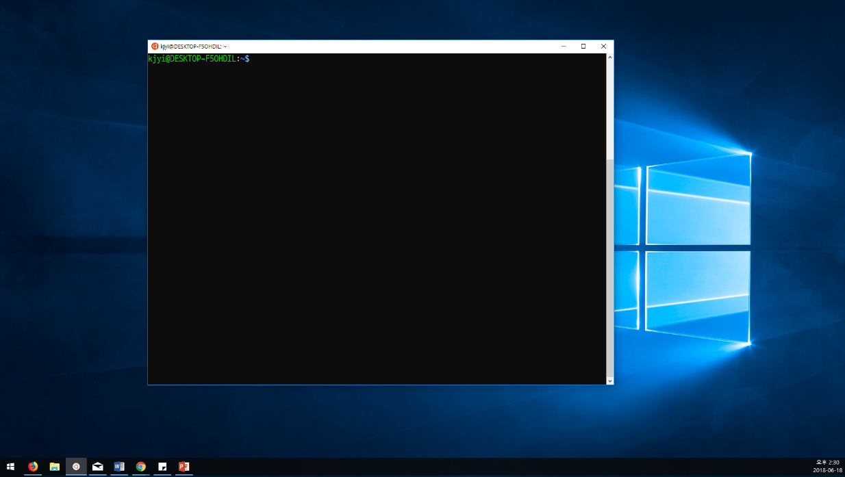

Slide 24
Basic linux command = Bash
왜 Bash를 배워야 하는가
쉘 스크립트의 동작 원리를 이해하는 것은 분석에 필요한 tool들을 구동하는데 필수적임
대부분의 tool들이 shell (bash)에서 분석을 구현하도록 함
예외: (Bioconductor) R packages, python modules
간단하고 빠른 prototype 코드의 구현
Bash로 해결할 수 없는 경우
속도가 중요한 작업을 할 때
복잡한 산술 연산 작업들
플랫폼간 이식성이 필요할 때 (리눅스 배포판 간 호환성이 안좋음)

Slide 25
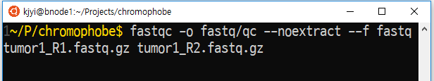
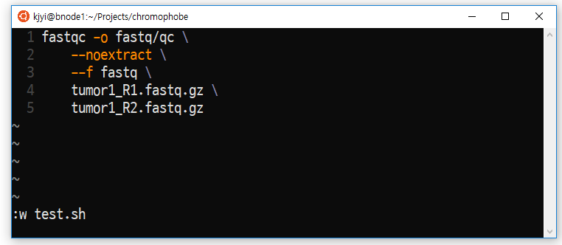
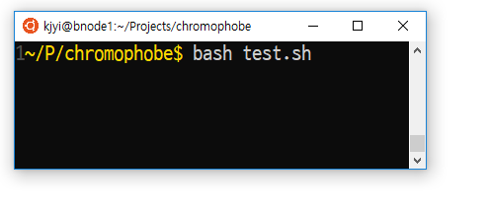
BASH: 터미널에서 입력하는 것이 곧 script
터미널에 직접 입력
작성한 스크립트를 실행
개행문자(enter)를 escape해줌
Vim 등의 editor를 이용해서 스크립트 작성

Slide 26
유념해야 할 것
절대경로/상대경로/현재위치
PATH (명령어를 탐색할 위치들)
대소문자를 구분할 것
주요 커맨드
cd, pwd, ls, mv, cp, mkdir
cat (파일 내용을 출력), less (pager), vim (editor)
Soft link (윈도우의 바로가기와 유사)
ln –s 상대경로 링크파일
change directory
print working directory
list
move (rename)
copy make directory
concatenate
echo

Slide 27
효율적인 script의 첫걸음: redirect(>)와 pipe(|)
$ zcat ./log.gz | grep “error” | tail –n 20 > ./last_errors.txt
현재 directory의 log.gz라는 파일의 압축을 풀어 출력해서
이중 error라는 단어가 포함된 줄만 골라서
마지막 20줄만
현재 directory의 last_errors.txt라는 파일에 써라
| 는 앞 명령의 standard output을 뒷 명령어의 standard input으로 넘겨줌
>는 앞 명령의 standard output을 파일로 저장함

Slide 28
오래 걸리는 작업을 수행할 때
$ bash long_script.sh
작업 도중 Ctrl-C (windows user) –취소됨
터미널을 종료함 - 취소됨
노트북의 네트워크를 종료함 – 취소됨
$ bash long_script.sh &
$ nohup bash long_script.sh 1> stdout.txt 2> stderr.txt &
$ qsub –q day long_script.sh (job scheduler)
PBS/Torque
LSF / SGE / Slum
명령을 계속 입력할 수 있지만, shell이 종료되면 함께 종료됨
Spark/Hadoop (고성능 parallel computing)

Slide 29
Command separators
아무것도 안쓰면 (엔터): 오류가 나든 안 나든 다음 명령어가 실행됨
; 아무것도 안 쓴 것과 동일. 여러 줄의 command를 한 줄에 쓸 때 이용됨
& 앞 명령어가 background로 시작되고, 뒷 명령어가 fg로 실행됨
&& 앞 명령어가 정상 종료 (exit status zero)여야 뒷 명령어가 실행됨
|| 앞 명령어가 오류상태(non-zero status)로 끝나야 뒷 명령어가 실행됨

Slide 30
time
$ cat test.sh
command_1 &
command_2 &
command_3
command_4 &
command_5 &
command_6
echo “all done”
$ bash test.sh
all done
$ _
command_1
command_2
command_4
command_3
command_5
command_6
echo “all done”
$bash test.sh
script exit
All children exit

Slide 31
time
$ cat test.sh
command_1 &
command_2 &
command_3
wait
command_4 &
command_5 &
command_6
wait
echo “all done”
$ bash test.sh
all done
$ _
command_1
command_4
command_2
command_5
command_3
command_6
echo “all done”
$bash test.sh
script exit
All children exit

Slide 32
기본 SHELL SETTING에서는 에러가 나도 다음 STEP이 수행됨
$ cat test.sh
command_1 &&
command_2 &&
command_3
$ cat test2.sh
command_1 || exit 1
command_2 || exit 1
command_3 || exit 1
$ cat test3.sh
set -e
command_1
command_2
command_3
에러 발생시 다음 STEP을 시행하지 않으려면
이처럼 코딩 해야 함

Slide 33
ssh your_id@ooo.ooo.ooo.ooo –p oooo
(패스워드 입력 시 화면에 출력되지 않는 것은 정상)
Mac and linux users: use built-in terminal
Windows users: ①putty ②mobaXterm ③openSSH ④WSL
In this tutorial, use Rstudio-server in our cluster!

Slide 34
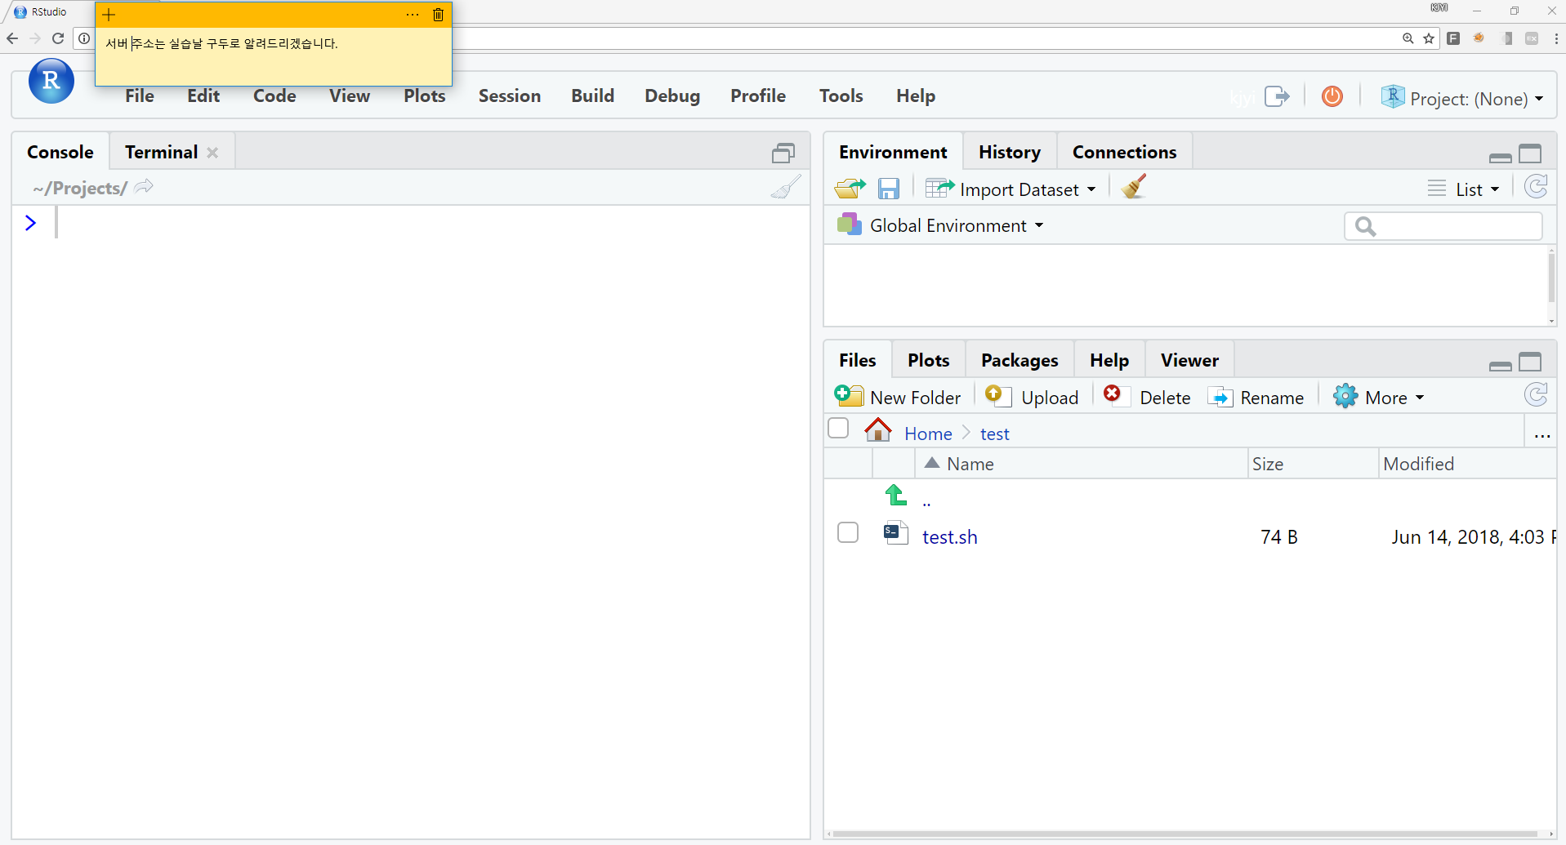
R kernel
Upload file
Change directory

Slide 35
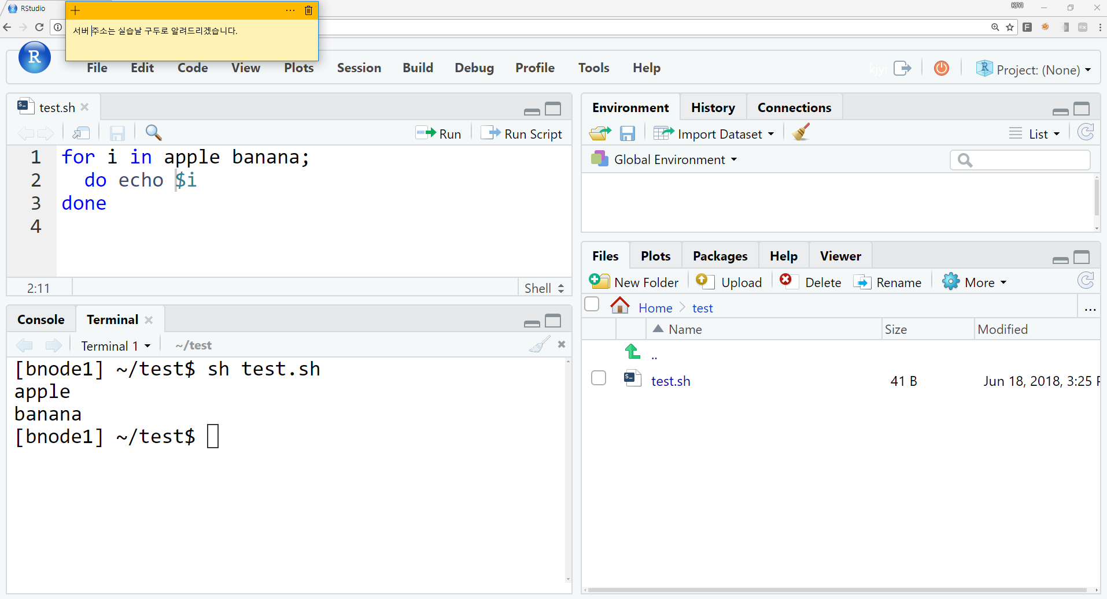

Slide 36
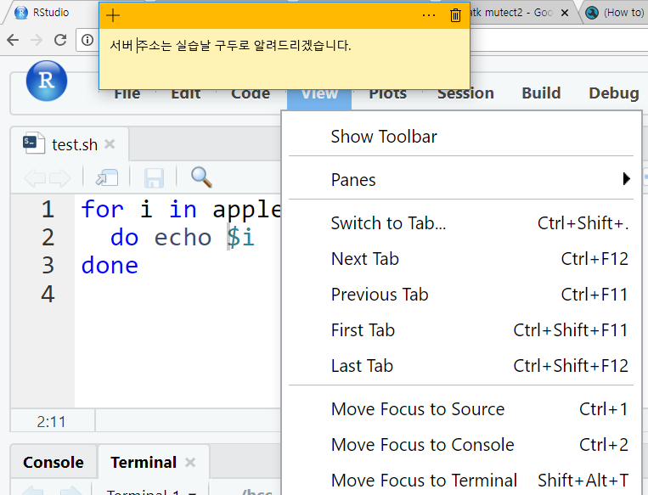
터미널 탭이 보이지 않으면

Slide 37
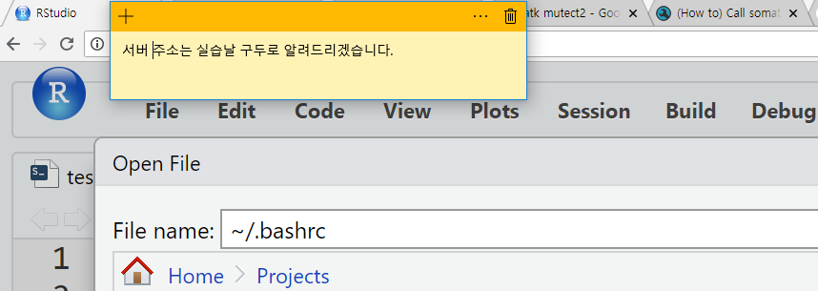
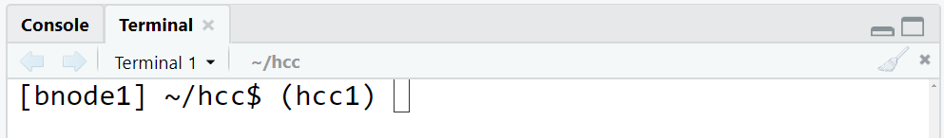
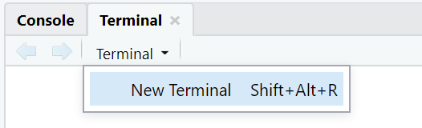
PATH 설정
$ echo $PATH 로 현재 PATH를 확인
export PATH=$HOME/bin:$PATH
터미널을 재시작해야 $PATH가 업데이트 됨
$ mkdir -p ~/bin
$ cd ~/bin
$ ln -s ~kjyi/tools/STAR/STAR-2.5.4b/bin/Linux_x86_64/STAR .
~/.bashrc에 추가하고 저장
링크 만들기
현재 directory 의미

Slide 38
PATH
잘 설정되었는지 테스트
$ STAR –help
…long help message…
$ _

Slide 39
tutorial
Rstudio-server terminal, 혹은 ssh 접속 환경에서 다음을 수행
$ cd ~
$ mkdir day1
$ cd day1
$ mkdir fastq
$ cd fastq
$ ln -s /home/users/kjyi/day1/fastq/* .
$ ls
$ cd ..
(home으로 이동)
(day1이란 폴더를 만듬)
(day1로 이동)
(day1안에 fastq라는 폴더를 만듬)
(fastq안으로 이동)
/home/users/kjyi/day1/fastq/ 에 있는
모든 파일에 대해 각 파일을 참조하는
softlink (바로가기)를 현재 위치에 생성

Slide 40
run_star.sh를 home director내의 day1 폴더 안에 작성
mkdir -p star/example1
STAR --runMode alignReads \
--outSAMtype BAM Unsorted \
--genomeDir /home/users/kjyi/ref/hg19/star_index \
--outFileNamePrefix star/example1/example1 \
--readFilesIn ./fastq/R1.fastq ./fastq/R2.fastq
주의: \ 뒤에 공백이 없어야 함
OS/browser 언어/font 환경에 따라 \ 대신 \로 보일 수 있음
실제 사용시엔 STAR manual 참조할 것
e.g. 압축된 fastq (fastq.gz)를 읽으려면?

Slide 41
다음 중 한가지 방법으로 코드를 실행
$ bash run_star.sh
$ nohup bash run_star.sh 1> stdout.txt 2> stderr.txt &
$ qsub -q day -l nodes=1:ppn=1 run_star.sh
(이 방법을 이용할 경우 run_star.sh의 맨 위에 다음과 같이 수정)
today
cd ~/day1
STAR –runMode alignReads \
…

Slide 42
결과물
star/example1/example1_STARgenome
star/example1/example1_STARtmp
star/example1/example1_STARAligned.out.bam
star/example1/example1_STARChimeric.out.junction
star/example1/example1_STARChimeric.out.sam
nohup code를 이용한 경우
stdout.txt
stderr.txt
qsub code를 이용한 경우
stdout.txt
stderr.txt
run_star.sh.o12345
run_star.sh.e12345

Slide 43
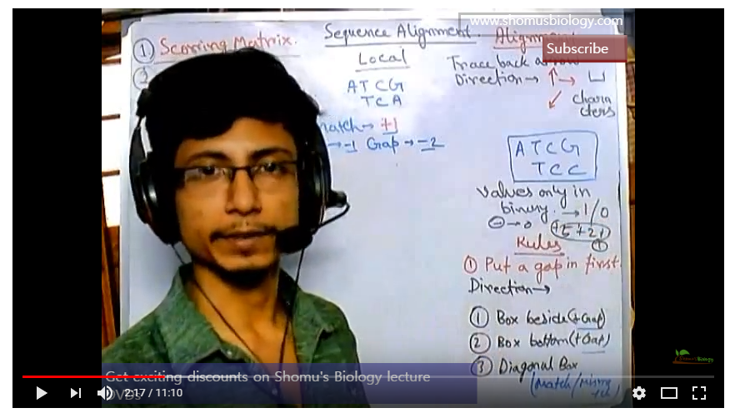
Further information
고급 Bash 스크립팅 가이드
https://wiki.kldp.org/HOWTO/html/Adv-Bash-Scr-HOWTO/index.html
STAR github (manual/download/paper)
https://github.com/alexdobin/STAR
https://www.ncbi.nlm.nih.gov/pubmed/23104886
Smith-Waterman algorithm (basic local alignment)
https://www.youtube.com/watch?v=IatoWOsJ35Q&t=101s

Slide 44
복잡한 STAR 명령문 예시
STAR --runMode alignReads --runThreadN 6 \ --genomeDir ~kjyi/ref/hg19/star_index \ --readFilesIn $FASTQ1 $FASTQ2 \ --outFileNamePrefix $outdir_star/$sample. \ --sjdbGTFfile /path/to/gencode.gtf.file \ --twoPassMode Basic \ --outFilterMultimapNmax 20 \ --alignSJoverhangMin 8 \ --alignSJDBoverhangMin 1 \ --outFilterMismatchNmax 999 \ --outFilterMismatchNoverLmax 0.1 \ --alignIntronMin 20 \ --alignIntronMax 1000000 \ --alignMatesGapMax 1000000 \ --outFilterType BySJout \ --outFilterScoreMinOverLread 0.33 \ --outFilterMatchNminOverLread 0.33 \ --limitSjdbInsertNsj 1200000 \ --outSAMstrandField intronMotif \ --outFilterIntronMotifs None \ --alignSoftClipAtReferenceEnds yes \ --quantMode 'TranscriptomeSAM GeneCounts' \ --outSAMtype 'BAM Unsorted‘ \ --outSAMunmapped Within \ --outSAMattributes 'NH HI AS nM NM ch' \ --outSAMattrRGline "ID:$sample SM:$sample $cmd_library $cmd_platform" \ --genomeLoad NoSharedMemory \ …

Slide 45
Quantification
제 1회 KAIST genomics workshop
2일차
Normalization
Advanced bash commands
(for, while, if, md5sum)
Introduction to R

