Slide 1

Team 5: Bugs Bunny
Less is More!

Slide 2


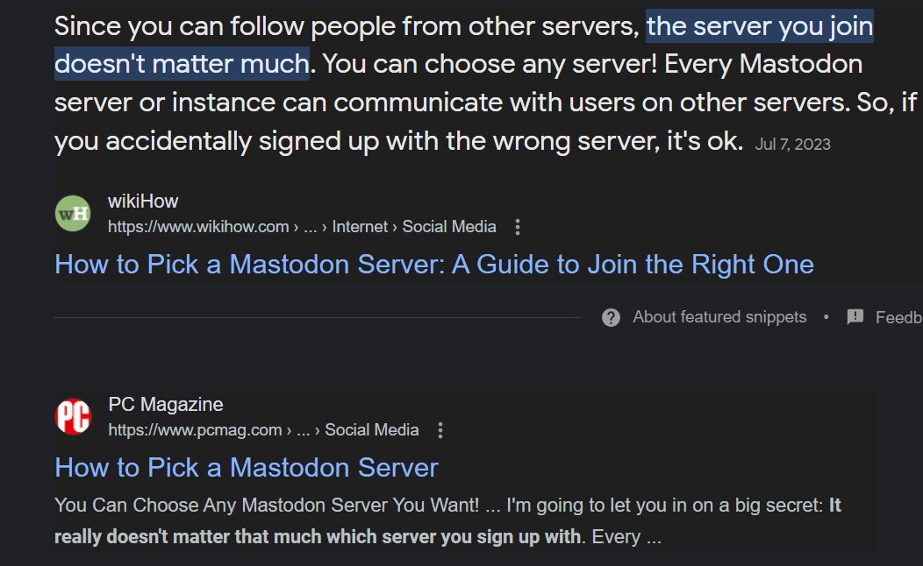
Two friends decide to try out Mastodon…
They set up their accounts independently…
Hi! My name is Bob.
I wanted to find an alternative to company based social media and after a lot of effort, managed to persuade my friend Tako to move with me to Mastodon!!
Tako
Wah!
A quick search told us that the server we choose doesn’t really matter, so we created our new accounts independently

Slide 3

..but there was a catch!
I set up my account on
generic.social and can see feeds from it and all federated servers…
…but Tako has niche interests and set up their account on an unfederated server!
I can’t see their posts!
generic.social
meow.io
federated
unfederated
unfederated
tomorrow.io
Managing multiple accounts is…annoying
Neither of us wanted to move, so I bit the bullet and set up another account on Tako’s server to follow them…
…but now I have to toggle between two accounts to see each server’s unique feeds!
It’s quite annoying
bob2@tomorrow.io
bob1@generic.social
tomorrow.io

Slide 4
Problem Statement
This is a problem faced by others too
It would be good if there was a way to see and interact with feeds from multiple accounts at one place
“My Twitter friends joined various Mastodon servers that didn’t talk to each other and I gave up on trying to figure it out.”
“I’m tech savvy and have found mastodon simply opaque. I’ve set up 4 accounts, each on a different server, and don’t know how to amalgamate all the people I’m following everywhere (assuming all those servers federate with each other).”
“discovered I was on some kind of different continent from my friends, and could not follow them, nor they me. Immediately felt frustration and disgust and never looked back.”
User stories of people who gave up on Mastodon quoted from “Mastodon Is Easy and Fun Except When It Isn’t - Erin Kissane's small internet website”

Slide 5
Proposed Solution: Introduction
Bugs Bunny cannot change the Federated nature of the Fediverse, and the need to create several accounts to follow feeds from unfederated servers .
But we can try to make interacting with several accounts easier!
Feed Amalgamator
Features:
Create account with amalgamator.
Add / Delete Mastodon account feed to amalgamator.
View amalgamated feed.
Interact with amalgamated feed: follow etc. (stretch goal for this sprint).
Our product:
An application that amalgamates feeds from different Mastodon accounts on different servers.

Slide 6
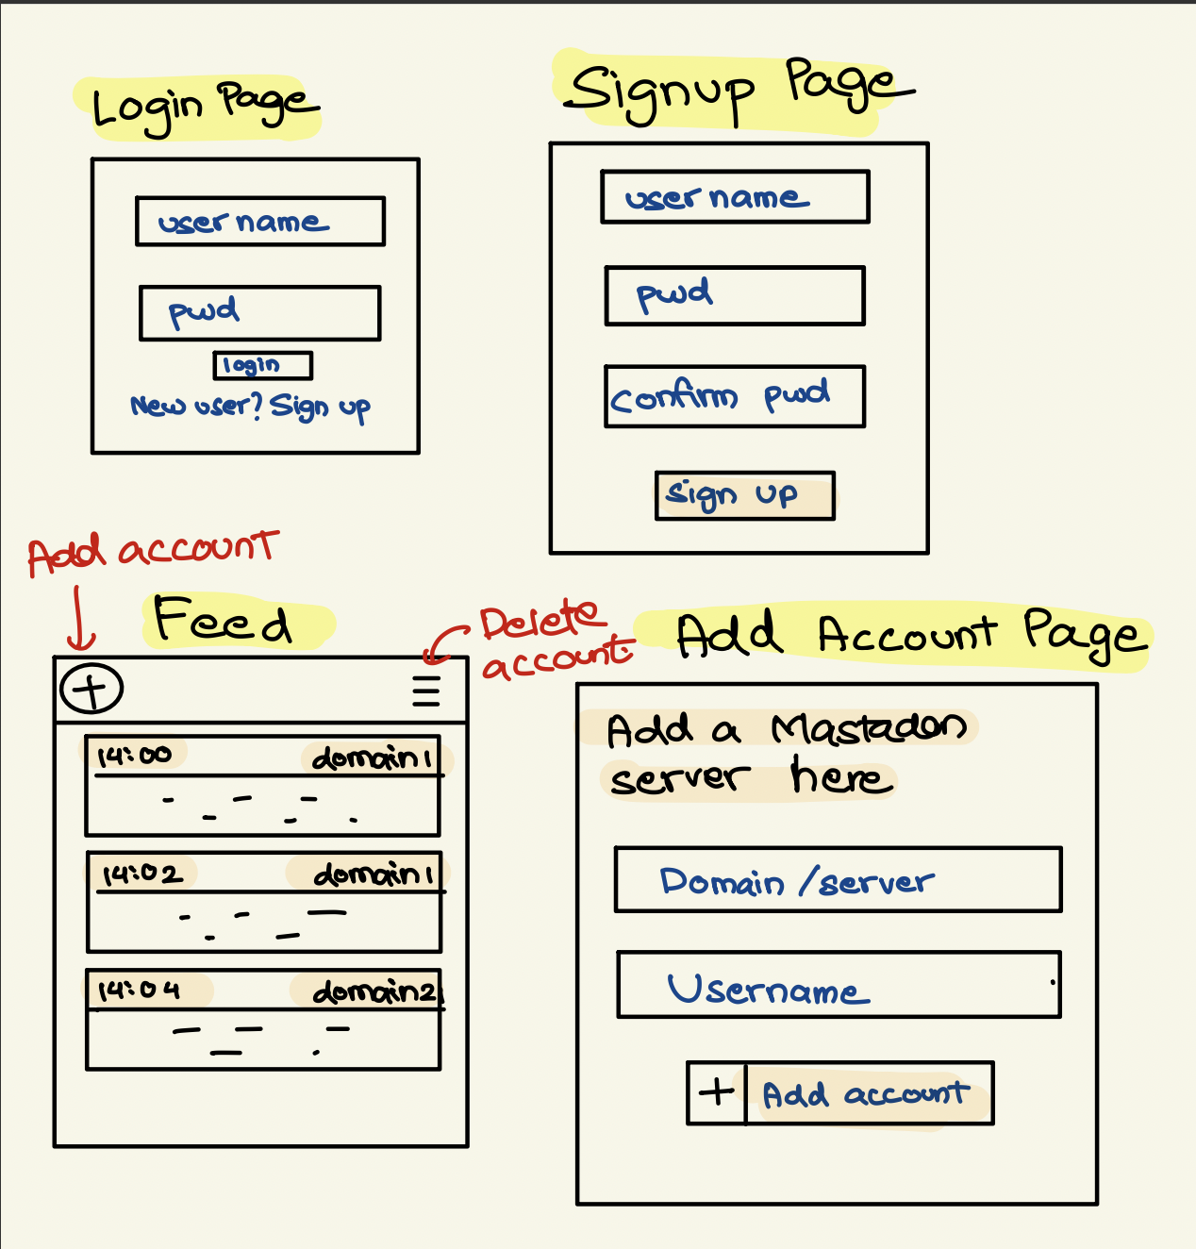
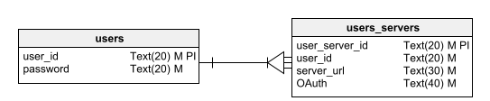
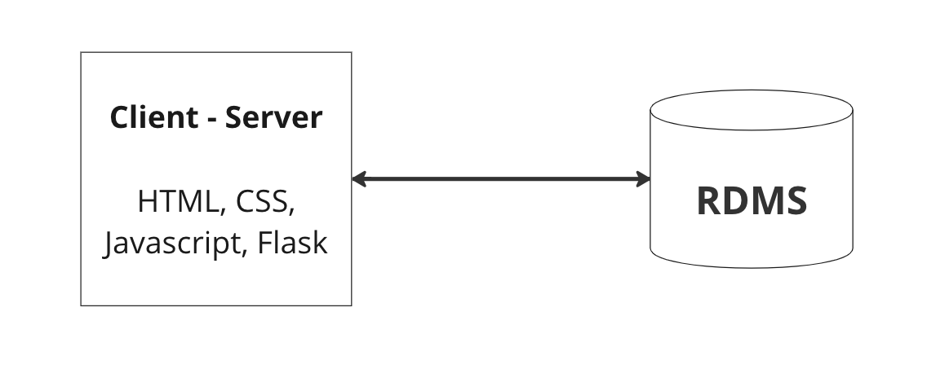
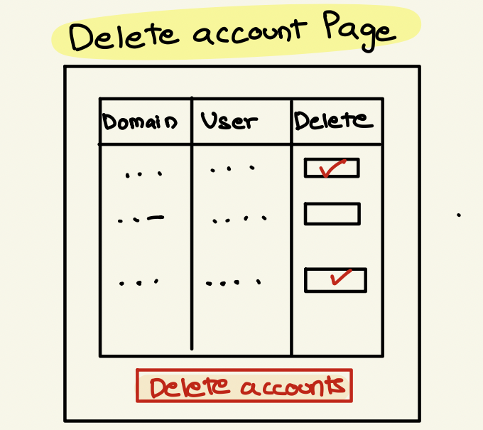
Fat Marker Sketch
Architecture and ER Diagram

Slide 7
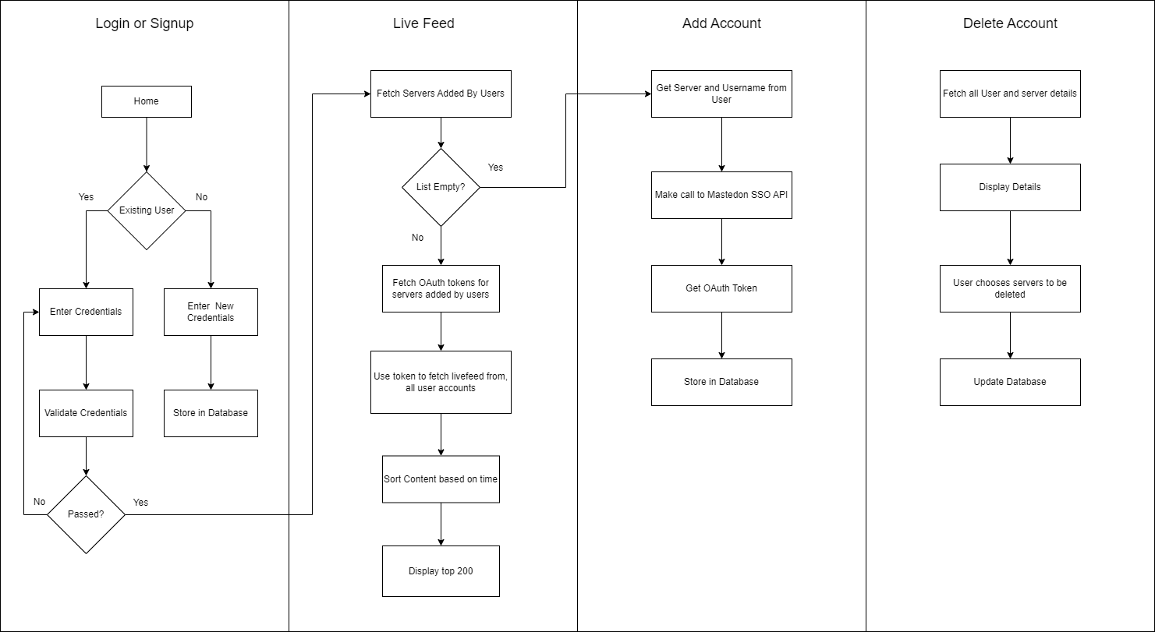
Dataflow Diagram

Slide 8
Risks and Rabbit Holes
Out of Bounds
Lack of Domain Knowledge: Since ActivityPub is something none of the team members are familiar with we might run into issues at some point.
Technical Issues: Considering the time span and the background of team members, we believe purely building the application using JS might result in issues.
Browser Limitations: Will need to limit display range of posts in order to fit within browser memory (or use react/angular to load content on scroll).
OAuth: Unsure of OAuth complexity.
Non-mastodon Fediverse Applications: If time permits, we can add other Fediverse feeds to our amalgamation but is not a priority.
No interactive menus: Using plain JS will make creating checkbox for filtering servers needlessly complicated so we will have separate settings window.

Slide 9
Any Questions / Suggestions?

