Slide 1
16S community sequencing pipeline using dada2 in R
Daniel Padfield

Slide 2
16S community sequencing analysis
16S rRNA variable regions
Most methods cluster sequences that occur with 97% similarity and assign these to “OTUs” from references trees
Do not incorporate quality scores of sequences

Slide 3
16S community sequencing analysis
16S rRNA variable regions
Most methods cluster sequences that occur with 97% similarity and assign these to “OTUs” from references trees
Do not incorporate quality scores of sequences
Enter dada2
Incorporates quality score information
Distinguishes sequencing errors from real biological variation
Full stack workflow available in R

Slide 4
dada2 pipeline
raw reads
learn error rate
dereplicate files
filter and trim
sample inference
merge reads
construct sequence table
remove chimeras
track reads
assign taxonomy
to phyloseq!!!

Slide 5
dada2 pipeline
raw reads
learn error rate
dereplicate files
filter and trim
sample inference
merge reads
construct sequence table
remove chimeras
track reads
assign taxonomy
to phyloseq!!!

Slide 6
dada2 pipeline
raw reads
learn error rate
dereplicate files
filter and trim
sample inference
merge reads
construct sequence table
remove chimeras
track reads
assign taxonomy
to phyloseq!!!

Slide 7
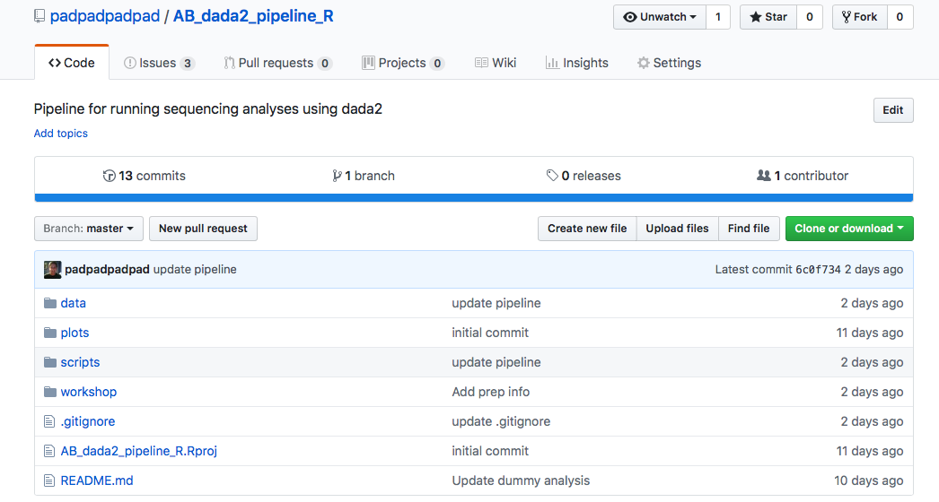
The AB sequencing pipeline

Slide 8
The AB sequencing pipeline

Slide 9
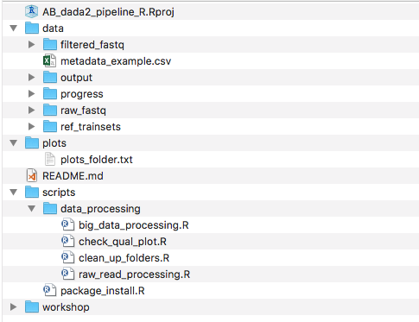
The AB sequencing pipeline

Slide 10
raw_read_processing vs big_data_processing
Pooling data allows information to be shared across samples. However is much much slower for big data sets
dada2 resolves sequence variants exactly, and as such DNA sequences are consistent across samples and can be recombined separately
big_data_processing speeds things up if needs be!

Slide 11
Bits to run supervised
Quality profiles
Setting trimming parameters
Check sample names = metadata$SampleID
Make sure there is a column called SampleID!

Slide 12
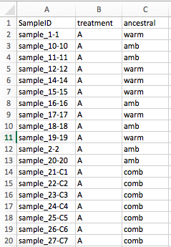
Correctly format metadata
SampleID == sample_names !!!

Slide 13
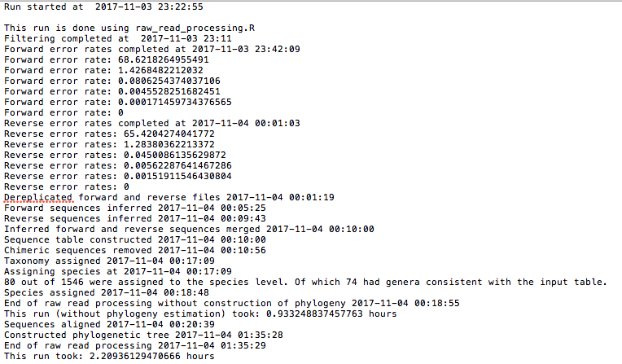
Progress file

Slide 14
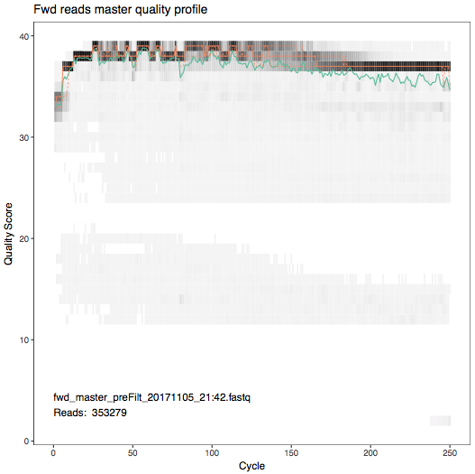
Plots
Before trimming and fltering

Slide 15
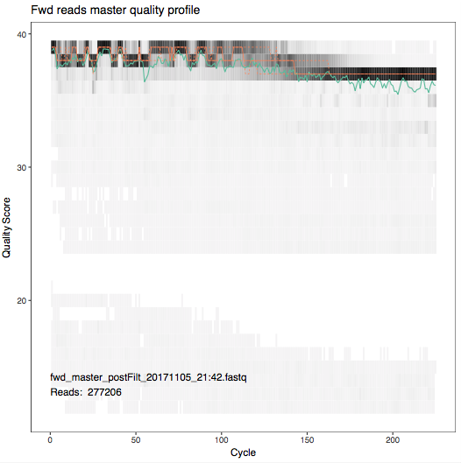
Plots
Before trimming and fltering
After trimming and fltering

Slide 16
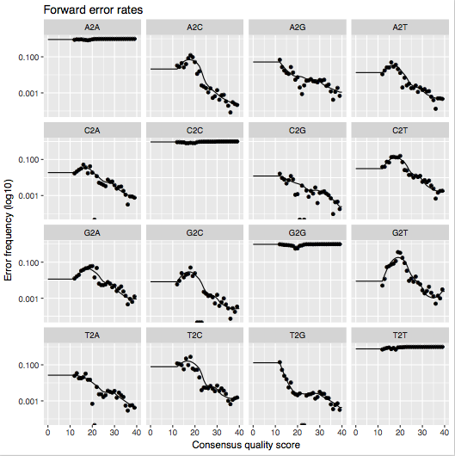
Plots
Plot of error rates

Slide 17
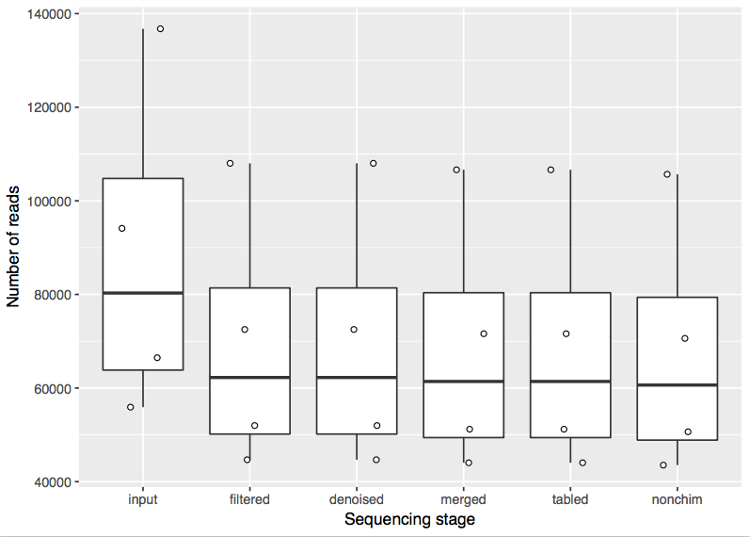
Plots
Track the number of reads through each stage

Slide 18
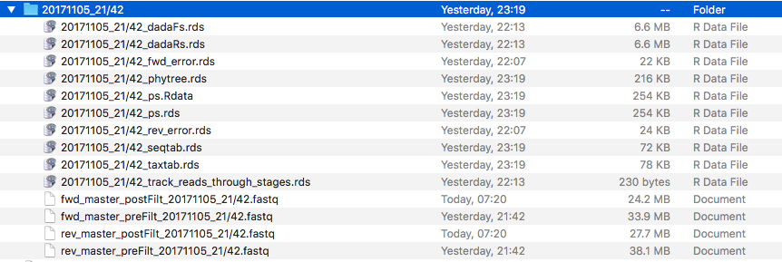
Output

Slide 19
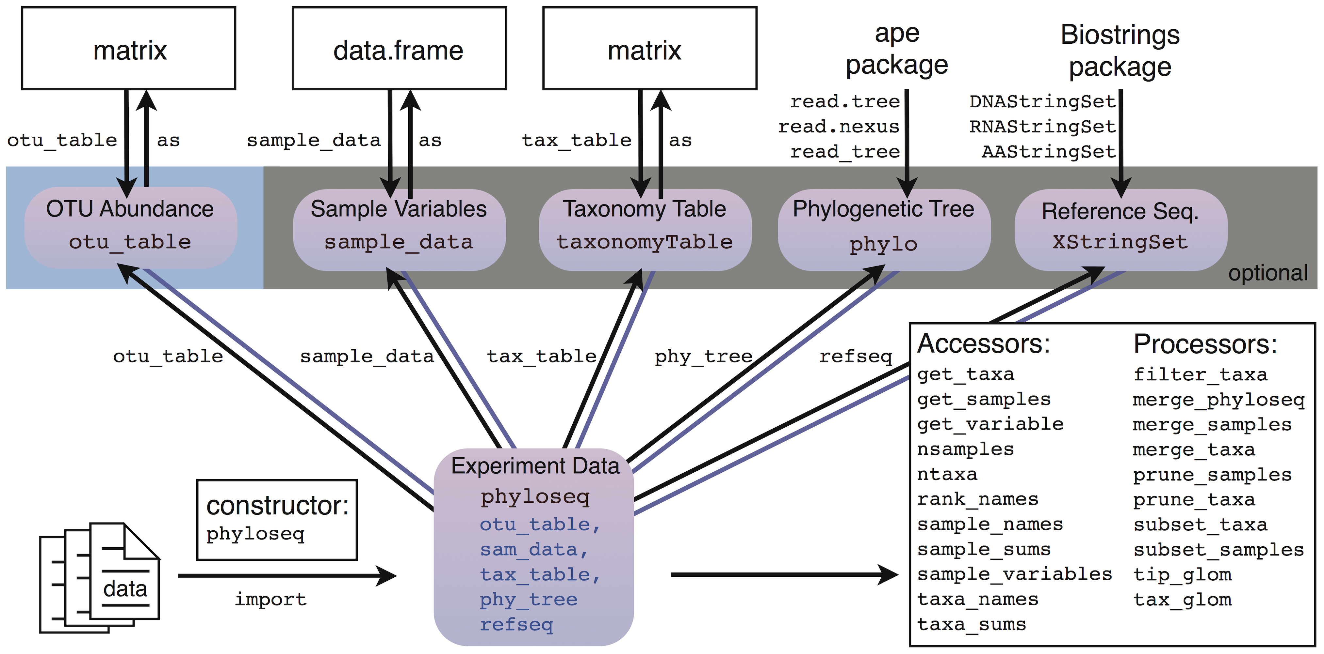
Bonus – integration with phyloseq

Slide 20
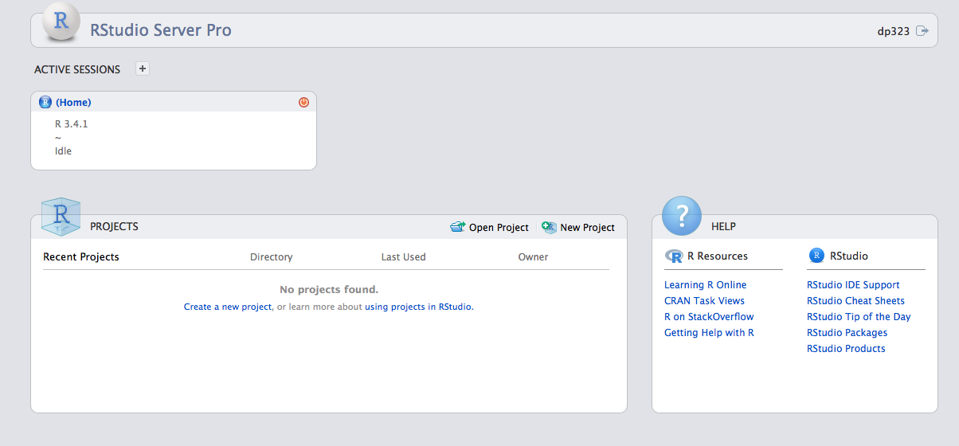
RStudio server
https://rstudio01.cles.ex.ac.uk (can be 01, 02, 03 or 04)

Slide 21
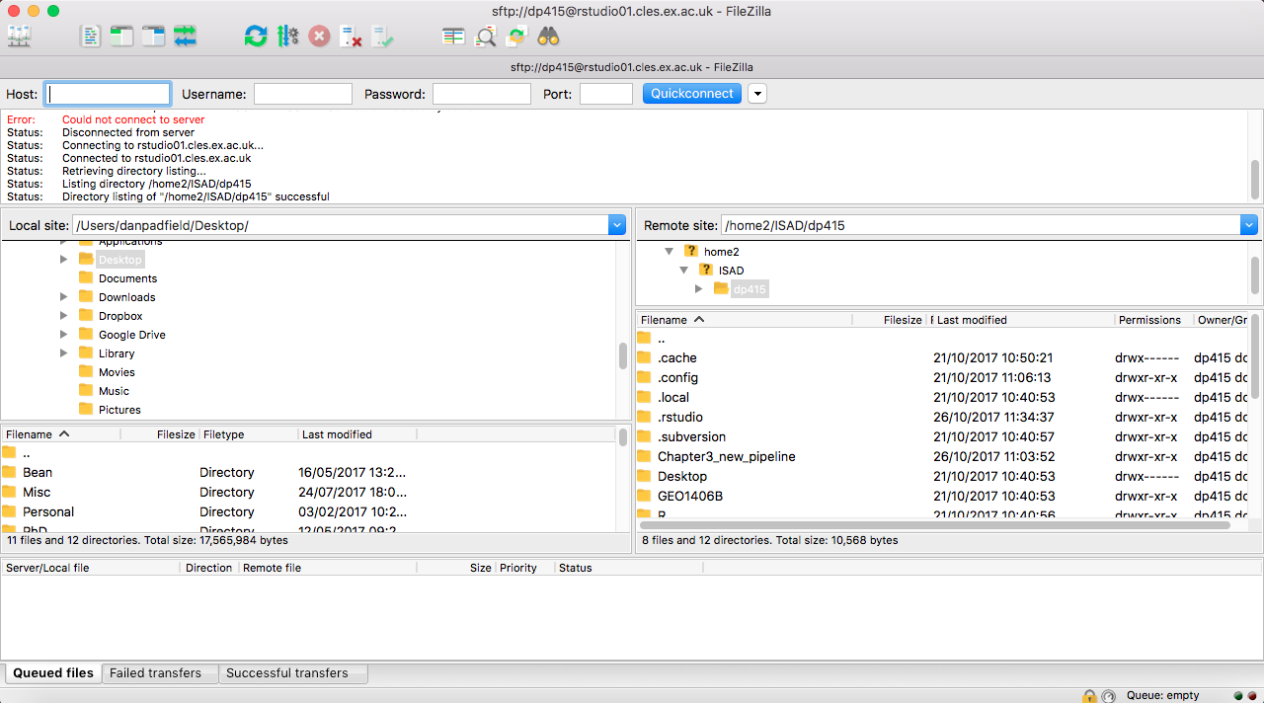
Filezilla
https://filezilla-project.org
sftp://https://<your username>@rstudio01.cles.ex.ac.uk

Slide 22
Phyloseq possibilities

Slide 23
Resources
dada2
Phyloseq
Complete AB sequencing workflow

Slide 24
References

Slide 25


Lets get our hands diRty!!!

