Slide 1

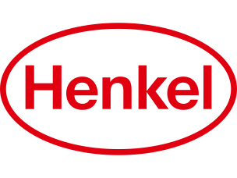
Risks
- Physical risks associated with extreme weather - Main risk here is the kernel oil production and mainly the risks of a low crop yield because of El Nino - Transition risks associated with the transition to low-emission economy and society. This risk mainly steam from a potential increase in costs associated with CO2 emissions
Sustainability strategy
Enviromental
Social
[[social]]
Governance
[[governance]]
Company:
Henkel
Industry:
Chemical
HQ:
Duesseldorf
No. Of Employees:
519500
General
- Increased traceability rate by 5% points for palm-based raw materials - Company has renewed its renewable energy contract - Further optimize transportation and logistic chain: - by analyzing the carbon footprint of logistics and assess how achieve further CO2 reductions in 18 countries Henkel operates in - Increase ocean freight and decrease air freight - invest in alternative drive trains. Ex. Battery and hydrogen powered ones - Expand the digital tools to increase efficiency of logistics
Ecovadis:
Platinum Medal
CDP:
A-
Sustainalytics:
18.5 ESG Risk Rating (Low Risk)
MSCI:
AAA
S&P Dow Jones:
None
Opportunities
- Relaunch shampoo and conditioner brand with more recycled plastic - Has published a 2030+ sustainability ambition framework with where they currently work on improving and have ambitions of improvingProvide a comprehensive sustainability profile for all products by 2025 - Reducing material in packaging - Invests in fund for sustainable packaging - Collaborates with “Plastic bank” to reduce plastic waste by developing recycling infrastructure in developing countries - Actively wants to contribute to thriving communities - Expand community education and volunteering programs - Try to engage and empower all employees to be more sustainable - Supply heat generated from their production to external users for heating in office buildings
Emission Management
[[env_management]]
ResourcesManagement
[[resources_management]]
WasteManagement
[[wast_management]]

