Slide 1





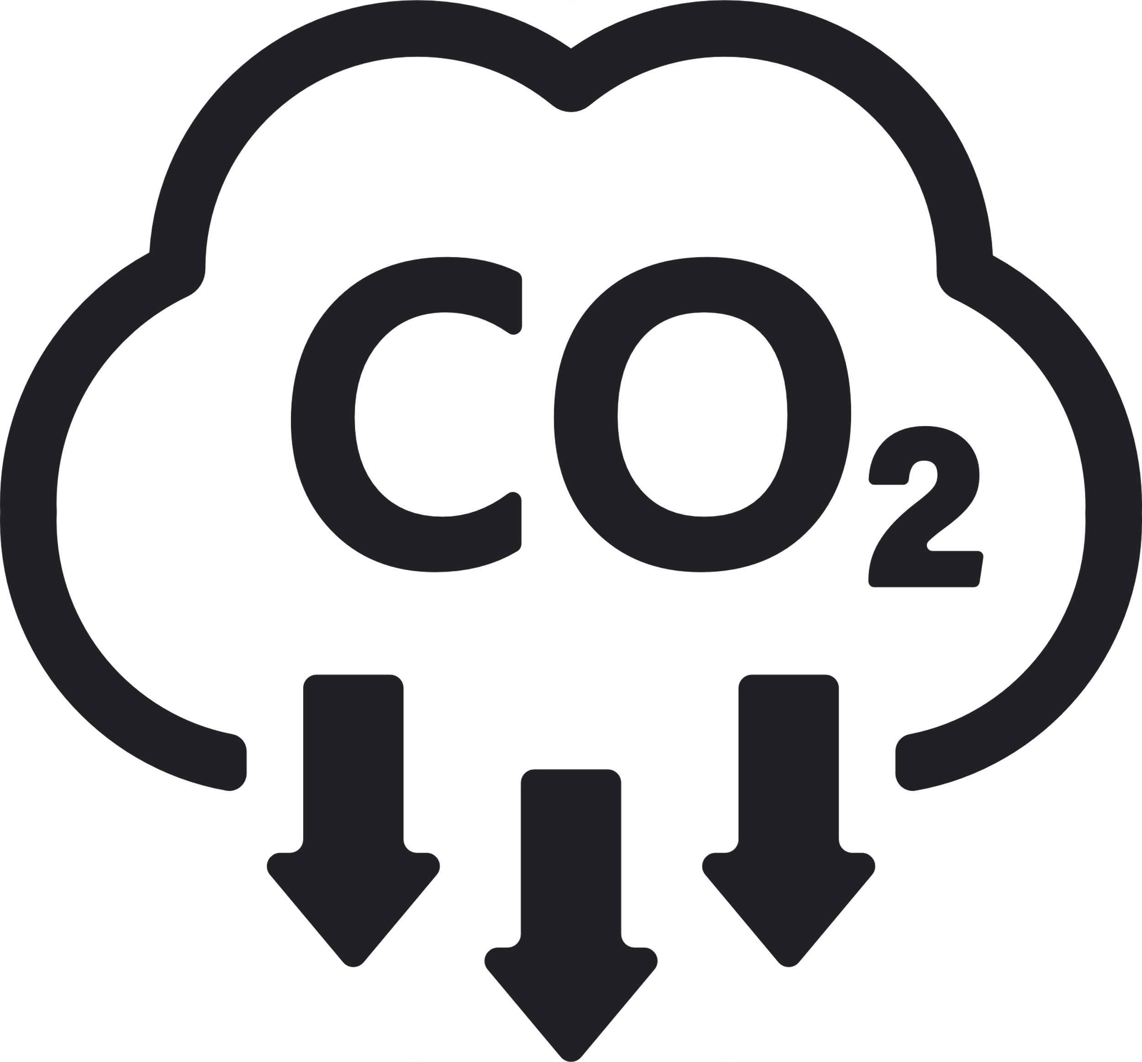





Sustainability REPORT 2023
Risks
- Transition risks become apparent as the company transitions to a low-emission economy, potentially increasing expenses associated with CO2 emissions. - The susceptibility of kernel oil production increases due to El Nino, heightening risks related to crop yield and financial outcomes. - The vulnerability of kernel oil production escalates with El Nino, increasing risks tied to crop yield and financial performance.
Environmental
Social
- Launched DE&l campaign and diversity week to enhance workplace inclusivity. - Established LGBTQ+ Network for a more accepting work atmosphere. - Striving for gender parity at all management levels by 2025. - Unveiled 'Sustainability at Heart' program for employee engagement. - Promoting lifelong learning to bridge generational gaps. - Established LGBTQ+ Network for openness and awareness at work. - Promoting continuous learning to bridge generational divides. - Consistent collaboration with OECD-backed B4IG for global partnerships. - Established LGBTQ+ Network to foster inclusivity and awareness. - Introduced DE&l campaign and diversity week to enhance workplace inclusivity.
Governance
- Their sustainability strategy, underpinned by a proficient board, drives their impactful sustainability initiatives. - A knowledgeable sustainability board and precise data analysis guide their impactful sustainability measures. - A knowledgeable board and precise data analysis underpin their meticulous sustainability tracking. - A proficient board and meticulous data analysis drive their strategic sustainability progress. - A knowledgeable board and accurate data analysis form the foundation of their meticulous sustainability tracking. - Their strategic sustainability strategy, guided by a proficient board, propels their impactful sustainability initiatives. - A knowledgeable board and accurate data analysis form the foundation of their meticulous sustainability tracking.
Emission Management
- Targeting a maximum of 100 million tons for value-chain CO2 by 2025. - Assessing carbon emissions to reduce logistics' impact in 18 countries. - Increasing logistics efficiency through the adoption of digital tools. - Setting a maximum of 100 million tons for value-chain CO2 by 2025. - Committing to 100% renewable energy utilization by 2030, currently 70%. - Optimizing transportation and logistics chains by analyzing carbon emissions.
Company:
Volkswagen
Industry:
Automotive
HQ:
Wolfsburg
No. Of Employees:
30000
Opportunities
- Utilize production heat to warm nearby offices, contributing to energy conservation. - Redefine shampoo and conditioner products with an intensified focus on incorporating recycled plastics. - Commit to delivering exhaustive sustainability profiles for all products, slated for completion by 2025. - Minimize materials in packaging, enhancing eco-friendliness. - Outlined a sustainability vision till 2030, focusing on constant improvements. - Commit to delivering thorough sustainability profiles for all products, ensuring completion by 2025. - Expand educational initiatives and volunteer programs, fostering community development.
8
Resources Management
- Aiming for 100% responsibly sourced palm and kernel oil by the year 2025. - Committing to sourcing 100% certified or externally confirmed palm and kernel oil by 2025. - Successfully renewed the company's contract for renewable energy. - Committing to sourcing 100% certified or externally confirmed palm and kernel oil by 2025. - Investigating battery and hydrogen-powered drive trains for sustainable options.
Ecovadis:
Bronze
CDP:
A
Sustainalytics:
C-
MSCI:
AA
S&P Dow Jones:
BBB
Waste Management
- Focus on eradicating plastic pollution from nature, setting a high aspiration. - Pledge to halve total waste by 50% by 2025 compared to 2010, demonstrating our strong commitment to sustainability. - Dedicate efforts to achieve 100% recyclable or reusable packaging by 2025, building on our current 87% rate. - Increasing ocean freight while reducing reliance on air transport.

