Slide 1





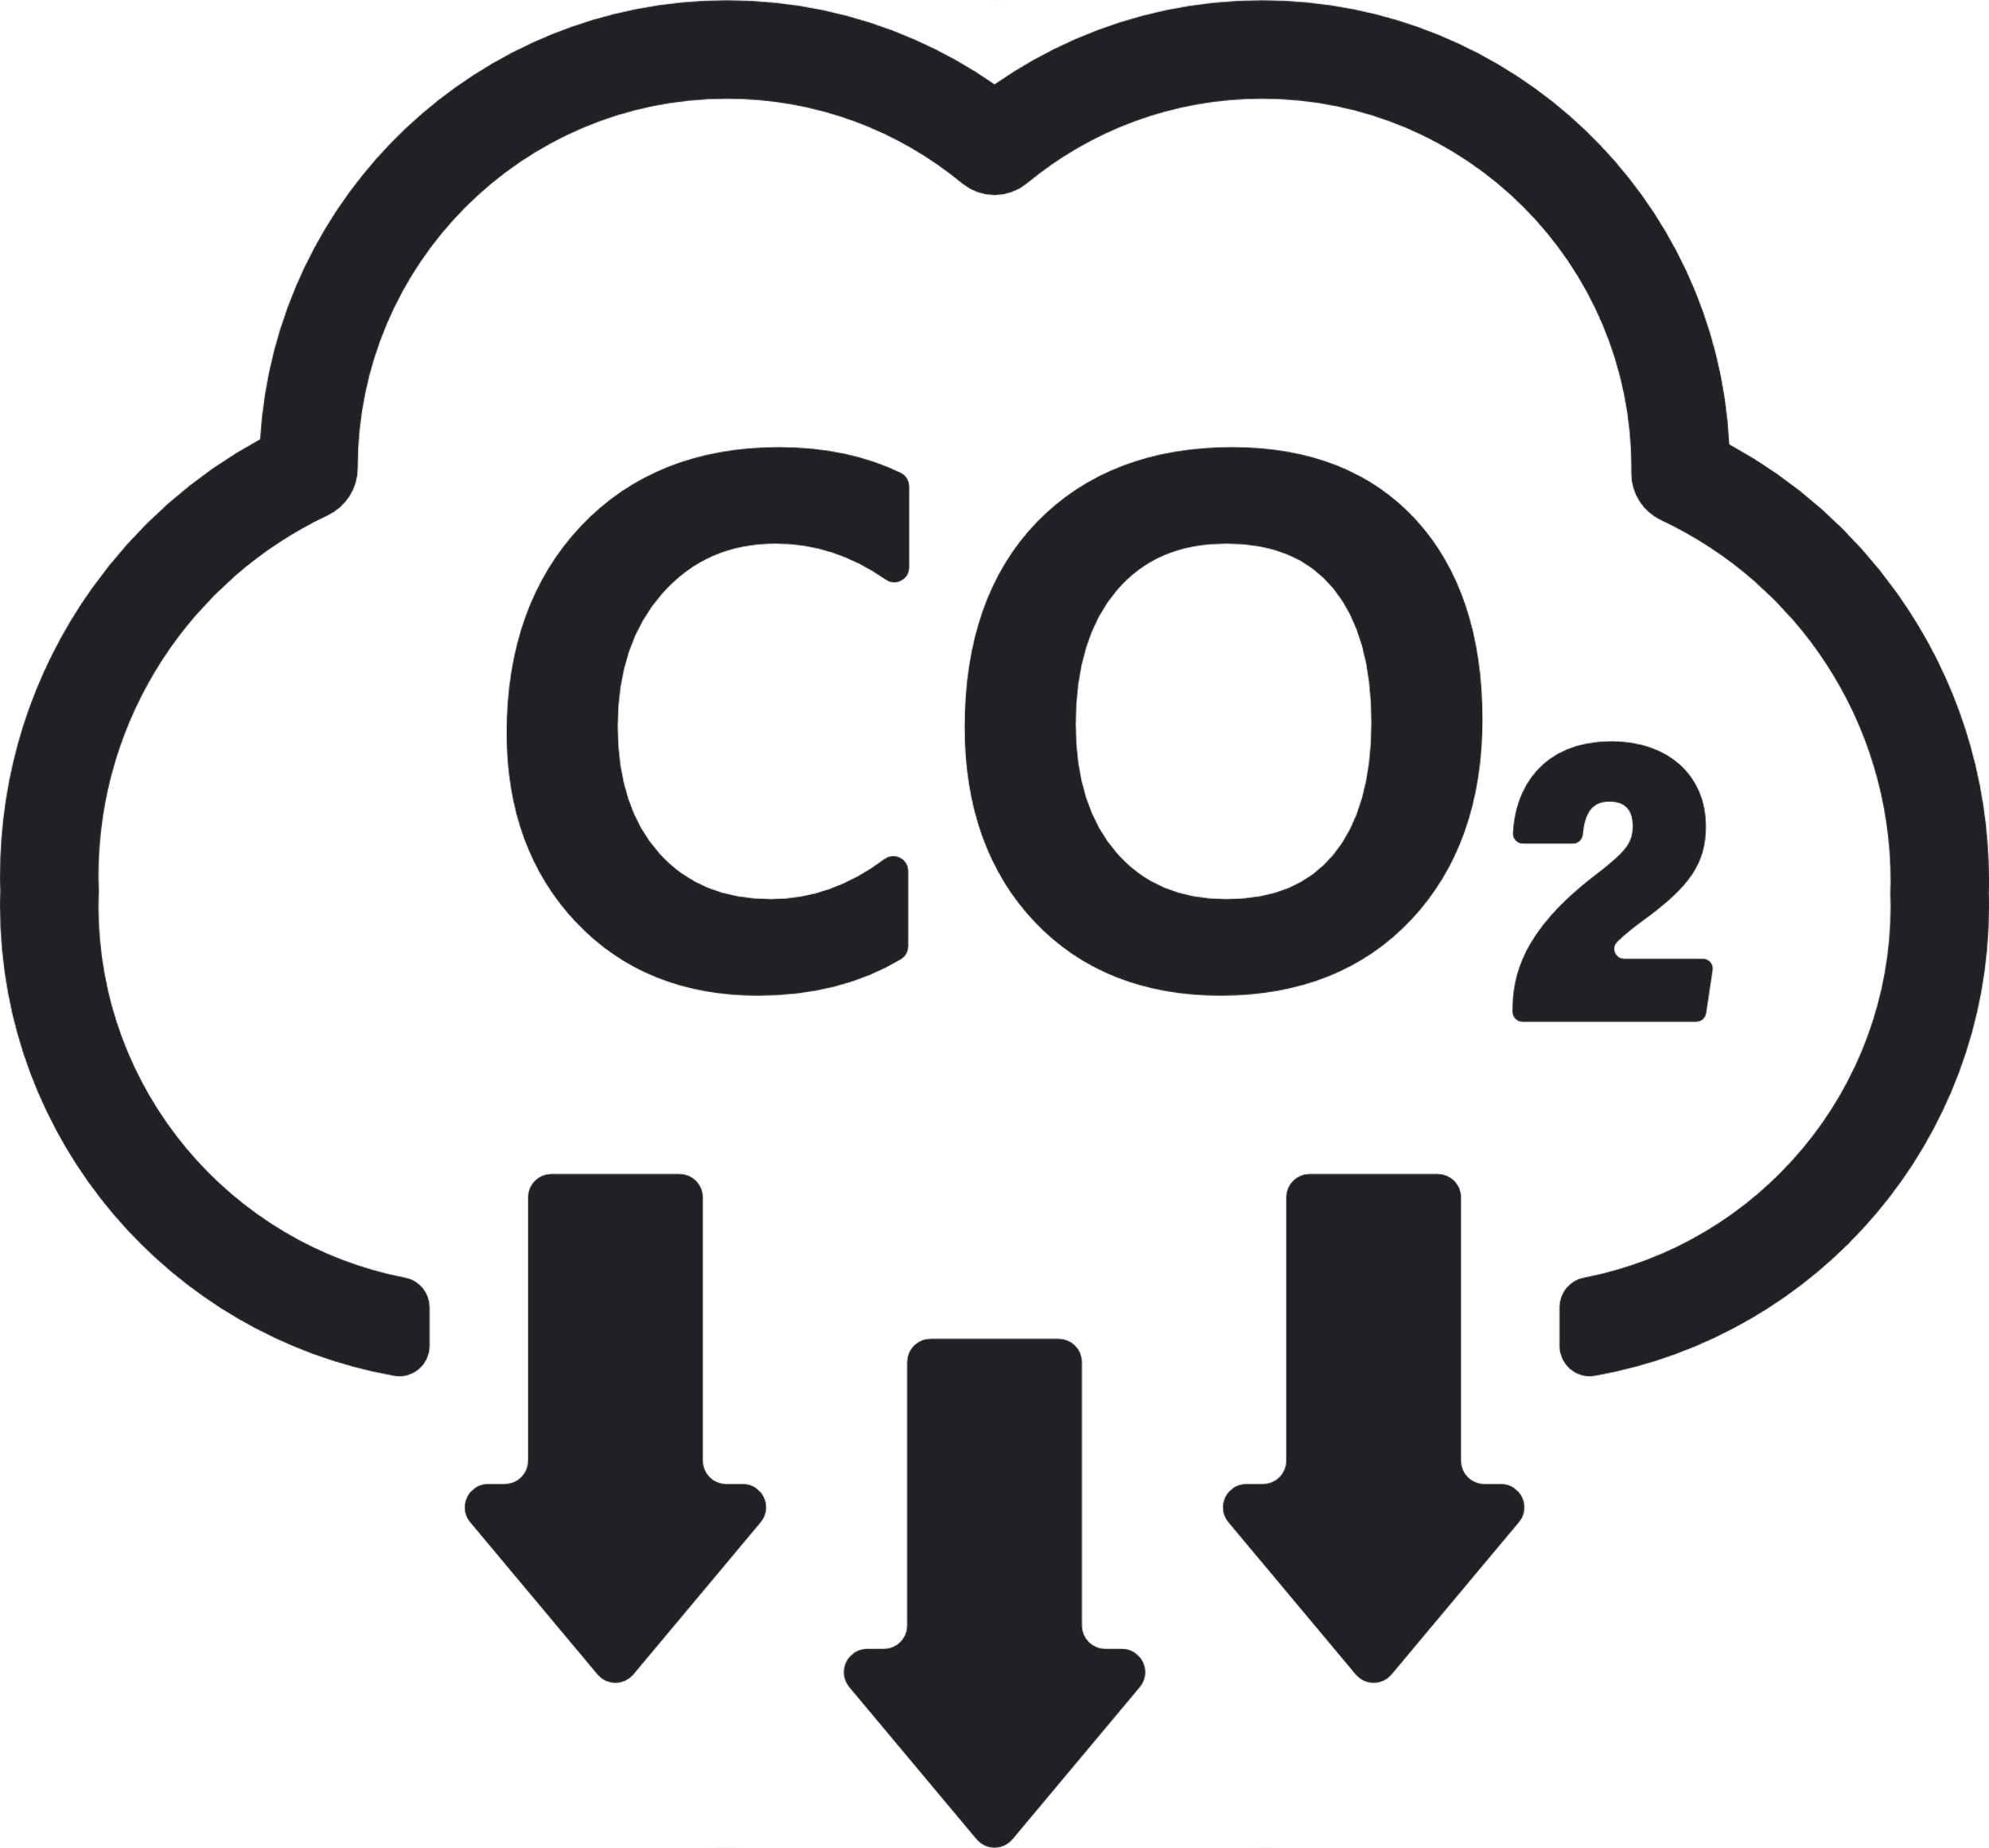





Sustainability REPORT 2023
Risks
- The company grapples with physical risks linked to extreme weather events, impacting its operational continuity and supply chain viability. - The company faces physical risks due to extreme weather events, jeopardizing its facilities and supply chain resilience. - Kernel oil production faces heightened vulnerability due to El Nino, increasing risks related to crop yield and economic performance.
Environmental
Social
- Introduced DE&l campaign and diversity week to enhance workplace inclusivity. - Inaugurated 'Sustainability at Heart' initiative for employee empowerment. - Promoting lifelong learning to bridge generational gaps. - Committed to gender parity in all management tiers by 2025. - Established LGBTQ+ Network for openness and awareness at work. - Implemented 'Sustainability at Heart' initiative for employee engagement. - Consistent collaboration with OECD-backed B4IG for global partnerships. - Launched 'Sustainability at Heart' initiative to empower employees. - Striving for gender parity in all management levels by 2025. - Collaborating with OECD-endorsed B4IG for global partnerships.
Governance
- Their strategic sustainability strategy, guided by a proficient board, propels their impactful sustainability initiatives. - Their sustainability strategy, guided by a proficient board, propels their impactful sustainability initiatives. - A knowledgeable sustainability board and precise data analysis guide their impactful sustainability measures. - A knowledgeable board and accurate data analysis form the foundation of their meticulous sustainability tracking. - Their sustainability strategy, underpinned by a proficient board, drives their impactful sustainability initiatives. - Their adept board and precise data analysis strengthen their strategic sustainability efforts. - Their strategic data collection and analysis empower their efforts in tracking diverse sustainability metrics.
Emission Management
- Aiming for a 65% decrease in CO2 emissions from operations by 2025. - Striving for 100% renewable energy usage by 2030, currently at 70%. - Striving for a 30% reduction in CO2 emissions from raw materials and packaging. - Transitioning to ocean freight, reducing environmental impact of air transport. - Committed to achieving 100% renewable energy usage by 2030, currently at 70%. - Working towards a 30% decrease in CO2 emissions from raw materials and packaging.
Company:
Mcdonalds
Industry:
Food
HQ:
Chicago
No. Of Employees:
42000
Opportunities
- Invest in a fund dedicated to sustainable packaging solutions. - Revitalize shampoo and conditioner products, emphasizing the use of recycled plastics. - Established a far-reaching sustainability vision extending to 2030, emphasizing constant progress. - Outlined a sustainability vision till 2030, focusing on constant improvements. - Expand educational initiatives and volunteer programs, fostering community development. - Allocate resources to a fund dedicated to sustainable and innovative packaging solutions. - Set forth a sustainability roadmap reaching into 2030, striving for continuous progress.
8
Resources Management
- Working to cut water consumption by 35% per ton of product by 2025. - Aiming for 100% responsibly sourced palm and kernel oil by the year 2025. - Pursuing a 35% decrease in water usage per ton of product by 2025. - Aiming for 100% responsibly sourced palm and kernel oil by 2025. - Expanding digital tools to optimize logistics and enhance overall efficiency.
Ecovadis:
Platinum
CDP:
A
Sustainalytics:
A
MSCI:
CCC
S&P Dow Jones:
BB
Waste Management
- Commit to reducing total waste by 50% by 2025 compared to 2010 levels, emphasizing our dedication to sustainability. - Achieved 5% points increase in traceability for palm-based materials. - Increasing ocean freight while reducing reliance on air transport. - Strive for a future with no plastic waste in nature, setting a high aspiration.

