Slide 1





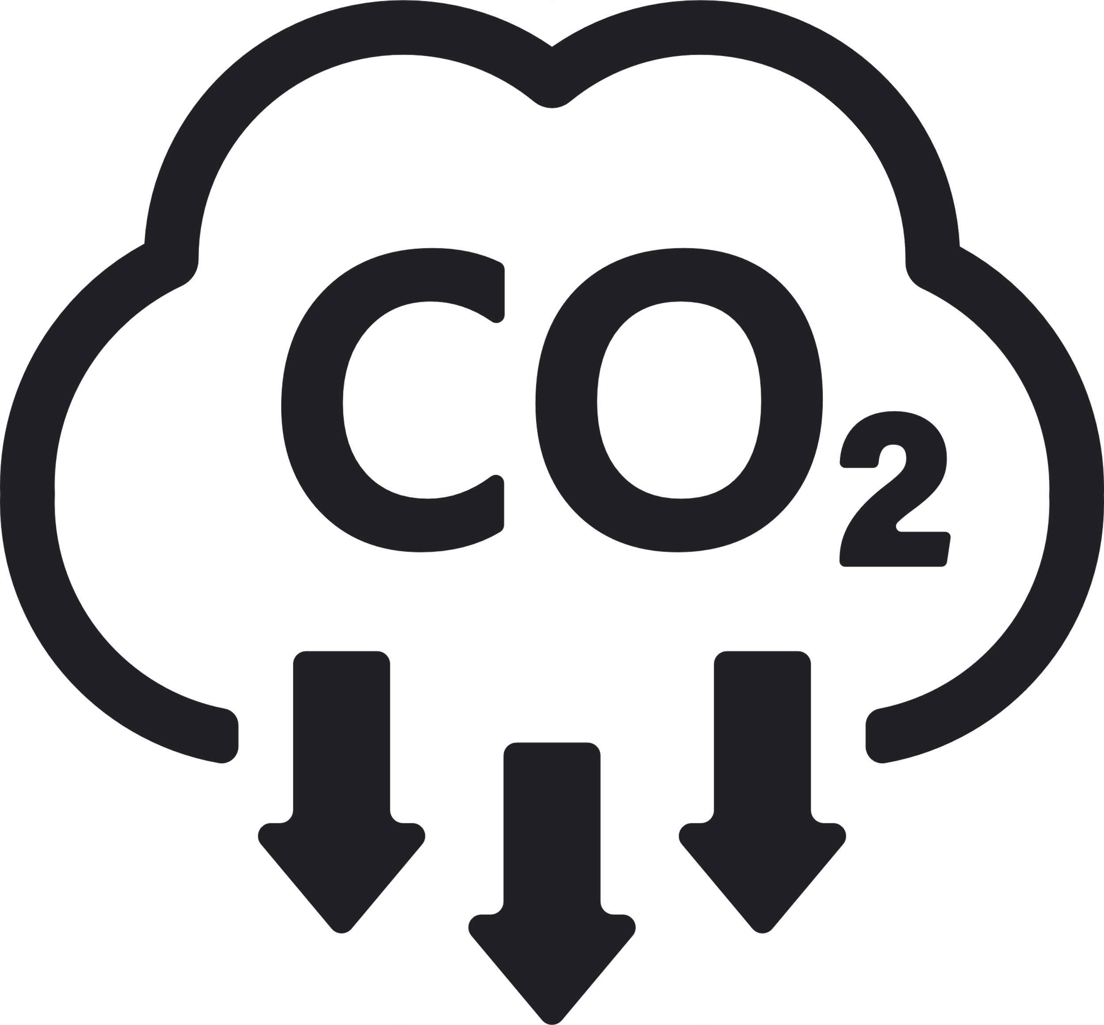





Sustainability REPORT 2023
Risks
- The company's exposure to extreme weather events poses physical risks, impacting its assets and supply chains. - Physical risks stemming from extreme weather events challenge the company's operational and supply chain stability. - Kernel oil production's vulnerability is evident during El Nino, posing significant risks to crop yield and profitability.
Environmental
Social
- Collaborating consistently with OECD-backed coalition, B4IG. - Established LGBTQ+ Network for a more accepting work atmosphere. - Inaugurated 'Sustainability at Heart' program for employee empowerment. - Promoting lifelong learning to bridge generational divides. - Implemented 'Sustainability at Heart' initiative for employee engagement. - Partnership with ability:IN to fast-track disability inclusion. - Enhancing small farmers' livelihoods while preserving ecosystems. - Engaging with OECD-backed B4IG for global collaboration efforts. - Launched 'Sustainability at Heart' initiative to empower employees. - Partnered with ability:IN to expedite disability inclusion efforts.
Governance
- A knowledgeable sustainability board and precise data analysis guide their impactful sustainability measures. - A diligent sustainability board and an adept data system facilitate their progress in the sustainability realm. - Their sustainability strategy, underpinned by a proficient board, drives their impactful sustainability initiatives. - A proficient board and meticulous data analysis drive their strategic sustainability progress. - The company possesses an expert sustainability board, guiding their strategic sustainability initiatives. - The company showcases an adeptness in data collection and analysis, essential for tracking diverse sustainability metrics. - Their comprehensive sustainability strategy, coupled with expert guidance, steers their impactful sustainability initiatives.
Emission Management
- Investing in alternative drive trains such as battery and hydrogen power. - Successfully renewed the company's contract for renewable energy. - Exploring battery and hydrogen-powered drive trains for eco-friendly options. - Secured renewed renewable energy contract for sustainable operations. - Aiming for a 65% cut in CO2 emissions from operations by the year 2025. - Aiming for a 30% reduction in CO2 emissions from raw materials and packaging.
Company:
Apple
Industry:
Tech
HQ:
Cupertino
No. Of Employees:
473000
Opportunities
- Collaborate closely with 'Plastic bank' to create robust recycling infrastructures in developing nations. - Inspire and empower employees to adopt sustainable practices in their daily lives. - Motivate employees to embrace sustainable practices in their daily routines. - Redefine shampoo and conditioner products, emphasizing the use of recycled plastics. - Charted a clear path for sustainability, outlining goals that extend to 2030 and beyond. - Optimize the use of production heat for heating nearby offices, conserving energy. - Invest in a dedicated fund for cutting-edge, sustainable packaging solutions.
8
Resources Management
- Analyzing logistics' carbon emissions to achieve further reductions. - Targeting a 35% reduction in per-ton water consumption by 2025. - Targeting a 35% reduction in per-ton water consumption by 2025. - Analyzing carbon emissions in logistics for sustainable CO2 reduction. - Pursuing a 35% decrease in water usage per ton of product by 2025.
Ecovadis:
Platinum
CDP:
C-
Sustainalytics:
C-
MSCI:
B
S&P Dow Jones:
B-
Waste Management
- Investigating battery and hydrogen-powered drive trains for sustainability. - Focus on eradicating plastic pollution from natural ecosystems, setting a high aspiration. - Target 30% recycled plastic, cutting fossil-based virgin plastics by 50% in consumer goods packaging by 2025, up from the current 16%. - Commit to reducing total waste by 50% by 2025 compared to 2010 levels, emphasizing our dedication to sustainability.

