Slide 1





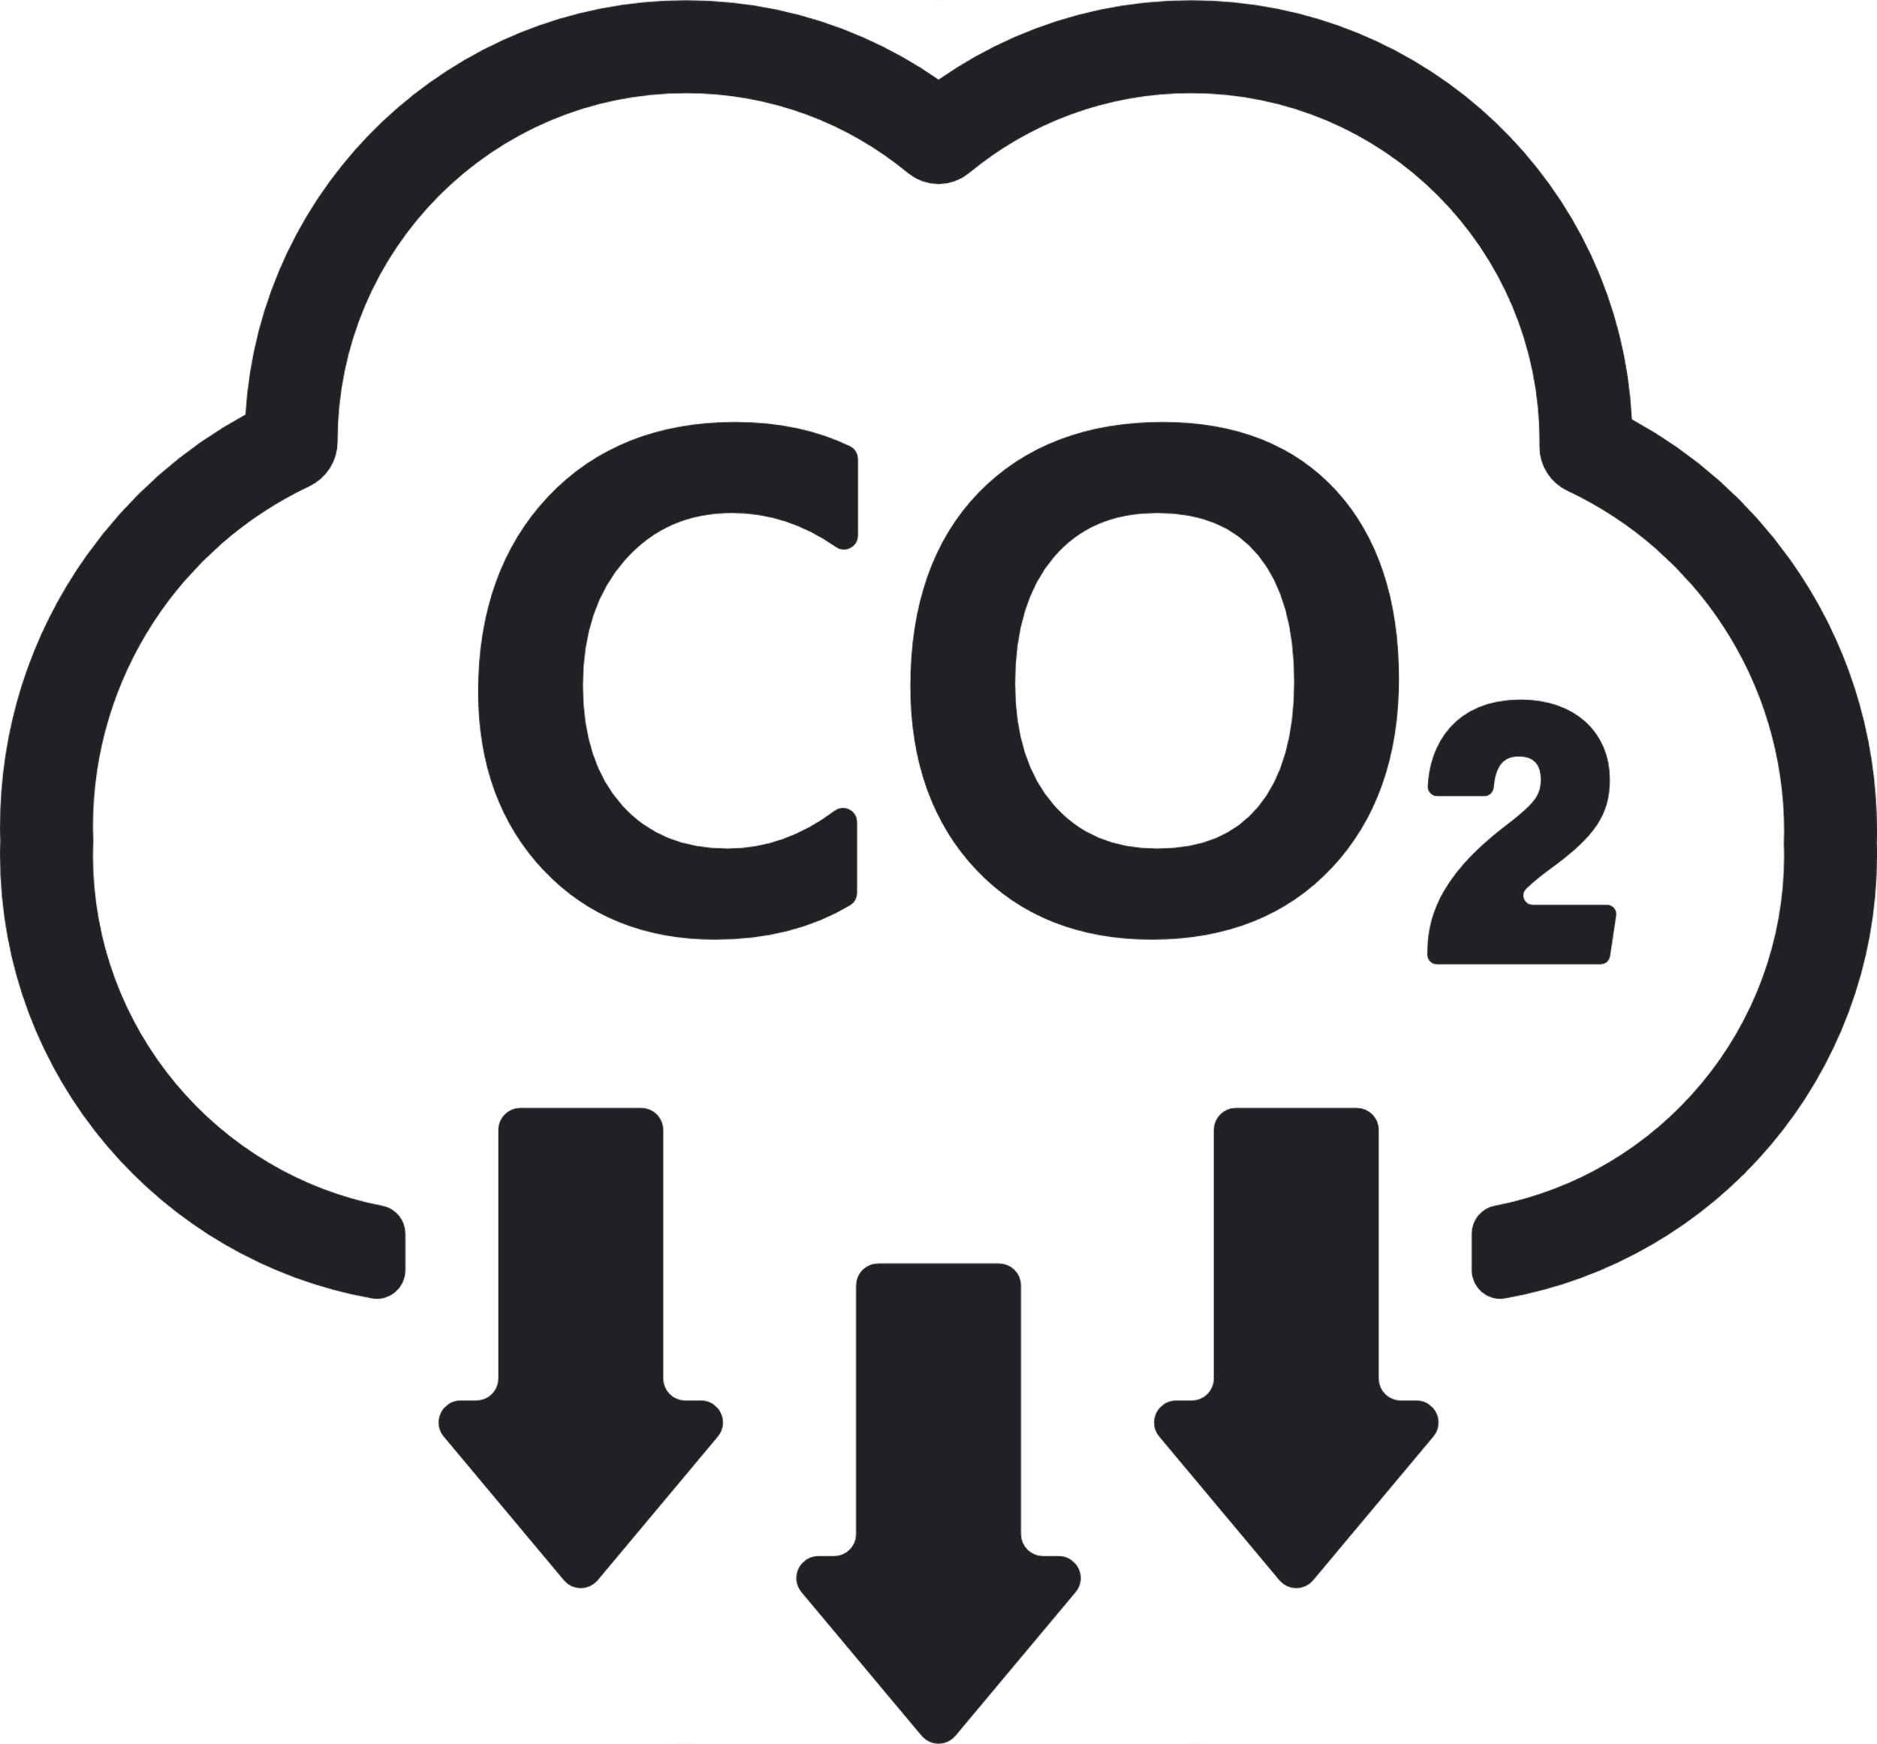





Sustainability REPORT 2023
Risks
- Transition risks become evident as the company shifts to a low-emission economy, potentially increasing expenses associated with CO2 emissions. - The company faces physical risks due to extreme weather events, jeopardizing its facilities and supply chain resilience. - Transition risks emerge as the company shifts towards a low-emission economy, potentially inflating costs linked to CO2 emissions.
Environmental
Social
- Committed to gender parity in all management tiers by 2025. - Collaborating with ability:IN for accelerated disability inclusion. - Collaborating with OECD-endorsed B4IG for global partnerships. - Partnership with ability:IN to fast-track disability inclusion. - Promoting lifelong learning to bridge generational gaps. - Striving for gender parity in all management levels by 2025. - Engaging with OECD-backed B4IG for global collaboration efforts. - Promoting continuous learning to bridge generational gaps. - Aiming for gender parity across management levels by 2025. - Initiated 'Sustainability at Heart' program to empower employees.
Governance
- Their comprehensive sustainability strategy, coupled with expert guidance, steers their impactful sustainability initiatives. - Their careful data analysis supports the tracking of various metrics, pivotal for their sustainability progress. - The company boasts a robust sustainability strategy and an expert board dedicated to sustainable advancement. - A knowledgeable board and precise data analysis underpin their meticulous sustainability tracking. - A knowledgeable board and accurate data analysis form the foundation of their meticulous sustainability tracking. - A knowledgeable board and accurate data analysis form the foundation of their meticulous sustainability tracking. - A knowledgeable board and accurate data analysis form the foundation of their meticulous sustainability tracking.
Emission Management
- Striving to achieve 100% renewable energy usage by 2030, currently at 70%. - Striving to reduce CO2 emissions from raw materials and packaging by 30%. - Expanding digital tools to optimize logistics and enhance efficiency. - Aiming for a 65% reduction in CO2 emissions from operations by 2025. - Striving for a 30% reduction in CO2 emissions from raw materials and packaging. - Working towards a 30% decrease in CO2 emissions from raw materials and packaging.
Company:
Amazon
Industry:
Tech
HQ:
Seattle
No. Of Employees:
33000
Opportunities
- Harness production heat efficiently, warming nearby offices and promoting energy efficiency. - Redefine shampoo and conditioner products, emphasizing the use of recycled plastics. - Invest in a dedicated fund for innovative, sustainable packaging solutions. - Motivate and enable employees to embrace sustainable practices in their daily routines. - Actively engage in initiatives aimed at fostering the well-being of local communities. - Expand educational initiatives and volunteer programs, fostering community development. - Reinvent shampoo and conditioner products with an increased focus on recycled plastics.
8
Resources Management
- Aiming for 100% responsibly sourced palm and kernel oil by the year 2025. - Pursuing a 35% decrease in water usage per ton of product by 2025. - Committing to sourcing 100% certified or externally confirmed palm and kernel oil by 2025. - Pursuing a 35% decrease in water usage per ton of product by 2025. - Committing to sourcing 100% certified or externally confirmed palm and kernel oil by 2025.
Ecovadis:
Silver
CDP:
B
Sustainalytics:
C+
MSCI:
AA
S&P Dow Jones:
BB
Waste Management
- Transitioning to ocean freight, reducing environmental impact of air transport. - Successfully renewed the company's contract for renewable energy. - Improved traceability rates for palm-based raw materials by 5% points. - Dedicate efforts to achieve 100% recyclable or reusable packaging by 2025, building on our current 87% rate.

