Slide 1





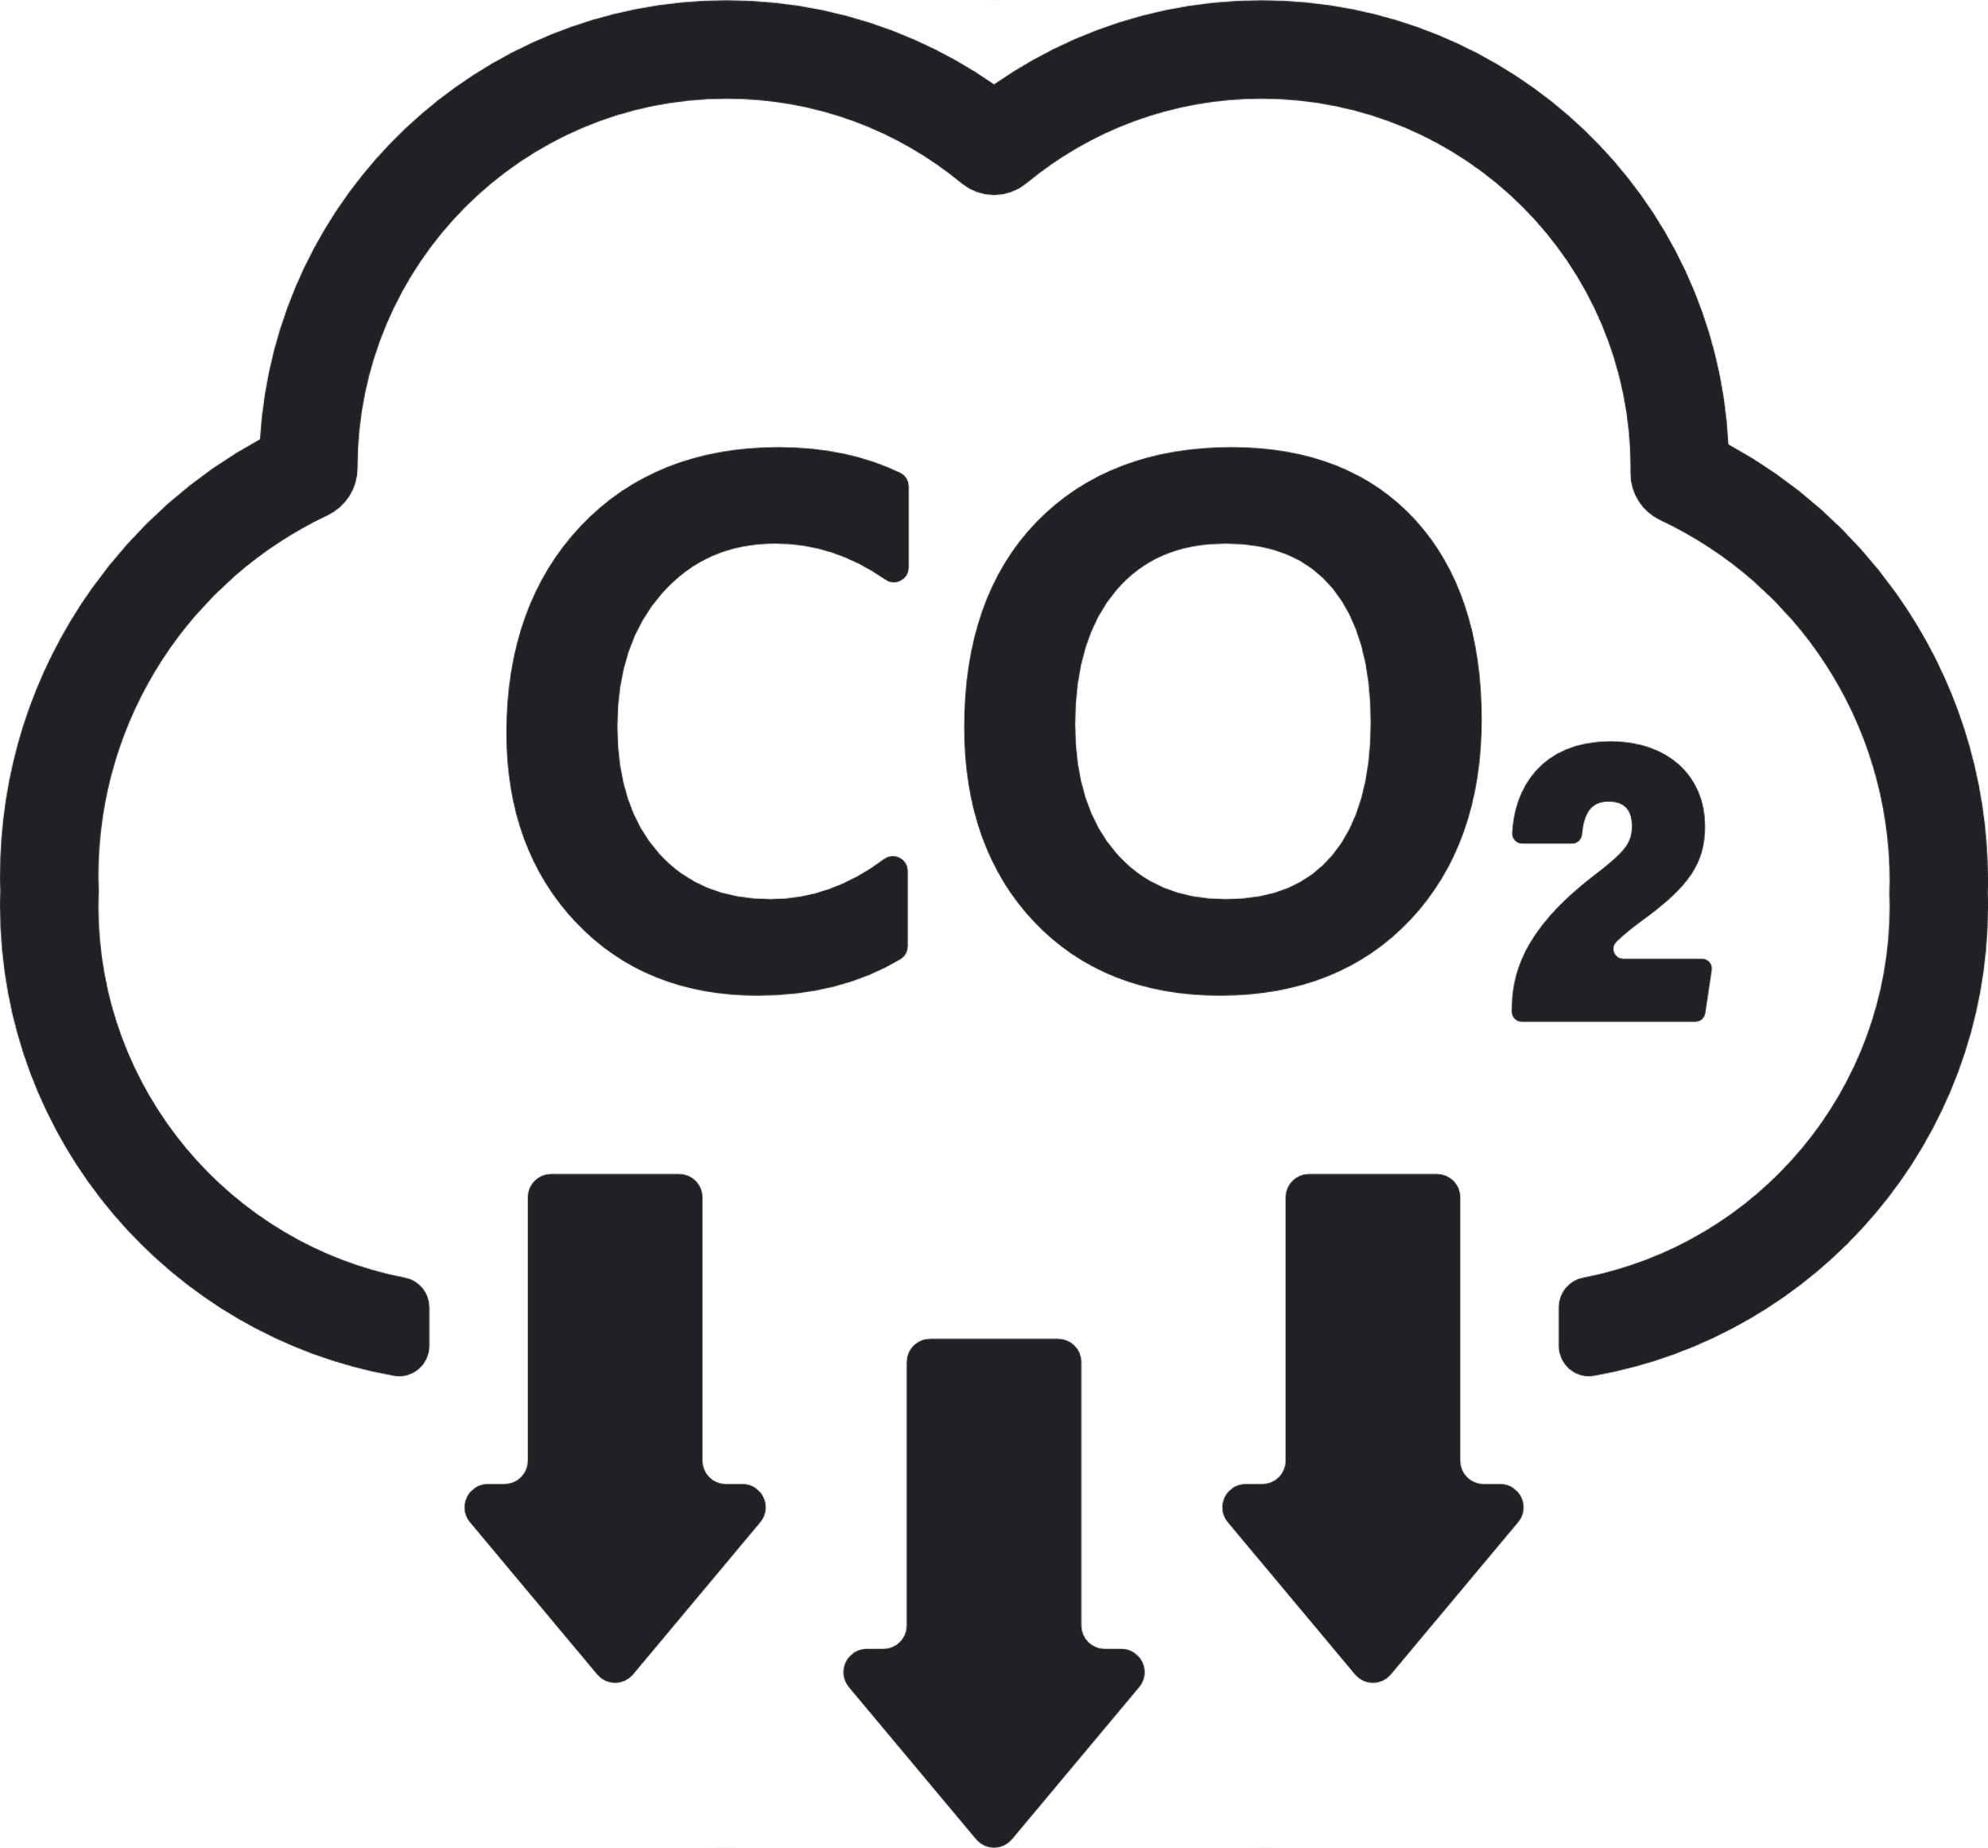





Sustainability REPORT 2023
Risks
- Physical risks stemming from extreme weather events challenge the company's operational continuity, impacting facilities, supply chain, and overall functioning. - Transition risks become evident during the company's shift to a low-emission economy, potentially increasing costs related to CO2 emissions. - Kernel oil production's vulnerability rises due to El Nino, heightening risks associated with crop yield and overall economic health.
Environmental
Social
- Collaborating with ability:IN for accelerated disability inclusion. - Launched 'Sustainability at Heart' program to engage and empower employees. - Established LGBTQ+ Network to foster inclusivity and awareness. - Partnered with ability:IN to accelerate disability inclusion efforts. - Collaborating consistently with OECD-backed coalition, B4IG. - Promoting lifelong learning to bridge generational gaps. - Striving for gender parity at all management levels by 2025. - Launched 'Sustainability at Heart' initiative to empower employees. - Enhancing small farmers' lives while preserving nature. - Committed to gender parity in all management tiers by 2025.
Governance
- Their strategic sustainability strategy, guided by a proficient board, propels their impactful sustainability initiatives. - A proficient board and meticulous data analysis drive their strategic sustainability progress. - Their sustainability strategy, underpinned by a proficient board, drives their impactful sustainability initiatives. - A knowledgeable board and precise data analysis underpin their meticulous sustainability tracking. - Their sustainability strategy, guided by a proficient board, propels their impactful sustainability initiatives. - A knowledgeable board and accurate data analysis form the foundation of their meticulous sustainability tracking. - The company showcases an adeptness in data collection and analysis, essential for tracking diverse sustainability metrics.
Emission Management
- Envisioning 100% renewable energy usage by 2030, with 70% currently achieved. - Optimizing transportation and logistics chains by analyzing carbon emissions. - Analyzing logistics' carbon footprint for further CO2 emissions reduction. - Assessing carbon emissions to reduce logistics' impact in 18 countries. - Efforts underway to reduce CO2 emissions from operations by 65% by 2025. - Striving for a 30% reduction in CO2 emissions from raw materials and packaging.
Company:
Aldi
Industry:
Retail
HQ:
Essen
No. Of Employees:
142000
Opportunities
- Allocate resources to a dedicated fund supporting cutting-edge, sustainable packaging solutions. - Innovate shampoo and conditioner products with a greater focus on recycled plastic usage. - Commit to delivering thorough sustainability profiles for all products, ensuring completion by 2025. - Expand educational outreach and volunteer programs, promoting community development. - Pledged to provide detailed sustainability profiles for all products, a commitment to be met by 2025. - Redefine shampoo and conditioner products, emphasizing the use of recycled plastics. - Motivate employees to embrace sustainable practices in their daily routines.
8
Resources Management
- Committing to sourcing 100% certified or externally confirmed palm and kernel oil by 2025. - Committing to sourcing 100% certified or externally confirmed palm and kernel oil by 2025. - Pursuing a 35% decrease in water usage per ton of product by 2025. - Committing to sourcing 100% certified or externally confirmed palm and kernel oil by 2025. - Working to cut water use by 35% per ton of product by 2025.
Ecovadis:
Bronze
CDP:
C-
Sustainalytics:
D+
MSCI:
AAA
S&P Dow Jones:
A
Waste Management
- Pledge to halve total waste by 50% by 2025 compared to 2010, demonstrating our unwavering commitment to sustainability. - Target 30% recycled plastic, cutting fossil-based virgin plastics by 50% in consumer goods packaging by 2025, up from the current 16%. - Dedicate efforts to make all packaging 100% recyclable or reusable by 2025, building on our current 87% rate. - Commit to reducing total waste by 50% by 2025 compared to 2010 levels, emphasizing our dedication to sustainability.

