Slide 1

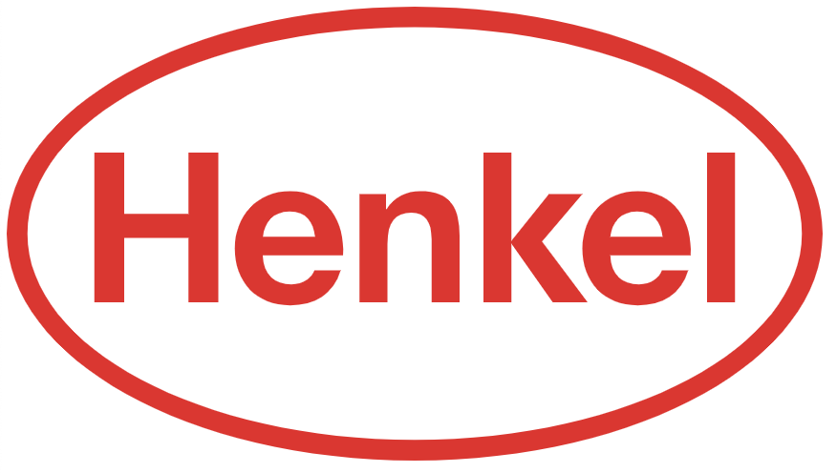



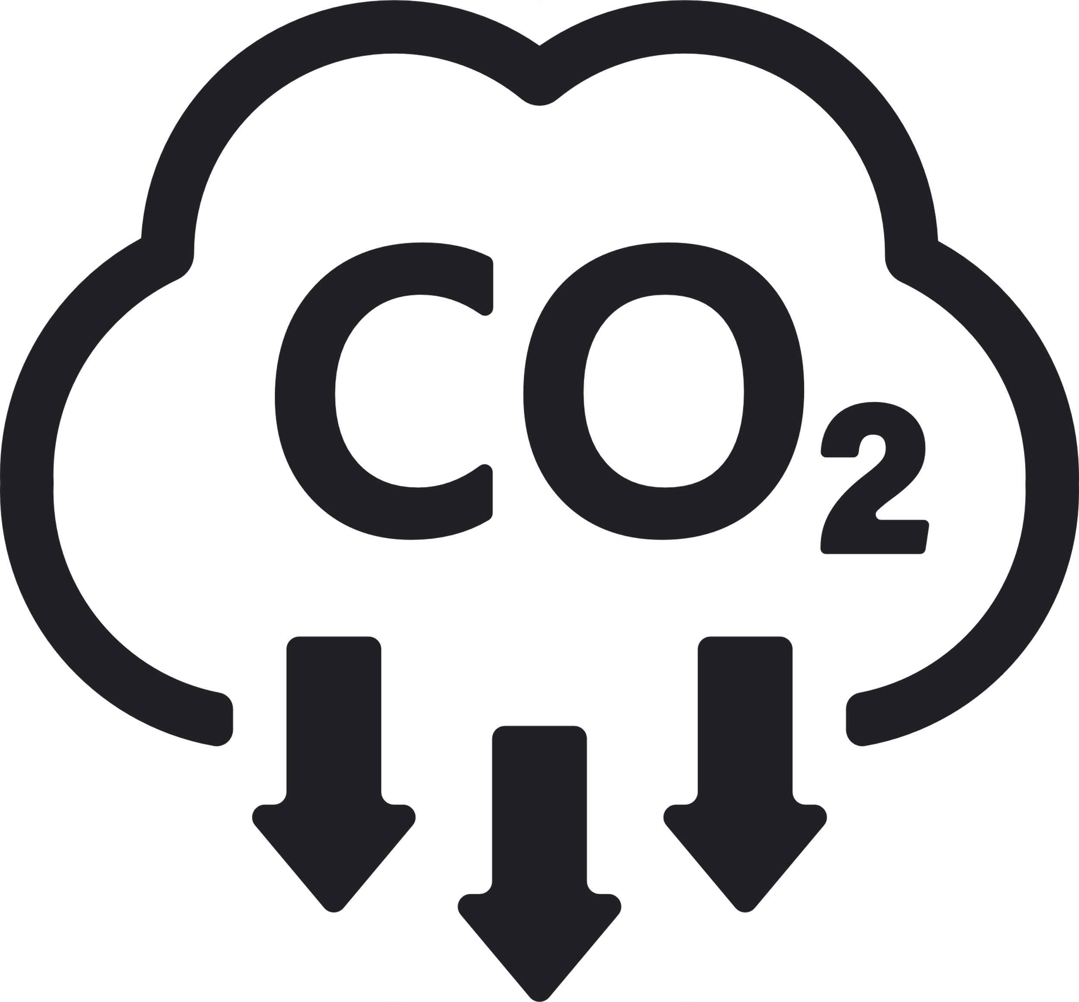





Sustainability REPORT 2023
Risks
- Physical risks associated with extreme weather - Main risk here is the kernel oil production and mainly the risks of a low crop yield because of El NinoTransition risks associated with the transition to low-emission economy and society. This risk mainly steam from a potential increase in costs associated with CO2 emissions
Environmental
Social
- They launched sustainability at heart program to inform and empower employees to support their joint engagement concerning sustainability - Improve livelihood of small farmers and protection of nature - Continuously collaborate with OECD supported global business coalition Business for Inclusive Growth (B4IG) - Has launched the DE&I campaign “I am unique. We are Henkel” and an diversity week that aims to expand the knowledge among workers about diversity, equity and inclusion - Have a LGBTQ+ Network that aims to create a more open work environment and raise awareness about different topics aimed at LGBTQ+ - Have ambitions of gender parity across all management levels 2025 - Has partnership with ability:IN to accelerate the inclusion of people with disabilities - Encourage lifelong learning to bridge the gap between generations.
Governance
- Henkel have an extensive sustainability strategy and a sustainability board that has extensive knowledge in how to move forward with sustainability - The company seem to have a good and correct way of collecting and analyzing data to keep track of different metrics and their sustainability progress, they also show their base year? - Their Carbon Disclosure Project score is A-
Emission Management
- 100% renewable energy to 2030 (currently have 70%) - 65% less CO2 emissions 2025 compared to 2015 from operations (currently have -55%) - 30% less CO2 emissions 2025 compared to 2015 from raw materials and packaging (currently have -55%) - 100 less million ton CO2 in their value-chain 2025 compared to 2016 (currently over 78 million)
Company:
Henkel
Industry:
Chemical
HQ:
Duesseldorf
No. Of Employees:
327000
Opportunities
- Relaunch shampoo and conditioner brand with more recycled plastic - Has published a 2030+ sustainability ambition framework with where they currently work on improving and have ambitions of improving - Provide a comprehensive sustainability profile for all products by 2025 - Reducing material in packaging - Invests in fund for sustainable packaging - Collaborates with “Plastic bank” to reduce plastic waste by developing recycling infrastructure in developing countries - Actively wants to contribute to thriving communities - Expand community education and volunteering programs - Try to engage and empower all employees to be more sustainable
8
Resources Management
- 35% less water consumption per ton of product 2025 compared to 2010 (currently -25%) - 100% palm and kernel oil whose responsible sourcing is certified or externally confirmed 2025 (currently 89%)
Ecovadis:
Bronze
CDP:
B
Sustainalytics:
A
MSCI:
CCC
S&P Dow Jones:
AA
Waste Management
- Have ambition of zero plastic waste into nature - 30% share of recycled plastic (–50% fossil-based virgin plastics) for all packaging of consumer goods products 2025 (currently 16%) - 100% of packaging designed for recycling or reusability 2025 (currently 87%) - Reduce total amount of waste by 50% 2025 compared to 2010

