Slide 1
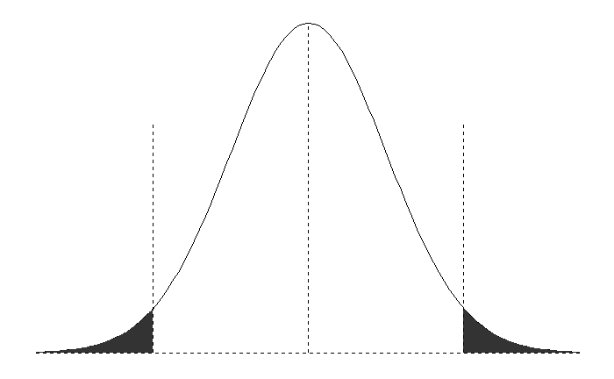


$$2c{\hat{σ}}_{h}$$
$${\hat{y}}_{T+h|T}$$
α/2
α/2

